Slide 1
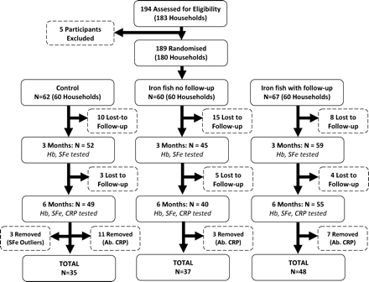
Figure 1 Trial profile for a randomized clinical trial of an iron ingot as a means of iron supplementation in women in ...
Notes:
Figure 1 Trial profile for a randomized clinical trial of an iron ingot as a means of iron supplementation in women in rural Cambodia. Hb, haemoglobin; SFe, serum iron; CRP, C-reactive protein; Ab. CRP, abnormal C-reactive protein (≥6.0 mg l−1); SFe outliers, serum iron outliers (≥130 µg l−1)
Unless provided in the caption above, the following copyright applies to the content of this slide: © The Author 2010. Published by Oxford University Press on behalf of the European Public Health Association. All rights reserved.

