Slide 1
1 Mühlhausen around 1650 (Matthäus Merian)
Notes:
1 Mühlhausen around 1650 (Matthäus Merian)
Unless provided in the caption above, the following copyright applies to the content of this slide: © The Author 2016. Published by Oxford University Press. All rights reserved.

Slide 2
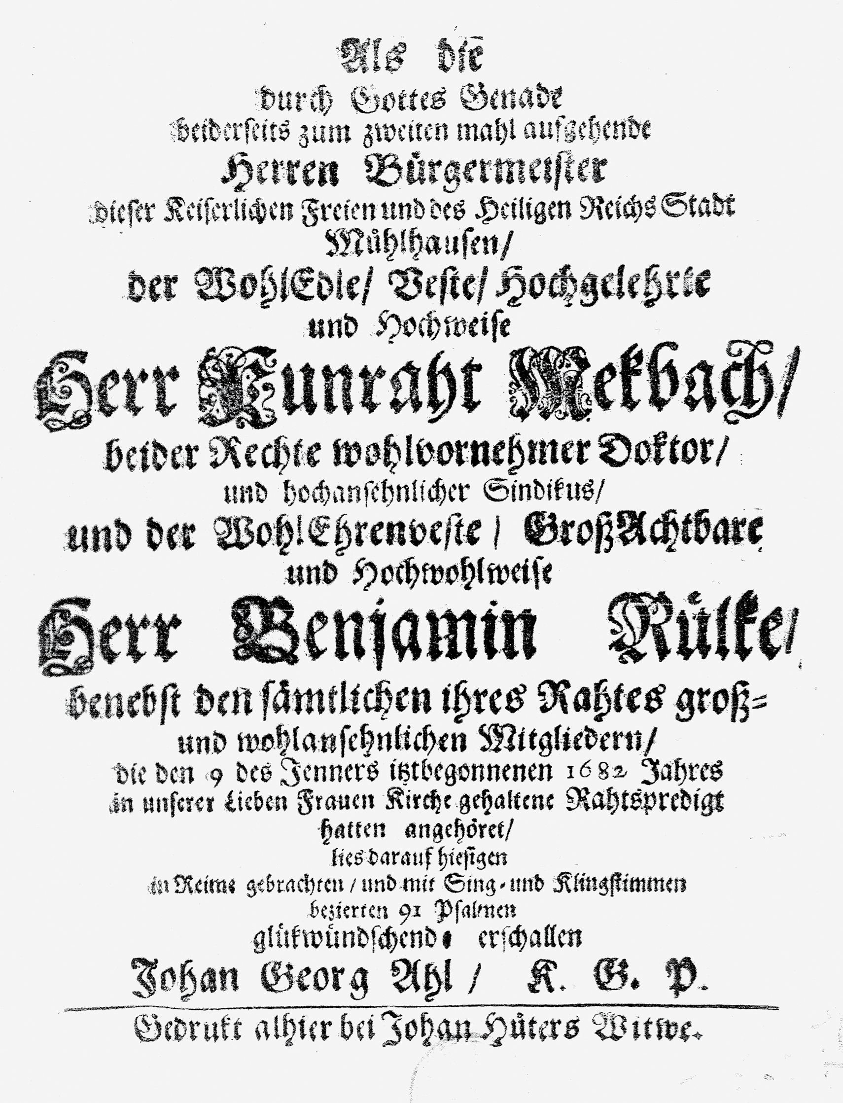
2 Title-page of Johann Georg Ahle’s concerto for the inauguration of the Mühlhausen town council in 1682, Als ...
Notes:
2 Title-page of Johann Georg Ahle’s concerto for the inauguration of the Mühlhausen town council in 1682, Als die durch Gottes Genade beiderseits zum zweiten mahl aufgehende Herren Bürgermeister... in unserer Lieben Frauen Kirche gehaltene Rahtspredigt hatten angehöret (Staatsbibliothek zu Berlin—Preußischer Kulturbesitz, Musikabteilung mit Mendelssohn-Archiv, Mus. Ant. 148 (Ahle))
Unless provided in the caption above, the following copyright applies to the content of this slide: © The Author 2016. Published by Oxford University Press. All rights reserved.

Slide 3
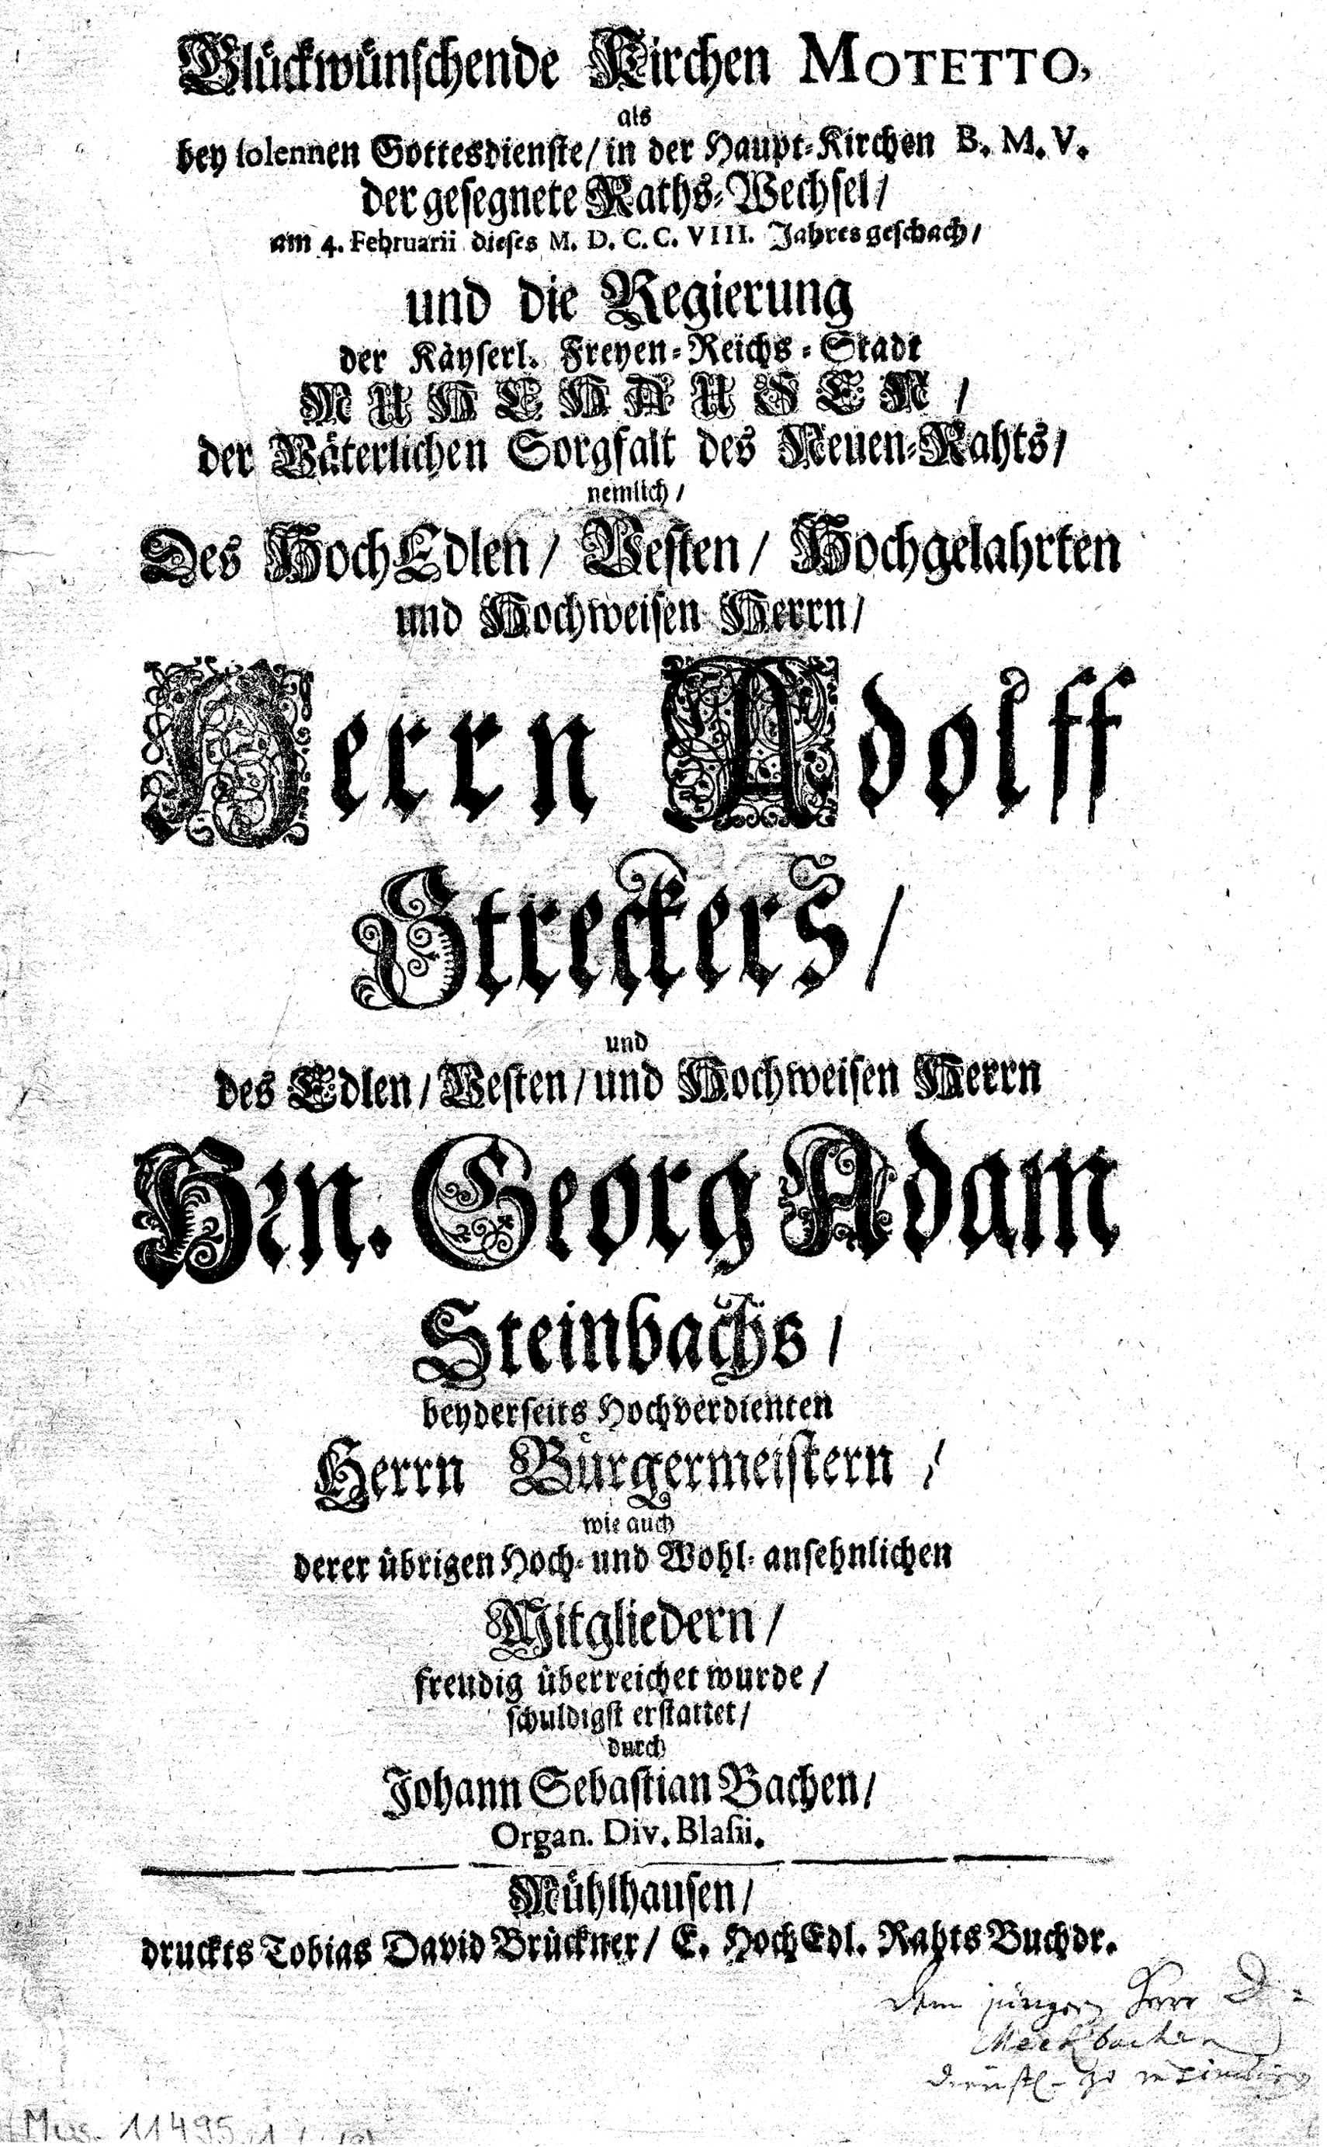
3 Title-page of Johann Sebastian Bach’s concerto for the inaguration of the Mühlhausen town council in 1708, ...
Notes:
3 Title-page of Johann Sebastian Bach’s concerto for the inaguration of the Mühlhausen town council in 1708, Gott ist mein Königbwv71 (Staatsbibliothek zu Berlin—Preußischer Kulturbesitz, Musikabteilung mit Mendelssohn-Archiv, Mus. 11495 (Bach))
Unless provided in the caption above, the following copyright applies to the content of this slide: © The Author 2016. Published by Oxford University Press. All rights reserved.

Slide 4
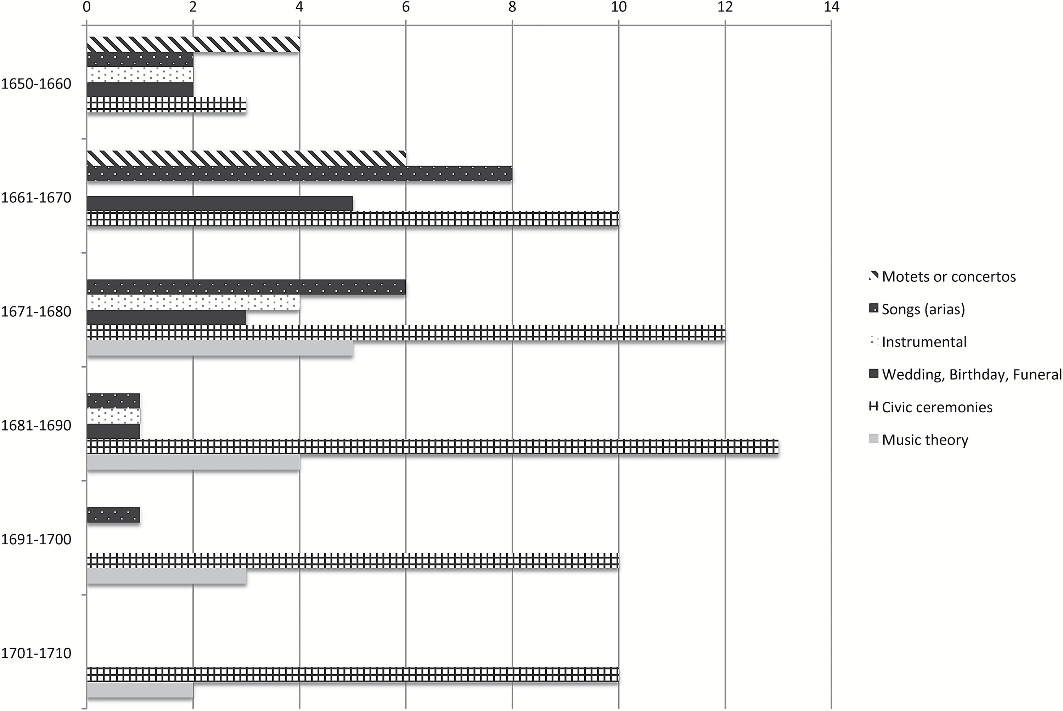
4 Output of printed music in Mühlhausen by decade, 1650–1710
Notes:
4 Output of printed music in Mühlhausen by decade, 1650–1710
Unless provided in the caption above, the following copyright applies to the content of this slide: © The Author 2016. Published by Oxford University Press. All rights reserved.

Slide 5
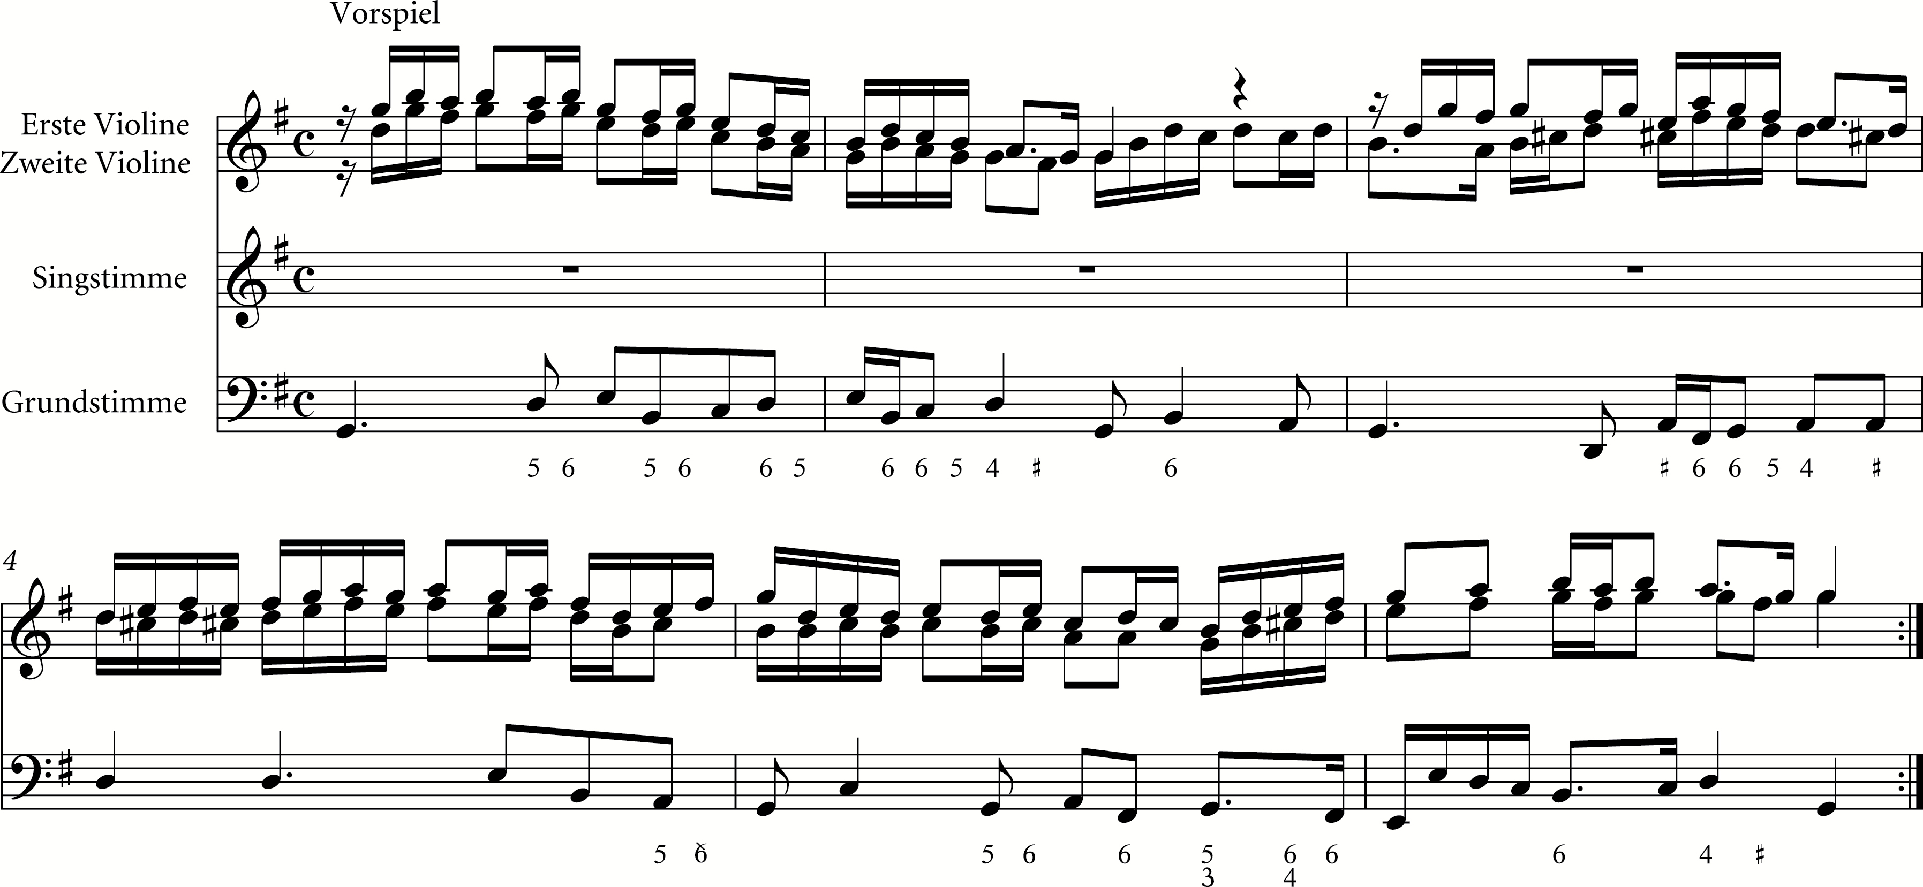
Ex.1 Johann Georg Ahle, Neujahrslied (1680), prelude
Notes:
Ex.1 Johann Georg Ahle, Neujahrslied (1680), prelude
Unless provided in the caption above, the following copyright applies to the content of this slide: © The Author 2016. Published by Oxford University Press. All rights reserved.

Slide 6
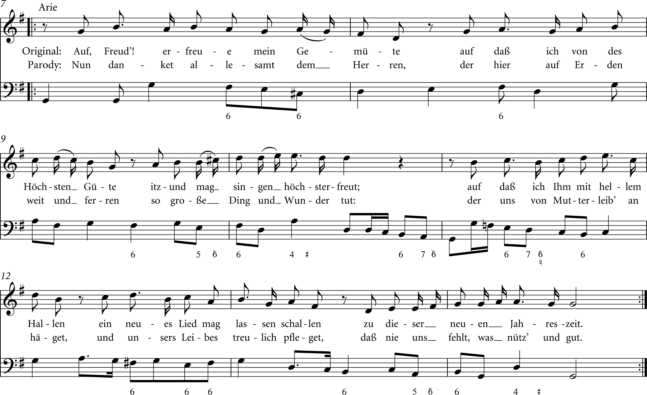
Ex.2 Johann Georg Ahle, Neujahrslied (1680), aria, also showing parodied text given in Unstrutischer Apollo ...
Notes:
Ex.2 Johann Georg Ahle, Neujahrslied (1680), aria, also showing parodied text given in Unstrutischer Apollo (1681)
Unless provided in the caption above, the following copyright applies to the content of this slide: © The Author 2016. Published by Oxford University Press. All rights reserved.

