Slide 1
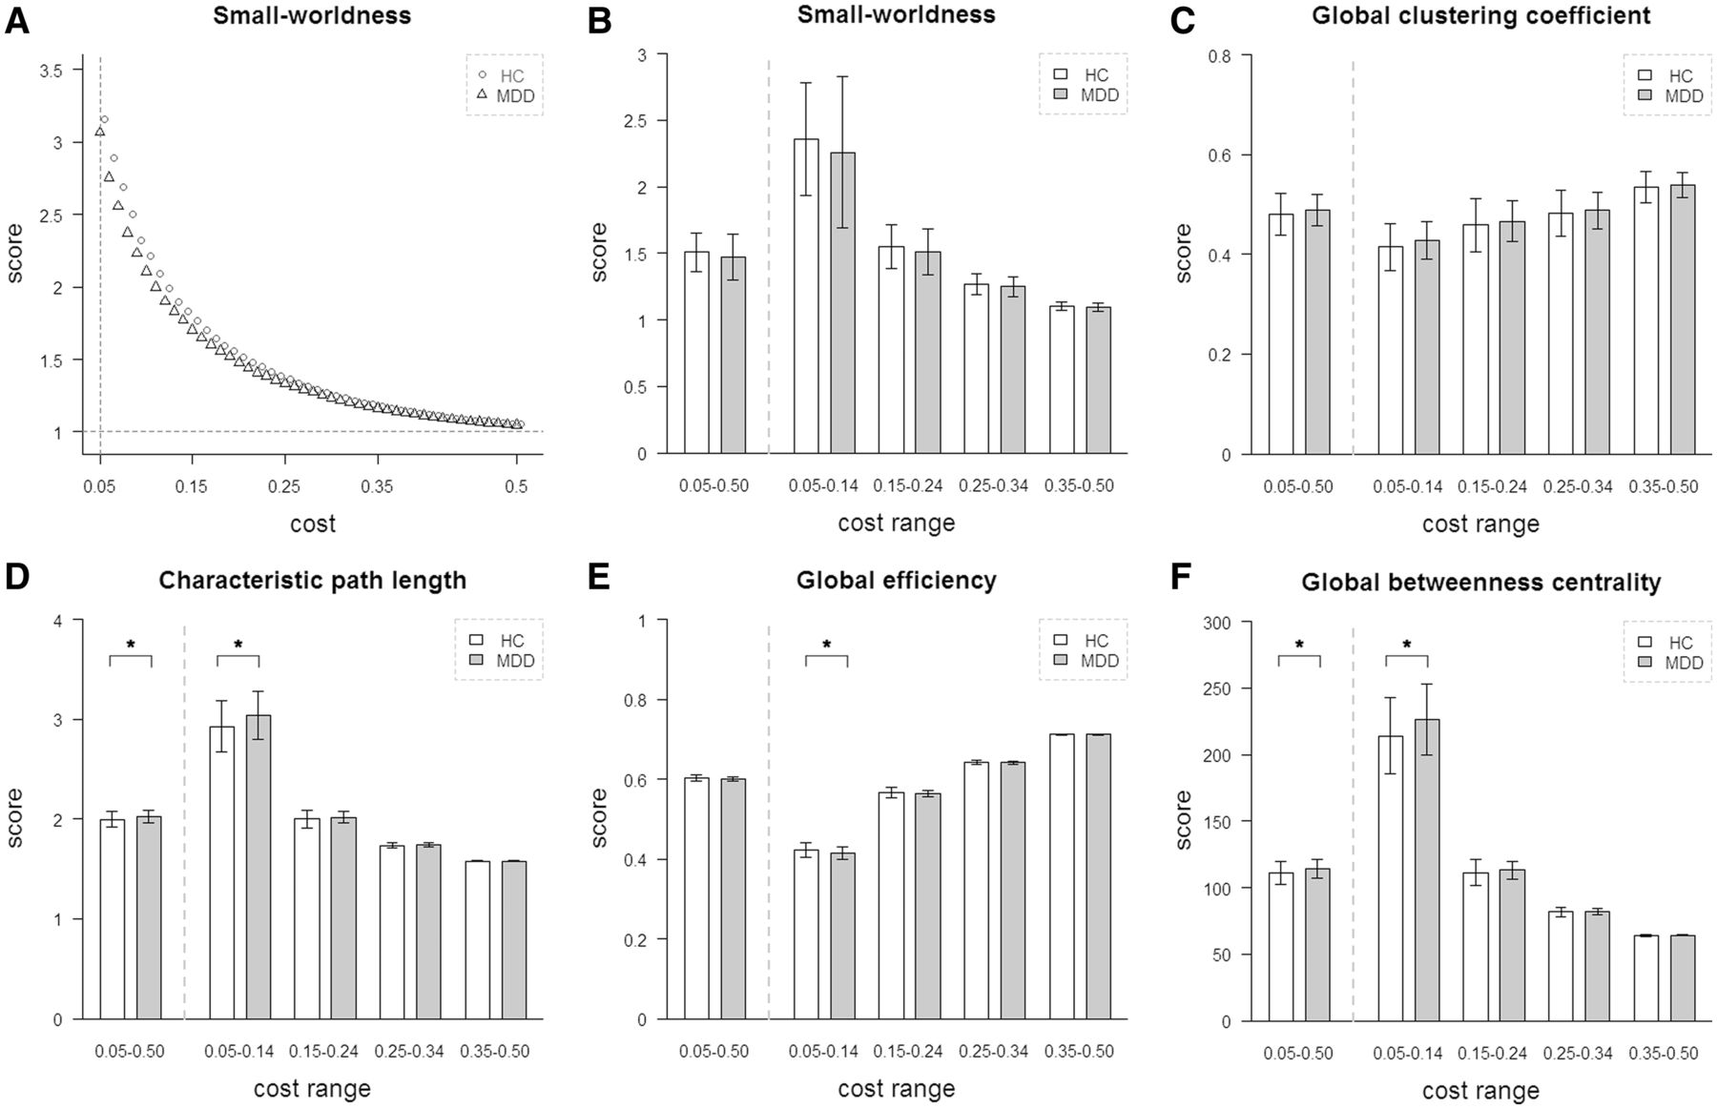
Figure 1 Global network topology in recurrent major depression. Group comparisons were based on permutation tests ...
Notes:
Figure 1 Global network topology in recurrent major depression. Group comparisons were based on permutation tests controlled for age, gender, and grey matter, P 1.22) for the investigated cost range (0.05–0.50). Small-world properties decrease with increasing network costs. At the cost of 0.14, averaged small-worldness was 1.77 in major depression and 1.83 in control subjects. (B and C) Small-worldness and global clustering coefficient were not significantly different across groups. (D–F) Significant group differences were found for characteristic path length (P = 0.029), global efficiency (P = 0.029), and global betweenness-centrality (P = 0.029) for the cost sub-range (0.05–0.14) (i.e. for networks of spatially sparse but strong functional connectivity). *Significant group difference.
Unless provided in the caption above, the following copyright applies to the content of this slide: © The Author (2013). Published by Oxford University Press on behalf of the Guarantors of Brain. All rights reserved. For Permissions, please email: journals.permissions@oup.com

Slide 2
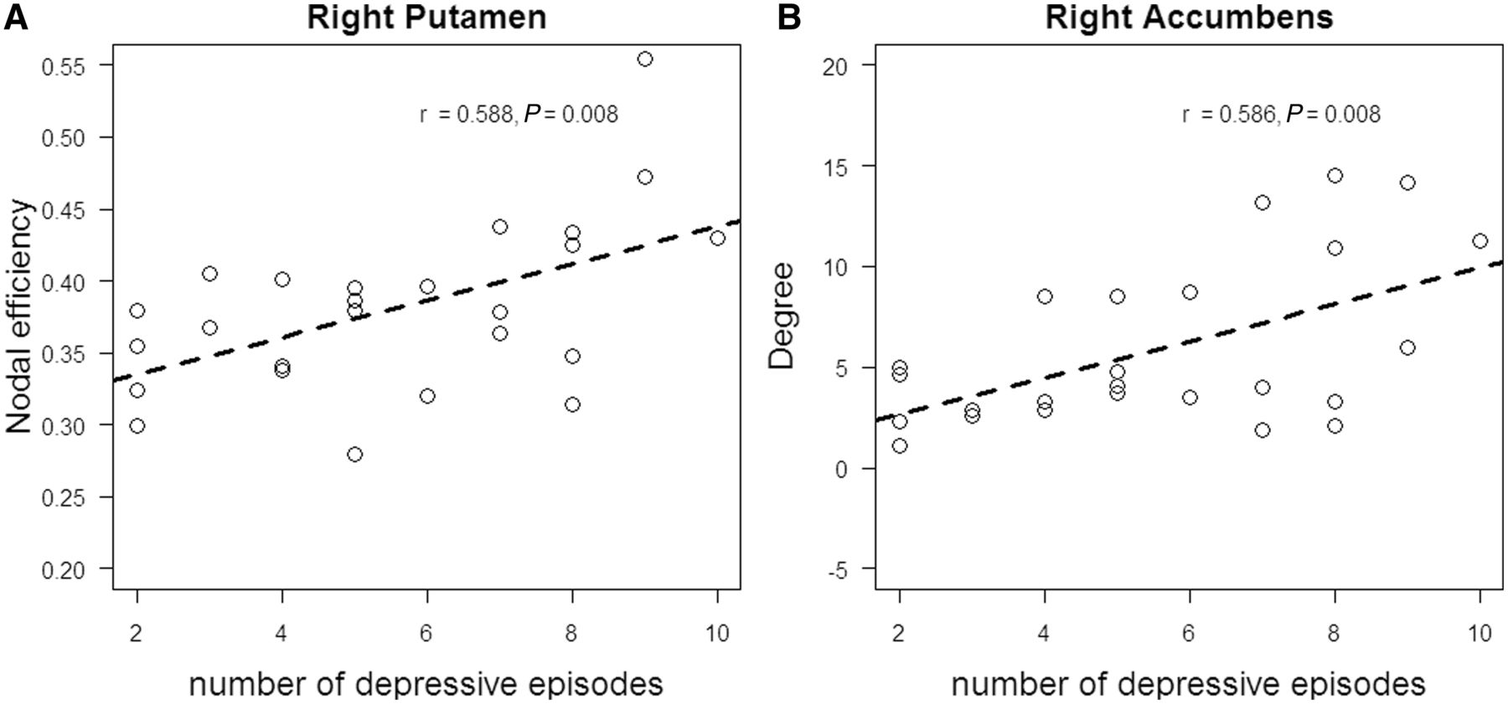
Figure 3 Association between striatal connectivity topology and number of depressive episodes in patients with ...
Notes:
Figure 3 Association between striatal connectivity topology and number of depressive episodes in patients with recurrent major depression, independently of current symptoms and disease duration. Partial correlation analysis of nodal topological scores and number of depressive episodes, including additional covariates of current symptoms, age, gender, grey matter brain volume, medication effects and disease duration, P < 0.009 based on false positive correction for multiple testing. Scatter plots reflect significant correlations between different striatal network scores and the number of depressive episodes in patients with recurrent major depression.
Unless provided in the caption above, the following copyright applies to the content of this slide: © The Author (2013). Published by Oxford University Press on behalf of the Guarantors of Brain. All rights reserved. For Permissions, please email: journals.permissions@oup.com

Slide 3
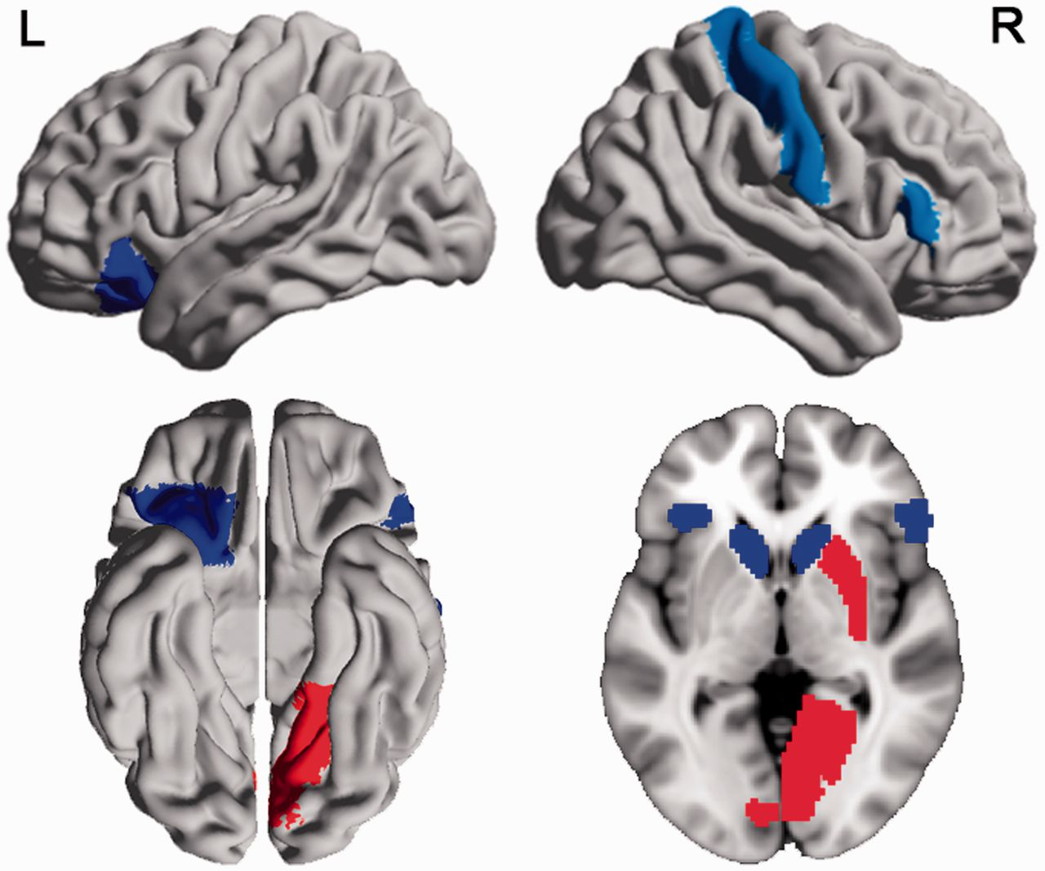
Figure 2 Brain regions with aberrant nodal efficiency and centrality in recurrent major depression. Group comparisons ...
Notes:
Figure 2 Brain regions with aberrant nodal efficiency and centrality in recurrent major depression. Group comparisons were based on permutation tests controlled for age, gender and grey matter volume, P < 0.009 based on false positive correction for multiple testing, 100 000 permutations. Coloured regions indicate significantly changed nodal intrinsic functional connectivity network topology (i.e. nodal efficiency or centrality) in patients. Blue/red indicates decrease/increase of a topological property in patients. For more details see Table 3. L = left; R = right. This figure was visualized with the BrainNet Viewer (http://www.nitrc.org/projects/bnv/).
Unless provided in the caption above, the following copyright applies to the content of this slide: © The Author (2013). Published by Oxford University Press on behalf of the Guarantors of Brain. All rights reserved. For Permissions, please email: journals.permissions@oup.com

