Slide 1
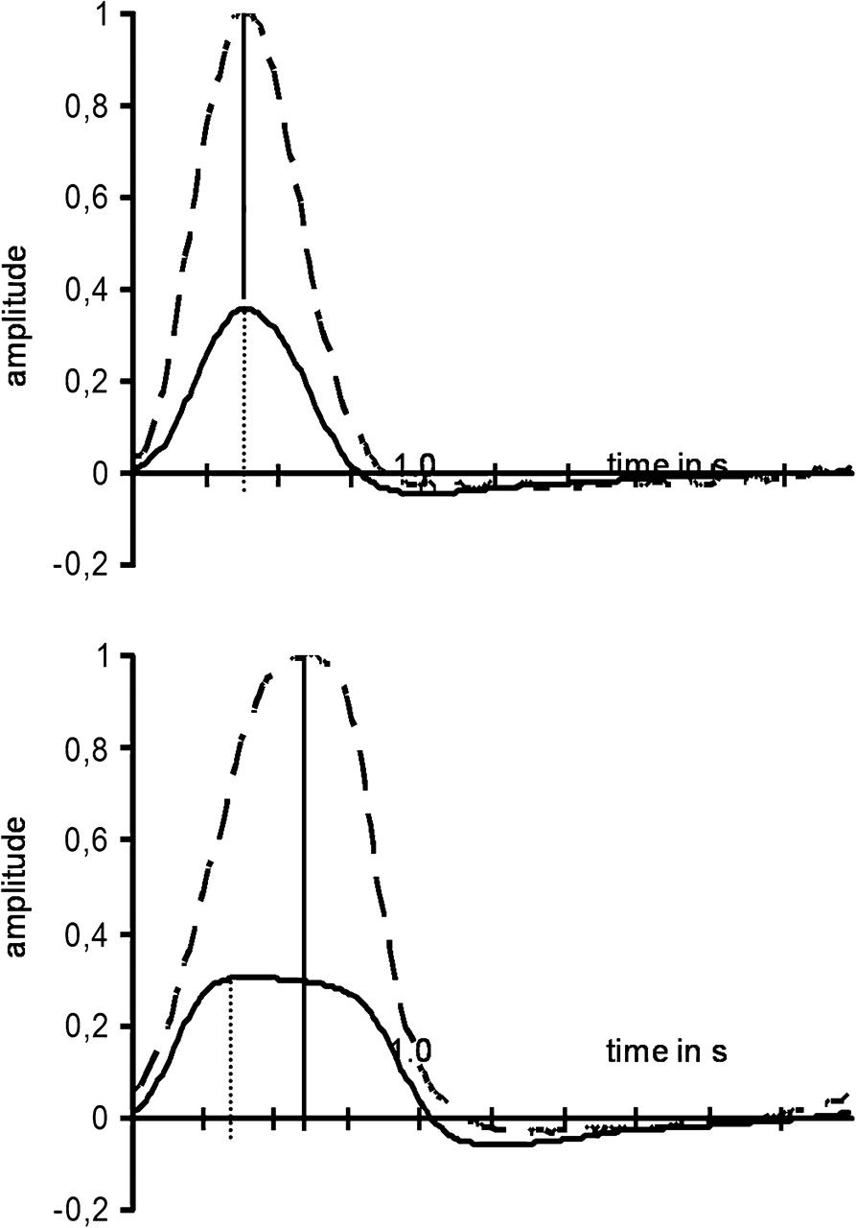
Figure 1. Time course of finger movements (average of 60 movements) during task sTdA requiring spatial but not temporal ...
Notes:
Figure 1. Time course of finger movements (average of 60 movements) during task sTdA requiring spatial but not temporal finger movement uncoupling (upper trace) and task dTdA requiring temporal and spatial finger movement uncoupling (lower trace) in subject 6. During task sTdA time-to-peak amplitude of small and large index finger movements were synchronous, whereas time-to-peak amplitude for the small movement was shorter during task dTdA. The amplitude of the small movement is shown with respect to the large movement (normalized to 1).
Unless provided in the caption above, the following copyright applies to the content of this slide: © The Author 2010. Published by Oxford University Press. All rights reserved. For permissions, please e-mail: journals.permissions@oxfordjournals.org

Slide 2
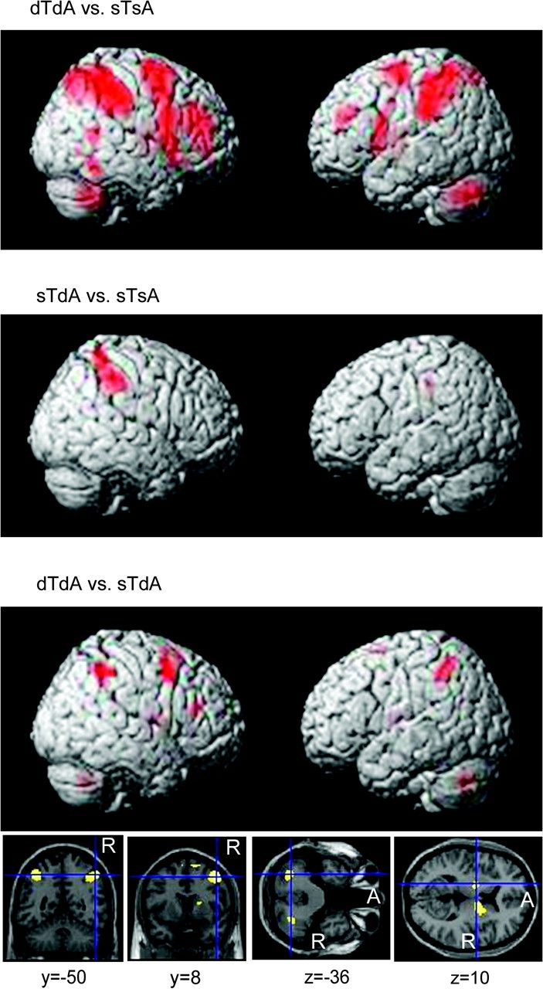
Figure 2. Networks recruited during spatial and temporal uncoupling of bilateral finger movements according to the ...
Notes:
Figure 2. Networks recruited during spatial and temporal uncoupling of bilateral finger movements according to the ANOVA data analysis (P < 0.05, family wise-error corrected). Above, task dTdA versus sTsA, that is, the network recruited for both temporal and spatial movement uncoupling of bilateral finger movements compared with simple finger movements. Middle, task sTdA versus sTsA. This contrast compared spatial uncoupling of bilateral finger movements with simple finger movements showing a right parietal region. Below, tasks dTdA versus sTdA, that is, the network involved in temporal uncoupling of bilateral finger movements. Temporal uncoupling required involvement of bilateral inferior parietal and right frontal cortical regions as well as bilateral basal ganglia and cerebellum regions.
Unless provided in the caption above, the following copyright applies to the content of this slide: © The Author 2010. Published by Oxford University Press. All rights reserved. For permissions, please e-mail: journals.permissions@oxfordjournals.org

Slide 3
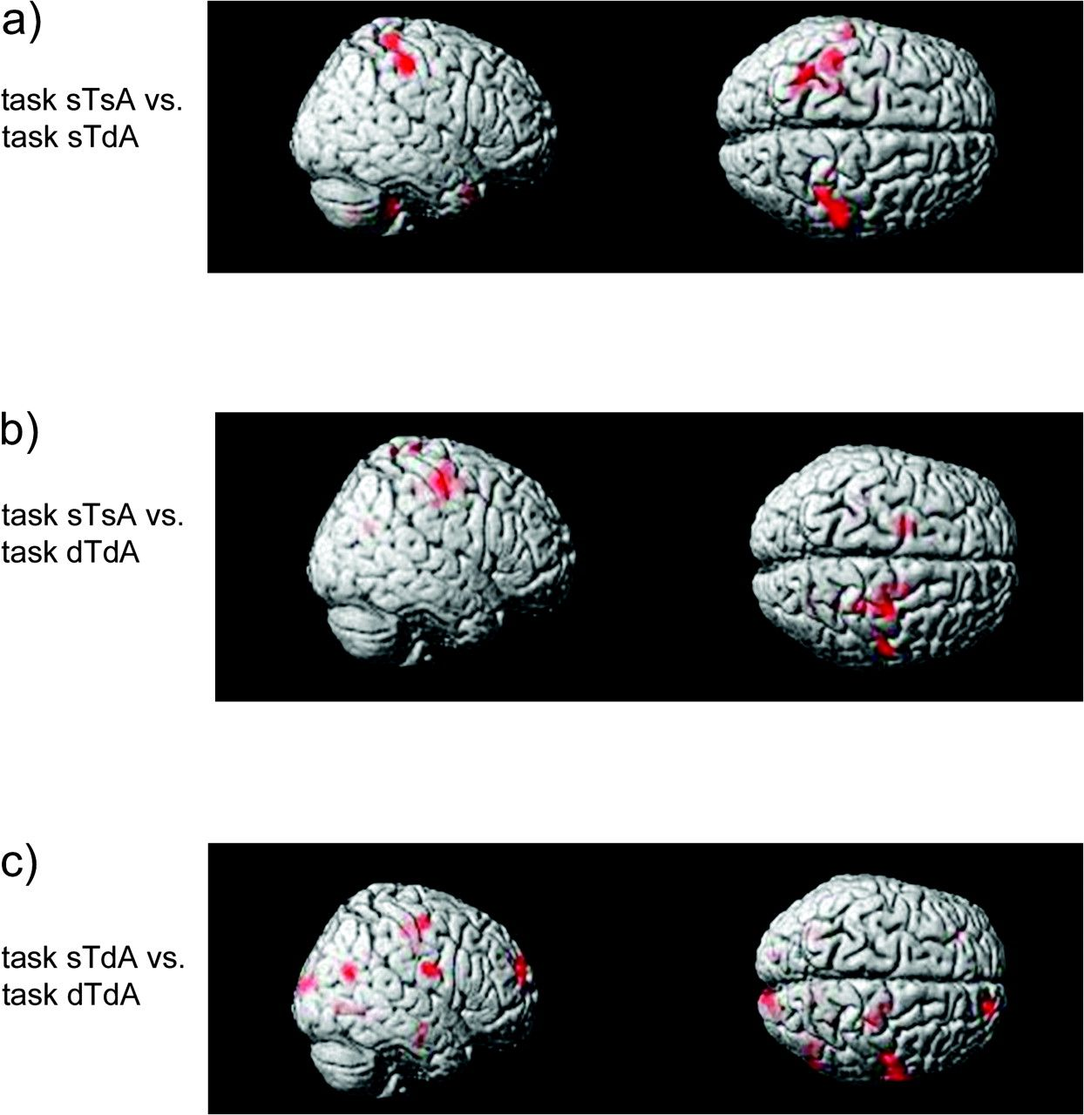
Figure 3. Regions showing a decrease in functional connectivity with the left primary motor cortex for comparison of ...
Notes:
Figure 3. Regions showing a decrease in functional connectivity with the left primary motor cortex for comparison of spatially but not temporally uncoupled bimanual movements (a) or temporally and spatially uncoupled movements (b) with simple finger movements (which were spatially and temporally coupled). The connectivity between bihemispheric primary hand motor regions is higher for the coupled bimanual movements and decreases with spatial and temporal uncoupling. The comparison of left M1 connectivity changes of spatially but not temporally uncoupled bimanual movements with spatially and temporally uncoupled movements revealed that temporal uncoupling led to a decrease of bihemispheric M1 connectivity (c) and connectivity of left M1 with other regions on the right hemisphere, as well.
Unless provided in the caption above, the following copyright applies to the content of this slide: © The Author 2010. Published by Oxford University Press. All rights reserved. For permissions, please e-mail: journals.permissions@oxfordjournals.org

Slide 4
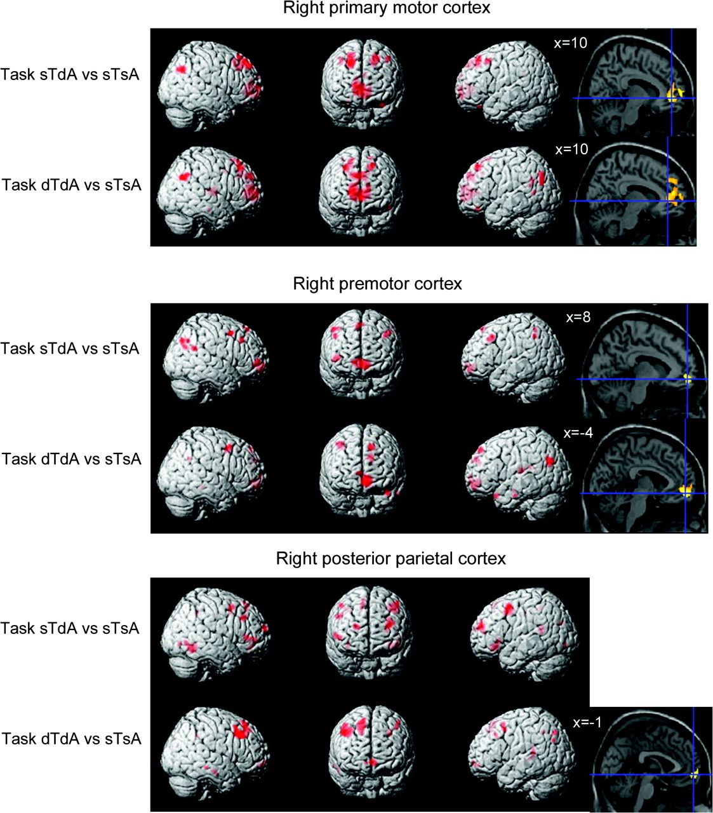
Figure 4. Regions showing an increase in functional connectivity during task sTdA, requiring spatial uncoupling and ...
Notes:
Figure 4. Regions showing an increase in functional connectivity during task sTdA, requiring spatial uncoupling and task dTdA, requiring spatial and temporal uncoupling of finger movements compared with control task sTsA (simple finger movements which were spatially and temporally coupled). Connectivity of right primary motor cortex, premotor, and posterior parietal regions with anterior cingulate and dorsolateral prefrontal regions increased during spatial and temporal uncoupling of finger movements.
Unless provided in the caption above, the following copyright applies to the content of this slide: © The Author 2010. Published by Oxford University Press. All rights reserved. For permissions, please e-mail: journals.permissions@oxfordjournals.org

