Slide 1
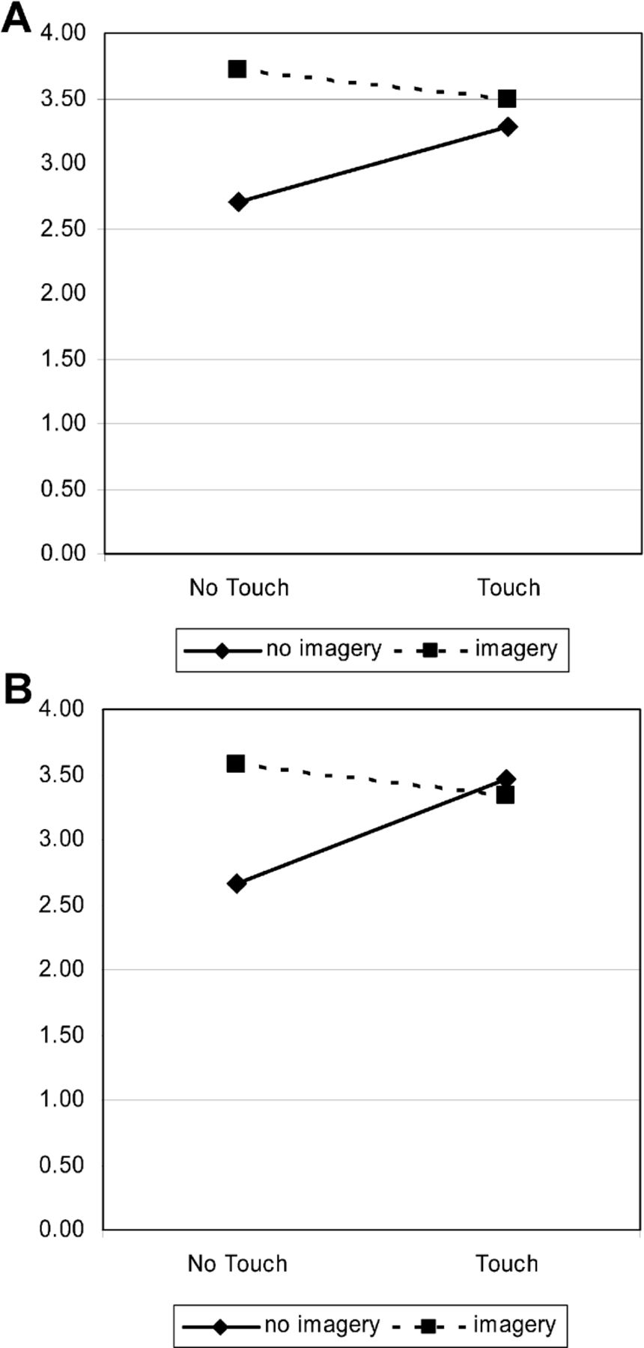
Figure 1 Study 1: A, perceived ownership (1–7) by touch and imagery conditions; B, Valuation ($) by touch and imagery ...
Notes:
Figure 1 Study 1: A, perceived ownership (1–7) by touch and imagery conditions; B, Valuation ($) by touch and imagery conditions
Unless provided in the caption above, the following copyright applies to the content of this slide: © 2009 by JOURNAL OF CONSUMER RESEARCH, Inc.

Slide 2
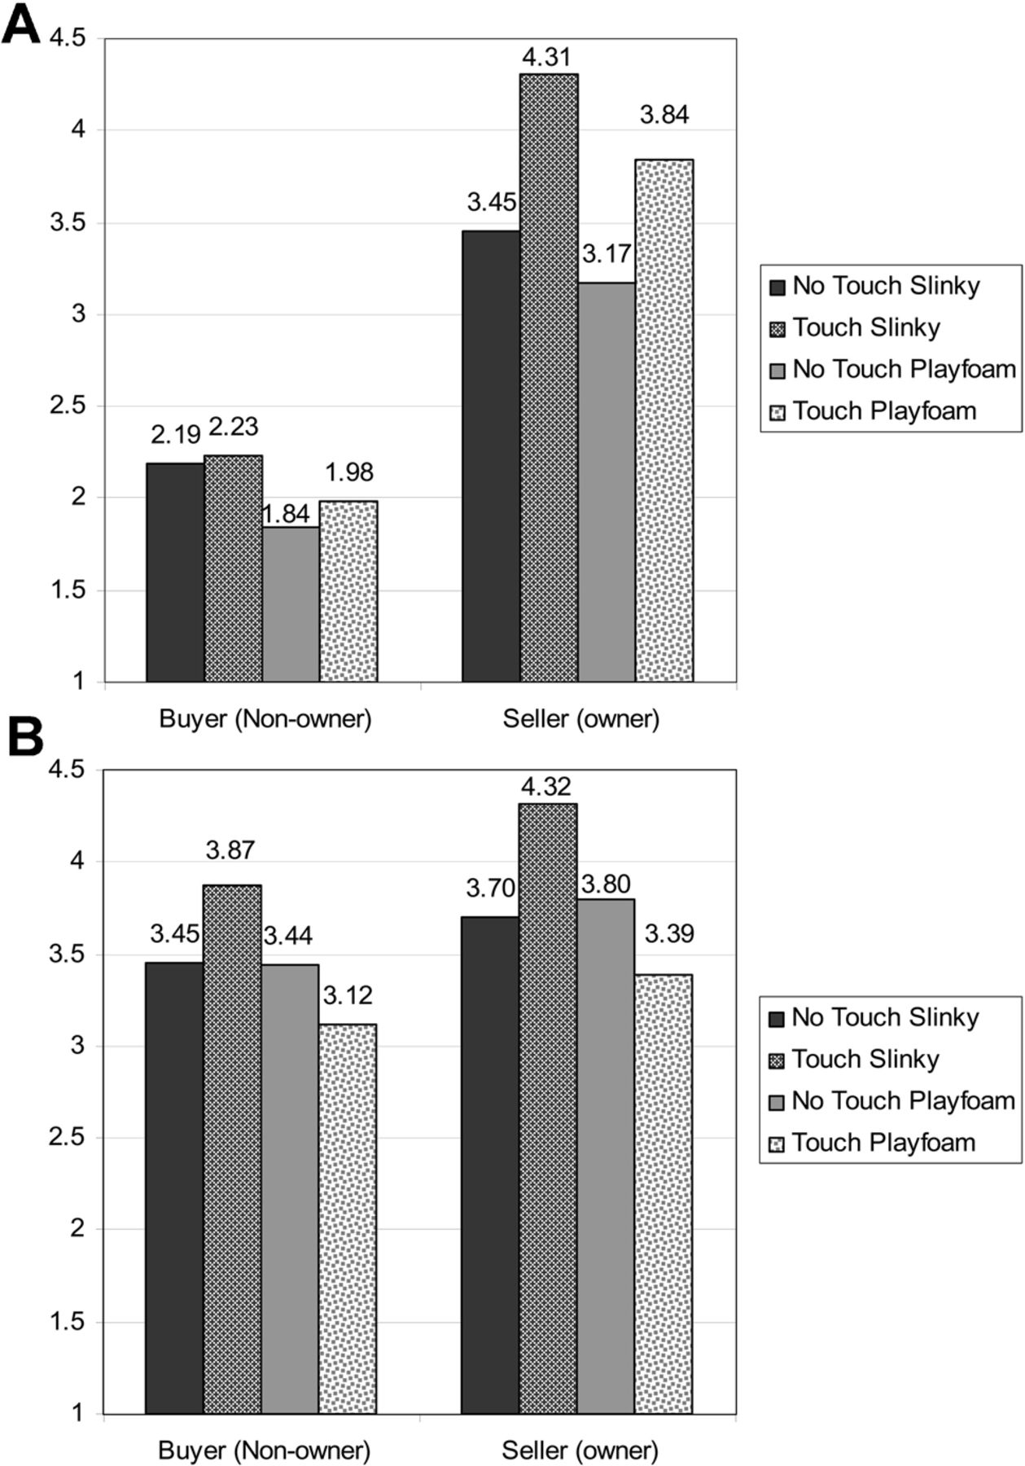
Figure 2 Studies 3 and 4: A, perceived ownership by role, touch, and product type; B, affective reaction by role, ...
Notes:
Figure 2 Studies 3 and 4: A, perceived ownership by role, touch, and product type; B, affective reaction by role, touch, and product type
Unless provided in the caption above, the following copyright applies to the content of this slide: © 2009 by JOURNAL OF CONSUMER RESEARCH, Inc.

