Slide 1
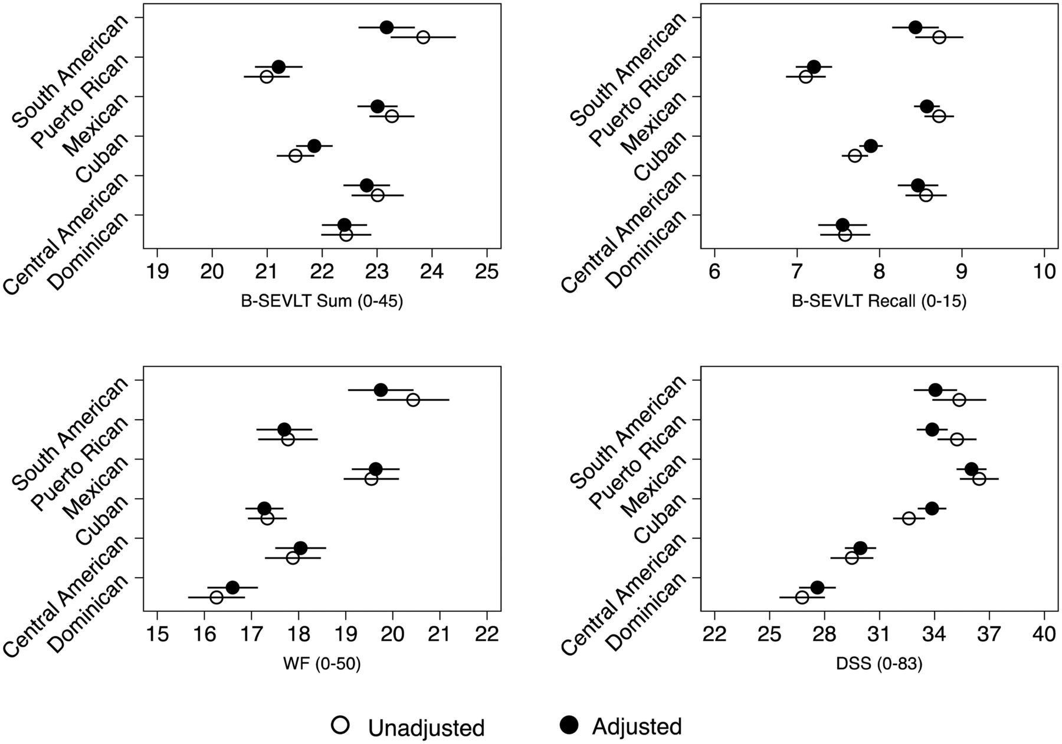
Fig. 1. Unadjusted and adjusted neurocognitive test score means by Hispanic/Latino groups (ages 45–74 years old). ...
Notes:
Fig. 1. Unadjusted and adjusted neurocognitive test score means by Hispanic/Latino groups (ages 45–74 years old). Results are from multivariable analyses of the Hispanic Community Health Study/Study of Latinos baseline (2008–2011). Note 1: All reported results are weighted to represent the target Hispanics/Latinos population. Note 2: Unadjusted indicates unadjusted bivariate linear regression model for survey data. Note 3: Adjusted indicates fully adjusted linear regression model for survey data. Covariates include sex, age, education, household income, language and depressive symptoms (CES-D-10; 10-item Center for Epidemiological Studies Depression Scale) score. Note 4: The Spanish English Verbal Learning Test (SEVLT). Note 5: The Word Fluency (WF) test of the Controlled Oral Word Association Test. Note 6: The Digit Symbol Substitution (DSS) test of the Wechsler Adult Intelligence Scale-Revised. Note 7: Lines represent the 95% confidence intervals of the estimated means.
Unless provided in the caption above, the following copyright applies to the content of this slide: © The Author 2014. Published by Oxford University Press. All rights reserved. For permissions, please e-mail: journals.permissions@oup.com.

Slide 2
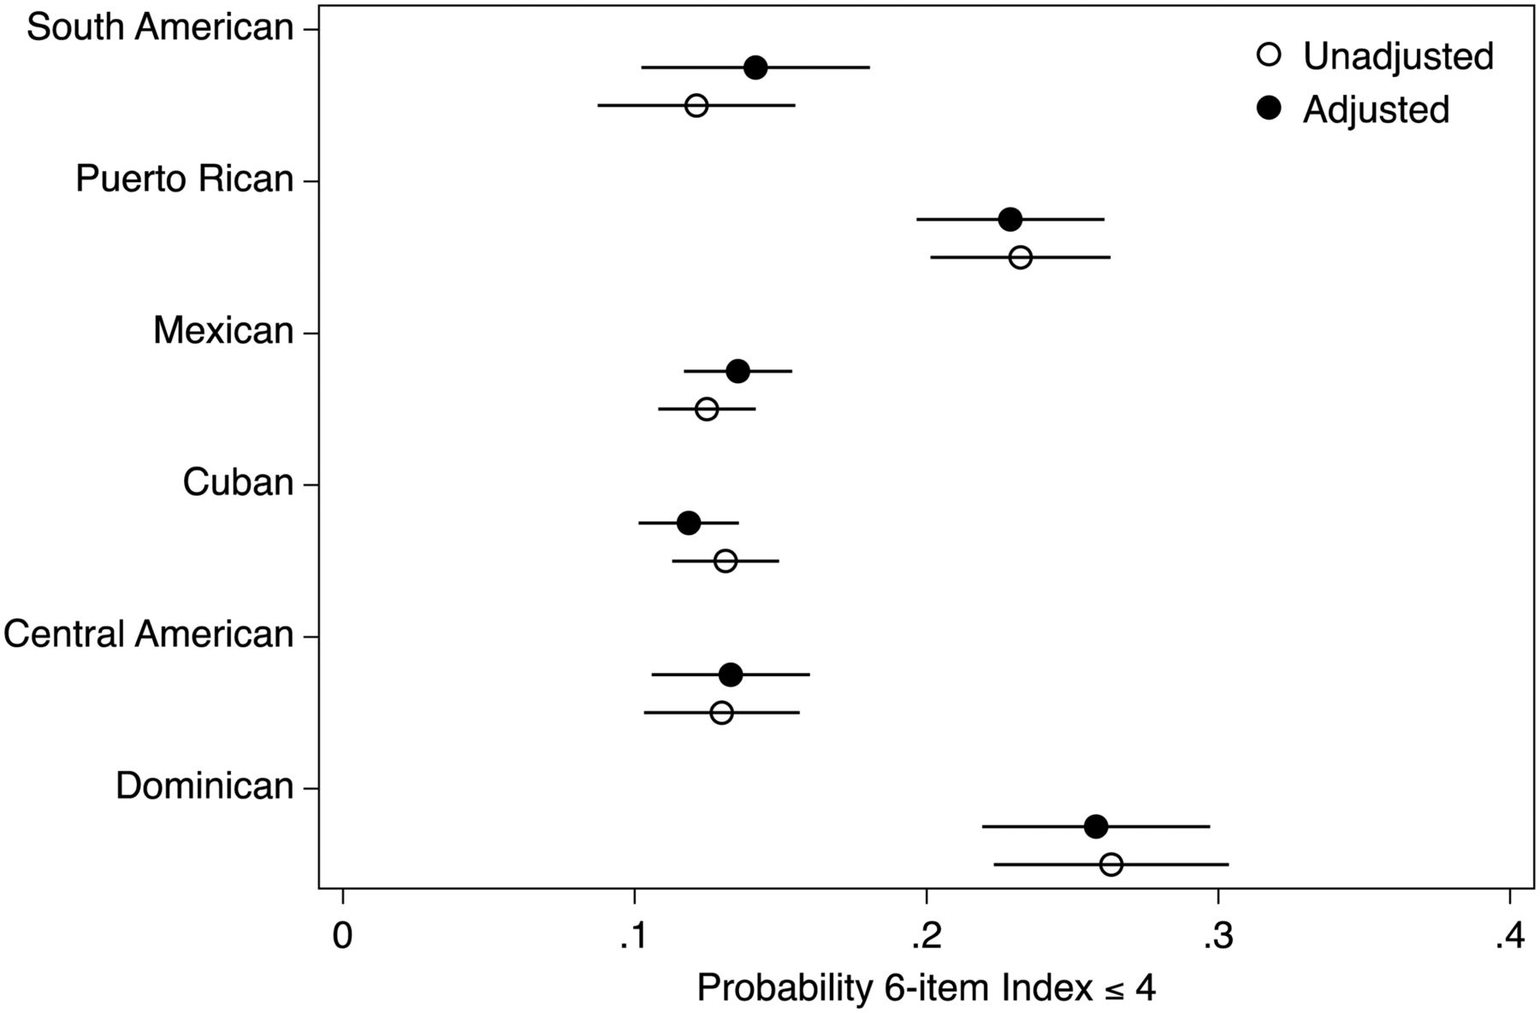
Fig. 2. Unadjusted and adjusted probability estimates for low Six-Item Screener performance by Hispanic/Latino ...
Notes:
Fig. 2. Unadjusted and adjusted probability estimates for low Six-Item Screener performance by Hispanic/Latino background (ages 45–74 years old). Results are from multivariable logistic analyses of the Hispanic Community Health Study/Study of Latinos baseline (2008–2011). Note 1: All reported results are weighted to represent the target Hispanics/Latinos population. Note 2: Unadjusted stands for unadjusted logistic survey regression model. Note 3: Adjusted indicates fully adjusted logistic survey regression model. Covariates include sex, age, education, household income, language and depressive symptoms (CES-D-10; 10-item Center for Epidemiological Studies Depression Scale) score. Note 4: The lines represent the 95% confidence intervals for the estimated probabilities.
Unless provided in the caption above, the following copyright applies to the content of this slide: © The Author 2014. Published by Oxford University Press. All rights reserved. For permissions, please e-mail: journals.permissions@oup.com.

