Slide 1
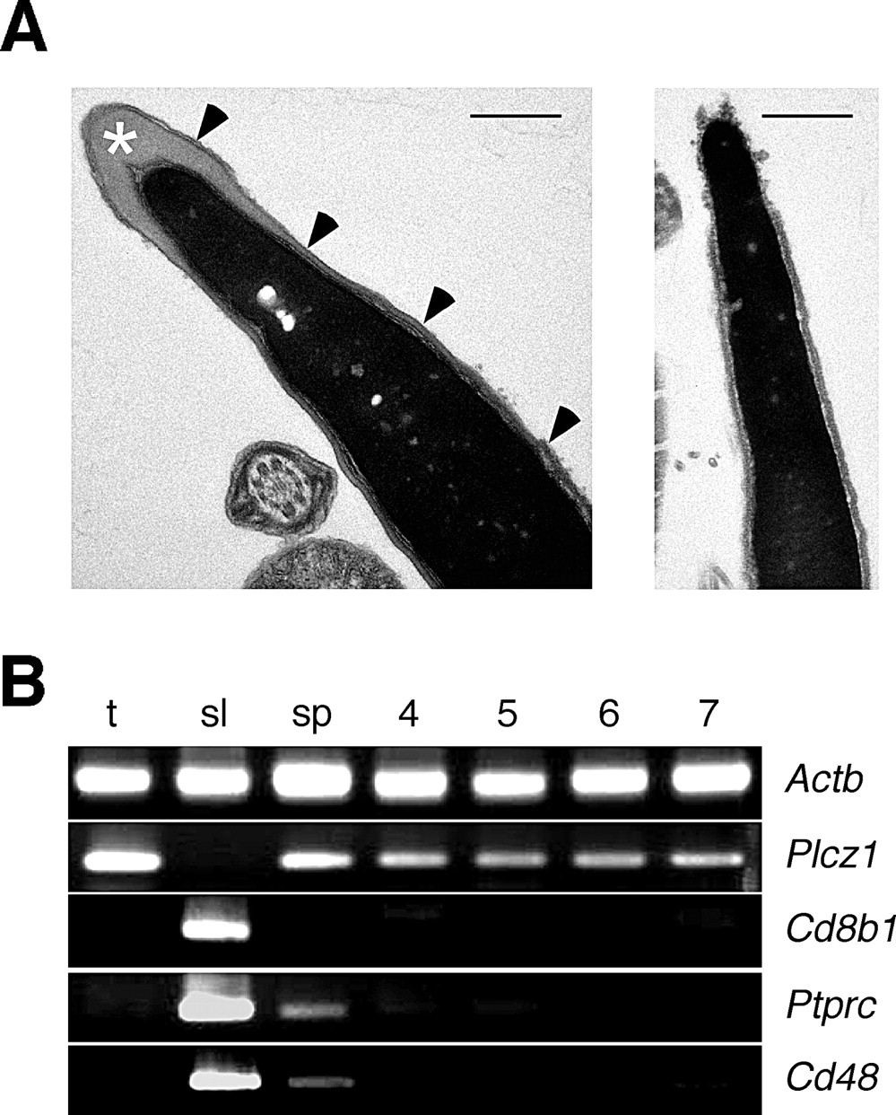
Fig. 1 Preparation of spermatozoa for miRNA microarray analysis. A) Electron micrographs showing sagittal sections ...
Notes:
Fig. 1 Preparation of spermatozoa for miRNA microarray analysis. A) Electron micrographs showing sagittal sections of untreated (left) and Triton X-100-extracted cauda epididymidal sperm heads. A white asterisk marks the acrosome and arrowheads indicate the plasma membrane, both of which are absent from the detergent-treated sample (right). Bar = 0.5 μm. B) RT-PCR of RNA preparations from testis (t), spleen (sl), untreated cauda epididymidal sperm (sp), and Triton X-100-extracted cauda epididymidal sperm in Samples 4, 5, 6, and 7.
Unless provided in the caption above, the following copyright applies to the content of this slide: © 2006 by the Society for the Study of Reproduction, Inc.

Slide 2
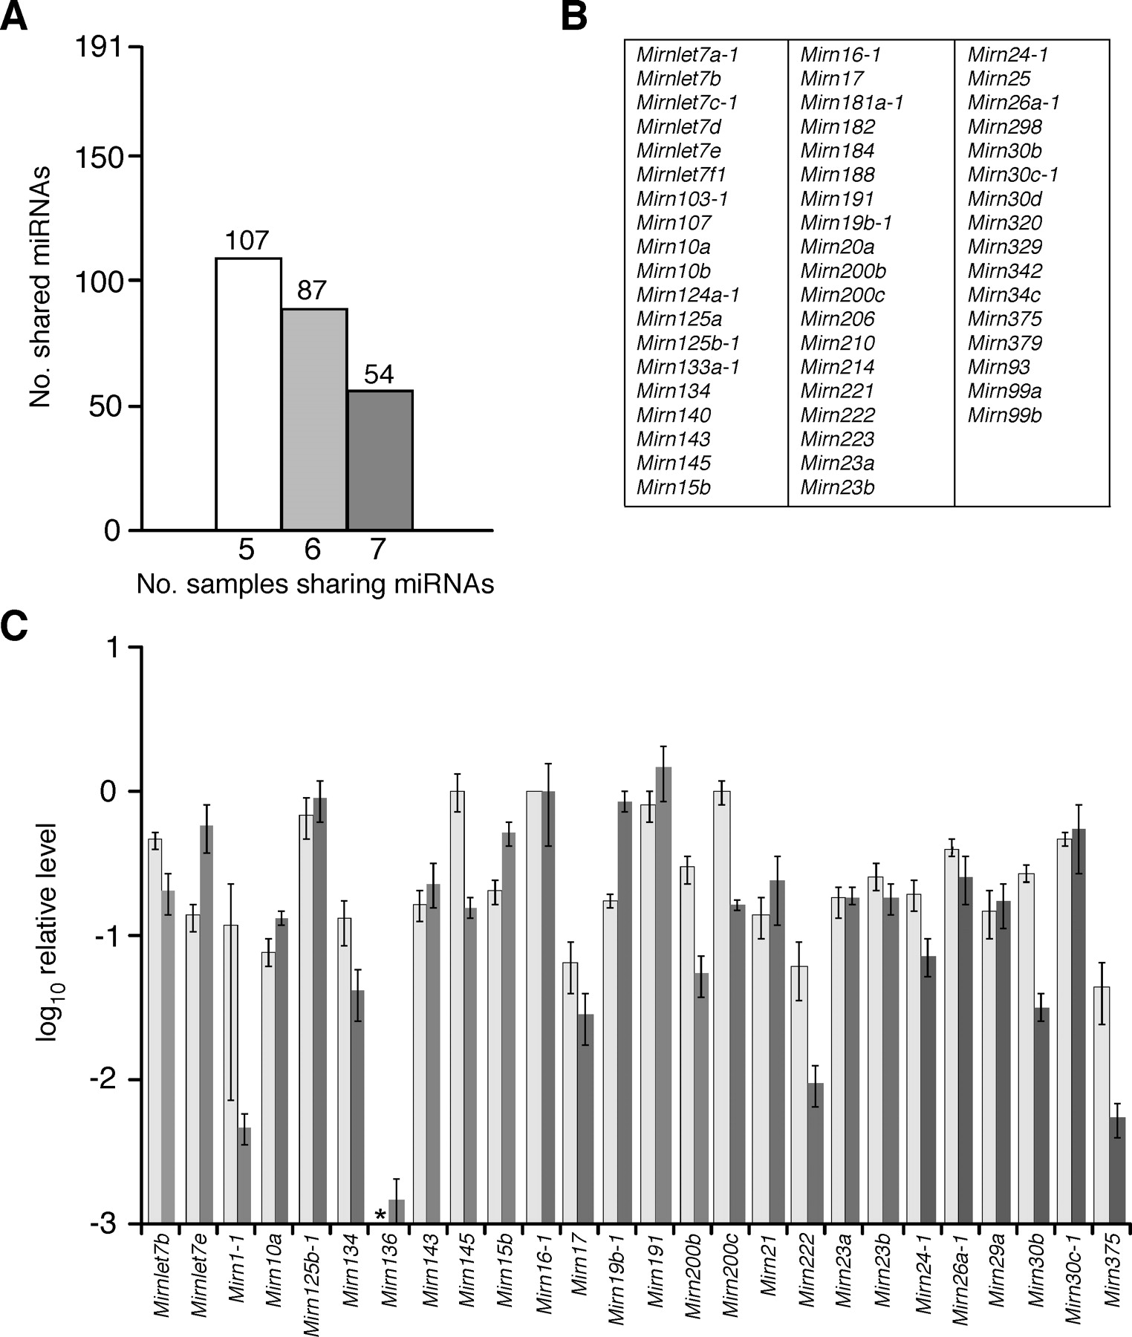
Fig. 2 Microarray analysis of mouse sperm-borne miRNAs. A) The number of miRNAs found in 5, 6 or all 7 of the Triton ...
Notes:
Fig. 2 Microarray analysis of mouse sperm-borne miRNAs. A) The number of miRNAs found in 5, 6 or all 7 of the Triton X-100-extracted sperm-derived samples analyzed. B) Designations of core miRNAs detected in all seven Triton X-100-extracted sperm samples. C) Pairwise comparisons of miRNA levels determined by microarray profiling (light bars) and semiquantitative PCR (qPCR, dark bars). The values from each analysis are normalized to give a value for Mirn16–1 of 1.00. Asterisk, not detected.
Unless provided in the caption above, the following copyright applies to the content of this slide: © 2006 by the Society for the Study of Reproduction, Inc.

Slide 3
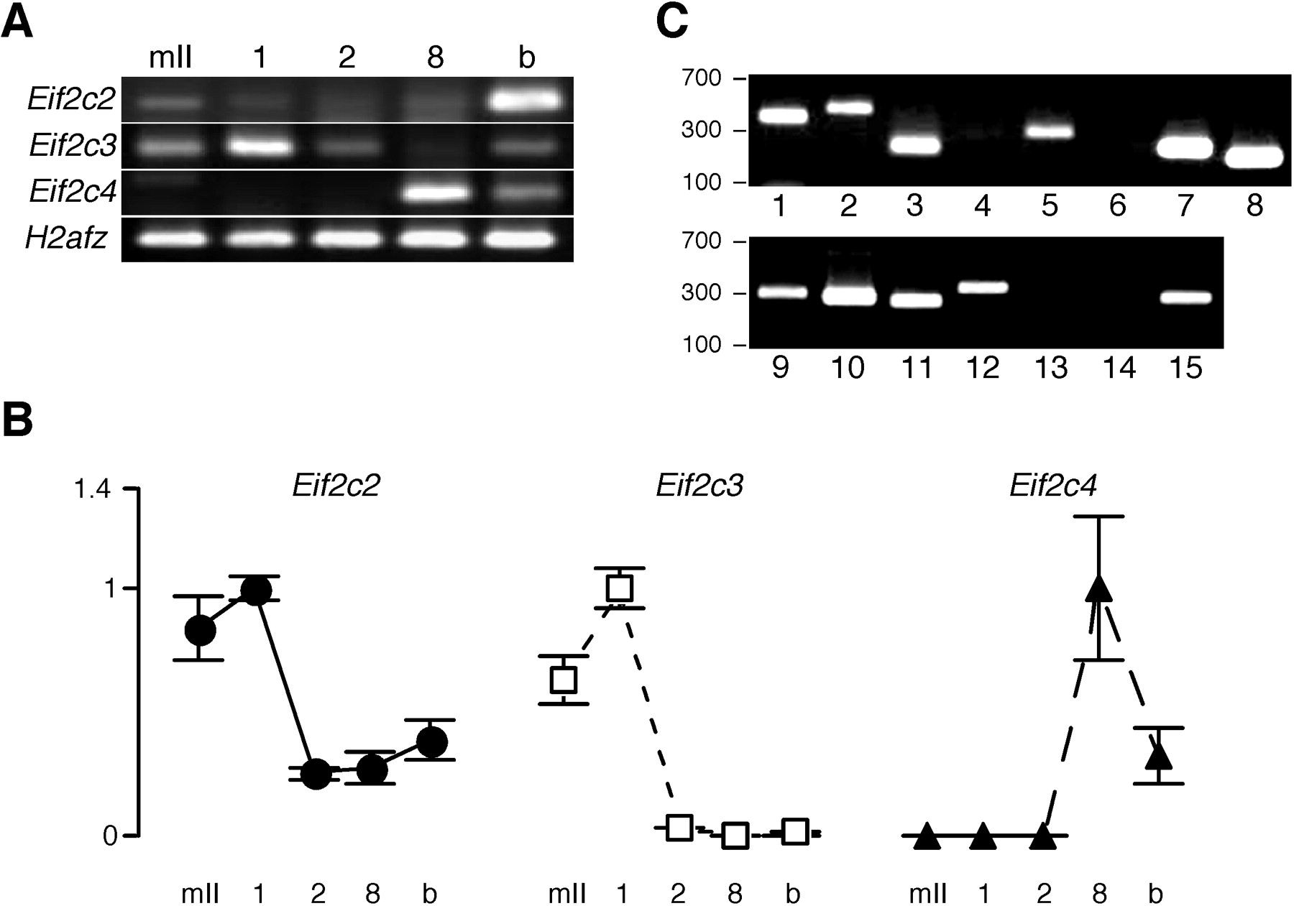
Fig. 3 A) Standard RT-PCR and B) qPCR showing the mRNA levels of Eif2c2 (formerly Ago2), Eif2c3 (Ago3), and Eif2c4 ...
Notes:
Fig. 3 A) Standard RT-PCR and B) qPCR showing the mRNA levels of Eif2c2 (formerly Ago2), Eif2c3 (Ago3), and Eif2c4 (Ago4) in mII oocytes (mII) and at the 1-cell (1), 2-cell (2), 8-cell (8), and blastocyst (b) stages of preimplantation development. Plots for qPCR are shown relative to the highest value, set at 1.00. Transcripts for Eif2c1 and Eif2c5 were not detected. C) RT-PCR of validated sperm-borne miRNA targets in mII oocytes. In addition to clearly identified products, faint bands were also present in lanes 4, 6, and 14, indicating low levels of the corresponding mRNAs. Lanes: 1, Mtpn; 2, Lin28; 3, Smc1a; 4, Mapk7; 5, 2700055K07Rik; 6, Bcl2; 7, E2f1; 8, Kit; 9, Mapk14; 10, Jak2; 11, Hdac4; 12, Lamc2; 13, Pten; 14, Cdk6; 15, Tmem2. Sizes are in base pairs.
Unless provided in the caption above, the following copyright applies to the content of this slide: © 2006 by the Society for the Study of Reproduction, Inc.

Slide 4
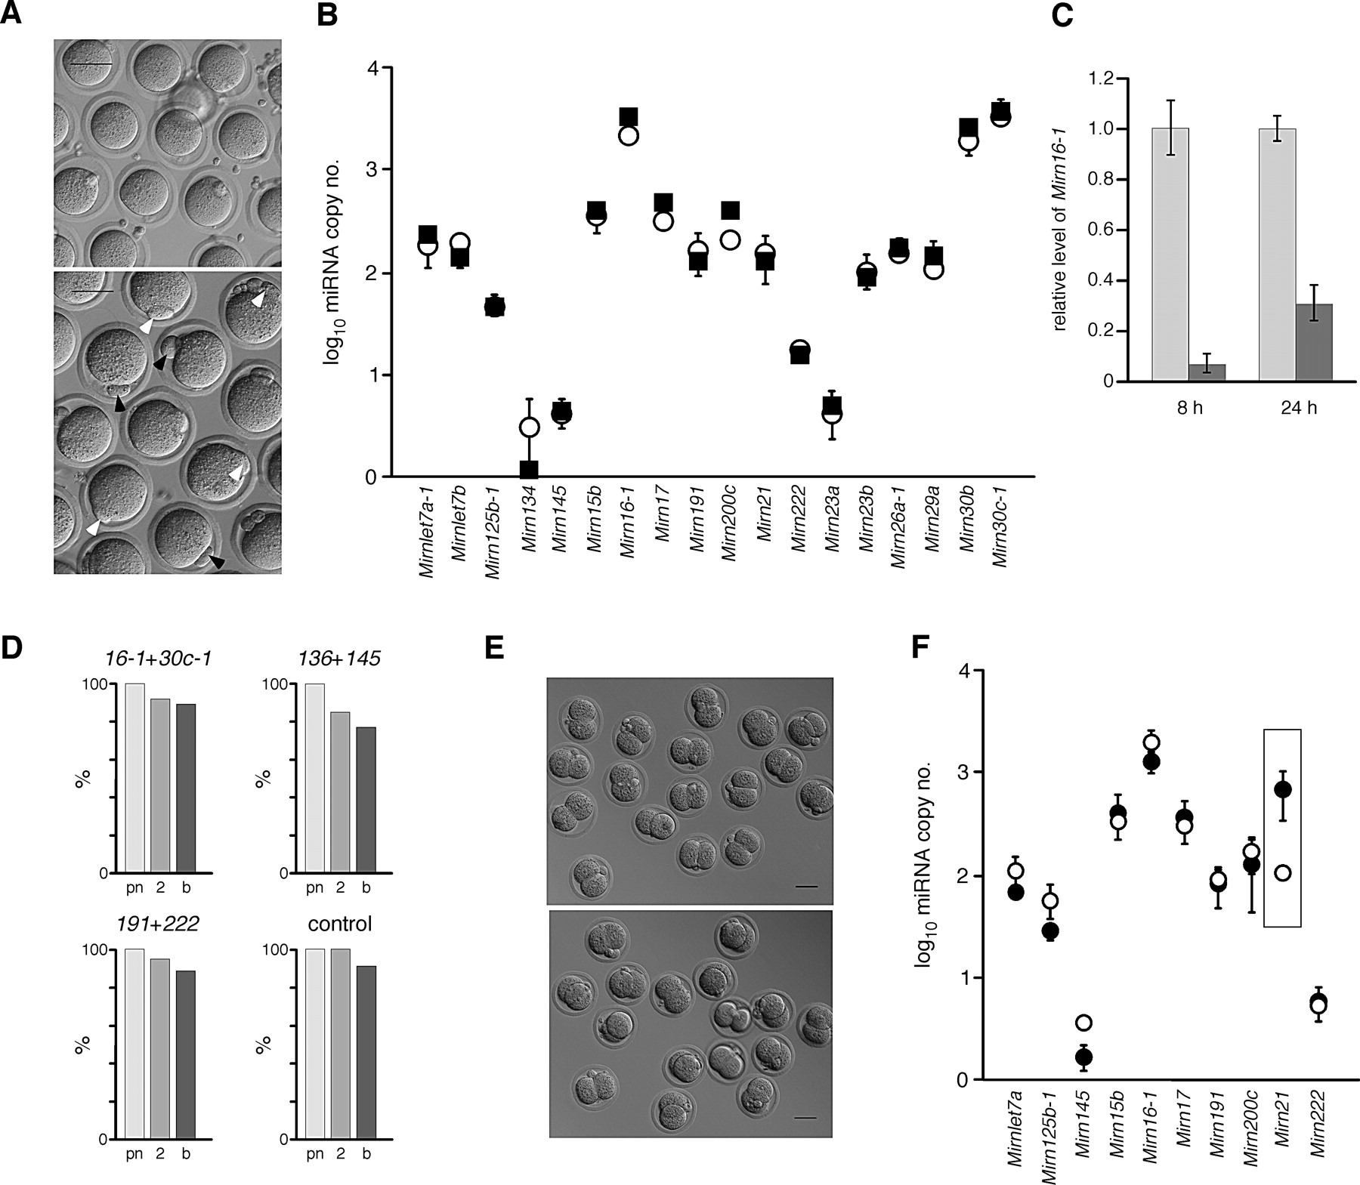
Fig. 4 Relationships between fertilization and development, nuclear transfer and levels of miRNAs. A) Hoffman ...
Notes:
Fig. 4 Relationships between fertilization and development, nuclear transfer and levels of miRNAs. A) Hoffman modulation microscopy of oocytes just prior to IVF (upper) and 2 h after mixing with capacitated sperm. Nascent (white arrowhead) and extruded (black arrowhead) Pb2 are shown. B) Estimated copy numbers (log10) of miRNAs in age-matched zona-free mII oocytes without fertilization (white circles) and 2 h after IVF. C) Relative levels of Mirn16–1 following coinjection of a sperm head plus control (light) anti-miR, or plus anti-Mirn16–1 and anti-Mirn30c-1, 8 or 24 h after injection. D) Development (% surviving injection) to the pronuclear (pn), 2-cell (2) or blastocyst (b) stages after coinjection of a sperm head plus anti-miRs as indicated (for 12–68 embryos surviving injection). E) Hoffman modulation microscopy showing normal cleavage of embryos produced 24 h after coinjection of mII oocytes with sperm and anti-Mirn16–1 plus anti-Mirn30c-1 (upper), or with sperm and anti-Mirn191 plus anti-Mirn222. Bar = 50 μm. F) Estimated copy numbers (log10) of miRNAs in age-matched zona-free, enucleated mII oocytes (white circles) ~30 min after cumulus cell nuclear transfer. Different levels of Mirn21 are highlighted with a box.
Unless provided in the caption above, the following copyright applies to the content of this slide: © 2006 by the Society for the Study of Reproduction, Inc.

