Slide 1
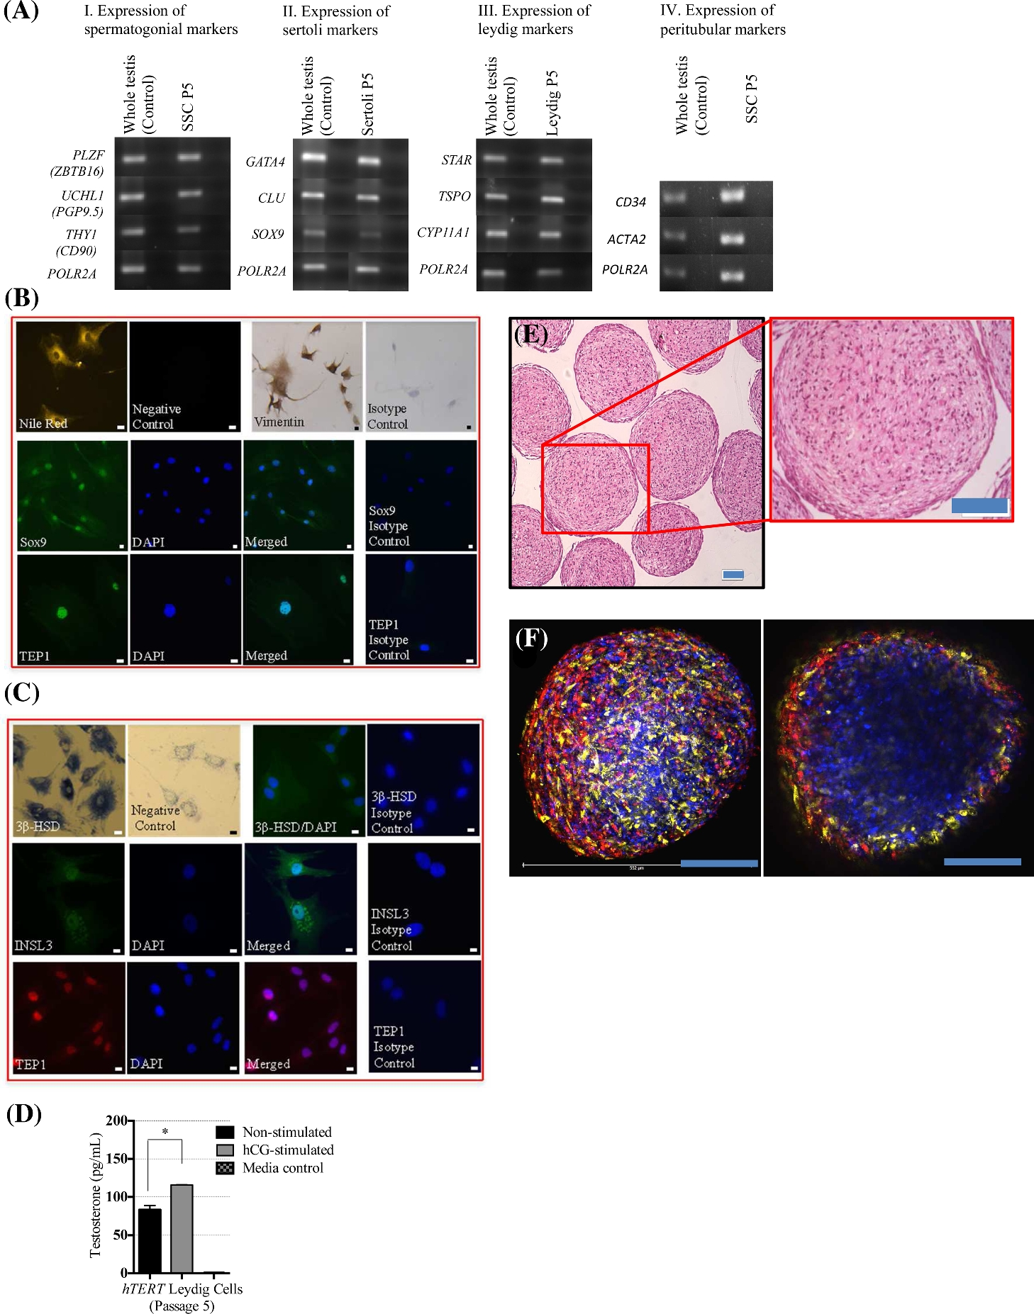
Figure 1. Characterization of testicular cells and organids. (A) Key spermatogonial stem cell (SSC), Sertoli, and ...
Notes:
Figure 1. Characterization of testicular cells and organids. (A) Key spermatogonial stem cell (SSC), Sertoli, and Leydig cell markers in 2D cultures of human testicular cell subtypes. (A-I) RT-PCR for spermatogonial cell markers: PLZF (promyelocytic leukemia zinc finger protein, ZTBT16), UCHL1 (ubiquitin carboxy-terminal hydrolase L1), and THY1 (cluster of differentiation 90). (A-II) Sertoli cells markers: GATA4, CLU (clusterin), and SOX9. (A-III) Leydig cells markers: STAR (steroidogenic acute regulatory protein), TSPO (translocator protein), and CYP11A1 (cholesterol side-chain cleavage enzyme). (A-IV) Peritubular cells markers: CD34 and ACTA2 (alpha-SM-actin) on whole testis and isolated cells from the same patient. POLR2A (DNA-directed RNA polymerase II subunit RPB1) was utilized as a reference marker in all cases. The second lane of each sample shows the negative reverse transcriptase (–RT) control. (B) Morphological characterization of immortalized Sertoli cells. Upper panel left: Nile red staining for characteristic lipid droplet accumulation. Top panel right: vimentin immunohistochemical staining. Middle panel: immunofluorescence staining for SOX9. Bottom panel: immunofluorescence staining for telomerase-associated protein 1 (TEP1) in immortalized Sertoli cells. (C) Morphological characterization of immortilized Leydig cells. Top panel: 3β-HSD chemical staining. Middle panel: immunofluorescence staining for INSL3. Bottom panel: Immunofluorescence staining for TEP1 in immortalized Leydig cells. (D) Quantification of secreted testosterone by ELISA over time for Leydig cells in 2D culture (n = 3). Data presented as mean ± SD. Significance: *p < 0.05. (E) Paraffin sections of testicular organoids stained by H&E after 2 weeks in culture (low and high magnification.). (F) Representative confocal microscopy 3D Z-Stack projection of 3D testicular organoid using Vybrant Cell-Labeling Solutions. Incorporated testicular cell subtypes have been individually labeled; SSC (blue), Sertoli cells (yellow), and Leydig cells (red). Left panel: external view, right panel: a confocal section approximately 75–100 μM into the organoid. Scale bars represent 100 μm.
Unless provided in the caption above, the following copyright applies to the content of this slide: © The Authors 2017. Published by Oxford University Press on behalf of Society for the Study of Reproduction. All rights reserved. For permissions, please e-mail: journals.permissions@oup.com

Slide 2
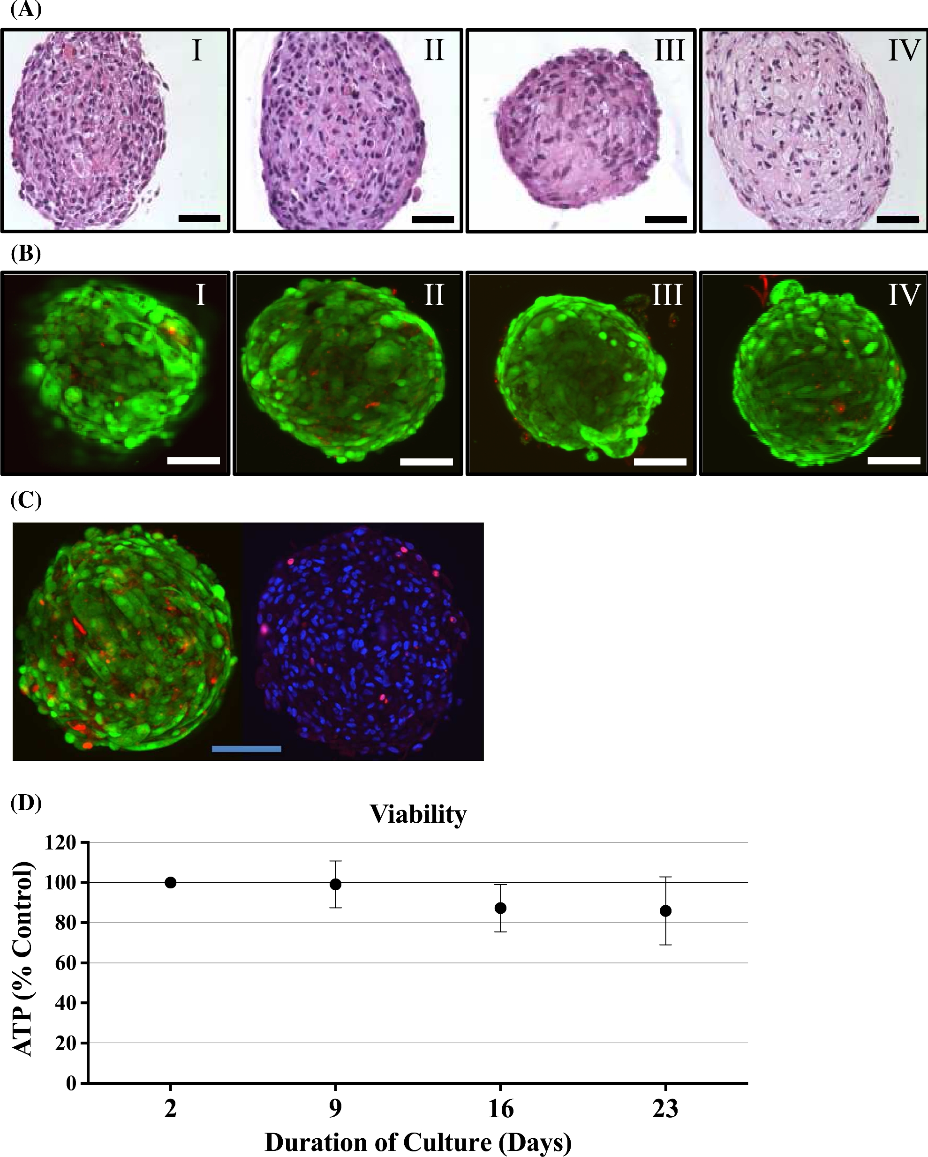
Figure 2. Testicular organoid morphological characterization and viability assessment. (A) Morphological ...
Notes:
Figure 2. Testicular organoid morphological characterization and viability assessment. (A) Morphological characterization of testicular organoids during extended culture (2, 9, 16, and 23 days). (A) Paraffin sections of 3D cultures stained with H&E for internal morphologic characterization (top panel, I–IV) revealed production of ECM within the organoids over time in culture without any sign of necrosis (scale bar 100 μm). (B) Organoids were stained using a Life Technologies LIVE/DEAD Cell Imaging Kit (live cell = green, dead cell = red) and imaged using an Olympus FV10i confocal microscope (bottom panels, I–IV). Scale bars represent 100 μm. (C) Viability and proliferative capacity of multicellular human testicular organoids. (Left) Live/Dead Confocal 3D Z-Stack projection of representative organoid after 2 weeks in culture. (Right) Ki-67 immunofluorescent staining of representative organoid paraffin section at week 2 of culture (red is Ki67 and blue is DAPI staining). (D) Evaluation of ATP production using CellTiter-Glo Luminescent Cell Viability Assays revealed consistent ATP production for the entire culture period (n = 6). Data presented as mean ± SD.
Unless provided in the caption above, the following copyright applies to the content of this slide: © The Authors 2017. Published by Oxford University Press on behalf of Society for the Study of Reproduction. All rights reserved. For permissions, please e-mail: journals.permissions@oup.com

Slide 3
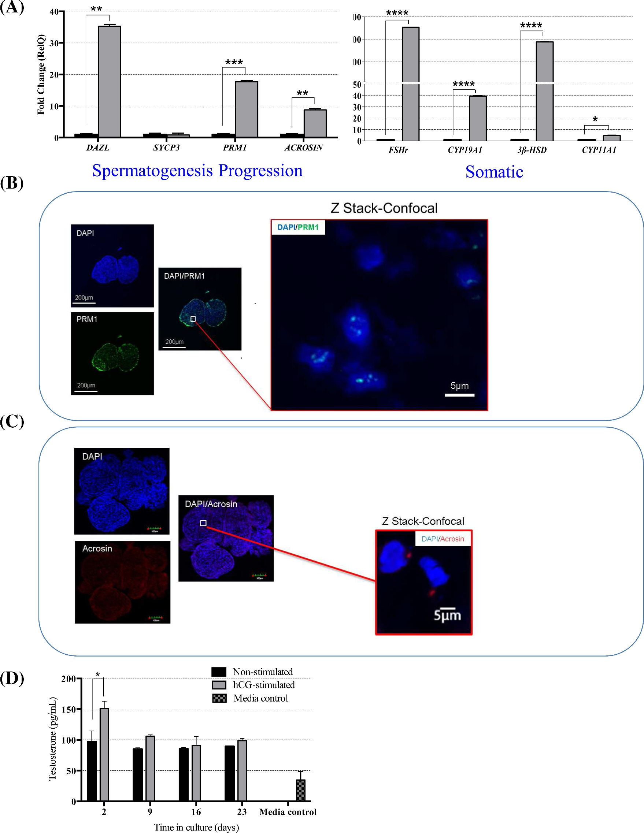
Figure 3. Testicular organoid gene expression changes following 23 days in culture. The fold change (RelQ, ...
Notes:
Figure 3. Testicular organoid gene expression changes following 23 days in culture. The fold change (RelQ, 2−ΔΔCT) for stage-specific spermatogenesis markers and somatic cell functional markers (A) revealed a significant upregulation of spermatogenesis (DAZL, ACR, PRM1) genes and a significant upregulation of both Leydig (3β-HSD, CYP11a1) and Sertoli (FSHr, CYP19a1) functional markers. A significant change in gene expression for undifferentiated spermatogonia (UCHL1, PLZF) was not observed; however, these genes maintained consistent expression for the entire culture period (n = 40). Data presented as mean ± SD. Significance: *p < 0.05; **p < 0.01; ***p < 0.001; ****p < 0.000. Evaluation of postmeiotic germ cell markers in differentiated human testicular organoids for PRM1 (B) and Acrosin (C). Quantification of secreted testosterone over time by testicular organoids (D) measured with ELISA (n = 10, in each time point a group of organoids were used that were not stimulated by hCG previously). Data presented as mean ± SD. Significance: *p < 0.05.
Unless provided in the caption above, the following copyright applies to the content of this slide: © The Authors 2017. Published by Oxford University Press on behalf of Society for the Study of Reproduction. All rights reserved. For permissions, please e-mail: journals.permissions@oup.com

Slide 4
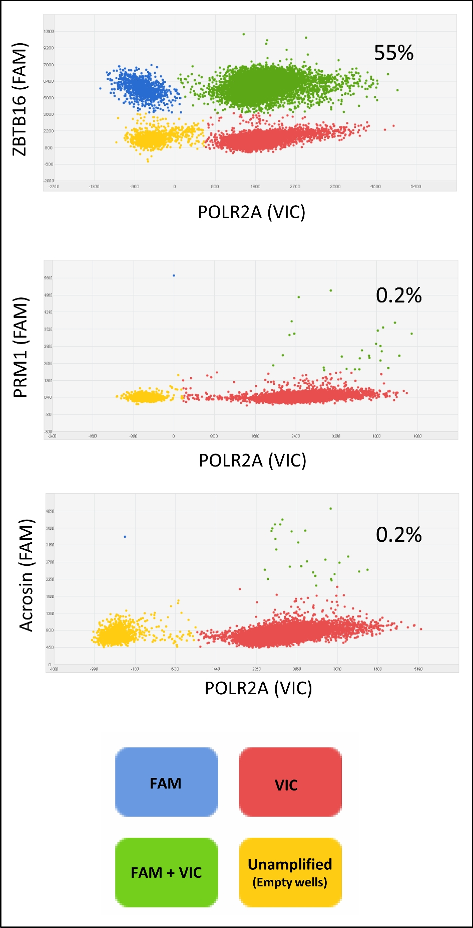
Figure 4. Quantification of germ cells at day 23 of 3D organoid culture. Digital PCR detecting single cell per well ...
Notes:
Figure 4. Quantification of germ cells at day 23 of 3D organoid culture. Digital PCR detecting single cell per well showed the percentage of undifferntaited spermatogonia cells (ZBTB16+) and postmeiotic germ cells (PRM1 and Acrosin). POLR2A primer labeled with VIC was used as housekeeping (reference marker), for all other cell-specific genes, we used primers labeled with FAM.
Unless provided in the caption above, the following copyright applies to the content of this slide: © The Authors 2017. Published by Oxford University Press on behalf of Society for the Study of Reproduction. All rights reserved. For permissions, please e-mail: journals.permissions@oup.com

Slide 5
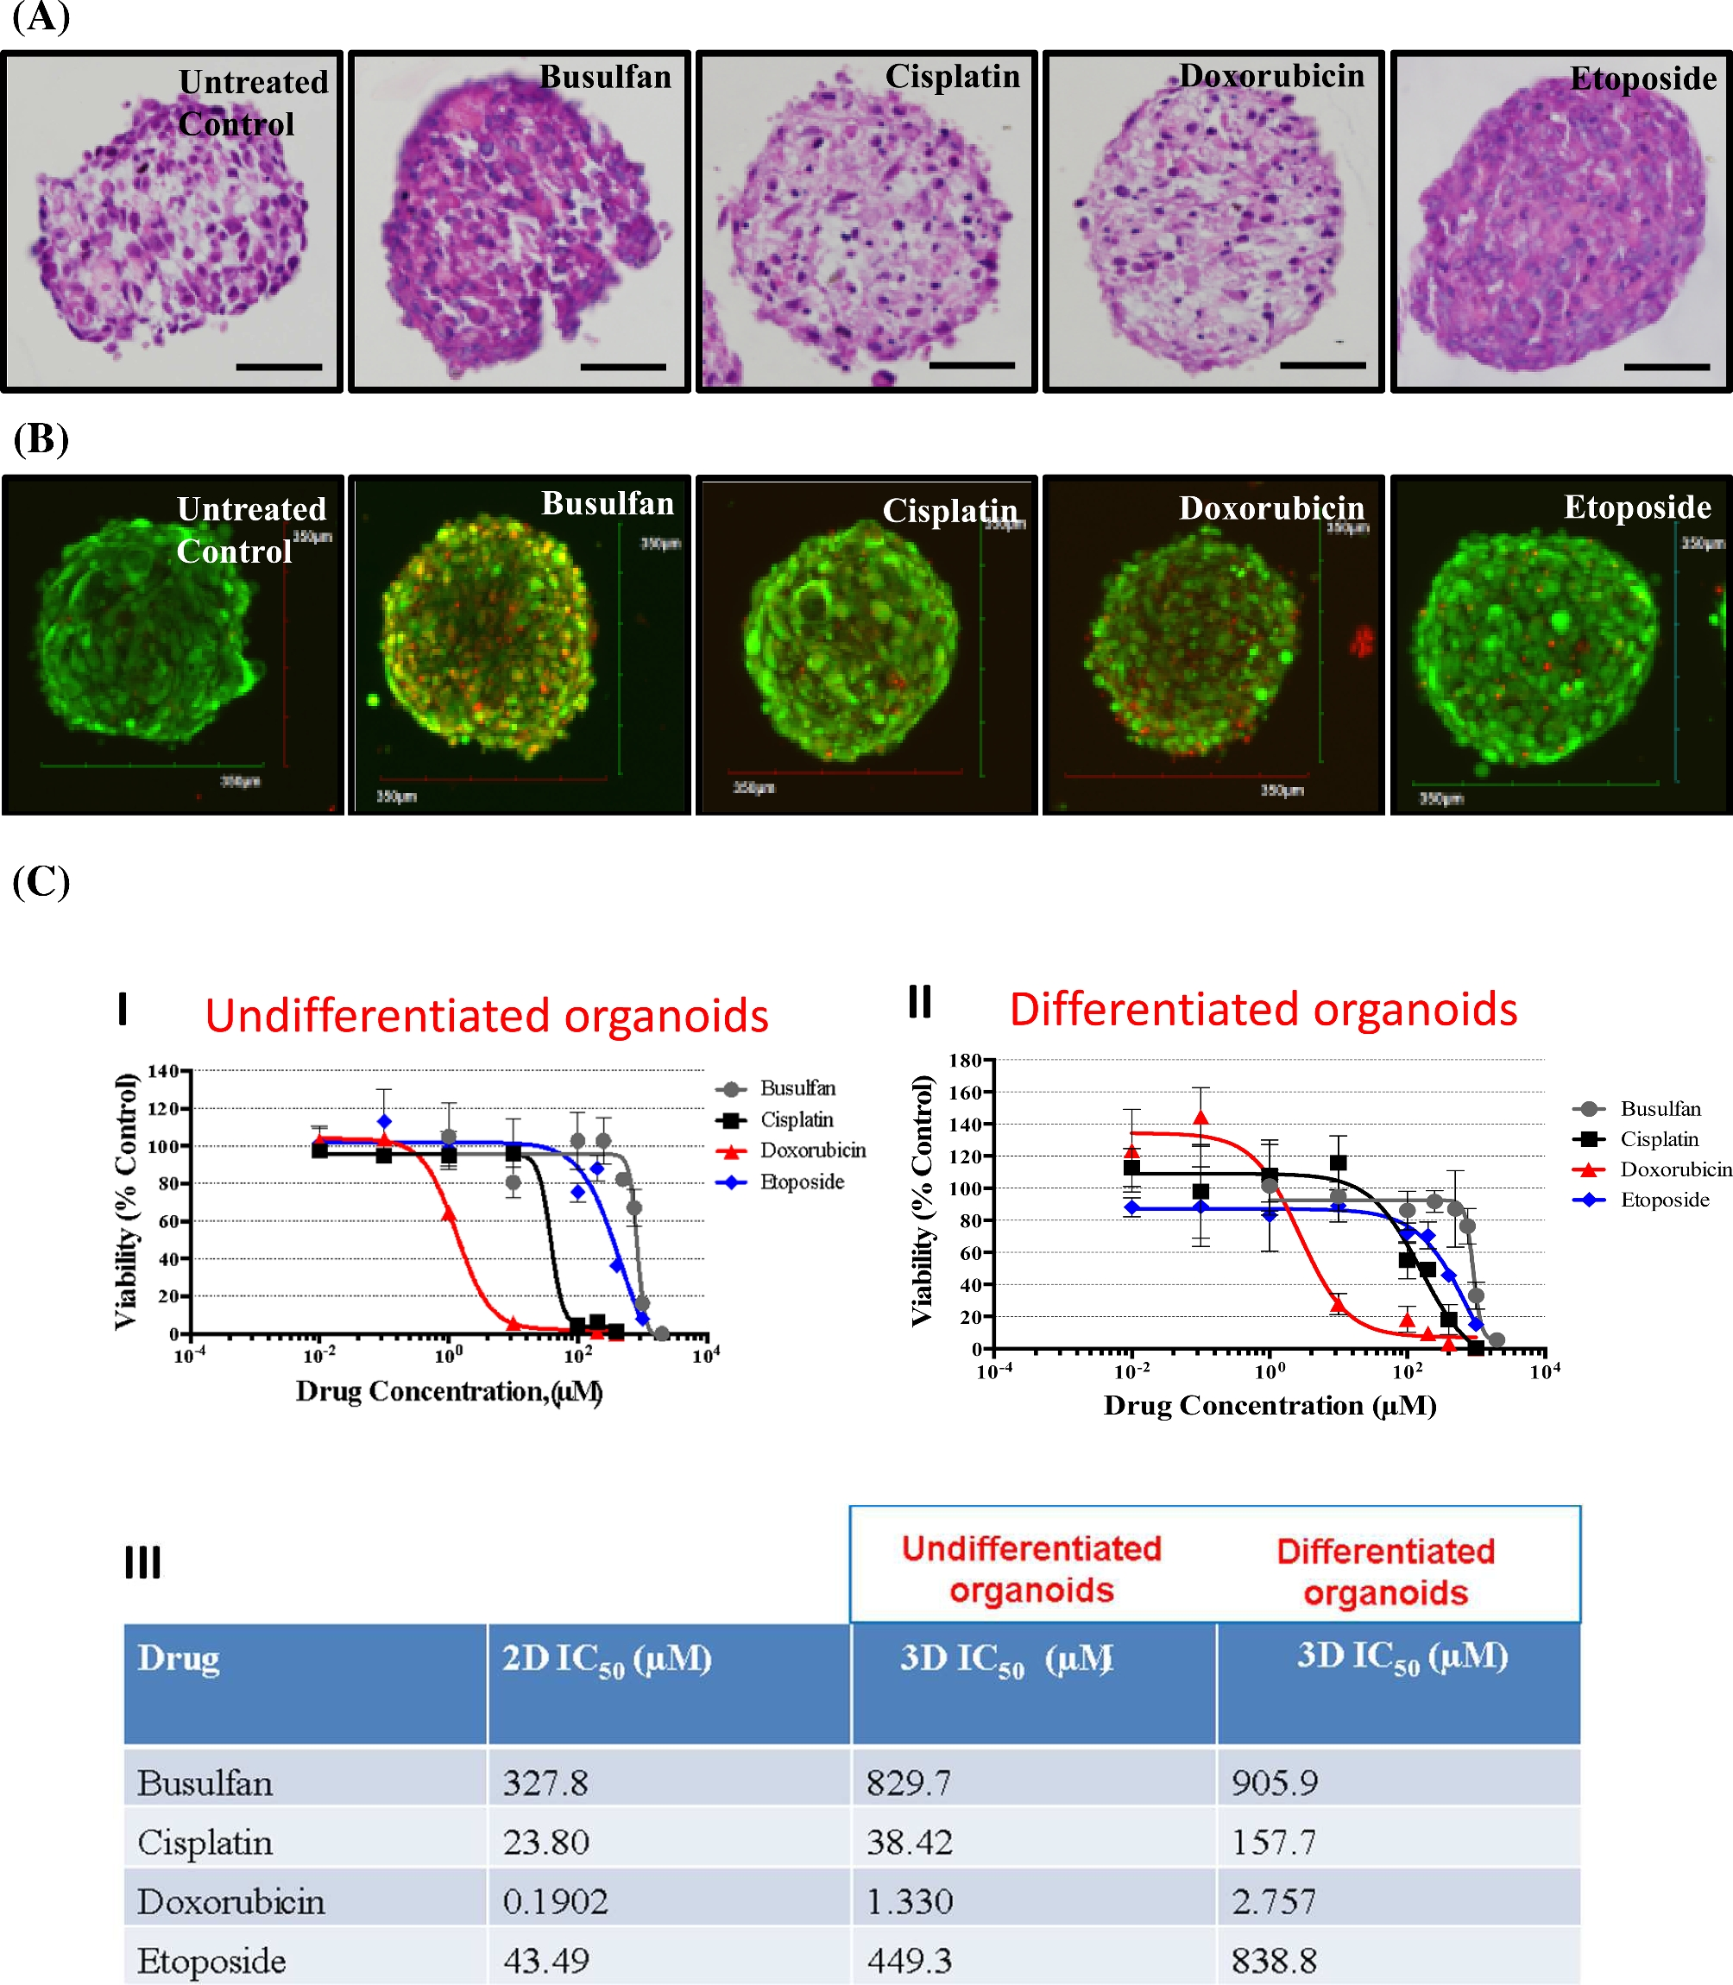
Figure 5. Morphological and viability assessment of human testicular 2D culture and 3D organoids following drug ...
Notes:
Figure 5. Morphological and viability assessment of human testicular 2D culture and 3D organoids following drug treatment. (A) Representative H&E (top panel) and (B) confocal live/dead 3D Z-stack projection images of 3D human testicular organoids (scale bar, 100 μm) following drug exposure to busulfan, cisplatin, doxorubicin, and etoposide for 48 h. (C) Drug effect on human testicular organoids. Undifferentiated (I) and differentiated (II) 3D cultures were exposed to drugs for 48 h prior to determination of ATP content via CellTiter-Glo Luminescent Cell Viability assays and subsequent generation of dose response curves (n = 3). Data in graphs presented as mean ± SD. (III) IC50 values (mean) for all treated drugs in 2D and 3D cultures.
Unless provided in the caption above, the following copyright applies to the content of this slide: © The Authors 2017. Published by Oxford University Press on behalf of Society for the Study of Reproduction. All rights reserved. For permissions, please e-mail: journals.permissions@oup.com

Slide 6
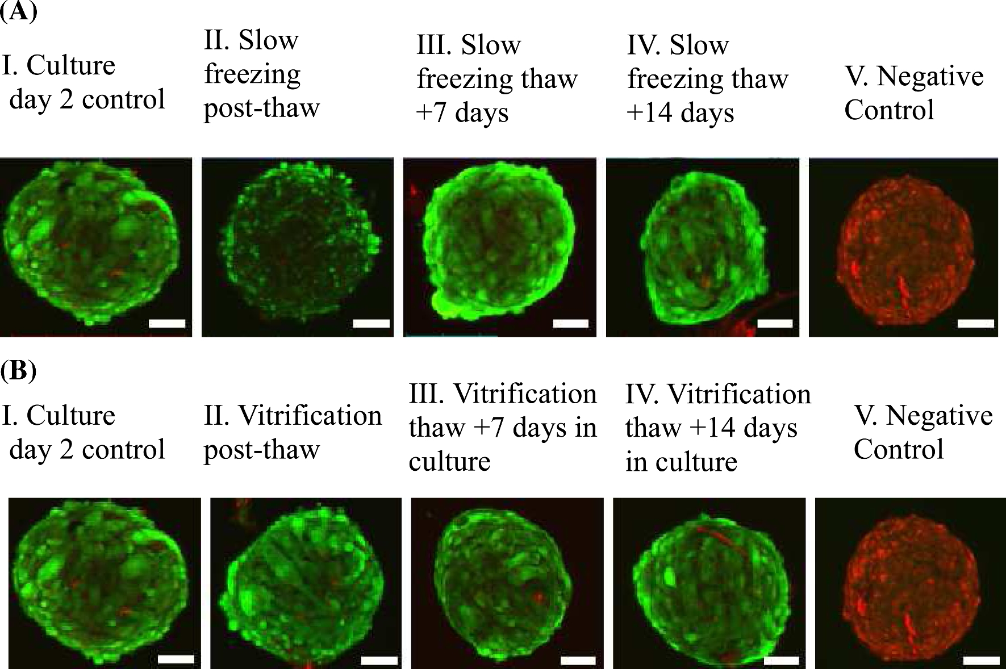
Figure 6. (A) Morphological and viability assessment of slowly cryopreserved human testicular organoids. Representative ...
Notes:
Figure 6. (A) Morphological and viability assessment of slowly cryopreserved human testicular organoids. Representative confocal live/dead images of human testicular organoids cryopreserved by standard 8% DMSO, 20% FBS in MEM freezing media. I. Fresh organoid 2 days in culture, as a positive control, was compared to freeze/thawed organoids immediately after thawing (II), and following an additional 7 (III) and 14 days (IV) recovery in culture. These images were compared to cold-methanol-treated organoids as a negative control (V). Cryopreserved organoids showed greater than 90% viability following thawing and subsequent to recovery in culture (scale bar 100 μm). (B) Morphological and viability assessment of vitrified cryopreserved human testicular organoids. Confocal live/dead images of human testicular organoids cryopreserved by vitrification method. I. Fresh organoid 2 days in culture, as a positive control, was compared to vitrified freeze/thawed organoids immediately after thawing (II), and following an additional 7 days (III) and 14 days (IV) recovery in culture. These images were compared to a cold-methanol-treated organoid as a negative control (V). Vitrified organoids showed greater than 90% viability following thawing and subsequent culture (scale bar, 100 μm).
Unless provided in the caption above, the following copyright applies to the content of this slide: © The Authors 2017. Published by Oxford University Press on behalf of Society for the Study of Reproduction. All rights reserved. For permissions, please e-mail: journals.permissions@oup.com

