Slide 1
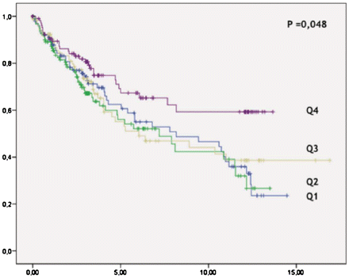
Figure 1. Months to first event (readmission or death).
Notes:
Figure 1. Months to first event (readmission or death).
Unless provided in the caption above, the following copyright applies to the content of this slide: © The Author 2010. Published by Oxford University Press on behalf of the Association of Physicians. All rights reserved. For Permissions, please email: journals.permissions@oup.com

