Slide 1
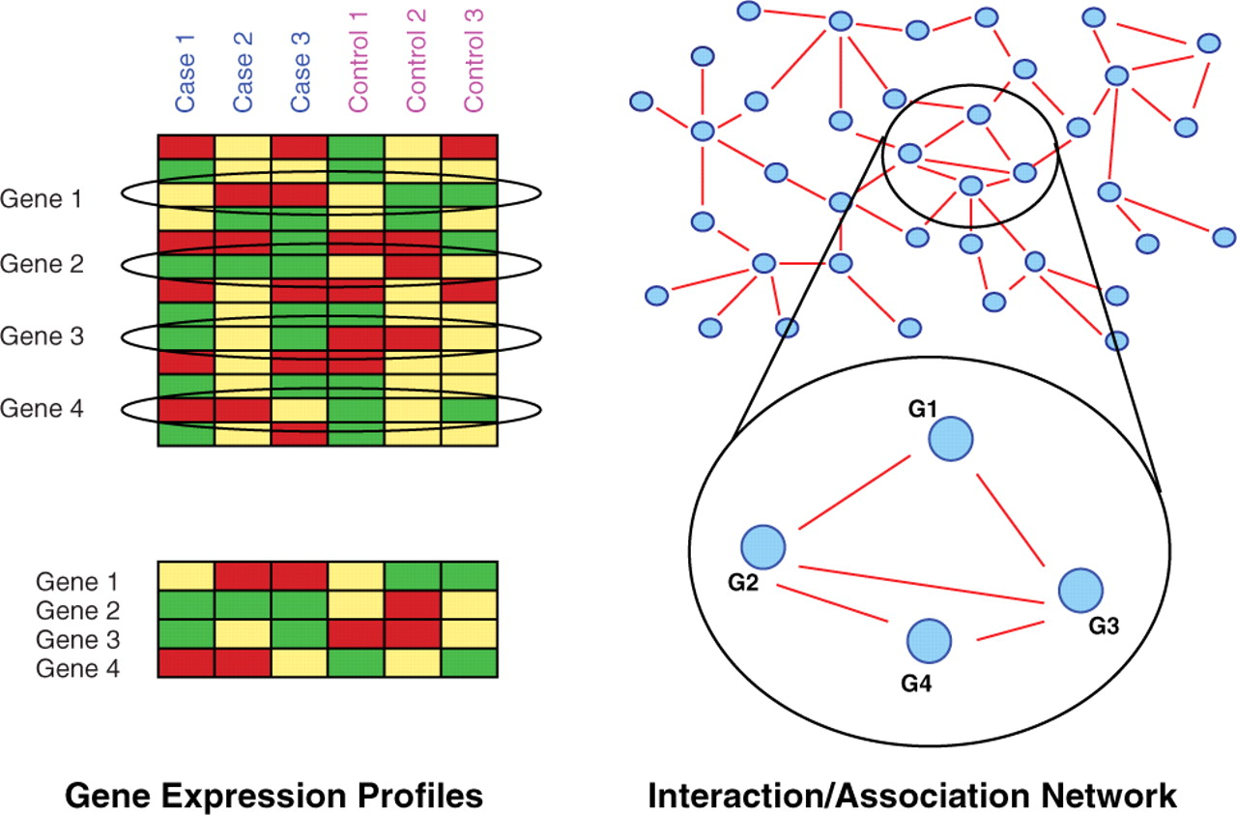
Fig. 1. When determining subnetwork markers one aims at finding groups of genes where genes have expression profiles ...
Notes:
Fig. 1. When determining subnetwork markers one aims at finding groups of genes where genes have expression profiles which are different in cancer and control and also form a connected pattern in an accompanying PPI network. Here, genes 1, 2, 3 and 4 comply with these criteria.
Unless provided in the caption above, the following copyright applies to the content of this slide: © The Author(s) 2010. Published by Oxford University Press.This is an Open Access article distributed under the terms of the Creative Commons Attribution Non-Commercial License (http://creativecommons.org/licenses/by-nc/2.5), which permits unrestricted non-commercial use, distribution, and reproduction in any medium, provided the original work is properly cited.

Slide 2
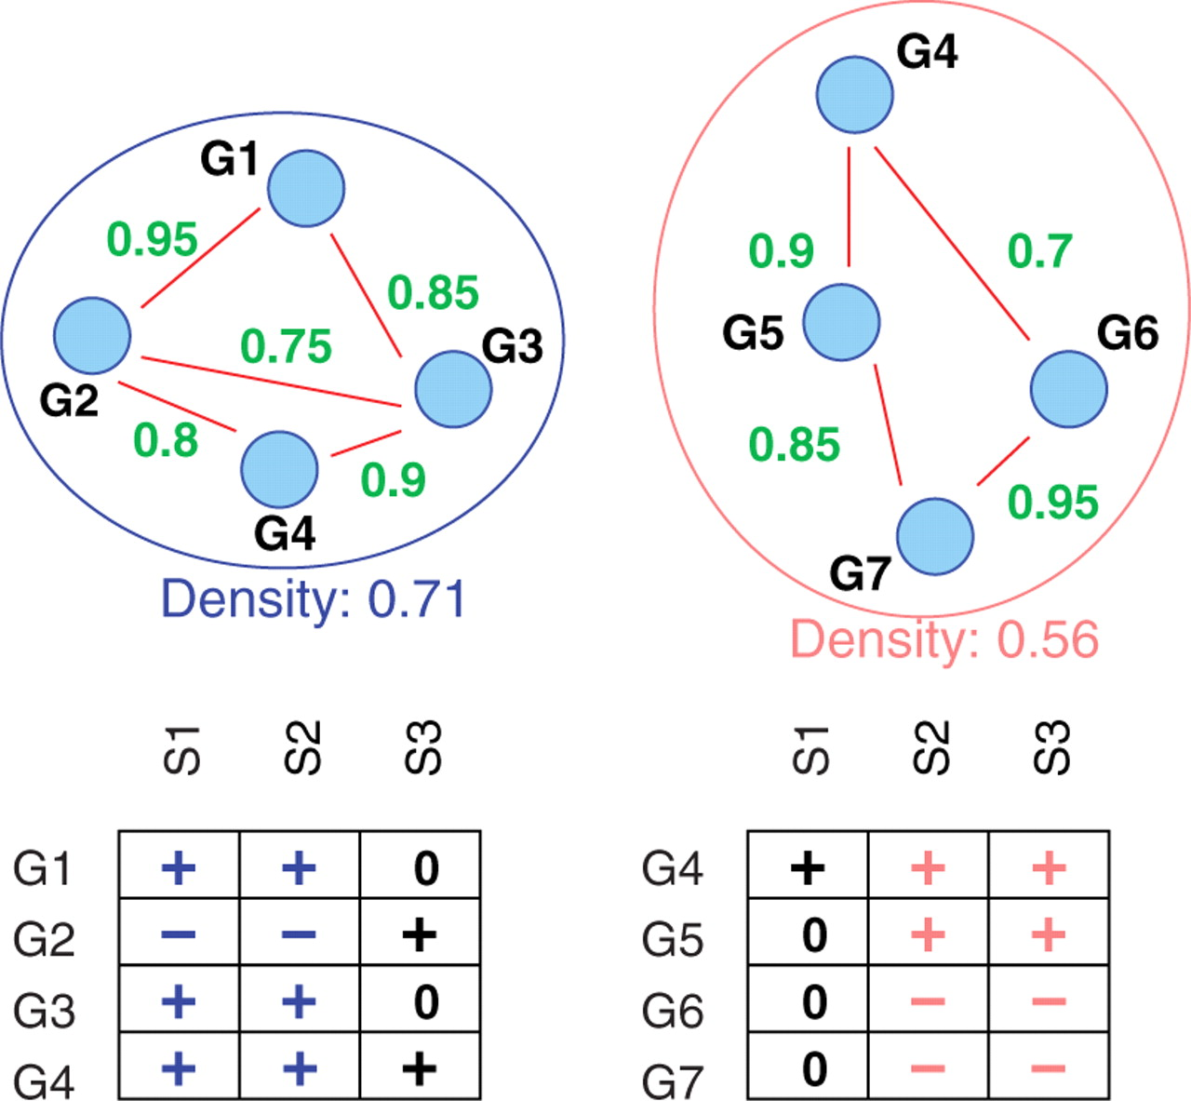
Fig. 2. Two density-constrained biclusters (see Section 3.1 for the definition of density) where genes are ...
Notes:
Fig. 2. Two density-constrained biclusters (see Section 3.1 for the definition of density) where genes are differentially, either consistently over- (+) or under- (−) expressed in a subset of size at least 2 of cancer samples. 0 is for no differential expression.
Unless provided in the caption above, the following copyright applies to the content of this slide: © The Author(s) 2010. Published by Oxford University Press.This is an Open Access article distributed under the terms of the Creative Commons Attribution Non-Commercial License (http://creativecommons.org/licenses/by-nc/2.5), which permits unrestricted non-commercial use, distribution, and reproduction in any medium, provided the original work is properly cited.

Slide 3
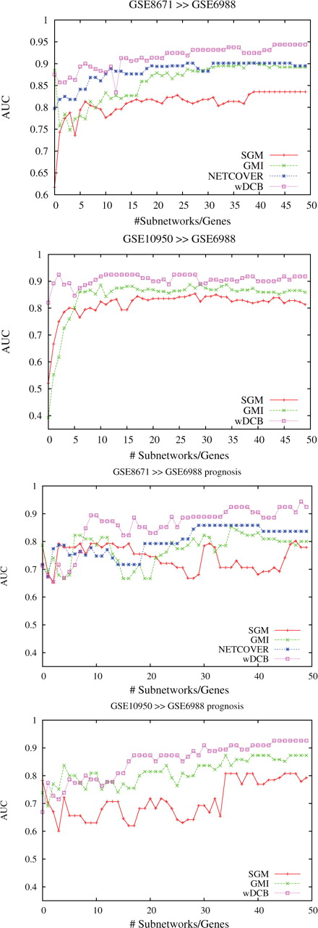
Fig. 3. Colon cancer: AUC versus numbers of subnetwork markers using markers extracted from GSE8671 and GSE10950 for ...
Notes:
Fig. 3. Colon cancer: AUC versus numbers of subnetwork markers using markers extracted from GSE8671 and GSE10950 for cancer versus non-cancer (upper two plots) and liver metastasis versus non-metastasis (lower two plots) prediction in GSE6988.
Unless provided in the caption above, the following copyright applies to the content of this slide: © The Author(s) 2010. Published by Oxford University Press.This is an Open Access article distributed under the terms of the Creative Commons Attribution Non-Commercial License (http://creativecommons.org/licenses/by-nc/2.5), which permits unrestricted non-commercial use, distribution, and reproduction in any medium, provided the original work is properly cited.

Slide 4
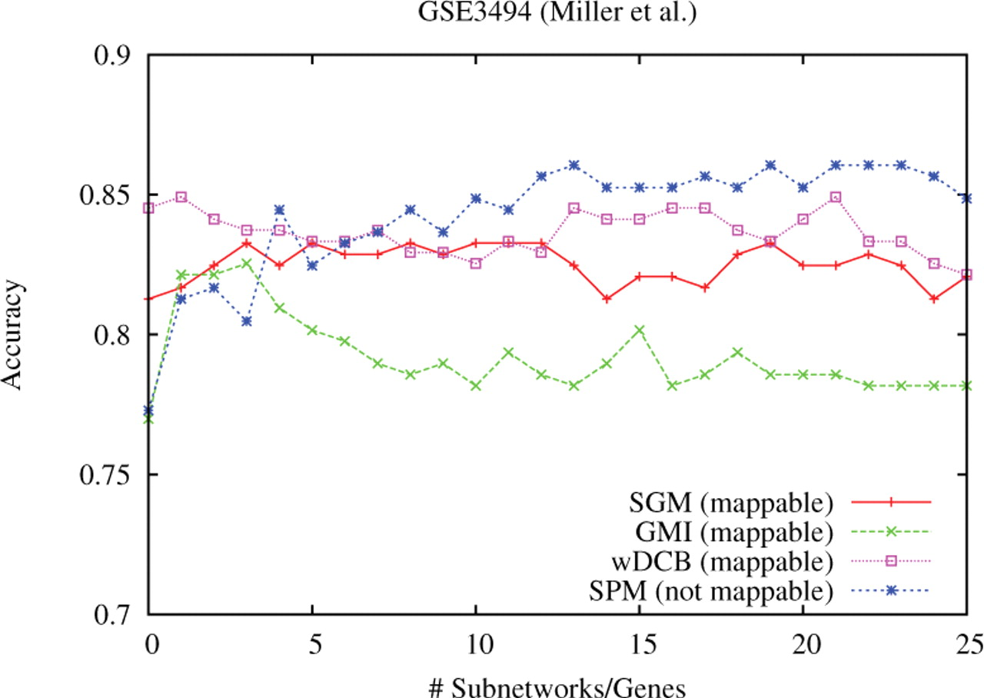
Fig. 4. Breast cancer: accuracy versus numbers of subnetwork markers using markers extracted from GSE3494 for ...
Notes:
Fig. 4. Breast cancer: accuracy versus numbers of subnetwork markers using markers extracted from GSE3494 for predicting TP53 mutation status (wildtype versus mutant) in GSE3494 (leave-one-out cross-validation).
Unless provided in the caption above, the following copyright applies to the content of this slide: © The Author(s) 2010. Published by Oxford University Press.This is an Open Access article distributed under the terms of the Creative Commons Attribution Non-Commercial License (http://creativecommons.org/licenses/by-nc/2.5), which permits unrestricted non-commercial use, distribution, and reproduction in any medium, provided the original work is properly cited.

