Slide 1
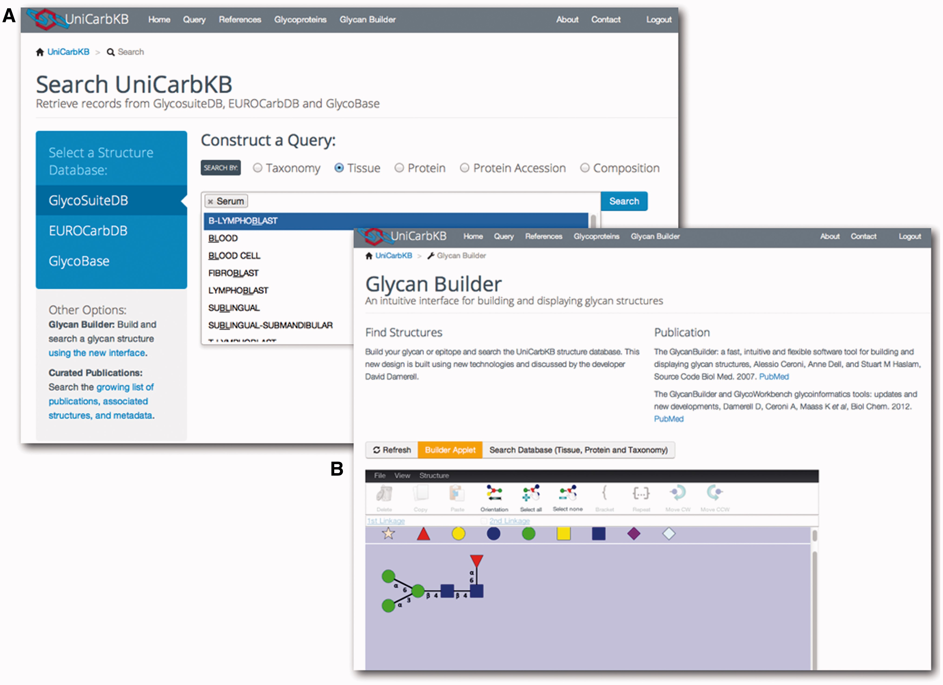
Figure 1. UniCarbKB offers a number of improved query interfaces. (A) Users can search the database content by ...
Notes:
Figure 1. UniCarbKB offers a number of improved query interfaces. (A) Users can search the database content by monosaccharide composition, attached protein, taxonomy or tissue by using an auto completion feature. (B) The integration of latest version of GlycanBuilder allows users to query UniCarbKB by (sub)structure searching.
Unless provided in the caption above, the following copyright applies to the content of this slide: © The Author(s) 2013. Published by Oxford University Press.This is an Open Access article distributed under the terms of the Creative Commons Attribution Non-Commercial License (http://creativecommons.org/licenses/by-nc/3.0/), which permits non-commercial re-use, distribution, and reproduction in any medium, provided the original work is properly cited. For commercial re-use, please contact journals.permissions@oup.com

Slide 2
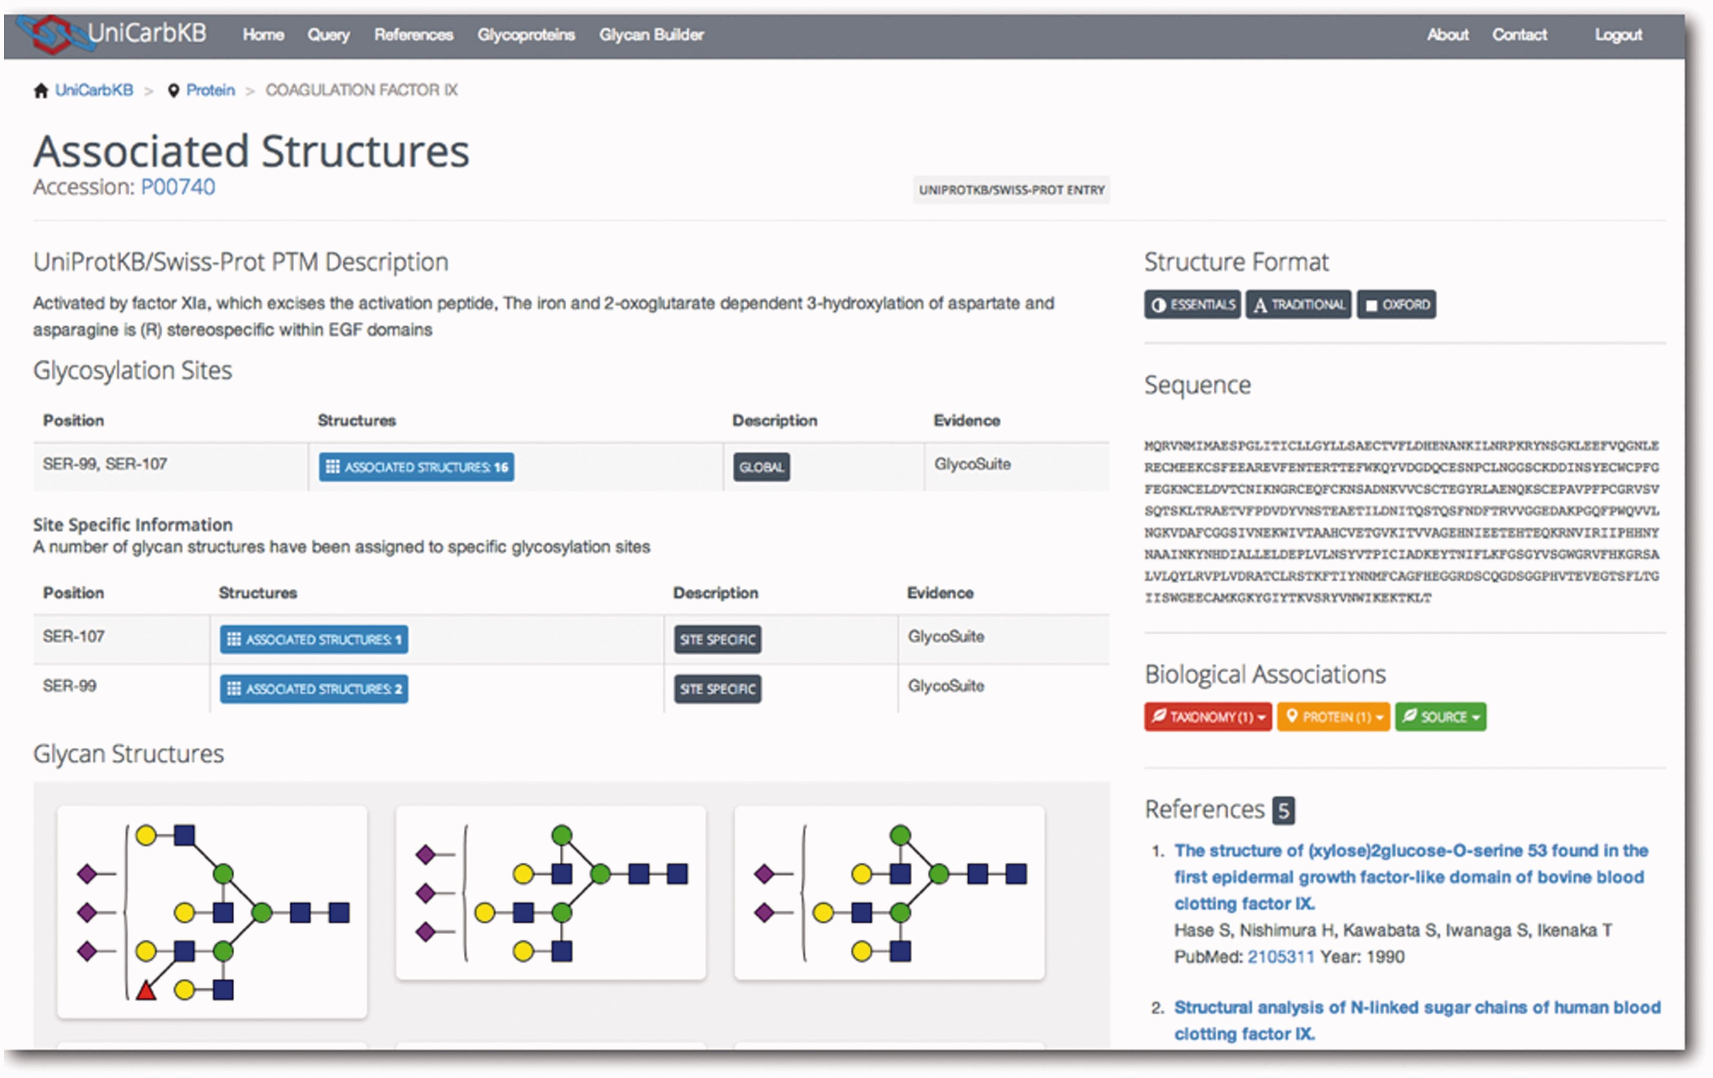
Figure 2. Screenshot for the Coagulation Factor IX entry in UniCarbKB. The database provides a description of the ...
Notes:
Figure 2. Screenshot for the Coagulation Factor IX entry in UniCarbKB. The database provides a description of the glycan structures characterized for this glycoprotein and the number of structures associated with experimentally confirmed glycosylation sites. A general description of the glycoprotein is provided that has been derived from the relevant UniProtKB entry in addition to the protein sequence. Users have the Structure Format option to select a preferred graphical format to display the glycan structures that includes the three most commonly used notations. Supporting biological metadata and publication information is also provided. The Biological Associations include details pertinent to the species, the individual protein and tissue/secretory fluid source. Finally, those References that have been manually curated to obtain this information are summarized with appropriate links to PubMed.
Unless provided in the caption above, the following copyright applies to the content of this slide: © The Author(s) 2013. Published by Oxford University Press.This is an Open Access article distributed under the terms of the Creative Commons Attribution Non-Commercial License (http://creativecommons.org/licenses/by-nc/3.0/), which permits non-commercial re-use, distribution, and reproduction in any medium, provided the original work is properly cited. For commercial re-use, please contact journals.permissions@oup.com

Slide 3
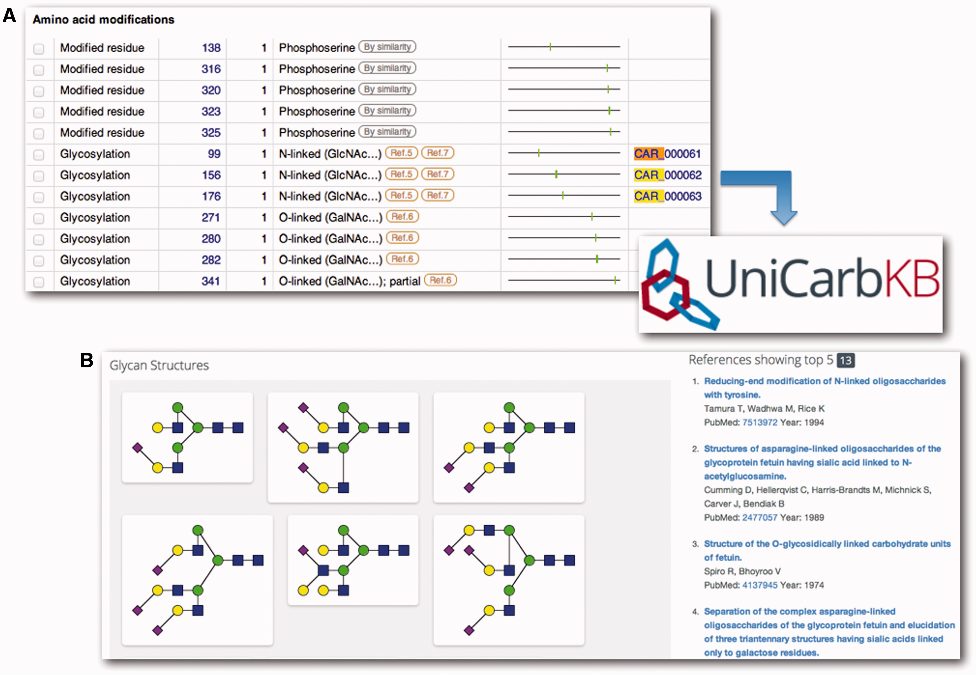
Figure 3. Navigating from UniProtKB to UniCarbKB. An example is shown for the (A) UniProtKB alpha-2-HS-glycoprotein ...
Notes:
Figure 3. Navigating from UniProtKB to UniCarbKB. An example is shown for the (A) UniProtKB alpha-2-HS-glycoprotein entry that is linked to (B) the glycan structures on the individual amino acid sites as curated in UniCarbKB, by CAR identifiers. The curated records in the first release of UniCarbKB are being updated and included in the sequence annotation feature records of UniProtKB.
Unless provided in the caption above, the following copyright applies to the content of this slide: © The Author(s) 2013. Published by Oxford University Press.This is an Open Access article distributed under the terms of the Creative Commons Attribution Non-Commercial License (http://creativecommons.org/licenses/by-nc/3.0/), which permits non-commercial re-use, distribution, and reproduction in any medium, provided the original work is properly cited. For commercial re-use, please contact journals.permissions@oup.com

