Slide 1
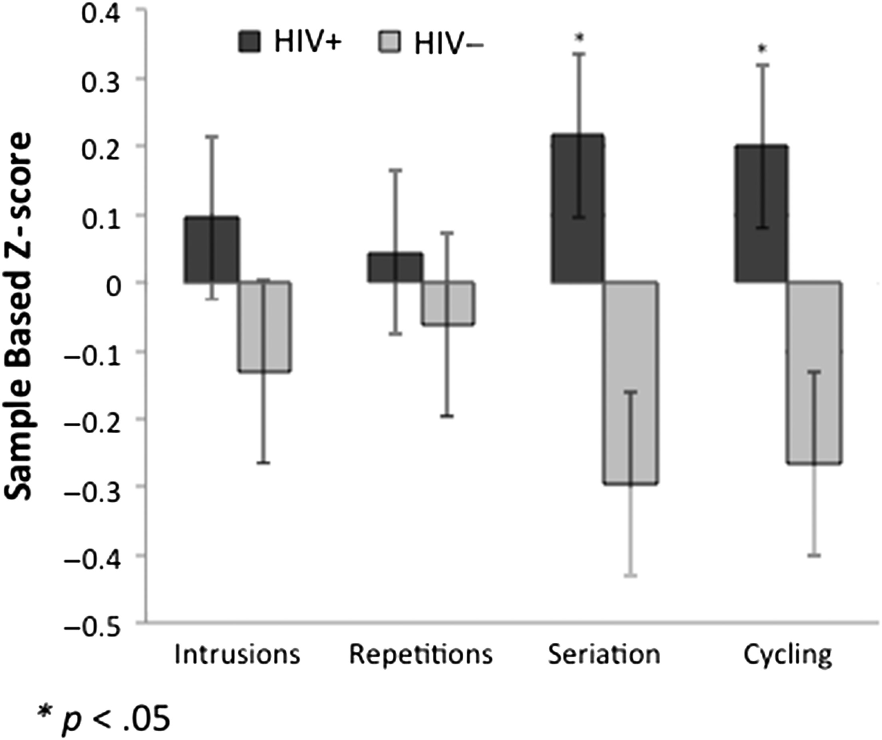
Fig. 1. Sample-based z-scores for intrusions, repetitions, seriation, and cycling (each divided by total number of ...
Notes:
Fig. 1. Sample-based z-scores for intrusions, repetitions, seriation, and cycling (each divided by total number of digits generated) in HIV+ and HIV− groups. Error bars represent standard errors.
Unless provided in the caption above, the following copyright applies to the content of this slide: © The Author 2016. Published by Oxford University Press. All rights reserved. For permissions, please e-mail: journals.permissions@oup.com.

