Slide 1
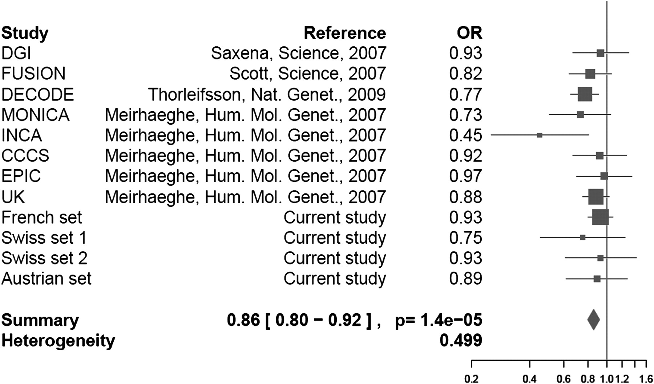
Figure 1. Meta-analysis of the association between BNP T-381C polymorphism and T2D risk. The meta-analysis includes 37 ...
Notes:
Figure 1. Meta-analysis of the association between BNP T-381C polymorphism and T2D risk. The meta-analysis includes 37 040 controls and 12 239 T2D cases. Summary illustrates the final OR under a recessive model; 95% CI is included in the pictogram.
Unless provided in the caption above, the following copyright applies to the content of this slide: © The Author 2009. Published by Oxford University Press. All rights reserved. For Permissions, please email: journals.permissions@oxfordjournals.org

