Slide 1
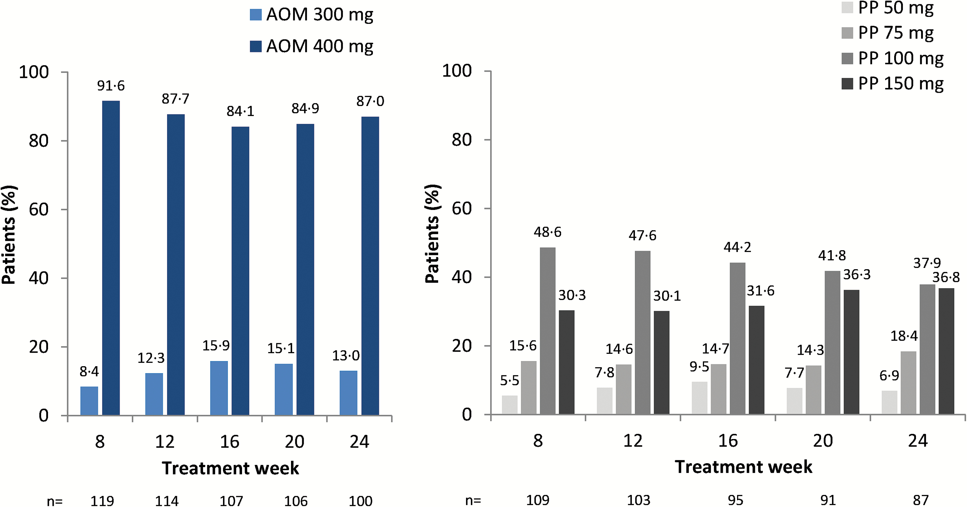
Figure 1. Distribution of aripiprazole once-monthly 400 mg (AOM 400) and paliperidone palmitate once-monthly (PP) doses ...
Notes:
Figure 1. Distribution of aripiprazole once-monthly 400 mg (AOM 400) and paliperidone palmitate once-monthly (PP) doses by treatment week in the all-patients-treated set (i.e., all patients randomized who took ≥1 dose of study medication). Percentages of patients receiving each dose is given above each bar, numbers below the axes refer to number of treated patients in the given treatment week. PP doses refer to paliperidone (50, 75, 100, and 150 mg [EU]) equivalent to paliperidone palmitate (78, 117, 156, and 234 mg [US]).
Unless provided in the caption above, the following copyright applies to the content of this slide: © The Author 2016. Published by Oxford University Press on behalf of CINP.This is an Open Access article distributed under the terms of the Creative Commons Attribution Non-Commercial License (http://creativecommons.org/licenses/by-nc/4.0/), which permits non-commercial re-use, distribution, and reproduction in any medium, provided the original work is properly cited. For commercial re-use, please contact journals.permissions@oup.com

Slide 2
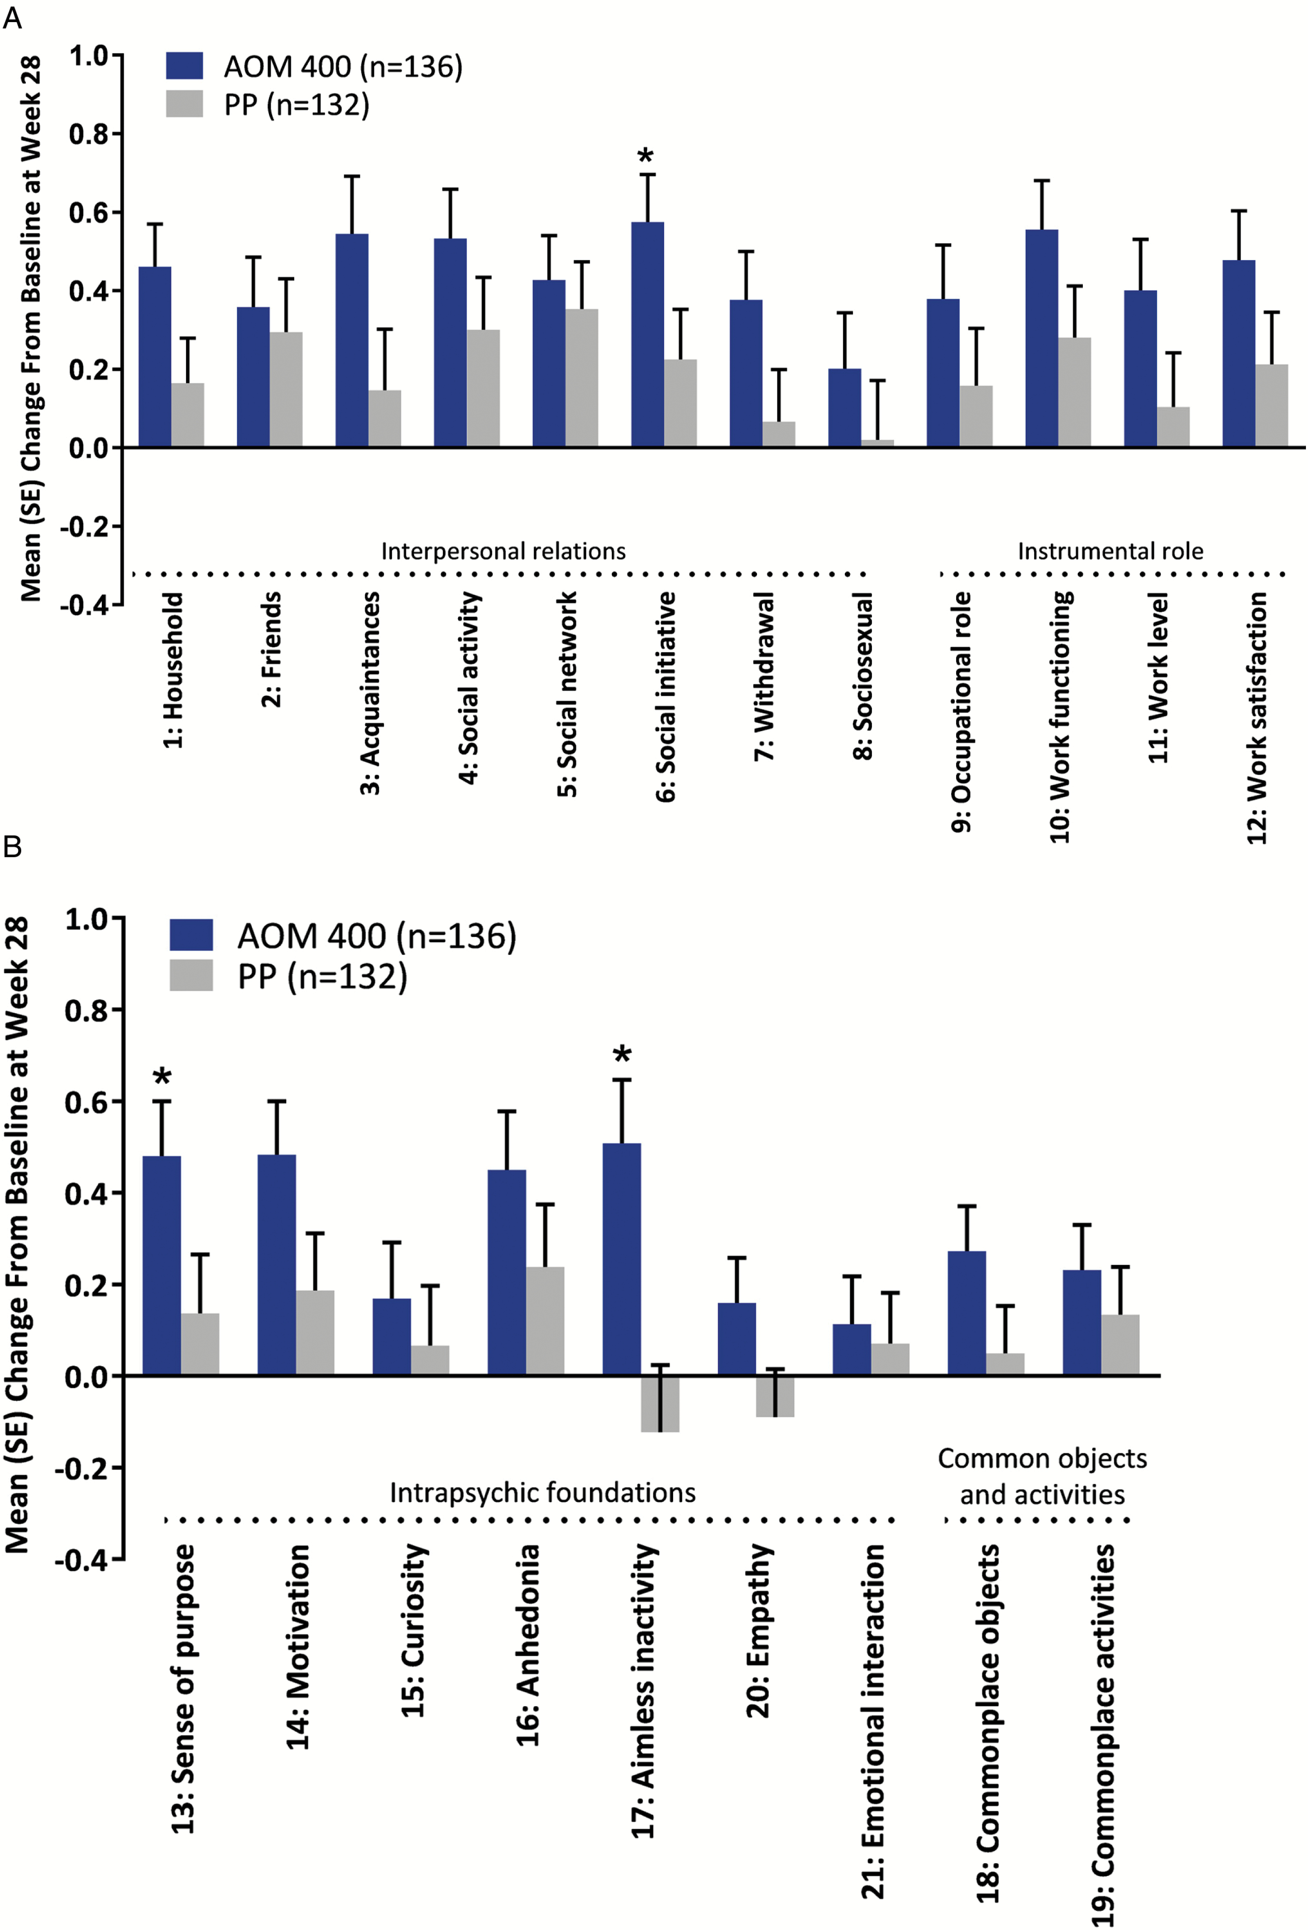
Figure 2. Change from baseline at week 28 on Heinrichs-Carpenter Quality of Life Scale (QLS) items. Full analysis set. ...
Notes:
Figure 2. Change from baseline at week 28 on Heinrichs-Carpenter Quality of Life Scale (QLS) items. Full analysis set. Results are shown for (a) the first 12 items on the scale and (b) the last 9 items on the scale. AOM 400, aripiprazole once-monthly 400 mg; PP, paliperidone palmitate once-monthly. *P<.05.
Unless provided in the caption above, the following copyright applies to the content of this slide: © The Author 2016. Published by Oxford University Press on behalf of CINP.This is an Open Access article distributed under the terms of the Creative Commons Attribution Non-Commercial License (http://creativecommons.org/licenses/by-nc/4.0/), which permits non-commercial re-use, distribution, and reproduction in any medium, provided the original work is properly cited. For commercial re-use, please contact journals.permissions@oup.com

Slide 3
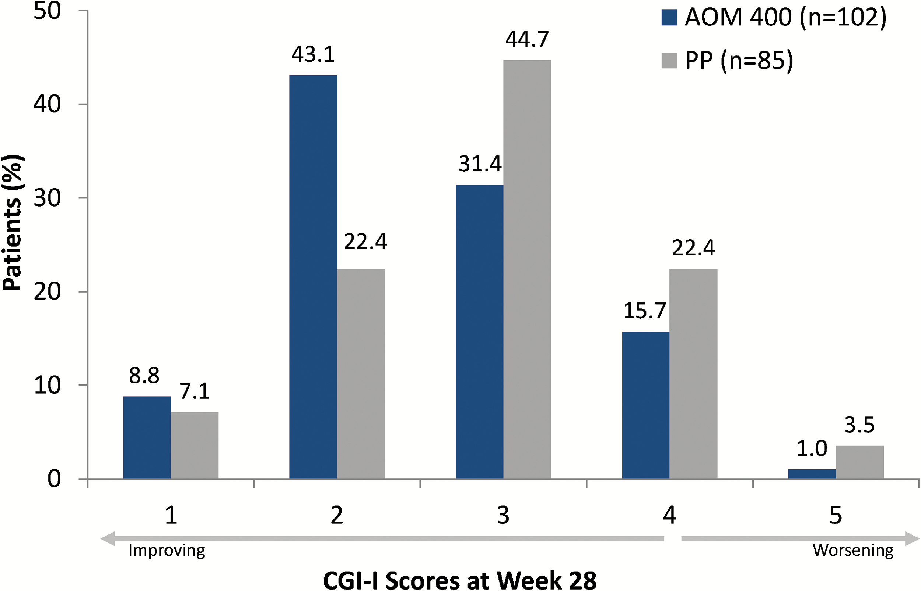
Figure 3. Distribution of Clinical Global Impressions–Improvement (CGI-I) scores at week 28. Full analysis set. 1, very ...
Notes:
Figure 3. Distribution of Clinical Global Impressions–Improvement (CGI-I) scores at week 28. Full analysis set. 1, very much improved; 2, much improved; 3, minimally improved; 4, no change; 5, minimally worse. Patients with CGI-I scores of 1 or 2 at week 28 were considered to be responders. AOM 400, aripiprazole once-monthly 400 mg; PP, paliperidone palmitate once-monthly.
Unless provided in the caption above, the following copyright applies to the content of this slide: © The Author 2016. Published by Oxford University Press on behalf of CINP.This is an Open Access article distributed under the terms of the Creative Commons Attribution Non-Commercial License (http://creativecommons.org/licenses/by-nc/4.0/), which permits non-commercial re-use, distribution, and reproduction in any medium, provided the original work is properly cited. For commercial re-use, please contact journals.permissions@oup.com

Slide 4
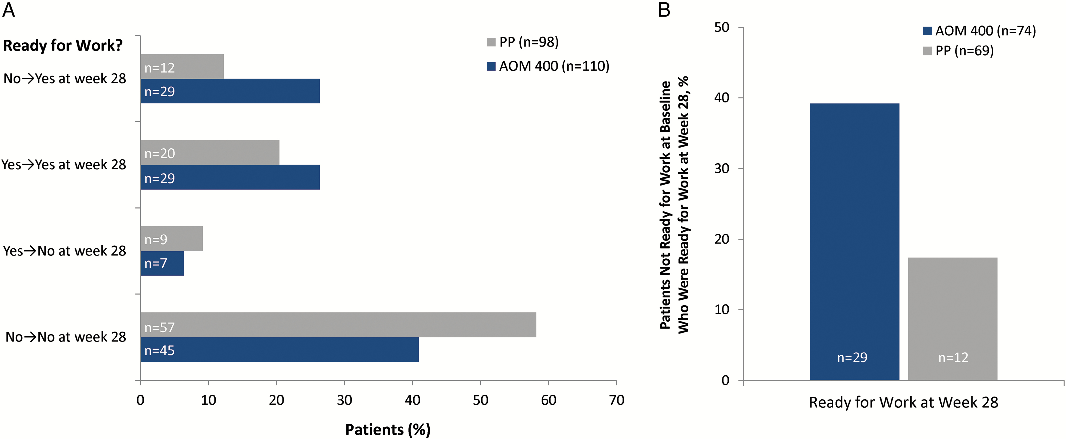
Figure 4. Shift from baseline in readiness for work status among (a) the full analysis set and (b) patients not ready ...
Notes:
Figure 4. Shift from baseline in readiness for work status among (a) the full analysis set and (b) patients not ready for work at baseline. Shift analysis was based on the WoRQ readiness to work question (item 8) at baseline and week 28: Based on your clinical judgment, is this patient ready for work? AOM 400, aripiprazole once-monthly 400 mg; FAS, full analysis set; PP, paliperidone palmitate once-monthly; WoRQ, Work Readiness Questionnaire.
Unless provided in the caption above, the following copyright applies to the content of this slide: © The Author 2016. Published by Oxford University Press on behalf of CINP.This is an Open Access article distributed under the terms of the Creative Commons Attribution Non-Commercial License (http://creativecommons.org/licenses/by-nc/4.0/), which permits non-commercial re-use, distribution, and reproduction in any medium, provided the original work is properly cited. For commercial re-use, please contact journals.permissions@oup.com

Slide 5
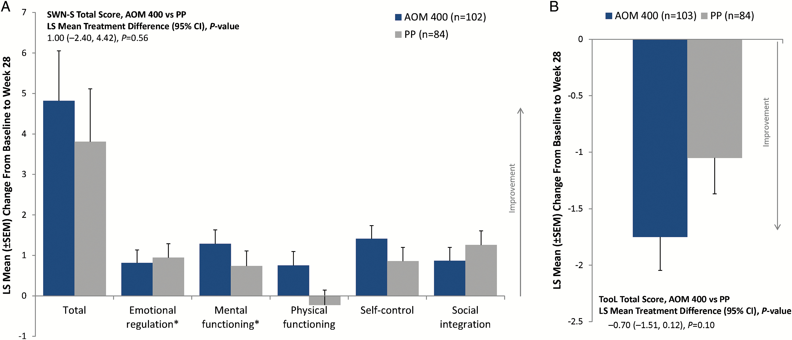
Figure 5. Change from baseline to week 28 in patient-rated (a) Subjective Well-Being Under Neuroleptics–short version ...
Notes:
Figure 5. Change from baseline to week 28 in patient-rated (a) Subjective Well-Being Under Neuroleptics–short version (SWN-S) total and subscale scores and (b) Tolerability and Quality of Life (TooL) total score. Full analysis set. AOM 400, aripiprazole once-monthly 400 mg; FAS, full analysis set; LS, least squares. *n=83 for the PP treatment group.
Unless provided in the caption above, the following copyright applies to the content of this slide: © The Author 2016. Published by Oxford University Press on behalf of CINP.This is an Open Access article distributed under the terms of the Creative Commons Attribution Non-Commercial License (http://creativecommons.org/licenses/by-nc/4.0/), which permits non-commercial re-use, distribution, and reproduction in any medium, provided the original work is properly cited. For commercial re-use, please contact journals.permissions@oup.com

