Slide 1
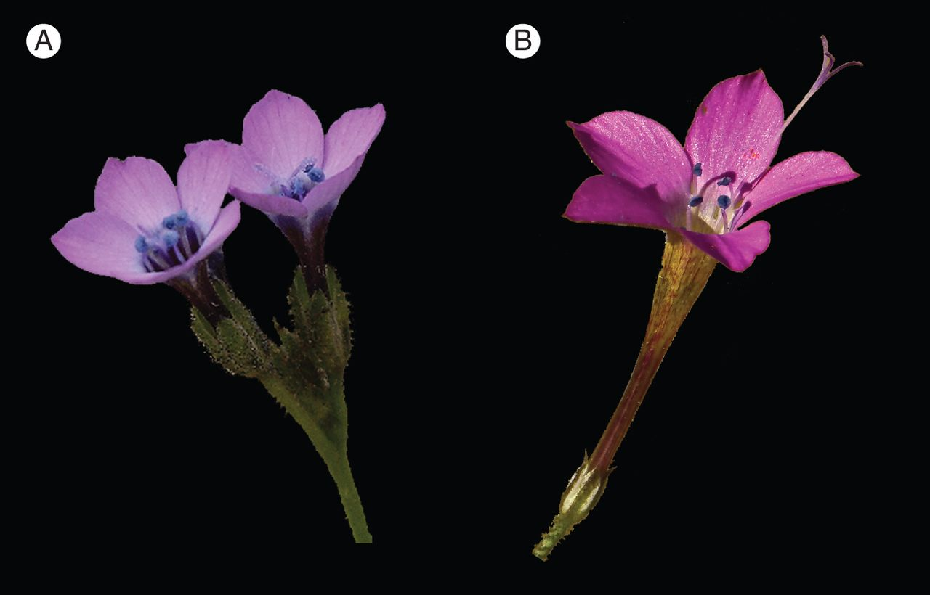
Fig. 1. Pollination races in Saltugilia splendens (previously known as Gilia splendens). (A) Saltugilia splendens ...
Notes:
Fig. 1. Pollination races in Saltugilia splendens (previously known as Gilia splendens). (A) Saltugilia splendens ssp. splendens from Pine Mountain in Ventura County (California, USA), and (B) S. splendens ssp. grantii from Mt. Mooney, near the crest of the San Gabriel Mountains in Los Angeles County (California, USA). Saltugilia splendens was studied by Verne and Karen Grant, who recognized four pollination races: a widespread short-tubed form pollinated mainly by bombyliid flies (probably the form shown in A), a local long-tubed form with a narrow throat pollinated mainly by long-tongued flies (probably the form shown in B), a local long-tubed form with a wide throat mainly pollinated by hummingbirds, and a local small-flowered autogamous form. The Grants laid the foundation for a conceptual model of pollinator-driven speciation, according to which pollinator-driven divergence at the population level leads to the formation of races (ecotypes). When this process occurs repeatedly, adaptive radiation of pollination systems may occur. Extensive pollinator observations and experiments to estimate breeding systems in the Phlox family were used to demonstrate these processes (Grant and Grant, 1965). (A) Photograph from Lynn Watson, Santa Barbara, CA, USA. (B) Photograph from Bob Sikora, Alameda, CA, USA.
Unless provided in the caption above, the following copyright applies to the content of this slide: © The Author 2014. Published by Oxford University Press on behalf of the Annals of Botany Company. All rights reserved. For Permissions, please email: journals.permissions@oup.com

Slide 2
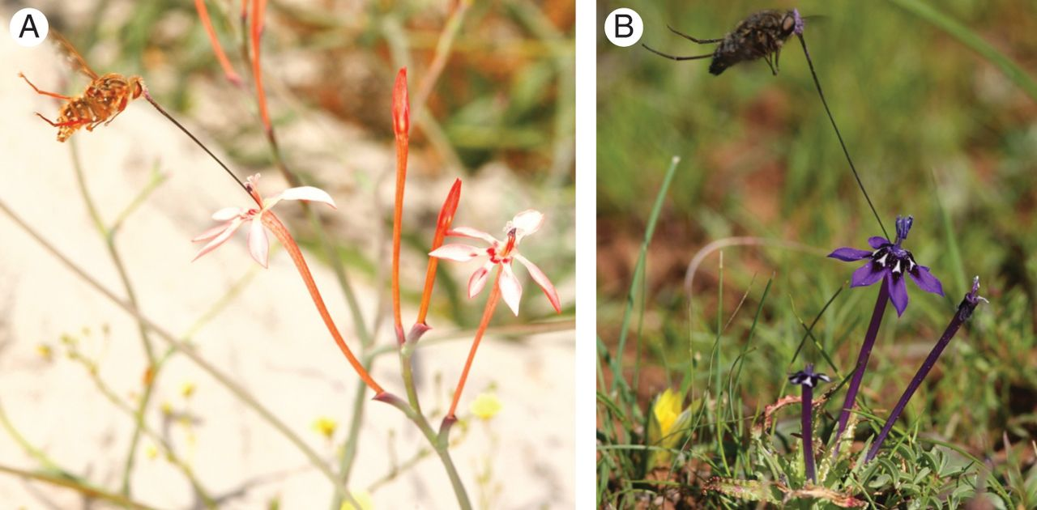
Fig. 2. Long-tongued fly pollination in painted petal irises (Lapeirousia) from South Africa. (A) Moegistorhynchus ...
Notes:
Fig. 2. Long-tongued fly pollination in painted petal irises (Lapeirousia) from South Africa. (A) Moegistorhynchus longirostris visiting Lapeirousia anceps, and (B) Prosoeca sp. nov. visiting L. oreogena. Lapeirousia species which belong to specialized pollination guilds, for instance those pollinated by different species of long-tongued fly, are characterized by specific suites of floral traits, such as a particular colour and nectar-tube length. Frequent shifts in pollination system have therefore led to a spectacular radiation in floral traits (Forest et al., 2014). (A) Photograph by Bruce Anderson, Stellenbosch, South Africa. (B) Photograph by Dennis Hansen, Zürich, Switzerland.
Unless provided in the caption above, the following copyright applies to the content of this slide: © The Author 2014. Published by Oxford University Press on behalf of the Annals of Botany Company. All rights reserved. For Permissions, please email: journals.permissions@oup.com

Slide 3
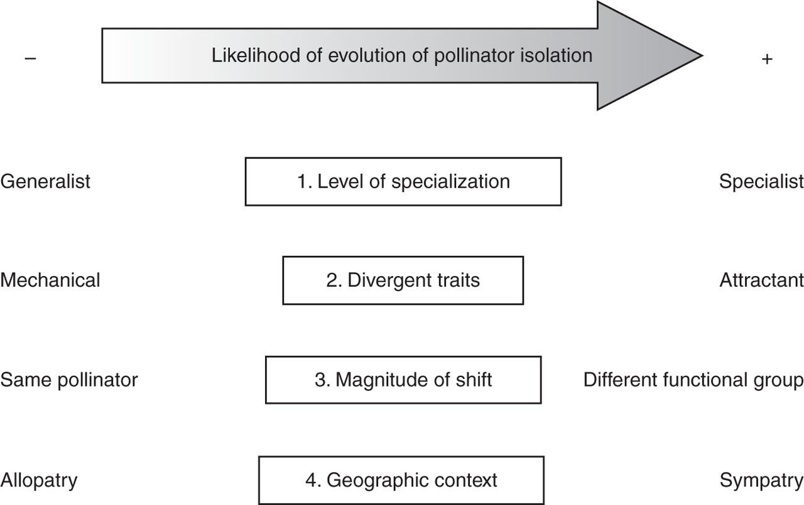
Fig. 4. Four axes along which shifts in pollination system can vary. Axis 1 represents the degree of pollinator ...
Notes:
Fig. 4. Four axes along which shifts in pollination system can vary. Axis 1 represents the degree of pollinator specialization, varying from generalist through functionally specialized (e.g. only bees), to extreme specialist. Axis 2 represents the type and extent of trait divergence, varying from divergence in mechanical traits to variation in attractant traits. Axis 3 represents the magnitude of pollination system shifts, varying from divergent use of the same pollinator through minor shifts between similar pollinator species to major shifts among functional pollinator groups (e.g. bees to birds). Axis 4 represents the geographic context of pollination system shift, varying from allopatric, through parapatric to sympatric ecotype ranges. The evolution of pollinator isolation is more likely for shifts in pollination system characterized by the intrinsic and extrinsic conditions listed on the right of each axis compared to those listed on the left.
Unless provided in the caption above, the following copyright applies to the content of this slide: © The Author 2014. Published by Oxford University Press on behalf of the Annals of Botany Company. All rights reserved. For Permissions, please email: journals.permissions@oup.com

Slide 4
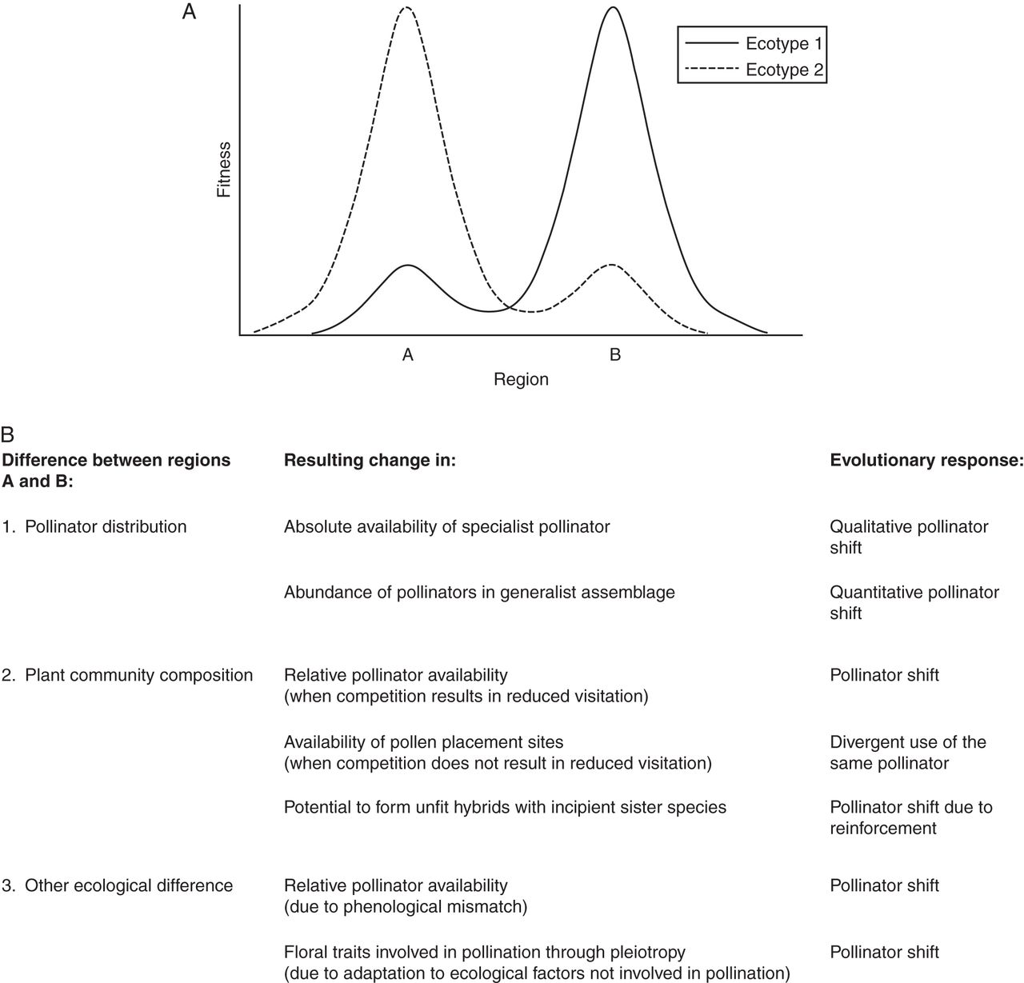
Fig. 3. The geographical mosaic of selection that leads to divergence in floral traits that characterizes pollination ...
Notes:
Fig. 3. The geographical mosaic of selection that leads to divergence in floral traits that characterizes pollination ecotypes. (A) The fitness of ecotypes 1 and 2 depends on the area in which they occur. Ecotype 1 is adapted to the conditions in region B, while ecotype 2 is adapted to the conditions in region A. (B) Several factors may determine divergent selection regimes between regions A and B. While all factors ultimately affect the local availability and/or efficiency of pollinators, the distribution of pollinators is not the only determinant. The evolutionary response depends on the change that is caused by differences between regions A and B. In this scheme the evolution to self-pollination as a response to pollen limitation is not considered, although it is a potential outcome under each scenario.
Unless provided in the caption above, the following copyright applies to the content of this slide: © The Author 2014. Published by Oxford University Press on behalf of the Annals of Botany Company. All rights reserved. For Permissions, please email: journals.permissions@oup.com

Slide 5
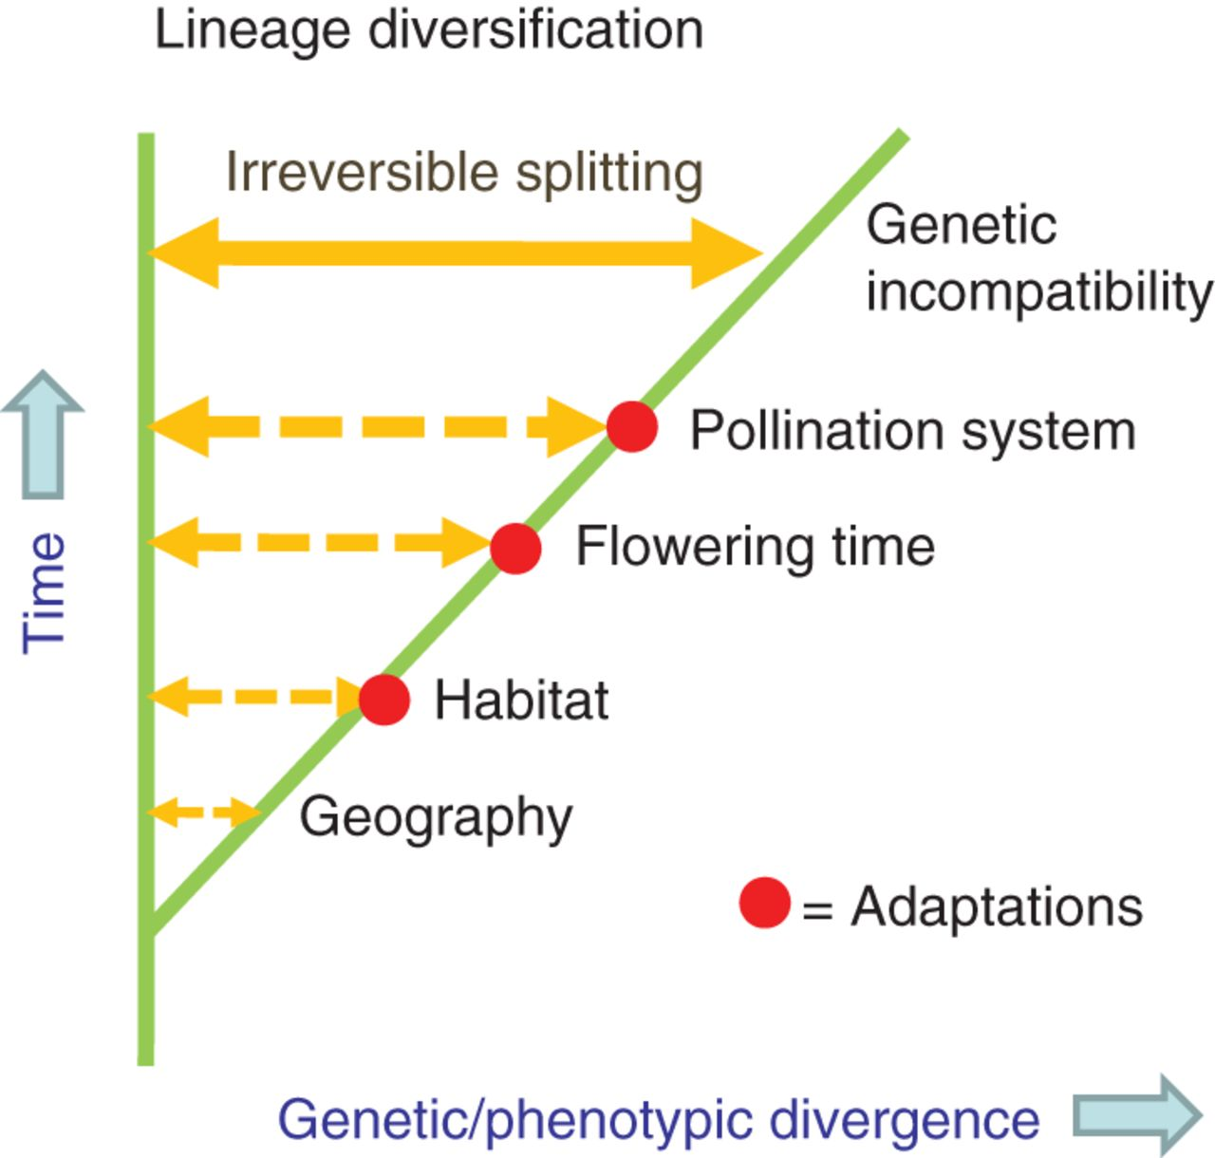
Fig. 5. Hypothetical example of allopatric speciation via the intermediate stage of ecotypes. Ecological adaptations ...
Notes:
Fig. 5. Hypothetical example of allopatric speciation via the intermediate stage of ecotypes. Ecological adaptations (including shifts in pollination system) resulting in genetic and/or phenotypic divergence can occur at any point in time, and in any sequence, after initial geographic isolation. Usually these adaptations will not lead to complete reproductive isolation, but since they occur between allopatric populations gene flow is limited. Full reproductive isolation, sufficient to maintain identity of forms during secondary contact, builds up gradually with time.
Unless provided in the caption above, the following copyright applies to the content of this slide: © The Author 2014. Published by Oxford University Press on behalf of the Annals of Botany Company. All rights reserved. For Permissions, please email: journals.permissions@oup.com

