Slide 1
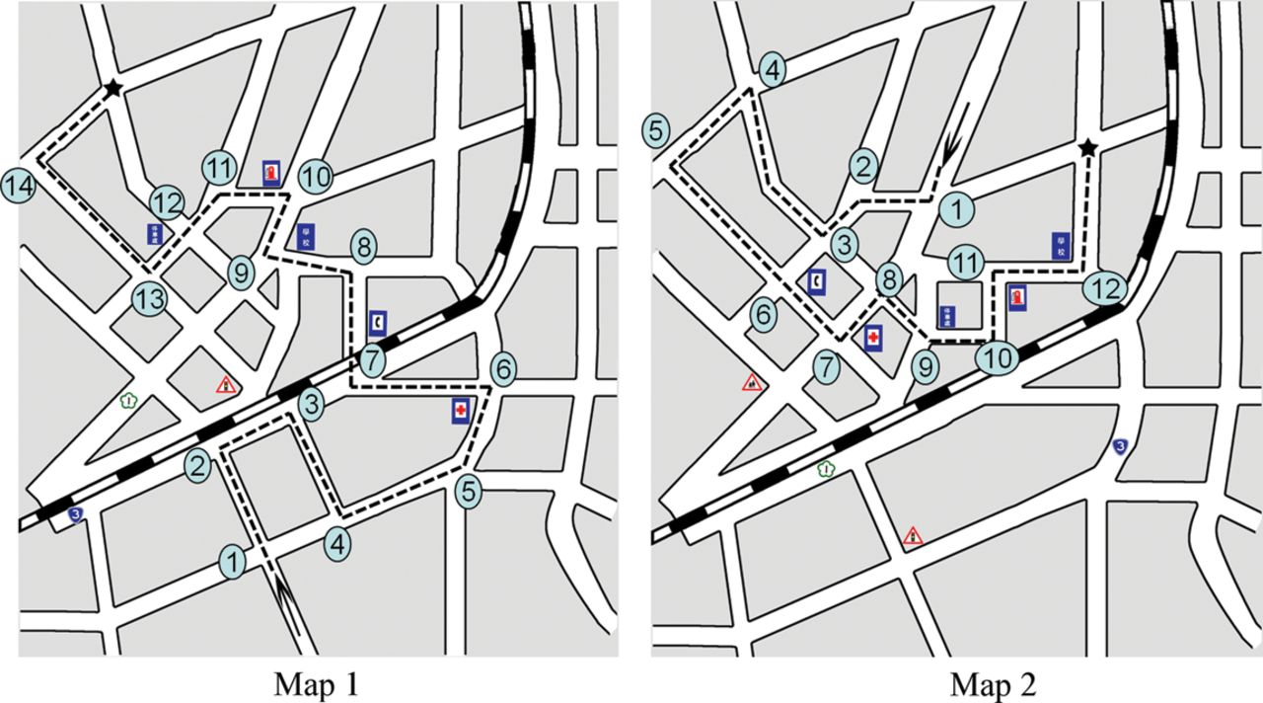
Fig. 1. The RMRT (Maps 1 and 2) with landmarks and numbered circles indicating the decision for directions.
Notes:
Fig. 1. The RMRT (Maps 1 and 2) with landmarks and numbered circles indicating the decision for directions.
Unless provided in the caption above, the following copyright applies to the content of this slide: © The Author 2012. Published by Oxford University Press. All rights reserved. For permissions, please e-mail: journals.permissions@oup.com.

Slide 2
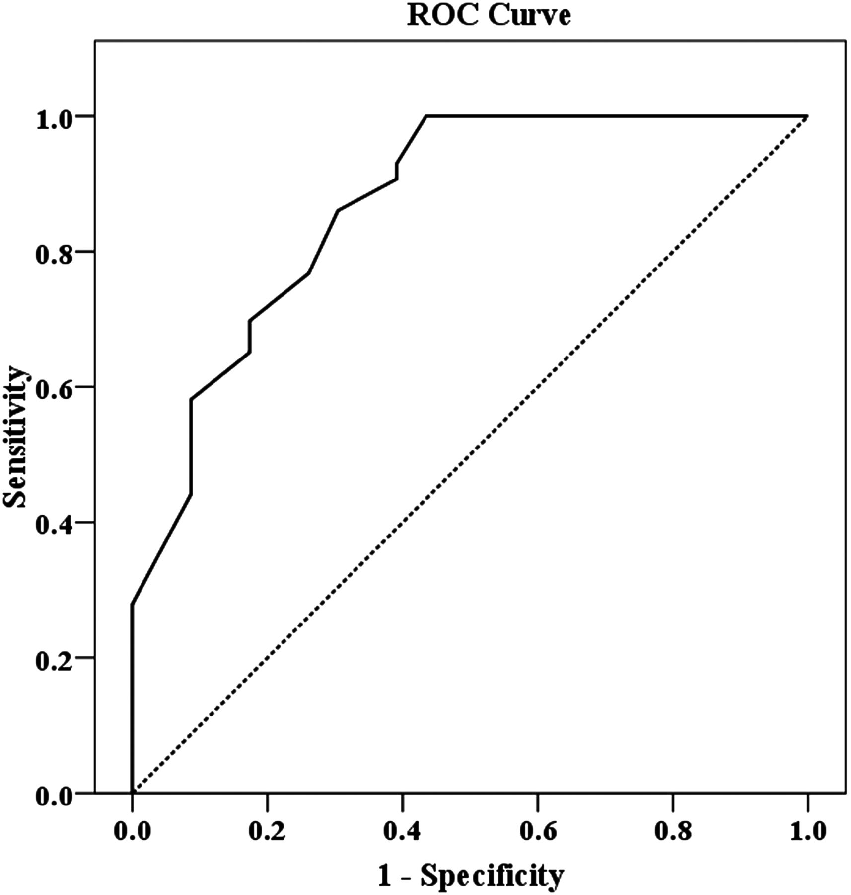
Fig. 2. ROC curve for the RMRT score for groups with and without AD.
Notes:
Fig. 2. ROC curve for the RMRT score for groups with and without AD.
Unless provided in the caption above, the following copyright applies to the content of this slide: © The Author 2012. Published by Oxford University Press. All rights reserved. For permissions, please e-mail: journals.permissions@oup.com.

