Slide 1
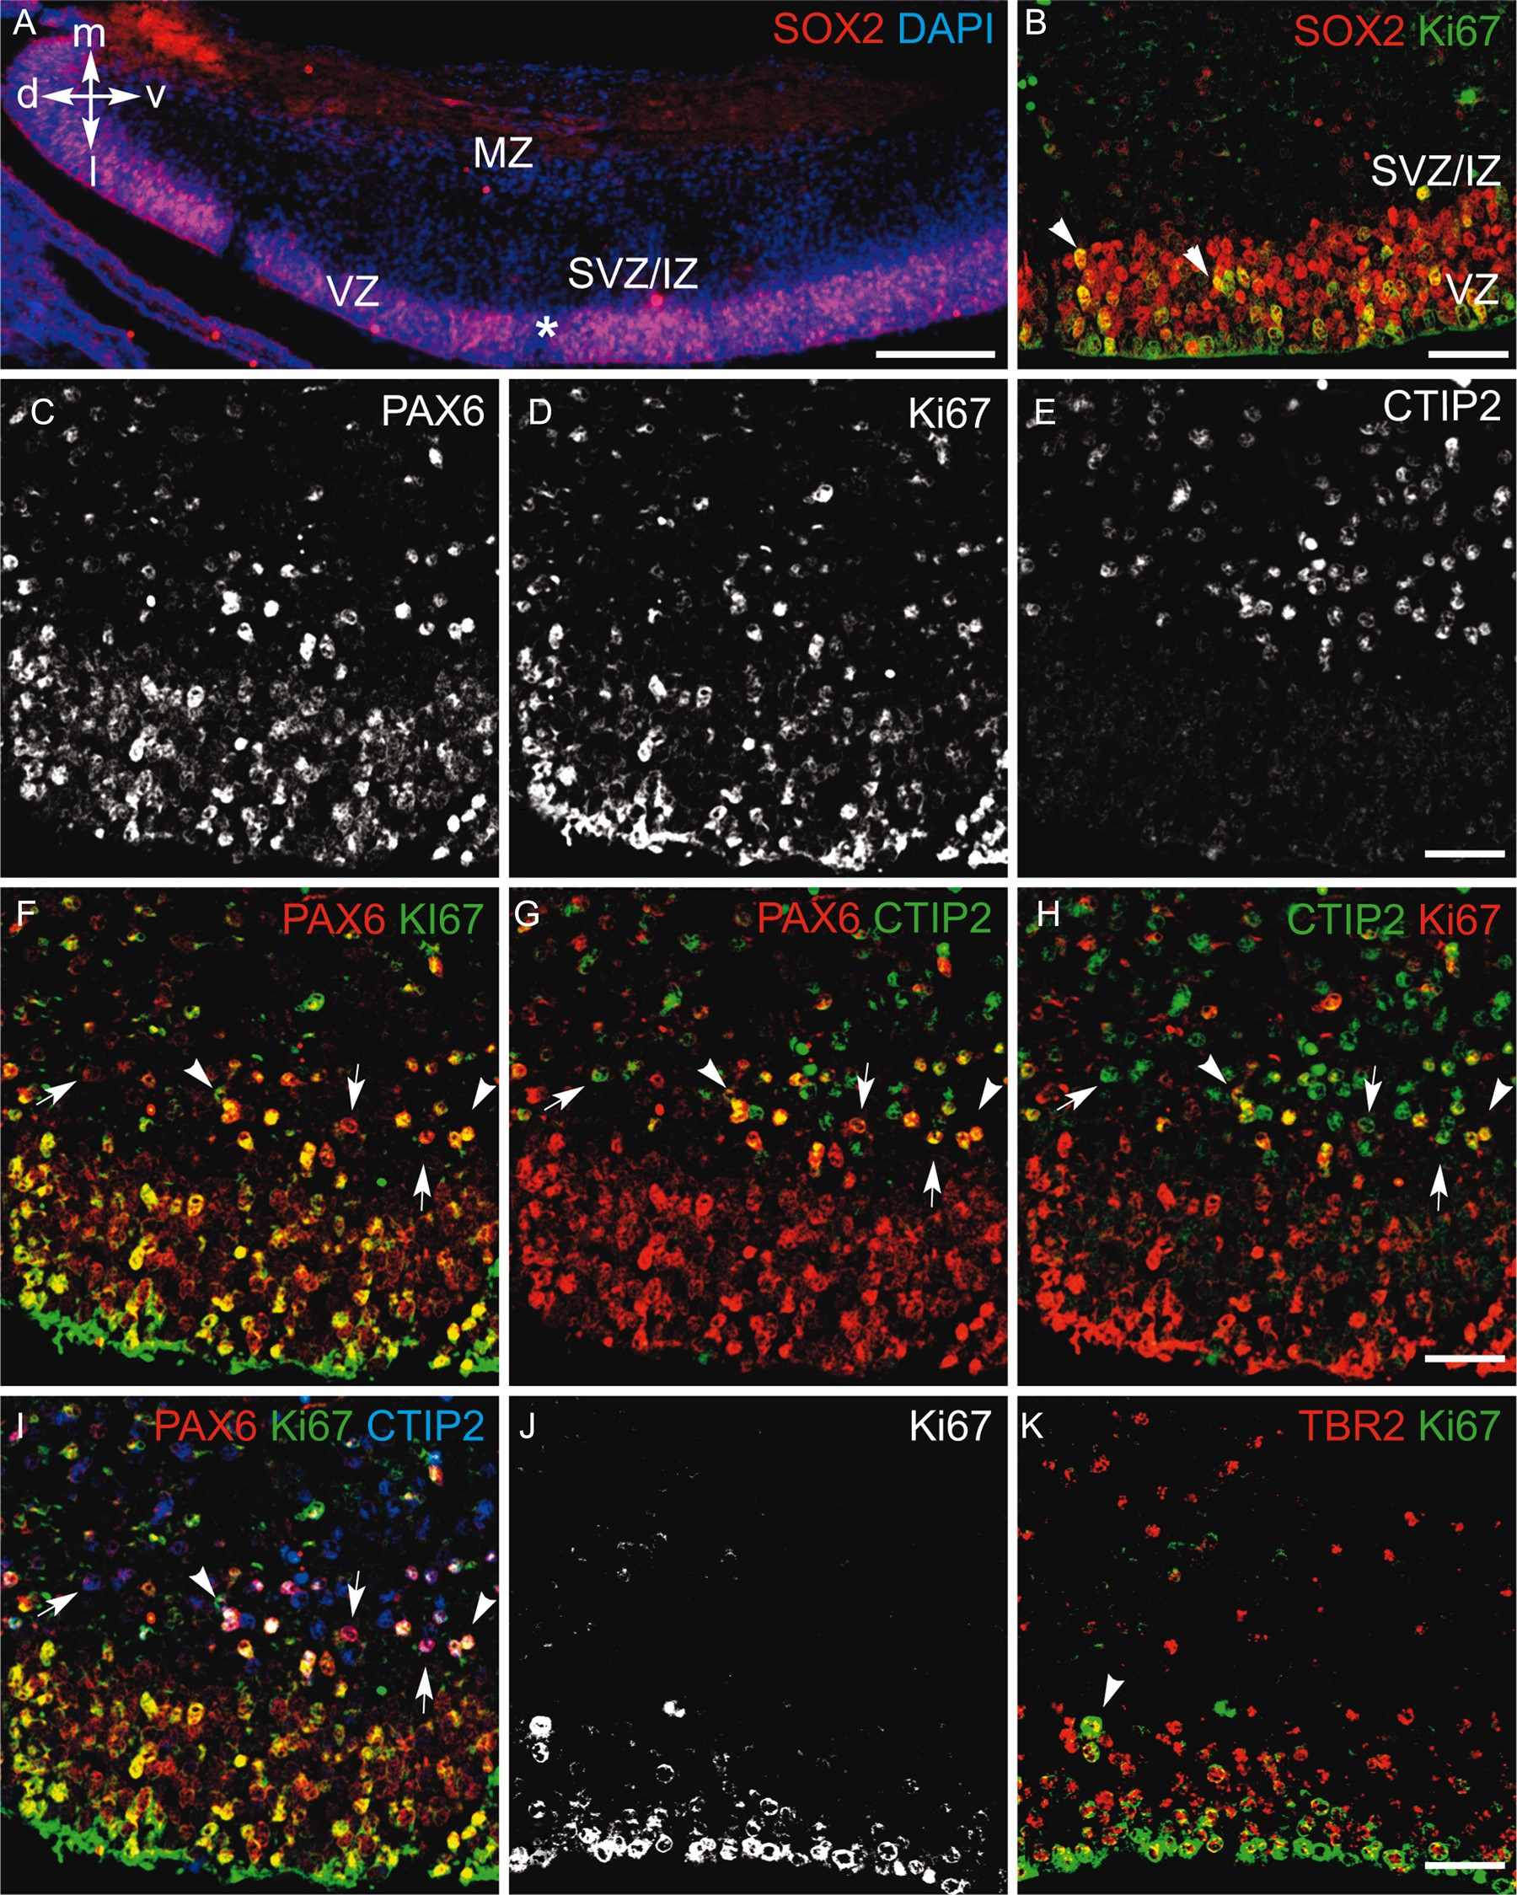
Figure 1. Analysis of progenitors and layer markers in coronal sections of the human hippocampal formation at GW 9. (A) ...
Notes:
Figure 1. Analysis of progenitors and layer markers in coronal sections of the human hippocampal formation at GW 9. (A) SOX2+ progenitors of the ventral cortical hem. The asterisk indicates the confocal image field in B–K. (B) SOX2/Ki67 double-labeling. (C–I) PAX6/Ki67/CTIP2 triple labeling. (B) SOX2+ and (C,D,F,I) PAX6+ progenitors show proliferative activity in the VZ and SVZ (arrowheads). (C,E,G,I) PAX6+/CTIP2+ cells are observed in the SVZ, at the border between the VZ and SVZ (arrows), and (H,I) some of which are also co-labeled with Ki67 (arrowheads). (J,K) Few TBR2+ cells show proliferative activity in the SVZ (arrowheads). Scale bar: 200 µm in A; 50 µm in B–K. d, dorsal zone; IZ, intermediate zone; l, lateral; m, medial; MZ, marginal; SVZ, subventricular zone; v, ventral; VZ, ventricular zone.
Unless provided in the caption above, the following copyright applies to the content of this slide: © The Author 2015. Published by Oxford University Press. All rights reserved. For Permissions, please e-mail: journals.permissions@oup.com

Slide 2
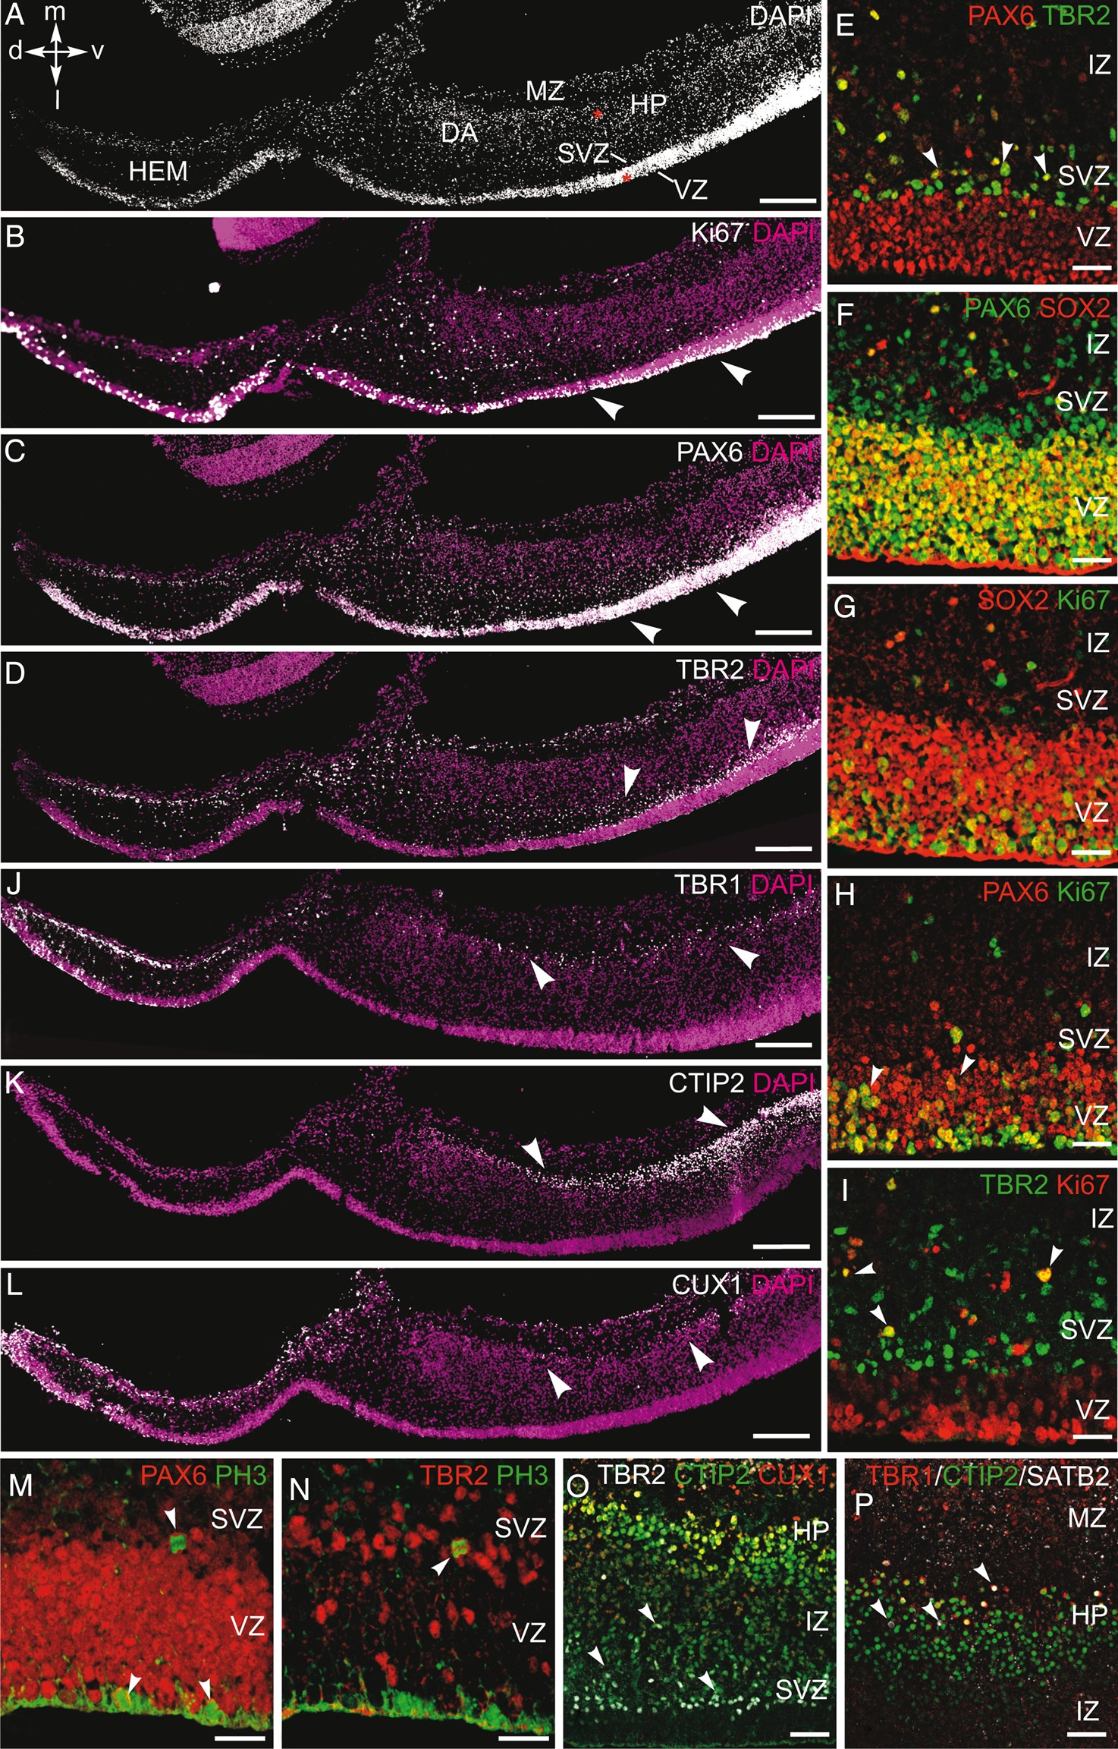
Figure 2. Analysis of progenitors and layer markers in coronal sections of the hippocampal formation at GW 11. (A) DAPI ...
Notes:
Figure 2. Analysis of progenitors and layer markers in coronal sections of the hippocampal formation at GW 11. (A) DAPI staining. Asterisks indicate the confocal image field in E–I and M–P. (B) Ki67, (C) PAX6, and (D) TBR2 immunolabeling showing the distribution of cycling and progenitor cells (arrowheads). PAX6+ cells are mainly observed in the VZ. TBR2+ cells are observed in the SVZ, at the border with the VZ. (E) Higher magnification showing the localization of PAX6+ and TBR2+ progenitors. PAX6+/TBR2+ co-labeled cells are present in the SVZ (arrowheads) and IZ. (F) PAX6+/SOX2+ co-labeled cells are visible in the VZ. Several PAX6+/SOX2 cells are observed in the SVZ. (G) Proliferative SOX2+ cells are observed in the VZ. The proliferative activity of (H) PAX6+ and (I) TBR2+ cells was analyzed using Ki67 co-labeling. Cycling PAX6+ progenitors are present in the VZ/SVZ (arrowheads). Cycling TBR2+ cells are observed in the SVZ and IZ (arrowheads). (J) TBR1, (K) CTIP2, and (L) CUX1 immunolabeling showing the distribution of postmitotic cells within the hippocampal plate (arrowheads). (M) PAX6/PH3 and (N) TBR2/PH3 double-labeling showing mitotic cells in the hippocampal VZ and SVZ (arrowheads). (O) Distribution of TBR2+ cells, CTIP2+, and CUX1+ neurons. The density of CTIP2+ cells increases from the SVZ toward the ammonic plate. TBR2/CTIP2 co-labeled cells are present in the SVZ (arrowheads), whereas CTIP2+/CUX1+ neurons are located in the upper hippocampal plate (shown in yellow). (P) Distribution of TBR1+, CTIP2+, and SATB2+ neurons within the hippocampal plate. A few TBR1+ neurons are present in the upper part of the plate. Arrowheads indicate SATB2+ cells. Scale bar: 200 µm in A–D and L,J; 25 µm in E–I and M and N; 50 µm in O and P. d, dorsal; DA, dentate anlage, HP, hippocampal plate; l, lateral; m, medial; MZ, marginal zone; SVZ, subventricular zone; IZ, intermediate zone; v, ventral; VZ, ventricular zone.
Unless provided in the caption above, the following copyright applies to the content of this slide: © The Author 2015. Published by Oxford University Press. All rights reserved. For Permissions, please e-mail: journals.permissions@oup.com

Slide 3
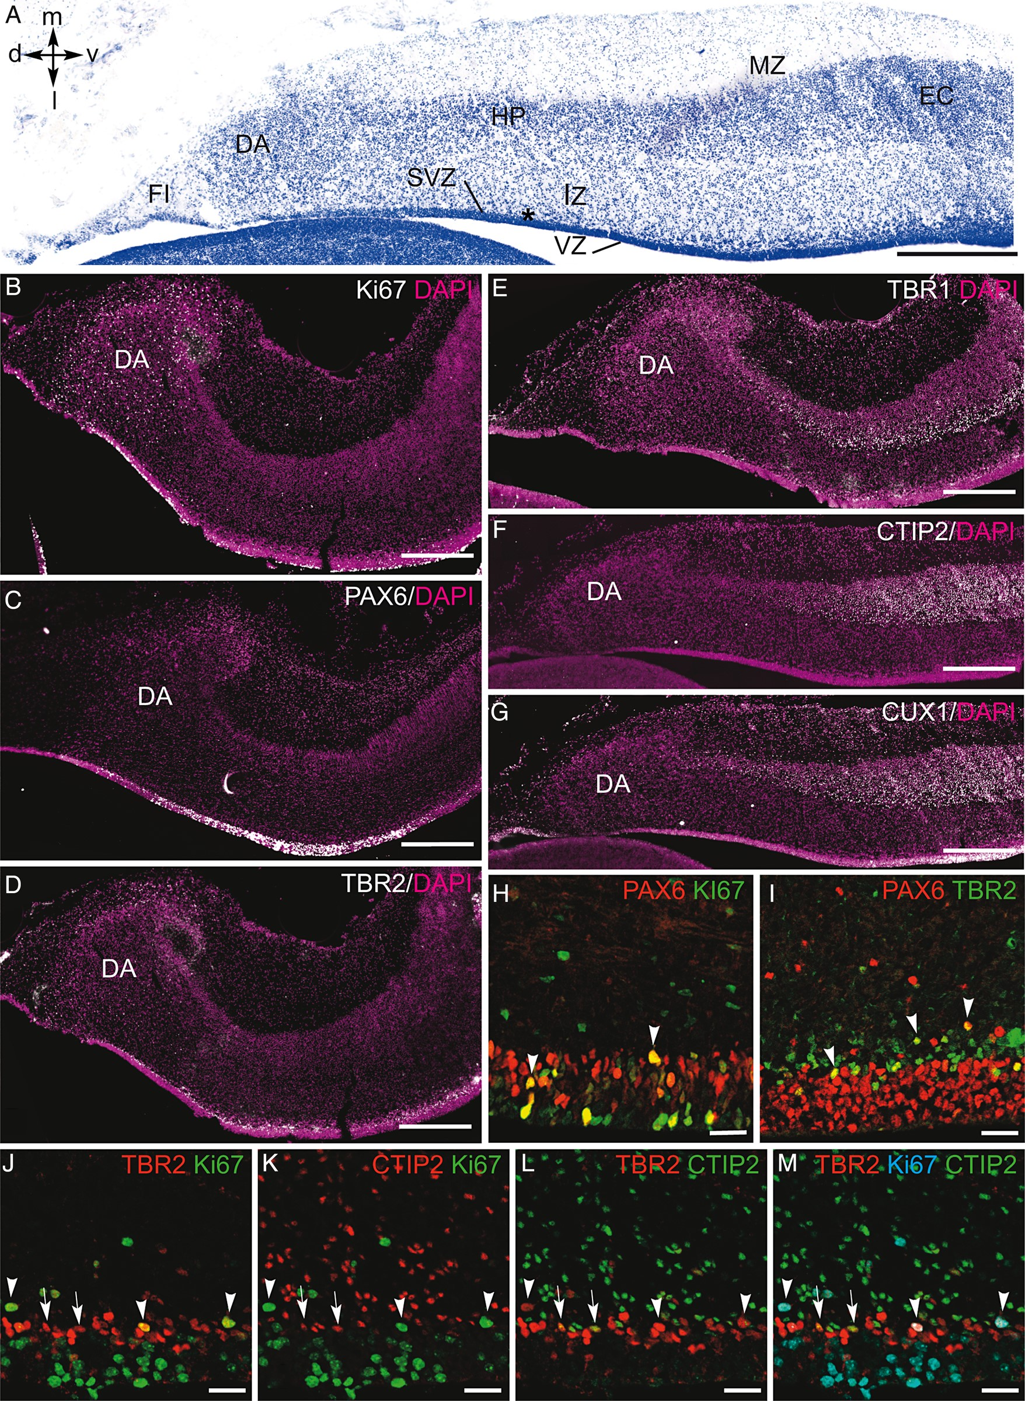
Figure 3. Analysis of progenitor- and cell fate-specific transcription factors in coronal sections of the hippocampal ...
Notes:
Figure 3. Analysis of progenitor- and cell fate-specific transcription factors in coronal sections of the hippocampal formation at GW 13. (A) Nissl staining. Asterisk indicates the confocal image field in E–G. (B) Ki67, (C) PAX6, and (D) TBR2 labeling showing the distribution of cycling and progenitor cells, similar to the previous stage. (E) TBR1, (F) CTIP2, and (G) CUX1 immunolabeling showing the distribution of neuronal subpopulations within the hippocampal plate. (H) Proliferative PAX6+/Ki67+ and (J) TBR2+/Ki67+ progenitors (arrowheads) are localized in the same compartments as observed at GW 11. (I) PAX6+ and TBR2+ progenitors continue to delineate the VZ and SVZ, respectively. Some PAX6+ progenitors are observed in the SVZ. (J–M) TBR2/CTIP2/Ki67 multiple labeling of the VZ, SVZ, and IZ. In the SVZ, TBR2+ cells expressing the postmitotic marker CTIP2 are not Ki67+ (arrows). Arrowheads indicate TBR2+/Ki67+ co-labeled cells. Scale bar: 400 µm in A–D and E–G; 25 µm in H–M. d, dorsal; DA, dentate anlage, FI, fimbria; HP, hippocampal plate; IZ, intermediate zone; l, lateral; m, medial; MZ, marginal zone; SVZ, subventricular zone; v, ventral; VZ, ventricular zone.
Unless provided in the caption above, the following copyright applies to the content of this slide: © The Author 2015. Published by Oxford University Press. All rights reserved. For Permissions, please e-mail: journals.permissions@oup.com

Slide 4
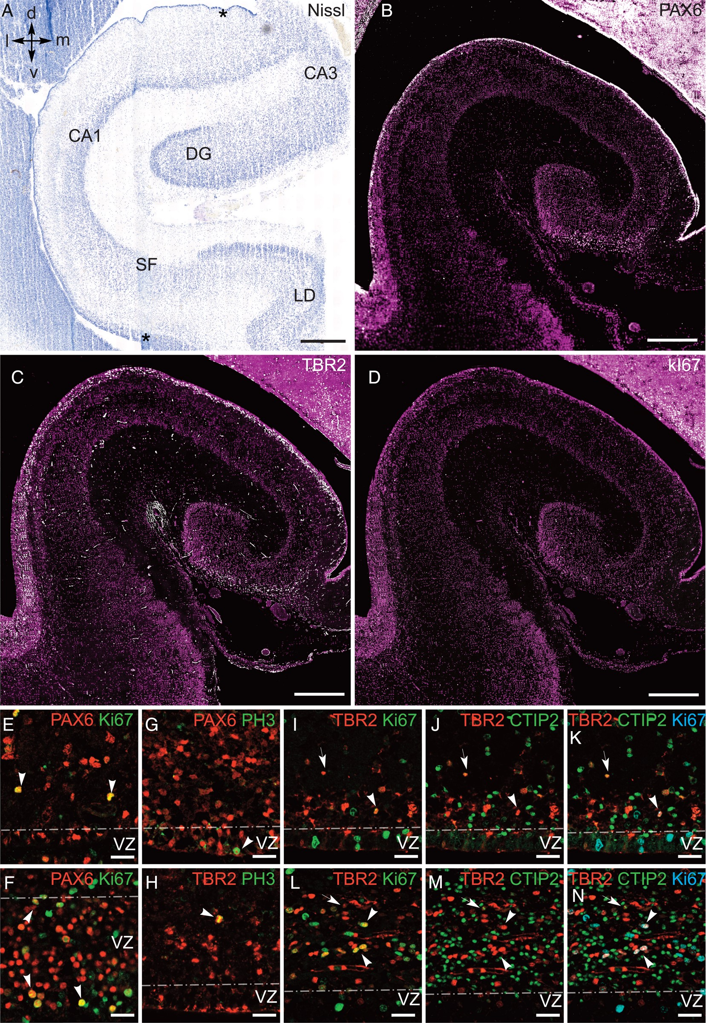
Figure 4. Analysis of progenitor markers in coronal sections of the hippocampal formation at GW 16. (A) Asterisks in ...
Notes:
Figure 4. Analysis of progenitor markers in coronal sections of the hippocampal formation at GW 16. (A) Asterisks in the VZ/SVZ of CA3 and subiculum indicate the confocal image fields in E, I-K and F, L-N, respectively. (B) PAX6, (C) TBR2, and (D) Ki67 labeling in the hippocampal formation. Ki67+ cells are rarely observed in the VZ and SVZ and difficult to see at low magnification. (E) and (F) show PAX6/Ki67 co-labeling in the VZ of the CA3 and subiculum, respectively. Differences in VZ thickness and cell density are visible between the 2 fields. (G) PAX6/PH3 and (H) TBR2/PH3 double-labeling showing mitotic cells in the hippocampal VZ and SVZ, respectively (arrowheads). (I–K) and (L–N) show TBR2/CTIP2/Ki67 multiple labeling in the SVZ of the CA3 and subiculum, respectively. Differences in layer thickness and cell density are visible between the 2 fields. Note that TBR2+/Ki67+ cells are not labeled for CTIP2 (arrowheads), whereas TBR2+/Ki67 cells are labeled for CTIP2 (arrows). The dashed line indicates the limit between the VZ and SVZ (E–N). Scale bar: 500 µm in A–D; 25 µm in E–N. d, dorsal; DG, dentate gyrus; l, lateral; LD, lamina dissecans; m, medial; SF, subicular field; v, ventral; VZ, ventricular zone.
Unless provided in the caption above, the following copyright applies to the content of this slide: © The Author 2015. Published by Oxford University Press. All rights reserved. For Permissions, please e-mail: journals.permissions@oup.com

Slide 5
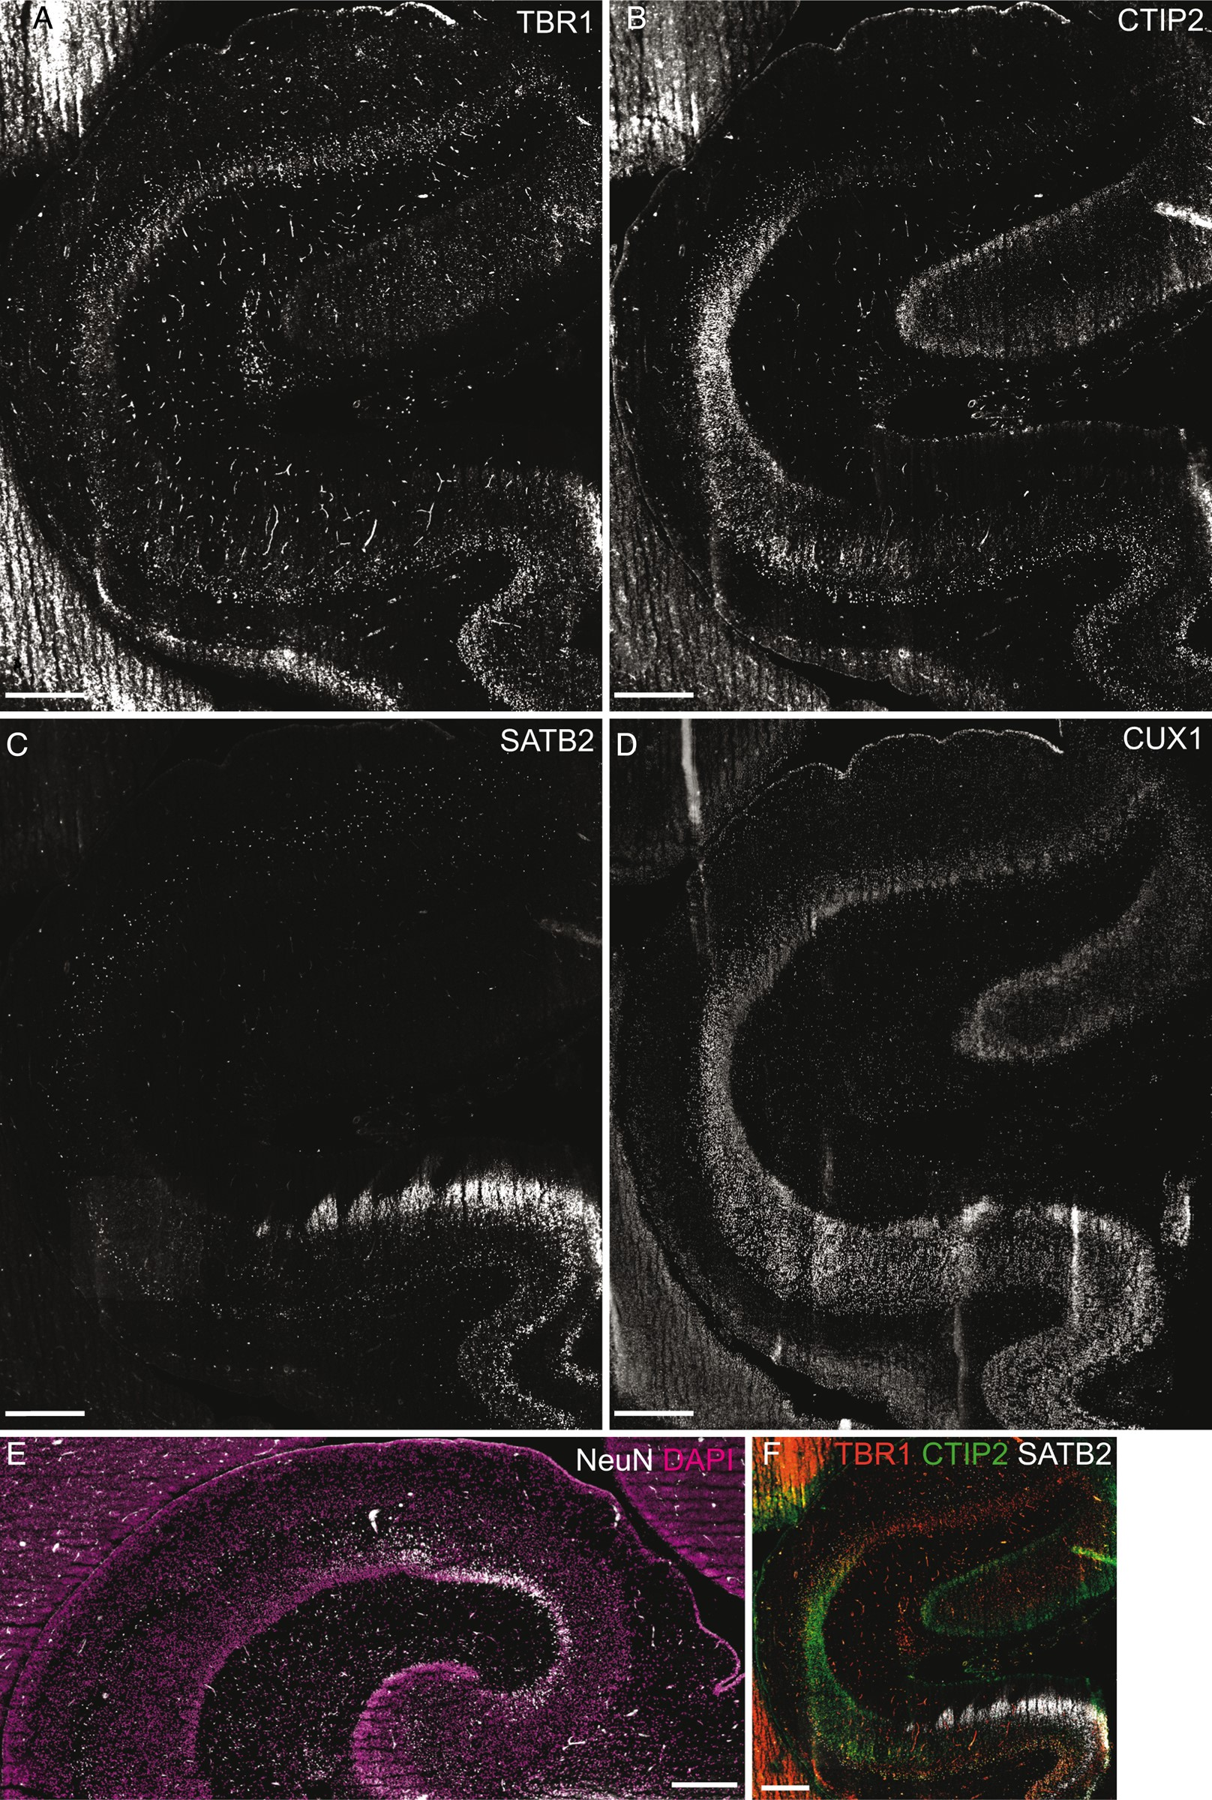
Figure 5. Analysis of postmitotic markers in coronal sections of the hippocampal formation at GW 16. (A) TBR1, (B) ...
Notes:
Figure 5. Analysis of postmitotic markers in coronal sections of the hippocampal formation at GW 16. (A) TBR1, (B) CTIP2, (C) SATB2, and (D) CUX1 labeling and (F) overlay showing the distribution of neuronal subpopulations within the hippocampal plate. (E) NeuN+ neurons appear in the CA3/CA2 field. Scale bar: 500 µm.
Unless provided in the caption above, the following copyright applies to the content of this slide: © The Author 2015. Published by Oxford University Press. All rights reserved. For Permissions, please e-mail: journals.permissions@oup.com

Slide 6
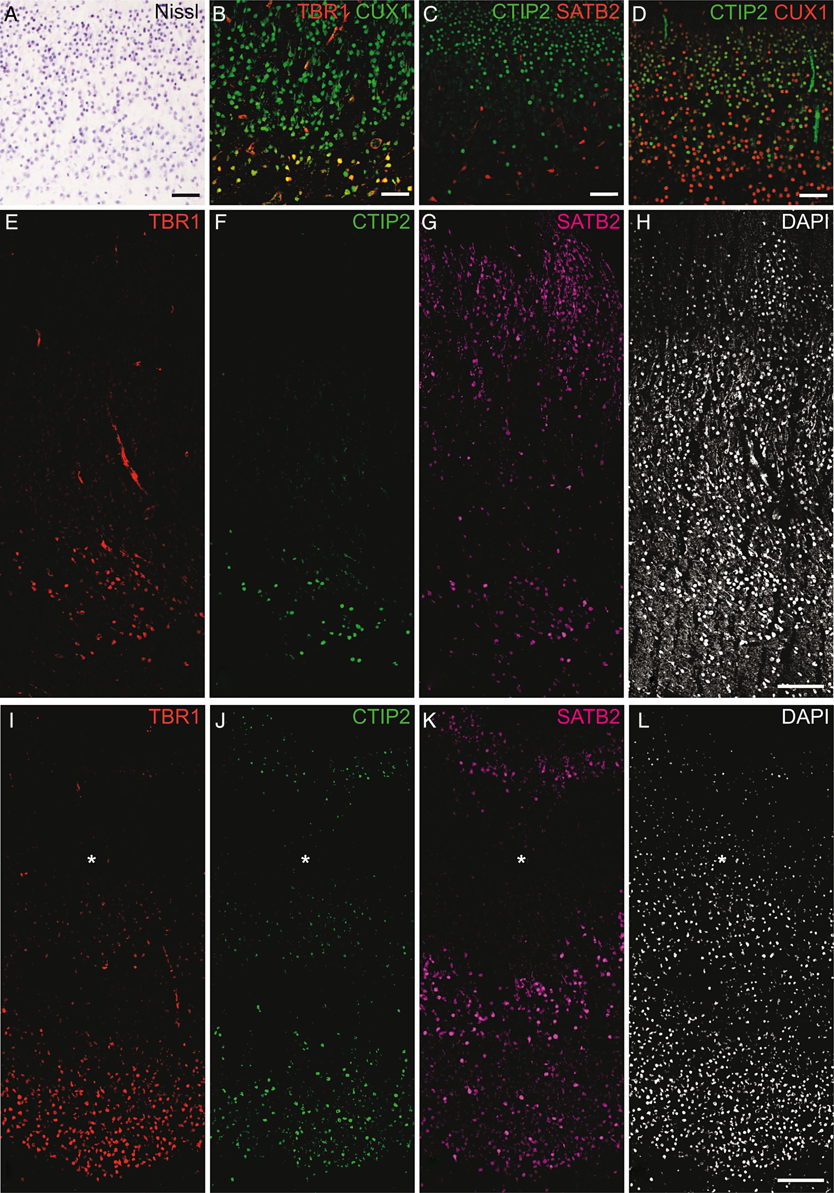
Figure 6. Cell layering in coronal sections of the hippocampal plate at GW 16. (A) Nissl staining of the CA1 field ...
Notes:
Figure 6. Cell layering in coronal sections of the hippocampal plate at GW 16. (A) Nissl staining of the CA1 field showing a maturation gradient that increases from superficial (upper part of the image) to deep layers. Distribution of (B) TBR1+ and CUX1+, (C) CTIP2+ and SATB2+, and (D) CTIP2+ and CUX1+ neurons in the CA1 field. Note that few TBR1+ and SATB2+ cells are visible in B and C, respectively. TBR1+/CTIP2+/SATB2+ cell localization in the (E–G) subicular and (I–K) entorhinal plate fields, respectively. (H) and (L) DAPI labeling of the subicular and entorhinal cortical fields, respectively. Different TBR1 (B,E,I) and SATB2 (C,G,K) band thicknesses are evident in the CA1 and subicular/entorhinal plates. Asterisks in I–L indicate the lamina dissecans. Scale bar: 50 µm in A and D; and 100 µm in E–L.
Unless provided in the caption above, the following copyright applies to the content of this slide: © The Author 2015. Published by Oxford University Press. All rights reserved. For Permissions, please e-mail: journals.permissions@oup.com

Slide 7
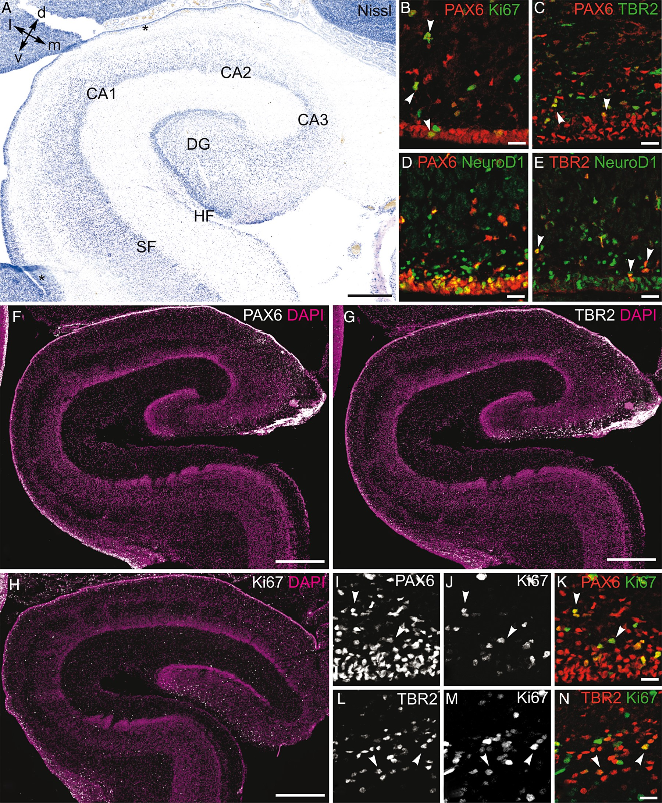
Figure 7. Analysis of progenitor markers in coronal sections of the hippocampal formation at GW 20. (A) Nissl staining. ...
Notes:
Figure 7. Analysis of progenitor markers in coronal sections of the hippocampal formation at GW 20. (A) Nissl staining. Asterisks in the VZ/SVZ of the CA1 and subiculum indicate the confocal image fields in B–E and I–N, respectively. (B–E) Analysis of markers in the ammonic VZ. (B) Rare cycling PAX6+/Ki67+ progenitors are visible in the thin ammonic VZ and in the IZ (arrowheads). (C) PAX6+/TBR2+ cells are detected in the SVZ (arrowheads). (D) PAX6+/NeuroD1+ and (E) TBR2+/NeuroD1+ cells are observed in the VZ and in the SVZ (arrowheads). Distribution of (F) PAX6+, (G) TBR2+, and (H) Ki67+ cells in the hippocampal formation. Note that labeled cells are mainly observed in the subicular area at this stage. (I–K) PAX6/Ki67 and (L–N) TBR2/Ki67 co-labeling in the subicular field showing some double-labeled cells (arrowheads). Larger fields are visible in Supplementary Figure 3A–F. Scale bar: 500 µm in A and F–H; 25 µm in B–E and I–L,N. d, dorsal; HF, hippocampal fissure; l, lateral; m, medial; DG, dentate gyrus; SF, subicular field; v, ventral.
Unless provided in the caption above, the following copyright applies to the content of this slide: © The Author 2015. Published by Oxford University Press. All rights reserved. For Permissions, please e-mail: journals.permissions@oup.com

Slide 8
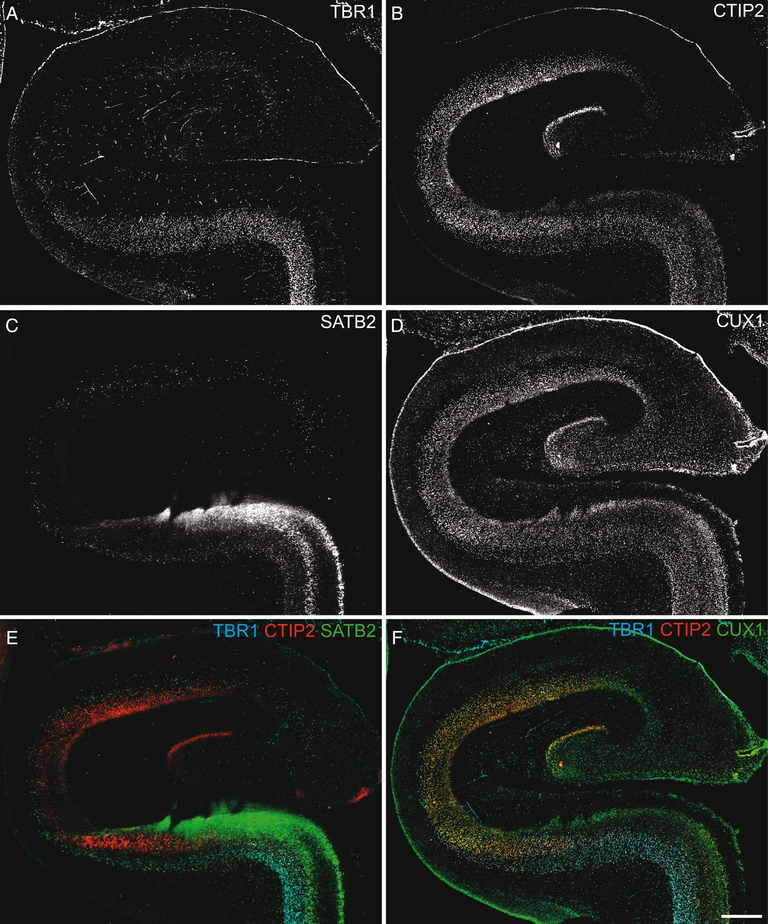
Figure 8. Analysis of layering markers in coronal sections of the hippocampal formation at GW 20. Location of (A) ...
Notes:
Figure 8. Analysis of layering markers in coronal sections of the hippocampal formation at GW 20. Location of (A) TBR1+, (B) CTIP2+, (C) SATB2+, and (D) CUX1+ neurons in the hippocampal formation. Note that TBR1 and SATB2 are poorly expressed in the hippocampus. (E) Overlays of TBR1/CTIP2/SATB2 and (F) TBR1/CTIP2/CUX1 multiple labeling. Scale bar: 500 µm.
Unless provided in the caption above, the following copyright applies to the content of this slide: © The Author 2015. Published by Oxford University Press. All rights reserved. For Permissions, please e-mail: journals.permissions@oup.com

Slide 9
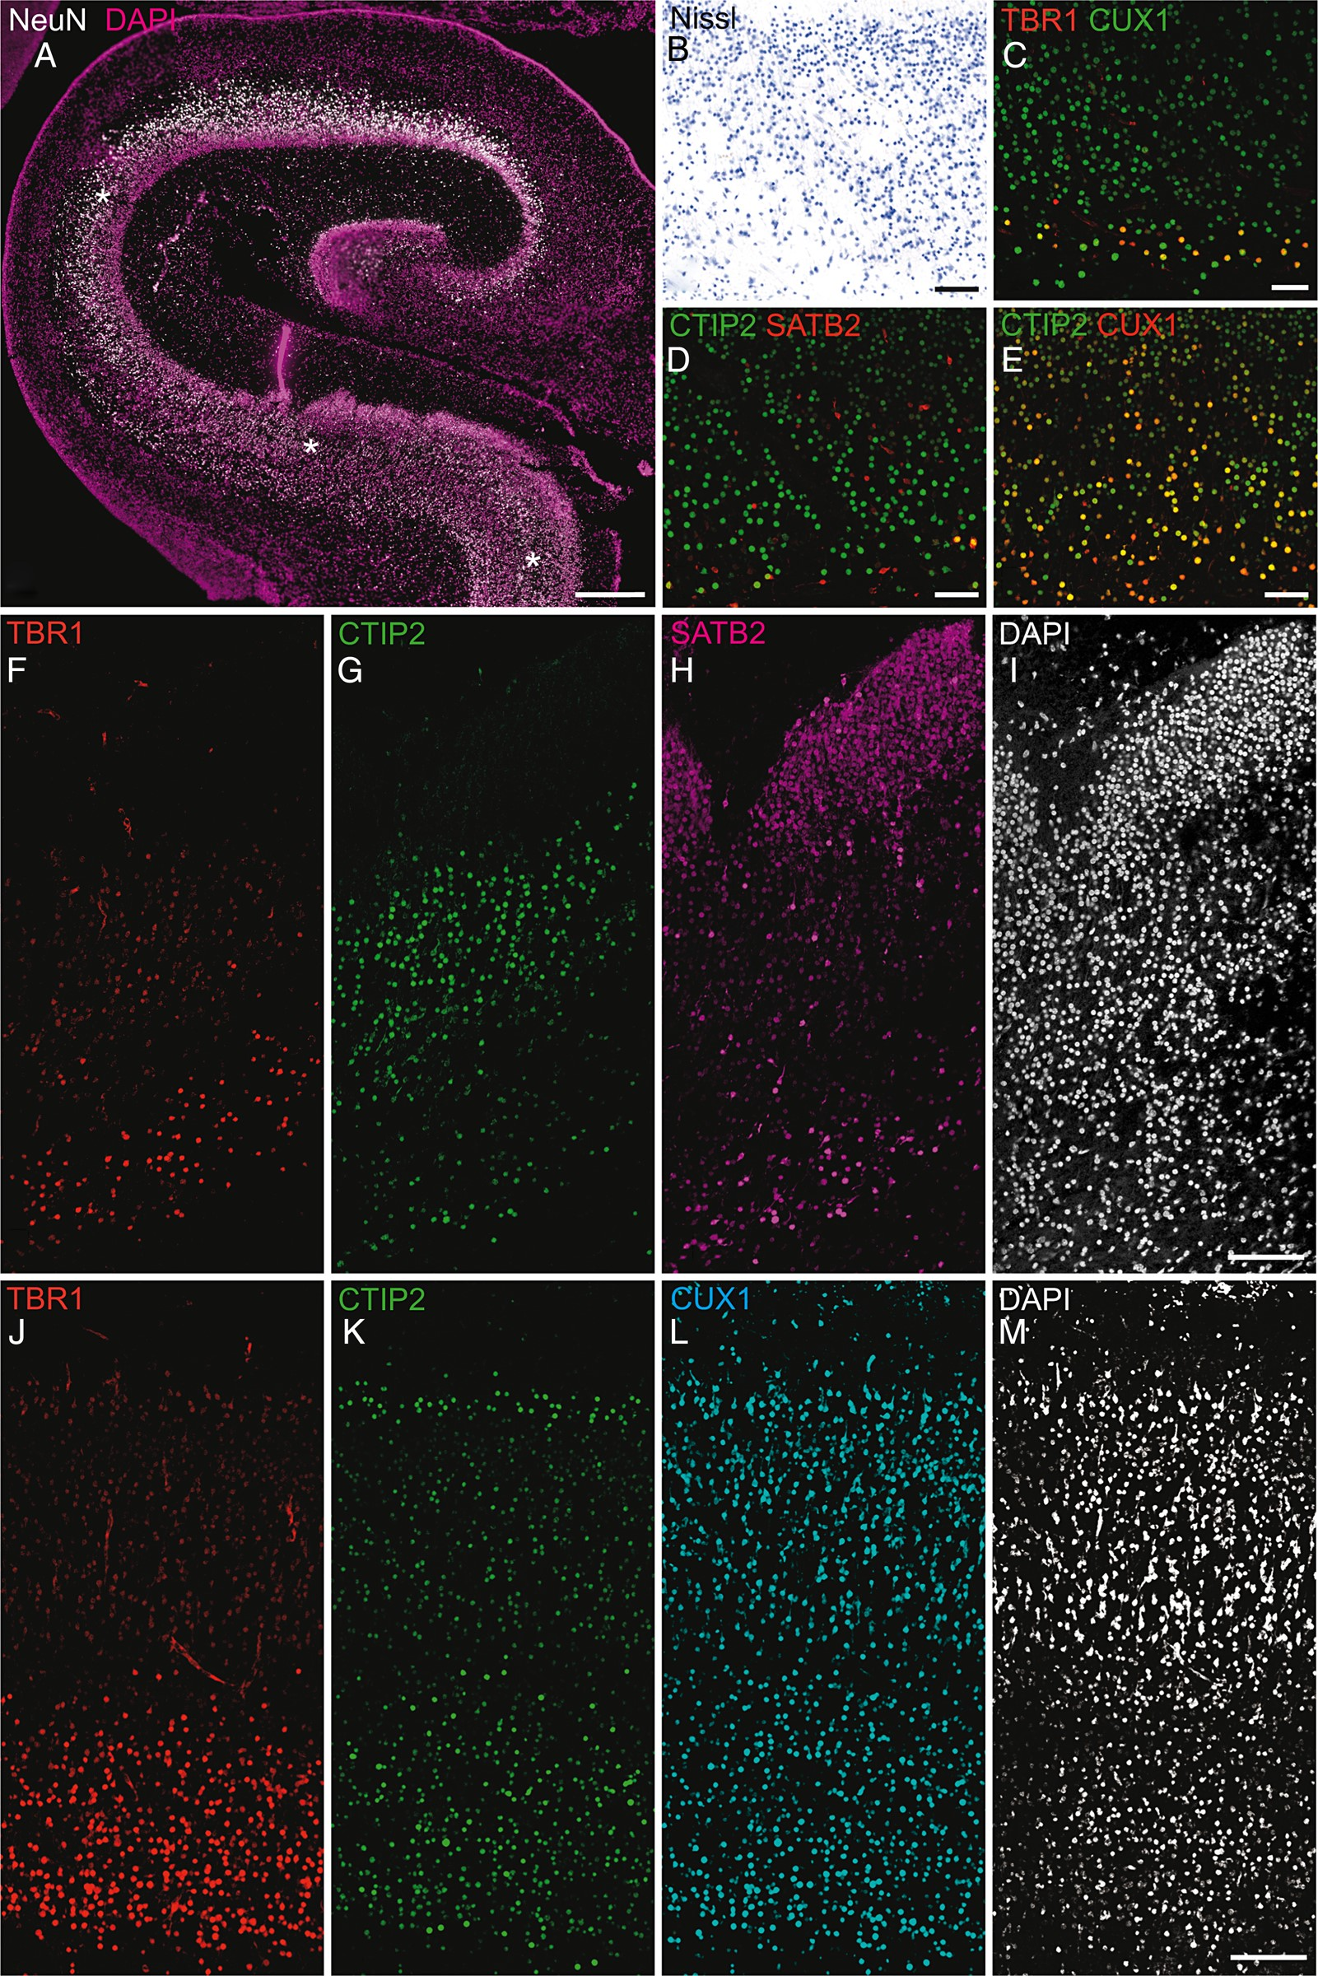
Figure 9. Cell layering in coronal sections of the hippocampal plate at GW 20. (A) The distribution of NeuN⁺ ...
Notes:
Figure 9. Cell layering in coronal sections of the hippocampal plate at GW 20. (A) The distribution of NeuN+ neurons predominates in the deep layers of the ammonic plate. The asterisks indicate the picture field in (B–E). (B) Nissl staining of the CA1 field. Distribution of (C) TBR1+ and CUX1+, (D) CTIP2+ and SATB2+, and (E) CTIP2+ and CUX1+ neurons in the CA1 field. Note that a few TBR1+ and SATB2+ cells are visible in C and D, respectively. (F–H) Triple labeling showing the localization of TBR1+/CTIP2+/SATB2+ neurons in the subicular field (I: DAPI staining). (J–L) Triple labeling showing the localization of TBR1+/CTIP2+/CUX1+ neurons in the entorhinal plate field. Different TBR1 (C,F,J) and SATB2 (D,H) band thicknesses are evident in the CA1 and subicular complex/entorhinal plate (M: DAPI staining). Scale bar: 500 µm in A; 50 µm in B–E; 100 µm in F–M.
Unless provided in the caption above, the following copyright applies to the content of this slide: © The Author 2015. Published by Oxford University Press. All rights reserved. For Permissions, please e-mail: journals.permissions@oup.com

