Slide 1
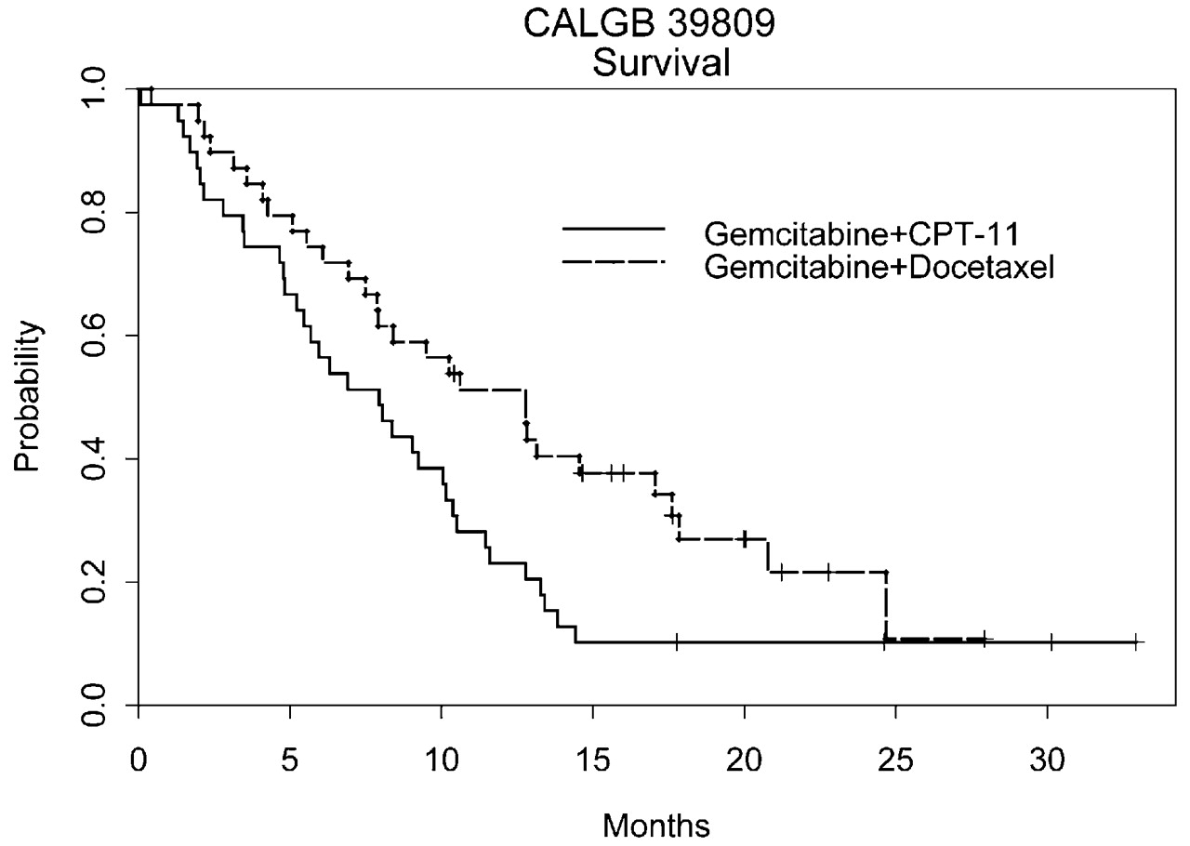
Figure 1. Overall survival.
Notes:
Figure 1. Overall survival.
Unless provided in the caption above, the following copyright applies to the content of this slide: European Society for Medical Oncology

Slide 2
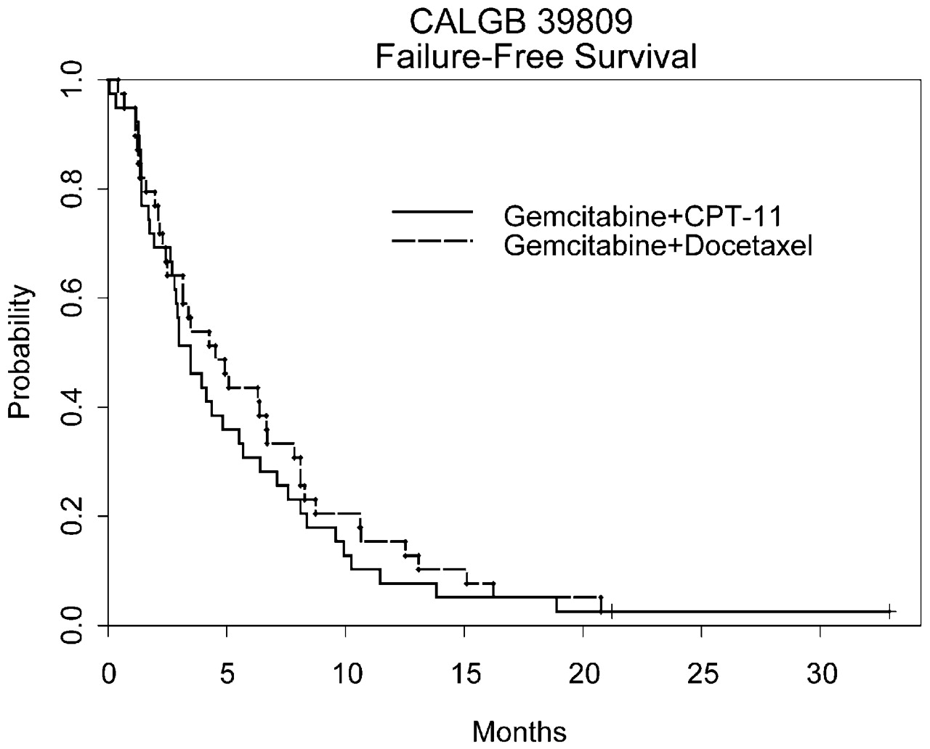
Figure 2. Failure-free survival.
Notes:
Figure 2. Failure-free survival.
Unless provided in the caption above, the following copyright applies to the content of this slide: European Society for Medical Oncology

