Slide 1
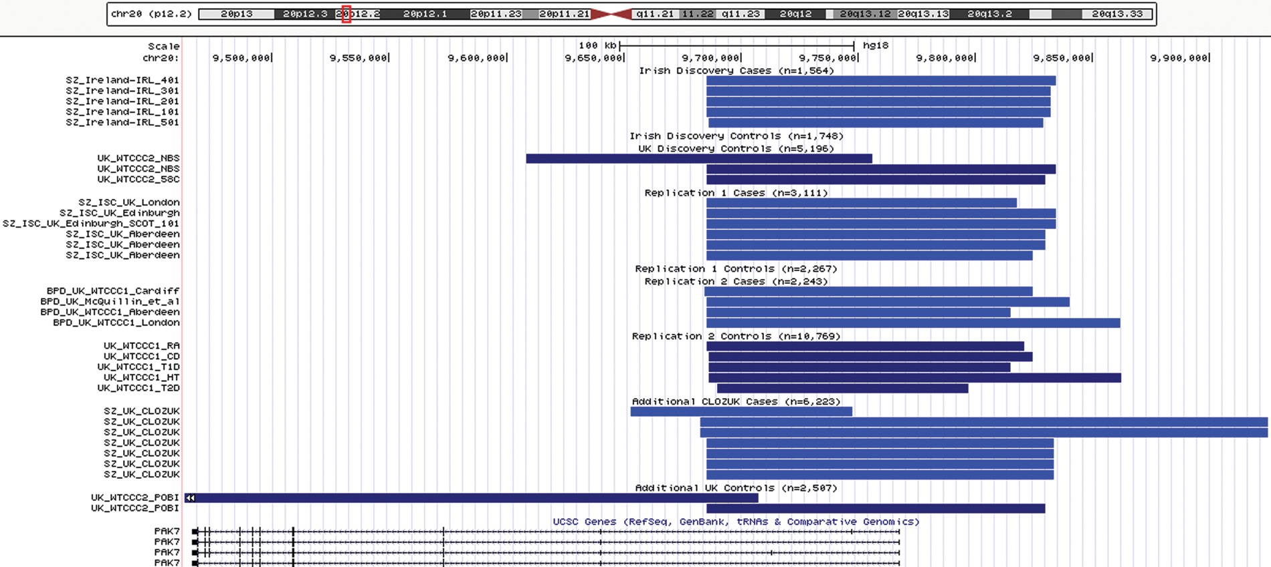
Figure 1. Inferred position of duplication events at the chr20p12.2 locus in build hg18. SZ, schizophrenia. BD, bipolar ...
Notes:
Figure 1. Inferred position of duplication events at the chr20p12.2 locus in build hg18. SZ, schizophrenia. BD, bipolar disorder. See Supplementary Material, Table S5 for exact start/stop coordinates. Duplications in controls are colored light blue and SZ or BP cases are colored dark blue.
Unless provided in the caption above, the following copyright applies to the content of this slide: © The Author 2014. Published by Oxford University Press.This is an Open Access article distributed under the terms of the Creative Commons Attribution License (http://creativecommons.org/licenses/by/3.0/), which permits unrestricted reuse, distribution, and reproduction in any medium, provided the original work is properly cited.

Slide 2
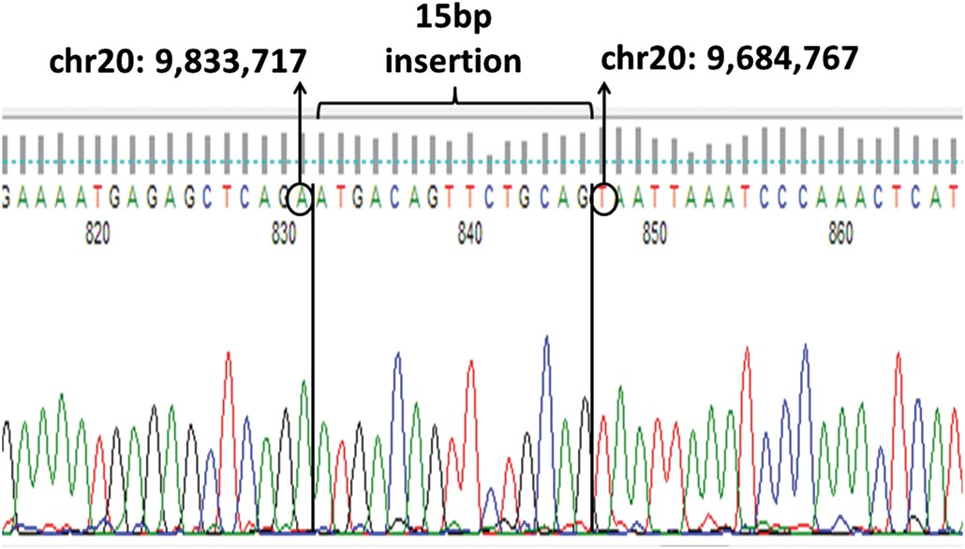
Figure 2. Capillary sequence of the unique region in the middle of the two copies of the tandem repeat sequence at the ...
Notes:
Figure 2. Capillary sequence of the unique region in the middle of the two copies of the tandem repeat sequence at the PAK7 duplication. The first copy of the sequence ends at chr20:9,833,717(hg18) and the second copy starts with sequence from chr20:9,684,767(hg18), thereby defining the breakpoints. A 15 bp sequence is present between the two copies.
Unless provided in the caption above, the following copyright applies to the content of this slide: © The Author 2014. Published by Oxford University Press.This is an Open Access article distributed under the terms of the Creative Commons Attribution License (http://creativecommons.org/licenses/by/3.0/), which permits unrestricted reuse, distribution, and reproduction in any medium, provided the original work is properly cited.

Slide 3
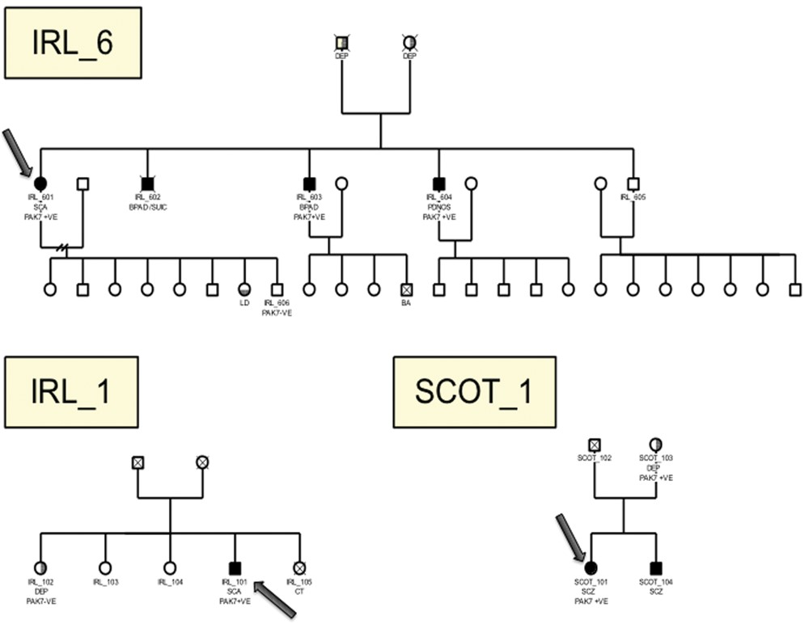
Figure 3. Familial pedigrees for patients from three families (IRL_6, IRL_1, SCOT_1) who were found to be positive for ...
Notes:
Figure 3. Familial pedigrees for patients from three families (IRL_6, IRL_1, SCOT_1) who were found to be positive for PAK7 duplications. The index individual in each family screened is indicated with an arrow. Individuals positive (PAK7 + VE) or negative (PAK7 − VE) for PAK7 are indicated. Filled symbols indicate individuals with psychotic disorders (SCZ, schizophrenia; SCA, schizoaffective disorder; BPA, bipolar affective disorder; PDNOS, psychotic disorder not otherwise specified). Partial vertically shaded symbol indicates depressive disorder (DEP, depression). Partial horizontal shaded symbol indicates learning disability (LD). Cause of death where known: SUIC, suicide; BA, birth asphyxia; CT, cerebral tumor.
Unless provided in the caption above, the following copyright applies to the content of this slide: © The Author 2014. Published by Oxford University Press.This is an Open Access article distributed under the terms of the Creative Commons Attribution License (http://creativecommons.org/licenses/by/3.0/), which permits unrestricted reuse, distribution, and reproduction in any medium, provided the original work is properly cited.

Slide 4
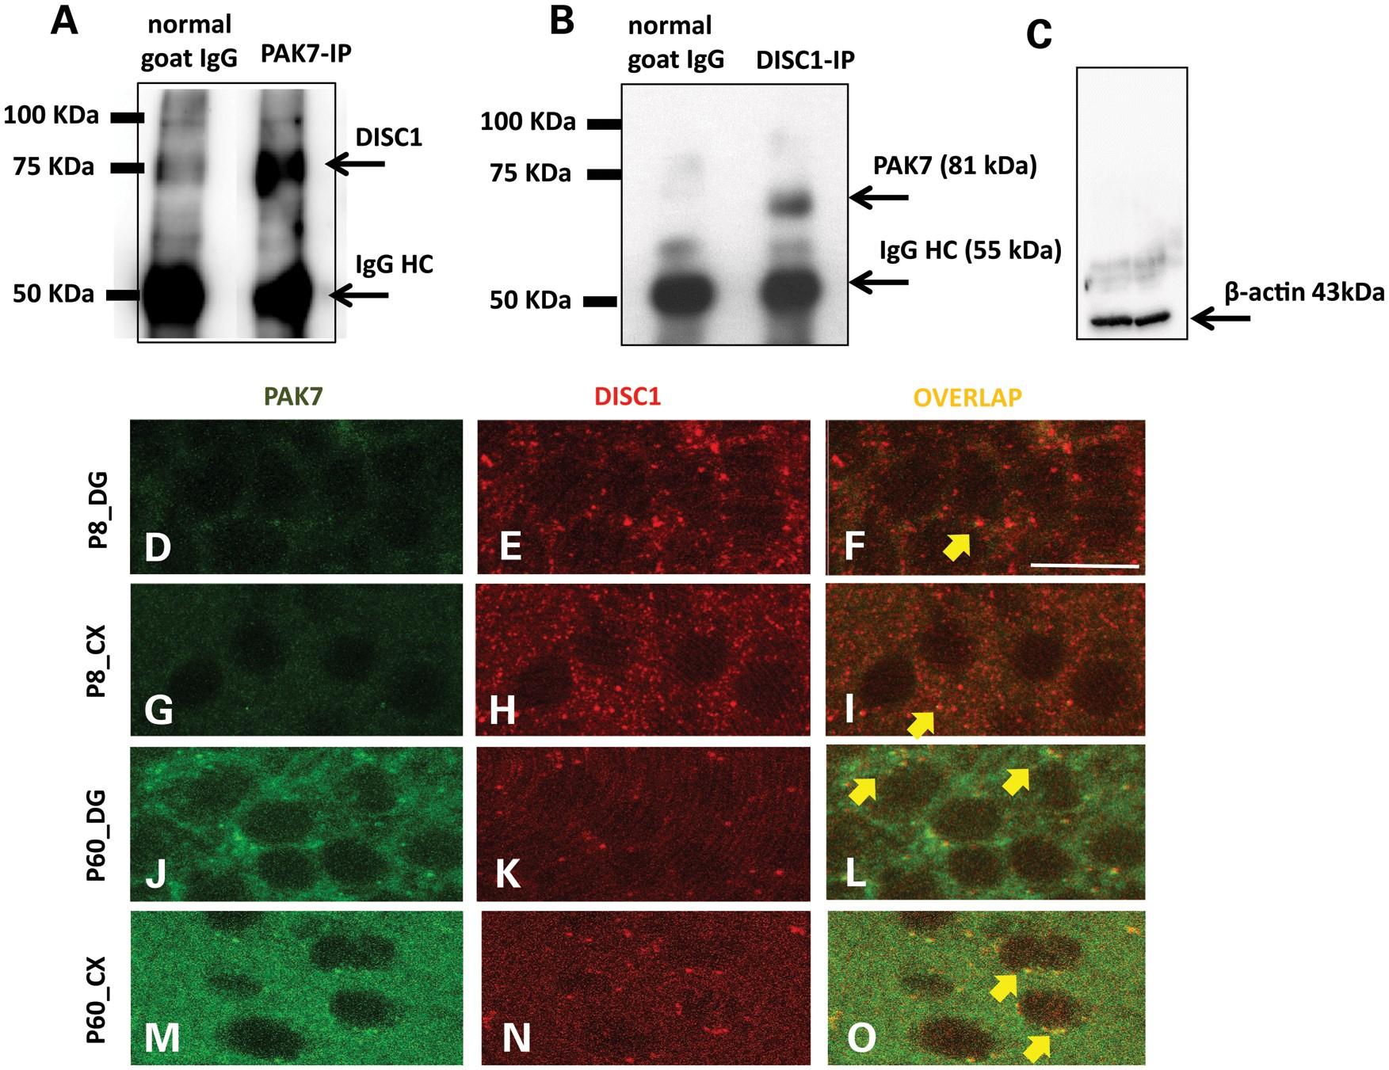
Figure 4. PAK7 and DISC1 interact in mouse brain synapses. (A) Immunoprecipitation of PAK7 and DISC1 from ...
Notes:
Figure 4. PAK7 and DISC1 interact in mouse brain synapses. (A) Immunoprecipitation of PAK7 and DISC1 from synaptoneurosomal extracts of adult mouse brains. The extract was immunoprecipitated for PAK7 and the eluate was immunostained for DISC1. (B) Reciprocal experiment described in A: immunoprecipitation of DISC1 followed by immunostaining of the eluate with antiPAK7. In both A and B, the samples immunoprecipitated with control IgG showed no signal, showing the specificity of the PAK7–DISC1 interaction. An additional control in (C) shows that the brain extracts before immunoprecipitation have the same amount of loading control (β-actin). (D–N) Immunostaining for PAK7 (green) and DISC1 (red) in brain sections containing Hippocampus and Cortex of P7 (D–I) and Adult (J–O) mice. The experiment shows an overlapping (yellow) of PAK7 and DISC1 in puncta, confirming a synaptic interaction between the two proteins. The co-localization is particularly evident in the adult (J–O) preparation.
Unless provided in the caption above, the following copyright applies to the content of this slide: © The Author 2014. Published by Oxford University Press.This is an Open Access article distributed under the terms of the Creative Commons Attribution License (http://creativecommons.org/licenses/by/3.0/), which permits unrestricted reuse, distribution, and reproduction in any medium, provided the original work is properly cited.

