Slide 1
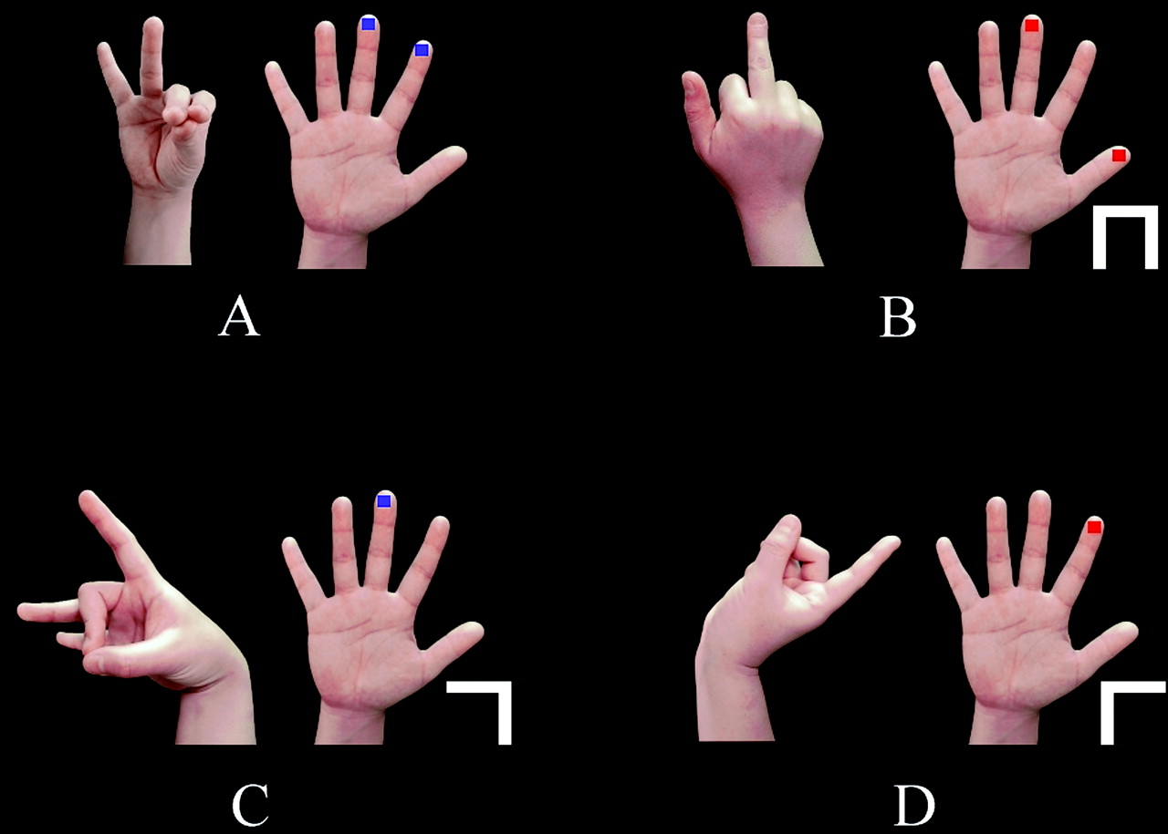
Figure 1. Examples of hand postures used in the experiment. Each pair indicates an identical posture: the left side ...
Notes:
Figure 1. Examples of hand postures used in the experiment. Each pair indicates an identical posture: the left side picture is for imitation; the right side picture is for symbolic instruction. Red squares mean ‘stick this finger out’. Blue squares mean ‘touch this finger with the thumb’. White symbols at the lower right of the hand specify wrist configurations: (A) (no symbol), palm upside; (B) palm down; (C) flexion of the wrist; (D) extension of the wrist.
Unless provided in the caption above, the following copyright applies to the content of this slide: Cerebral Cortex V 15 N 5 © Oxford University Press 2004; all rights reserved

Slide 2
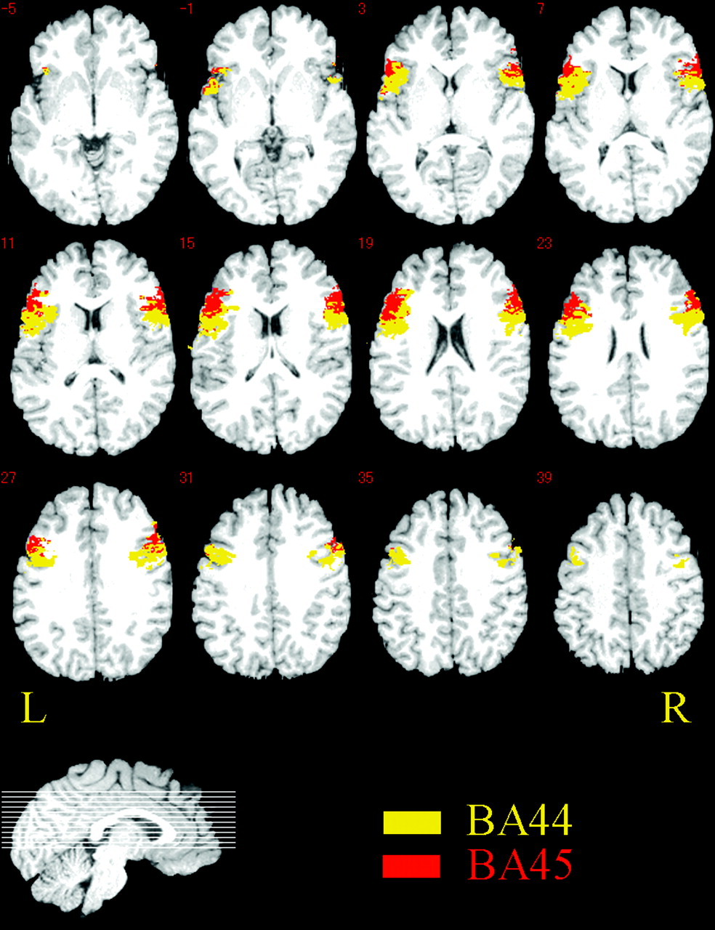
Figure 2. VOIs for ANOVA BA 44 (yellow) and 45 (red) defined by a probability map of cytoarchitectonics delineations of ...
Notes:
Figure 2. VOIs for ANOVA BA 44 (yellow) and 45 (red) defined by a probability map of cytoarchitectonics delineations of 10 post-mortem brains (Amunts et al., 1999).
Unless provided in the caption above, the following copyright applies to the content of this slide: Cerebral Cortex V 15 N 5 © Oxford University Press 2004; all rights reserved

Slide 3
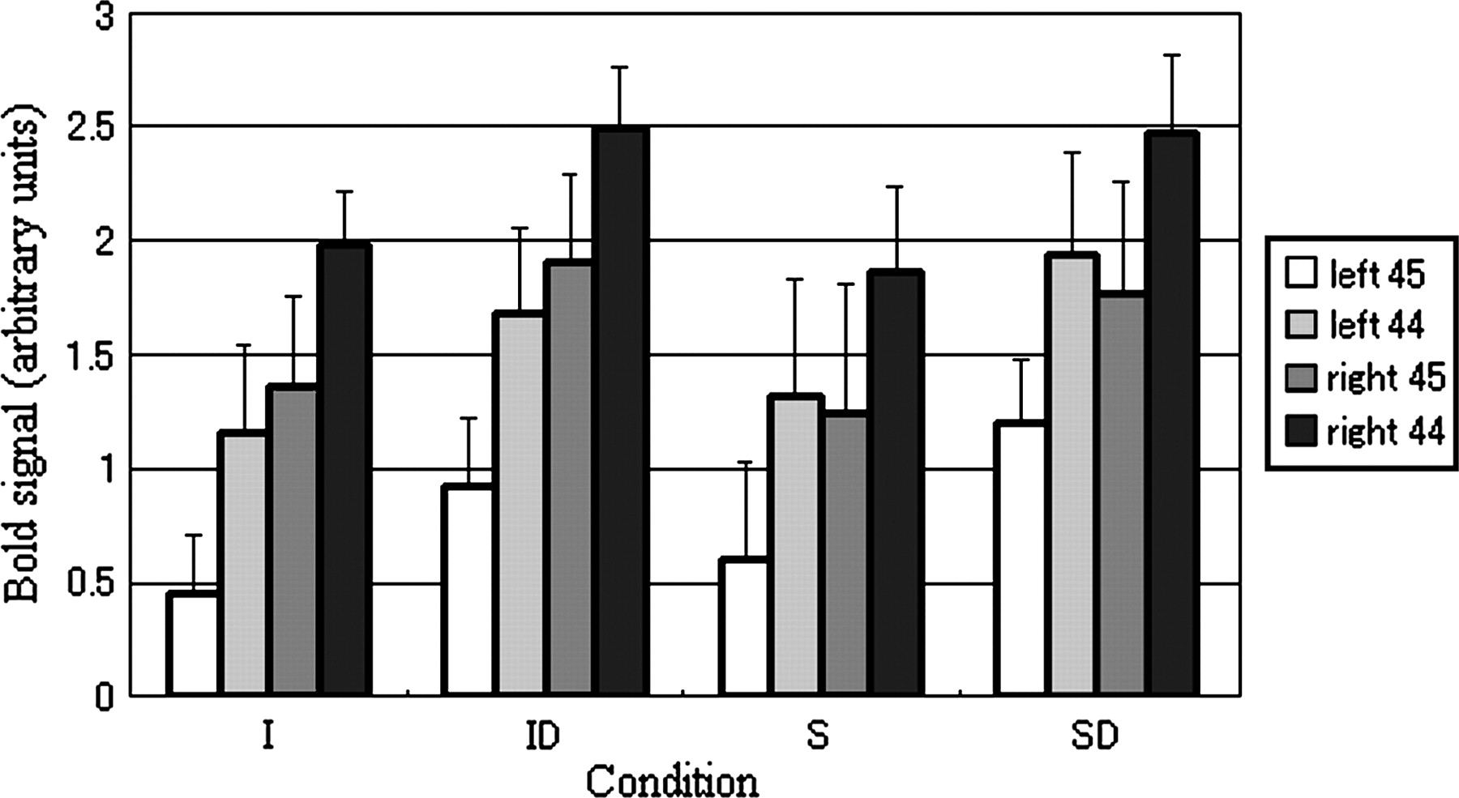
Figure 3. Mean VOI signal intensities for each condition. Mean signal intensities of four VOIs (left BA 45, left BA 44, ...
Notes:
Figure 3. Mean VOI signal intensities for each condition. Mean signal intensities of four VOIs (left BA 45, left BA 44, right BA 45 and right BA 44) in four conditions (I, ID, S and SD) are shown. Error bars indicate standard error.
Unless provided in the caption above, the following copyright applies to the content of this slide: Cerebral Cortex V 15 N 5 © Oxford University Press 2004; all rights reserved

Slide 4
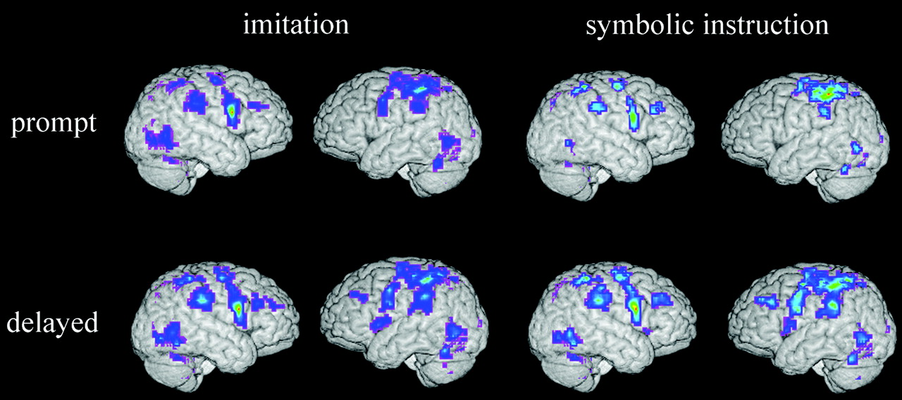
Figure 4. Surface rendered brains for activations in each condition (I, ID, S, and SD) compared with the baseline ...
Notes:
Figure 4. Surface rendered brains for activations in each condition (I, ID, S, and SD) compared with the baseline condition (B). Top left: I > B. Bottom left: ID > B. Top right: S > B. Bottom right: SD > B. Statistical inference was made at the cluster-level by thresholding at t = 5 in each voxel, then P < 0.05 for the spatial extent corrected for multiple non-independent comparisons in accordance with the Gaussian random field theory.
Unless provided in the caption above, the following copyright applies to the content of this slide: Cerebral Cortex V 15 N 5 © Oxford University Press 2004; all rights reserved

Slide 5
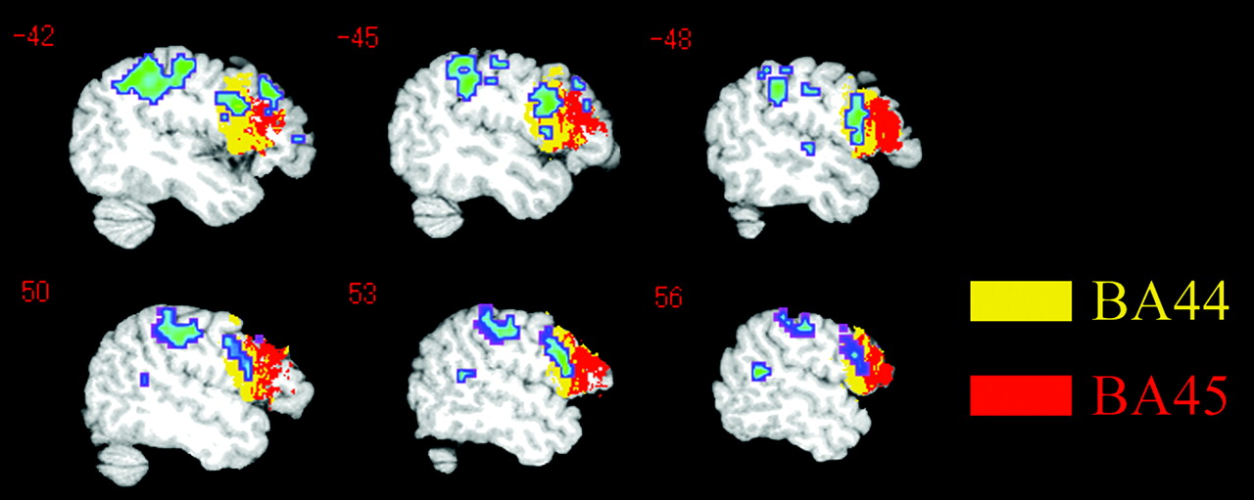
Figure 5. Activation in BA 44 revealed by the contrast of delayed execution condition against prompt execution ...
Notes:
Figure 5. Activation in BA 44 revealed by the contrast of delayed execution condition against prompt execution condition (ID + SD > I + S). Note that activated clusters appear in BA 44 bilaterally. An activated cluster was also found in the posterior part of the right superior temporal sulcus. Statistical inferences were made at the cluster-level by thresholding at t = 5 in each voxel, then P < 0.05 for the spatial extent corrected for multiple non-independent comparisons in accordance with the Gaussian random field theory. The x Talairach coordinate of the slice is given in the top left corner of each slice.
Unless provided in the caption above, the following copyright applies to the content of this slide: Cerebral Cortex V 15 N 5 © Oxford University Press 2004; all rights reserved

