Slide 1
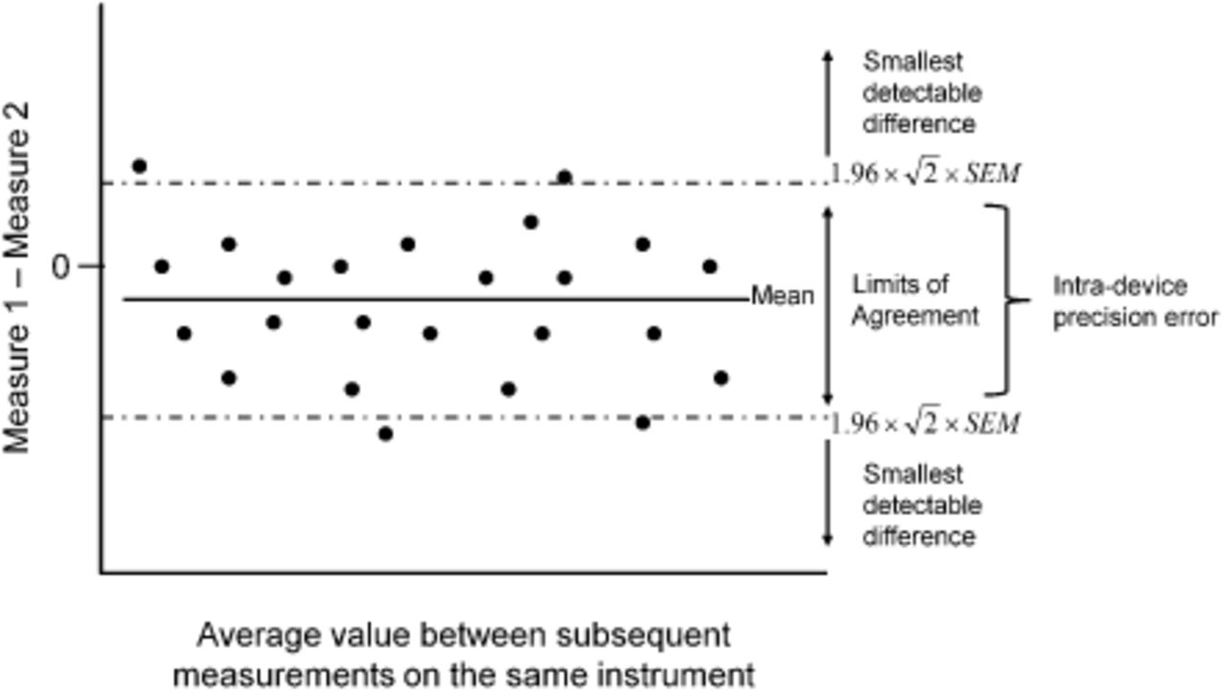
Figure 1 Bland-Altman plot demonstrating limits of agreement and the smallest detectable difference.
Notes:
Figure 1 Bland-Altman plot demonstrating limits of agreement and the smallest detectable difference.
Unless provided in the caption above, the following copyright applies to the content of this slide: © 2013 International Life Sciences Institute

