Slide 1
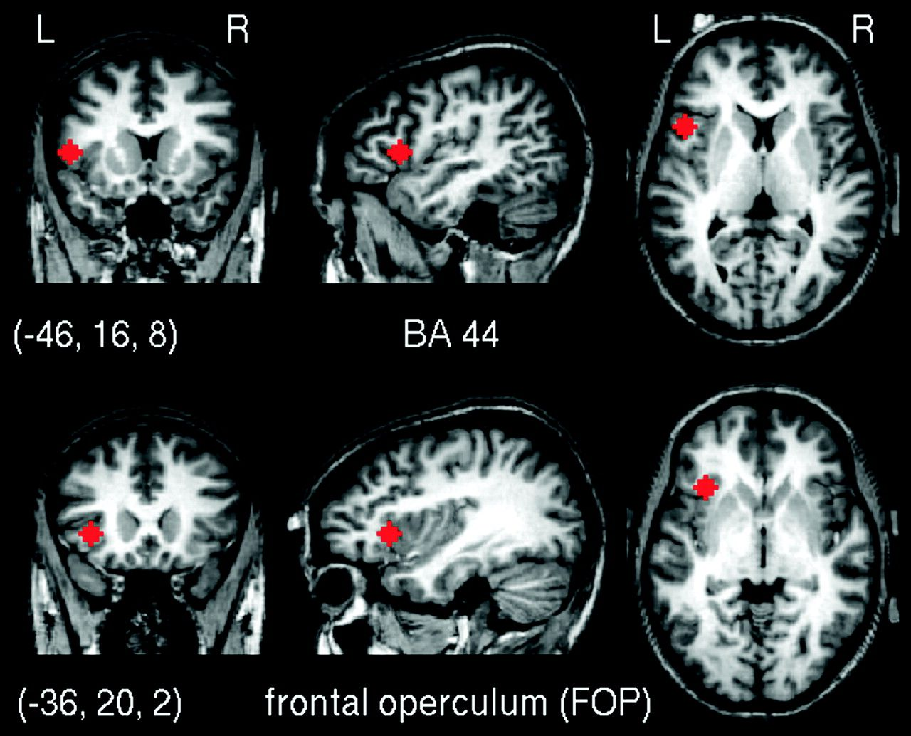
Figure 1. The 2 seed regions used for the correlation analysis. (Friederici et al. 2006)
Notes:
Figure 1. The 2 seed regions used for the correlation analysis. (Friederici et al. 2006)
Unless provided in the caption above, the following copyright applies to the content of this slide: © The Author 2009. Published by Oxford University Press. All rights reserved. For permissions, please e-mail: journals.permissions@oxfordjournals.org

Slide 2
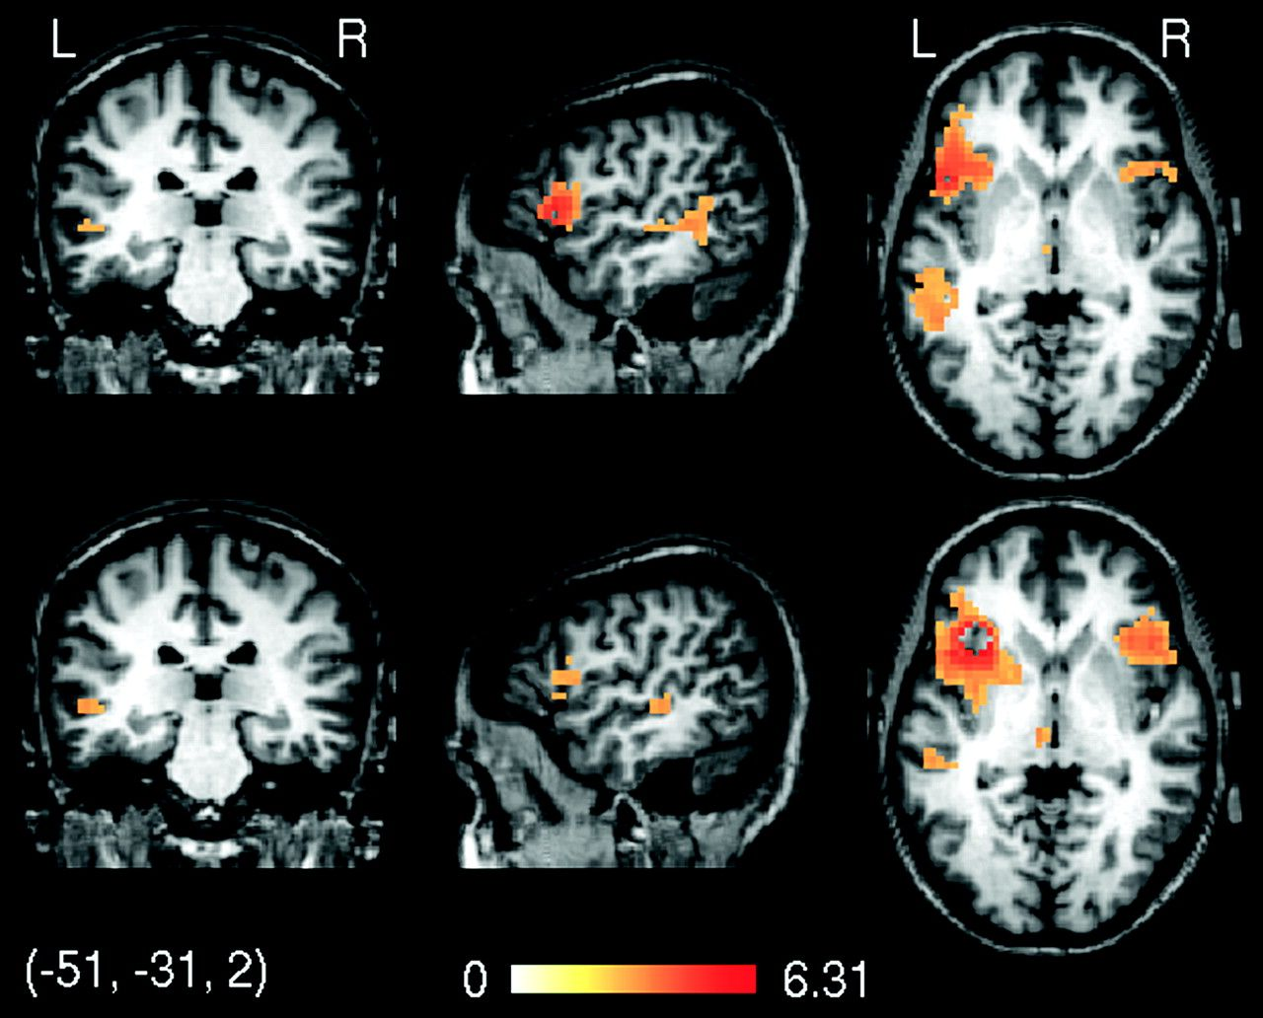
Figure 2. Results of a conjunction analysis involving 4 language experiments corrected for multiple comparisons using ...
Notes:
Figure 2. Results of a conjunction analysis involving 4 language experiments corrected for multiple comparisons using FDR thresholded at P < 0.05 (Table 1). The top row shows correlations with the seed region in BA44. The bottom row shows correlations with the seed region in FOP. For each experiment, the correlations were r-to-z transformed to ensure Gaussianity and then subjected to a voxelwise t-test across subjects. The map shows the z values for the conjunction of all 4 language studies. The z values are color coded as indicated by the color bar.
Unless provided in the caption above, the following copyright applies to the content of this slide: © The Author 2009. Published by Oxford University Press. All rights reserved. For permissions, please e-mail: journals.permissions@oxfordjournals.org

Slide 3
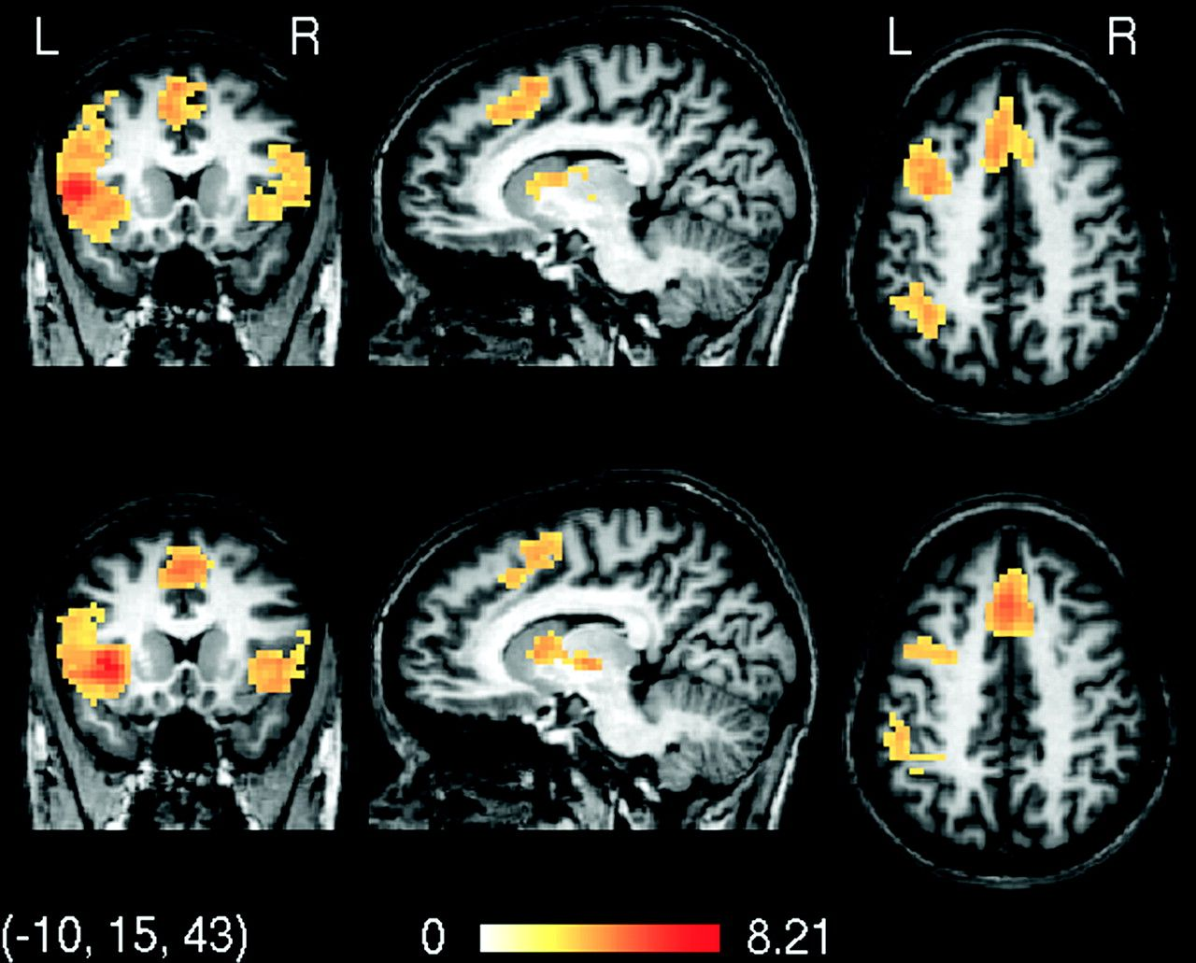
Figure 3. Results of a conjunction analysis involving 2 language experiments that had full brain coverage (Table 2). ...
Notes:
Figure 3. Results of a conjunction analysis involving 2 language experiments that had full brain coverage (Table 2). The top row shows correlations with the seed region in BA44. The bottom row shows correlations with the seed region in FOP. Note that additional regions appear in the medial wall and intraparietal sulci. As in Figure 2, the z values are color coded as indicated by the color bar.
Unless provided in the caption above, the following copyright applies to the content of this slide: © The Author 2009. Published by Oxford University Press. All rights reserved. For permissions, please e-mail: journals.permissions@oxfordjournals.org

Slide 4
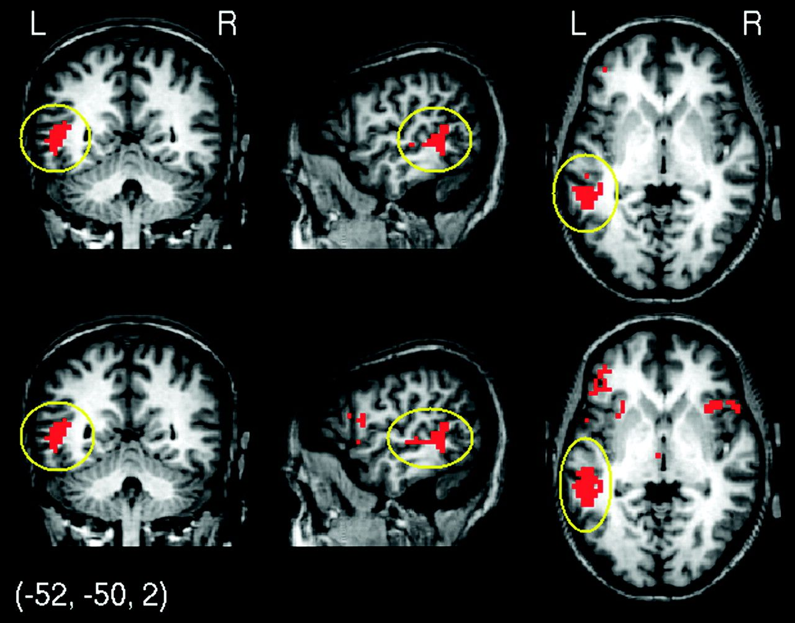
Figure 4. Difference between FDR-corrected conjunction map and FDR-corrected correlation map of the nonlanguage ...
Notes:
Figure 4. Difference between FDR-corrected conjunction map and FDR-corrected correlation map of the nonlanguage experiments 5 (top) and 6 (bottom) with the seed region in BA44 (see Table 3). Only regions where the conjunction of the language studies was significant but the nonlanguage correlation maps were not significant are shown. Note that there is a marked difference in the left STS between the language studies and the 2 nonlanguage studies.
Unless provided in the caption above, the following copyright applies to the content of this slide: © The Author 2009. Published by Oxford University Press. All rights reserved. For permissions, please e-mail: journals.permissions@oxfordjournals.org

Slide 5
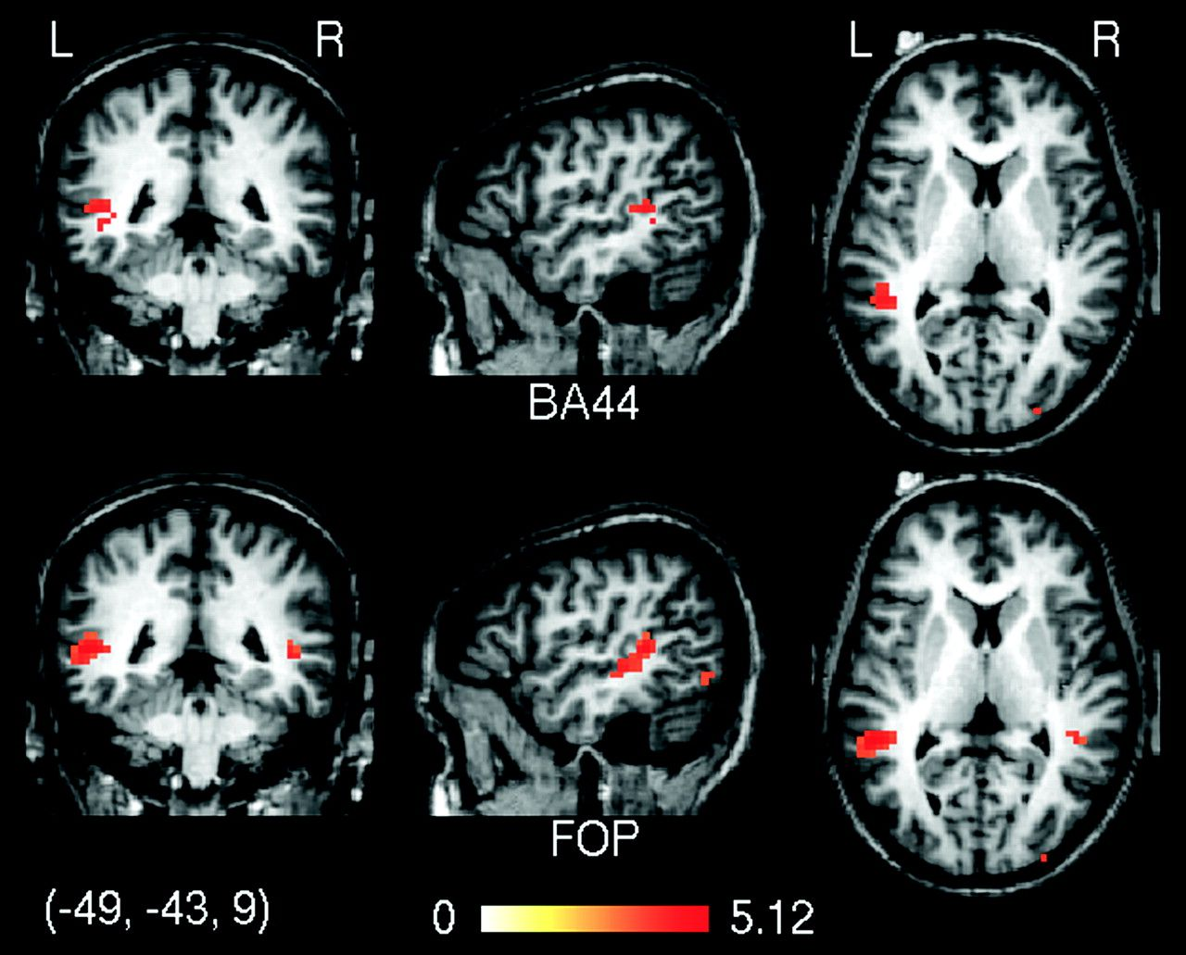
Figure 5. A second-level statistical map contrasting language versus nonlanguage experiments thresholded at P < 0.05 ...
Notes:
Figure 5. A second-level statistical map contrasting language versus nonlanguage experiments thresholded at P < 0.05 (FDR-corrected).
Unless provided in the caption above, the following copyright applies to the content of this slide: © The Author 2009. Published by Oxford University Press. All rights reserved. For permissions, please e-mail: journals.permissions@oxfordjournals.org

Slide 6
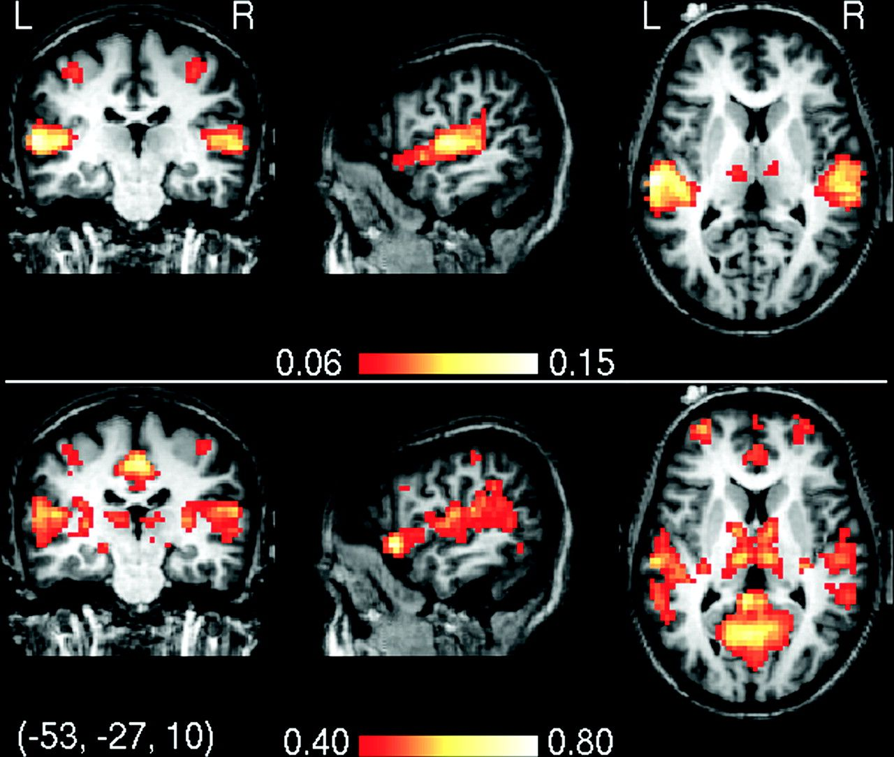
Figure 6. Percentage r² of variance explained by the regression model in experiment 3. The top image shows ...
Notes:
Figure 6. Percentage r2 of variance explained by the regression model in experiment 3. The top image shows r2 based on a regression that only contained hemodynamic models of the stimulus onsets. Note that r2 is less than 0.15 in the entire brain. The largest values are located in the auditory cortex (experiment 3 used an auditory stimulation). The bottom image shows r2 where the regression model additionally included a global covariate. Note that inclusion of the global covariate leads to a dramatic increase of r2. For ease of presentation, r2 is thresholded at 0.40.
Unless provided in the caption above, the following copyright applies to the content of this slide: © The Author 2009. Published by Oxford University Press. All rights reserved. For permissions, please e-mail: journals.permissions@oxfordjournals.org

Slide 7
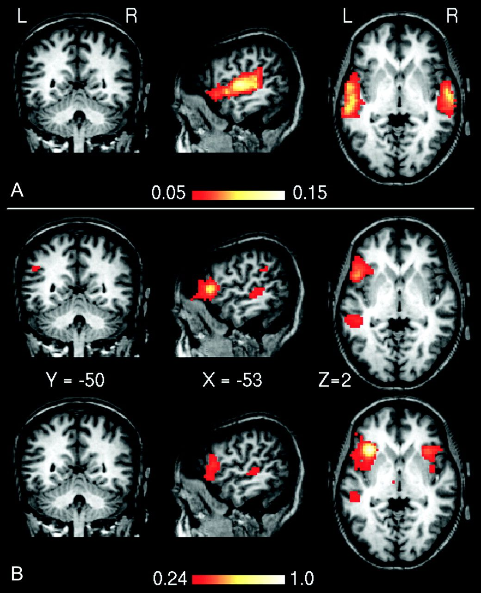
Figure 7. Correlation values in experiment 3 between low-pass-filtered residuals with the experimental design (A) and ...
Notes:
Figure 7. Correlation values in experiment 3 between low-pass-filtered residuals with the experimental design (A) and the seed regions (B). Note that correlations with the experimental design are less than 0.07 everywhere, whereas correlations with the seed regions—especially with the posterior portion of the STS/STG—are several times larger (>0.24). Therefore, the experimental design cannot have a significant influence on the correlations shown in image B.
Unless provided in the caption above, the following copyright applies to the content of this slide: © The Author 2009. Published by Oxford University Press. All rights reserved. For permissions, please e-mail: journals.permissions@oxfordjournals.org

