Slide 1
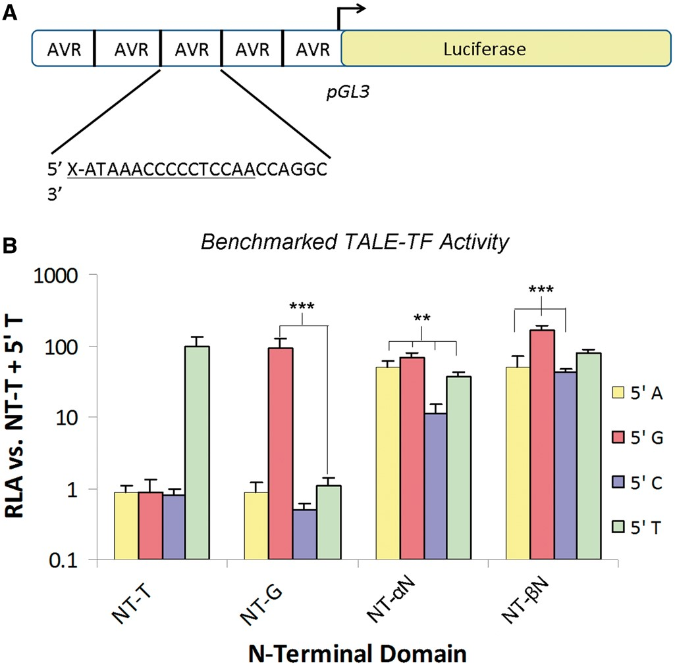
Figure 3. Analysis of selected NTDs in the context of TALE-TFs. (A) Illustration of 5xAvr promoter region on the ...
Notes:
Figure 3. Analysis of selected NTDs in the context of TALE-TFs. (A) Illustration of 5xAvr promoter region on the luciferase reporter plasmid used for transcription activation experiments. (B) Relative luciferase activation of substrates with indicated 5′ residues by TALE-TFs with NT-T, NT-G, NT-αN and NT-βN domains. (* = P < 0.05, ** = P < 0.01, *** = P < 0.001, compared with NT-T and respective 5′ A/G/C/T).
Unless provided in the caption above, the following copyright applies to the content of this slide: © The Author(s) 2013. Published by Oxford University Press.This is an Open Access article distributed under the terms of the Creative Commons Attribution Non-Commercial License (http://creativecommons.org/licenses/by-nc/3.0/), which permits non-commercial re-use, distribution, and reproduction in any medium, provided the original work is properly cited. For commercial re-use, please contact journals.permissions@oup.com

Slide 2
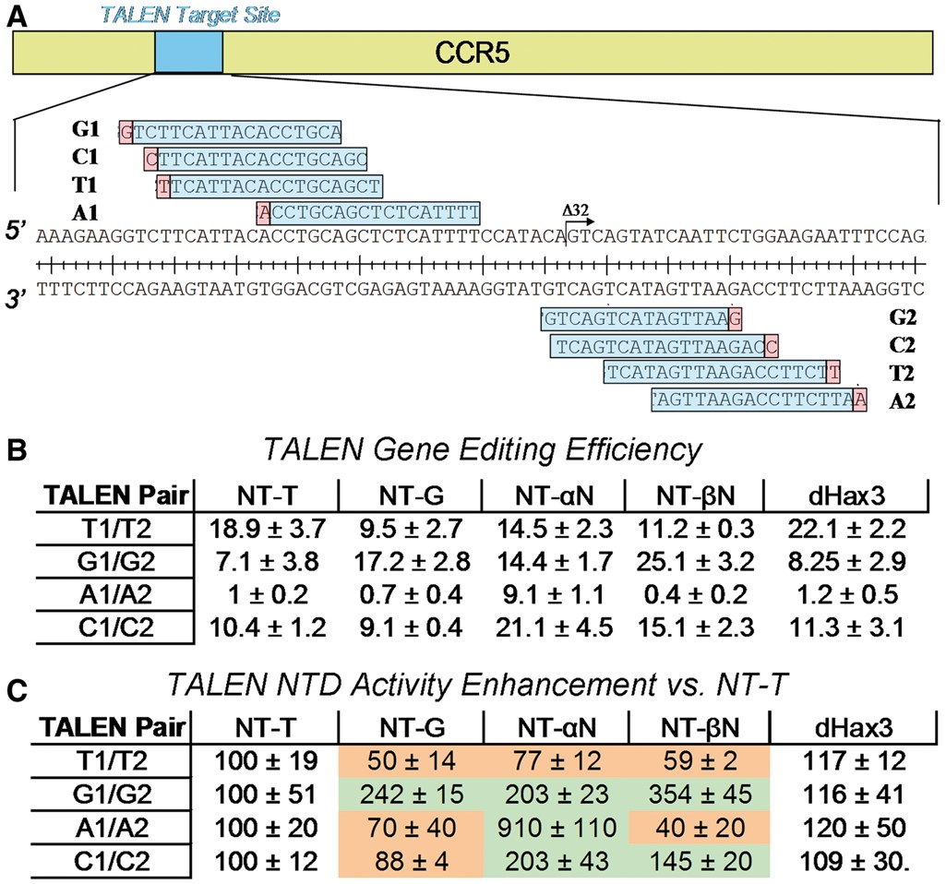
Figure 4. Design and activity of TALEN pairs with wild-type and evolved NTD’s with varying 5′ bases. (A) The CCR5 gene ...
Notes:
Figure 4. Design and activity of TALEN pairs with wild-type and evolved NTD’s with varying 5′ bases. (A) The CCR5 gene expanded to highlight the target site for induction of the Δ32 mutation. (B) Gene editing efficiency of the wild-type (NT-T) TALEN, TALENs with domains optimized for non-T 5′ residues, and dHax3 NTD. (C) Fold enhancement of the TALEN pairs with optimized NTD versus TALENs with 5′ T specificity. The activity of each NTD is shown on each TALEN pair substrate.
Unless provided in the caption above, the following copyright applies to the content of this slide: © The Author(s) 2013. Published by Oxford University Press.This is an Open Access article distributed under the terms of the Creative Commons Attribution Non-Commercial License (http://creativecommons.org/licenses/by-nc/3.0/), which permits non-commercial re-use, distribution, and reproduction in any medium, provided the original work is properly cited. For commercial re-use, please contact journals.permissions@oup.com

Slide 3
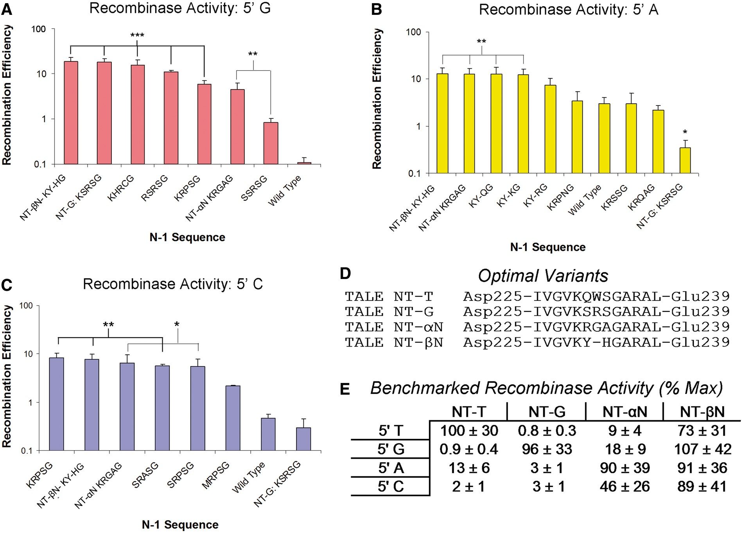
Figure 2. (A–C) Activities of recombinase selection variants against substrates with (A) 5′ G, (B) 5′ A and (C) 5′ C. ...
Notes:
Figure 2. (A–C) Activities of recombinase selection variants against substrates with (A) 5′ G, (B) 5′ A and (C) 5′ C. (D) Alignment of optimized TALE NTDs, illustrating sequence differences in the N-1 hairpin. (E) Comprehensive comparison of optimized NTD activities in the context of MBP-TALE AvrXa7. (* = P < 0.05, ** = P < 0.01, *** = P < 0.001, compared with wild-type and 5′ A/G/C).
Unless provided in the caption above, the following copyright applies to the content of this slide: © The Author(s) 2013. Published by Oxford University Press.This is an Open Access article distributed under the terms of the Creative Commons Attribution Non-Commercial License (http://creativecommons.org/licenses/by-nc/3.0/), which permits non-commercial re-use, distribution, and reproduction in any medium, provided the original work is properly cited. For commercial re-use, please contact journals.permissions@oup.com

Slide 4
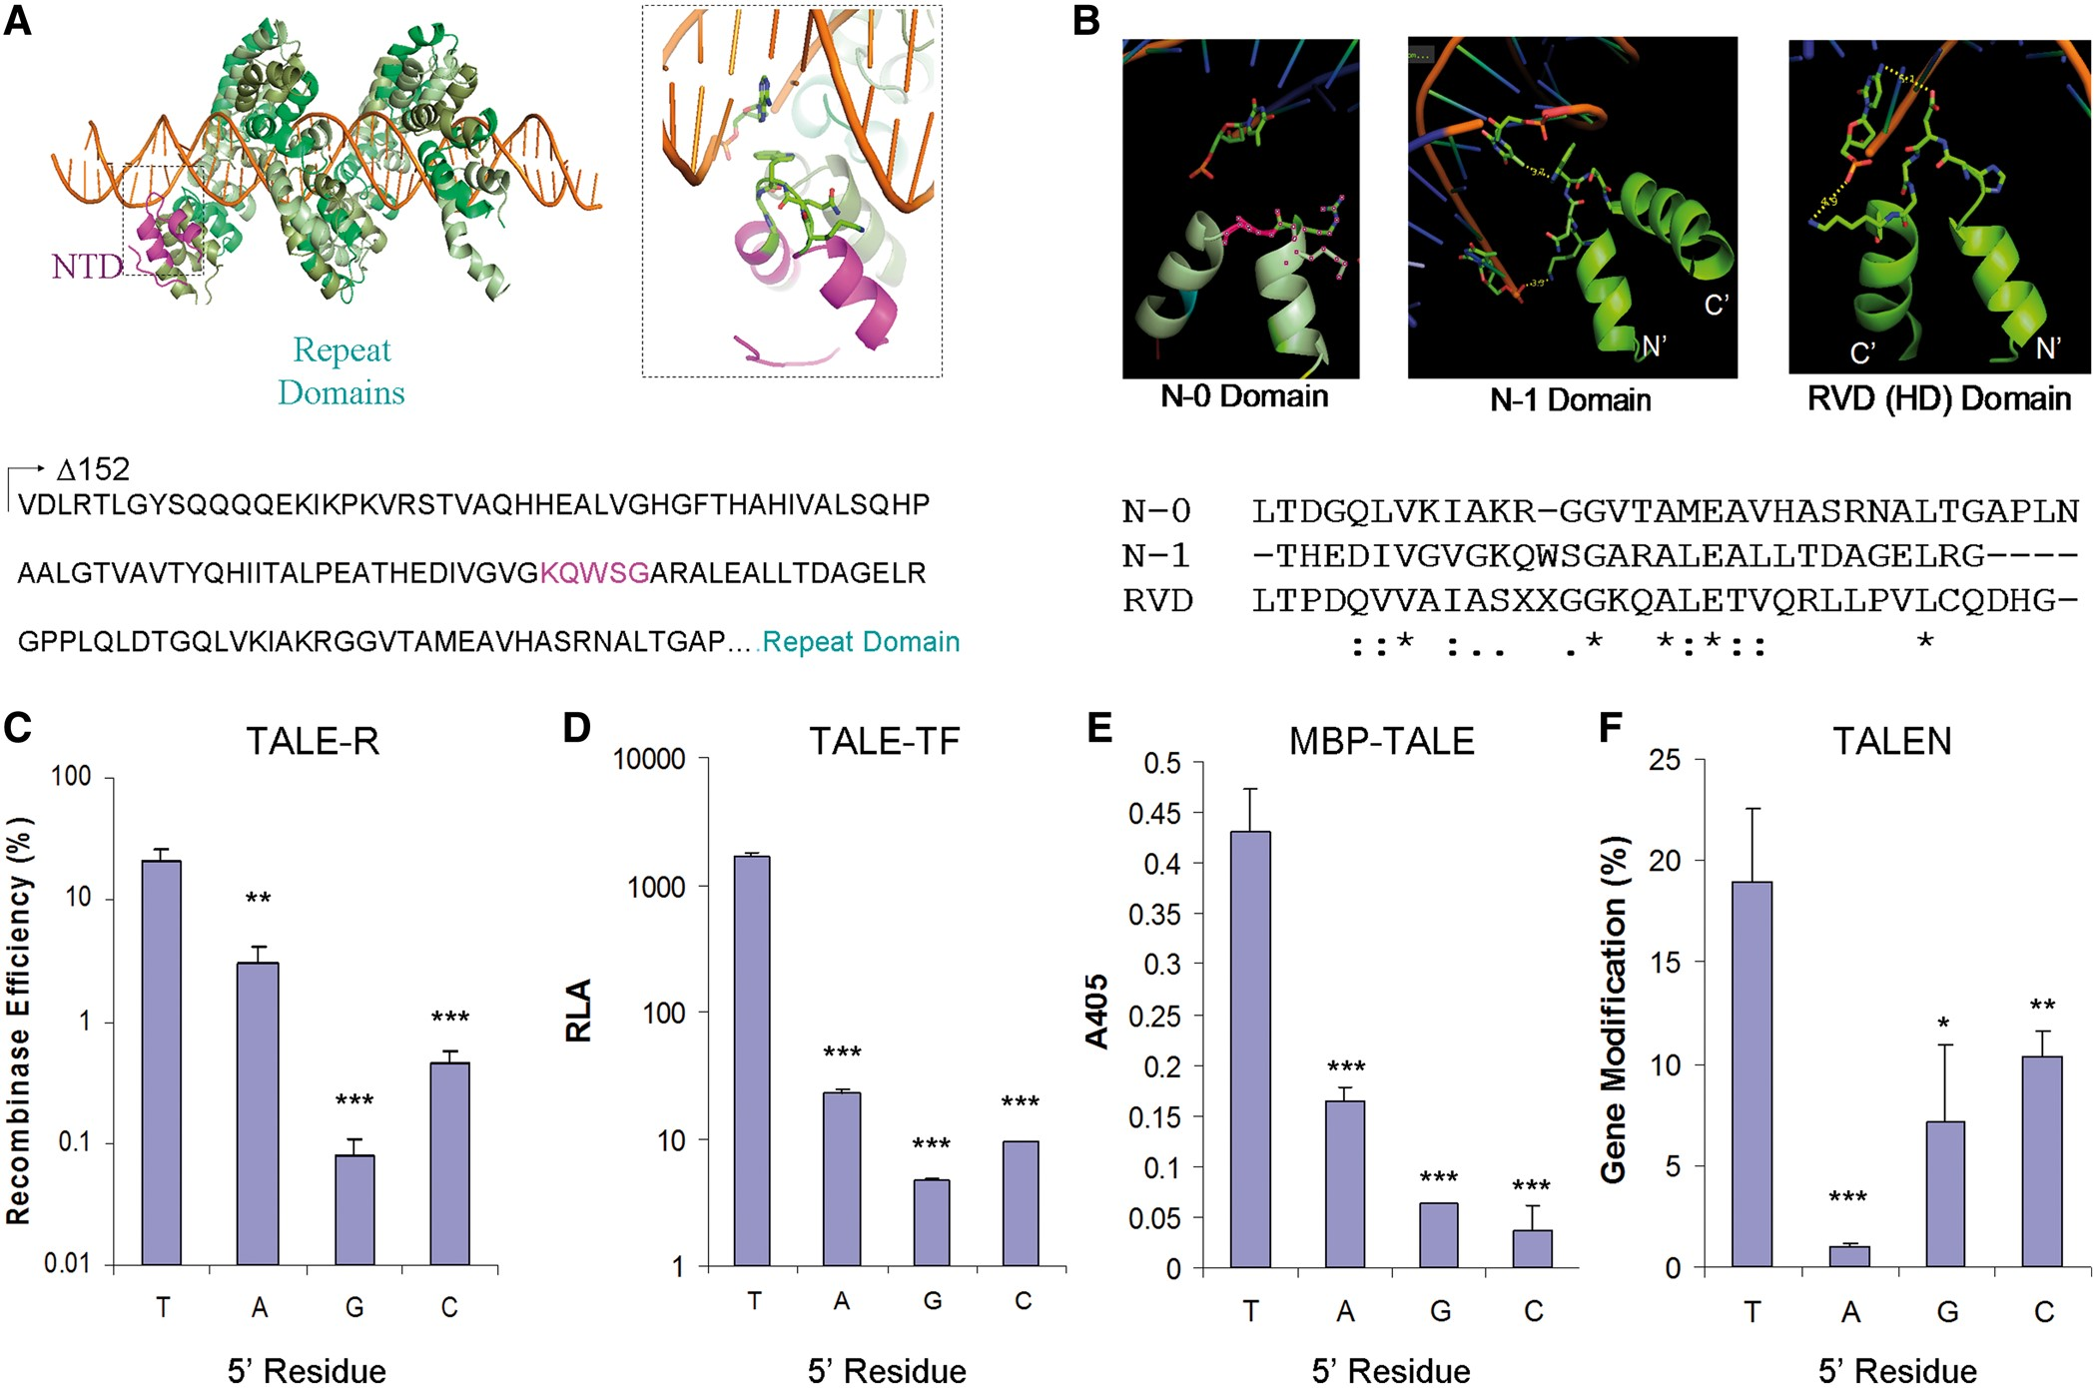
Figure 1. The specificity of the TALE NTD. (A) Illustration of a TALE bound to its target DNA (green, RVD domain; ...
Notes:
Figure 1. The specificity of the TALE NTD. (A) Illustration of a TALE bound to its target DNA (green, RVD domain; magenta, N-1 hairpin domain). (B) Structural analysis suggests contact of the 5′ T by W232 of the N-1 hairpin. This hairpin shares significant sequence homology with RVD hairpins. (C–F) Analyses of NT-T (wt) NTD in the context of (C) AvrXa7 TALE-R, (D) AvrXa7 TALE-TF, (E) AvrXa7 MBP-TALE and (F) a CCR5 targeting TALEN. (* = P < 0.05, ** = P < 0.01, *** = P < 0.001 compared with 5′ T).
Unless provided in the caption above, the following copyright applies to the content of this slide: © The Author(s) 2013. Published by Oxford University Press.This is an Open Access article distributed under the terms of the Creative Commons Attribution Non-Commercial License (http://creativecommons.org/licenses/by-nc/3.0/), which permits non-commercial re-use, distribution, and reproduction in any medium, provided the original work is properly cited. For commercial re-use, please contact journals.permissions@oup.com

