Slide 1
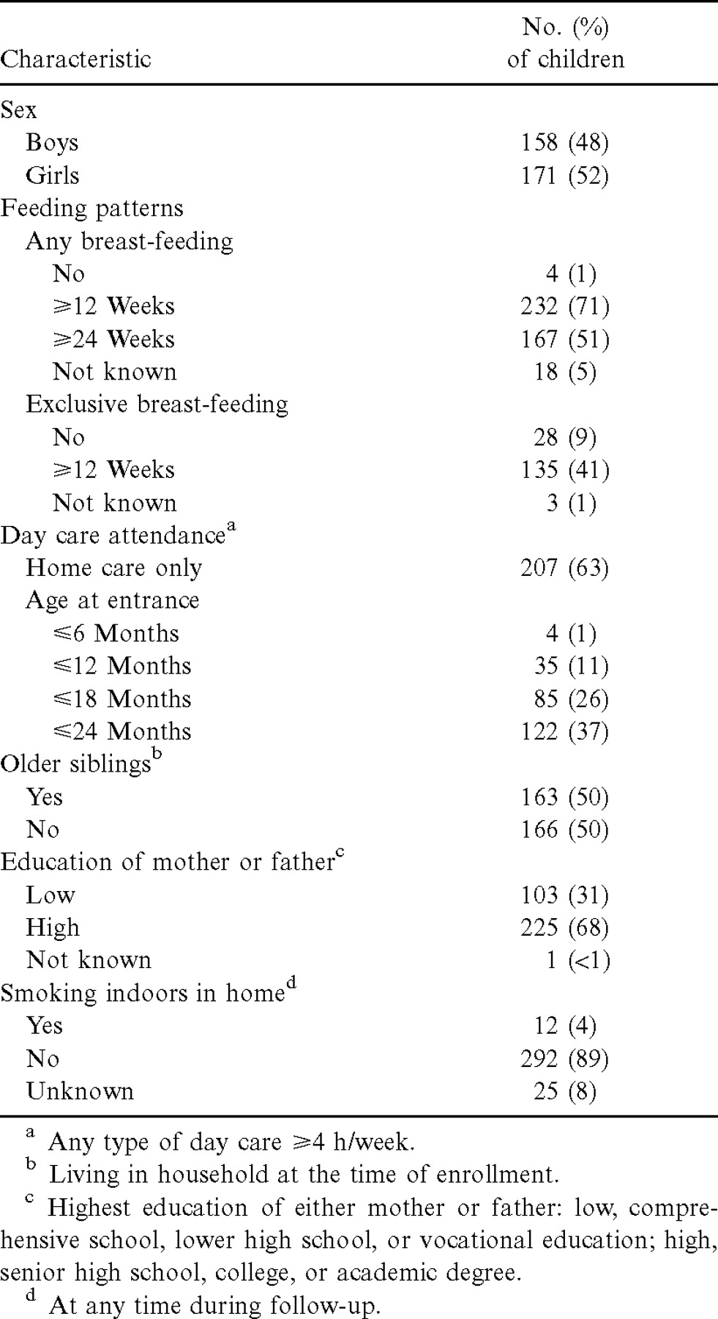
Table 1 Characteristics of the 329 study children
Notes:
Table 1 Characteristics of the 329 study children
Unless provided in the caption above, the following copyright applies to the content of this slide: © 2001 by the Infectious Diseases Society of America

Slide 2
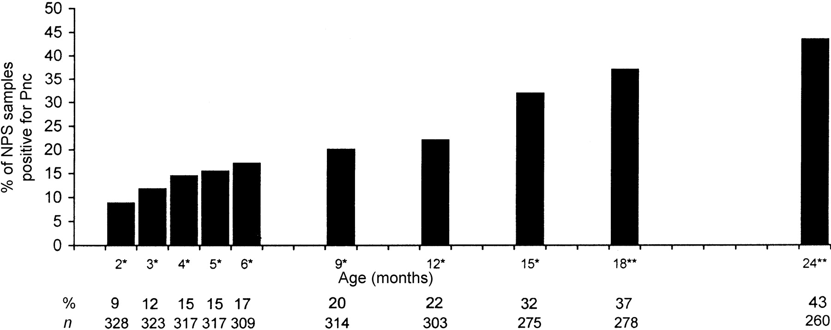
Figure 1 Age-specific prevalence of Streptococcus pneumoniae (Pnc) carriage in 329 children, detected in cultures of ...
Notes:
Figure 1 Age-specific prevalence of Streptococcus pneumoniae (Pnc) carriage in 329 children, detected in cultures of 3024 nasopharyngeal swab (NPS) samples obtained during 10 scheduled healthy visits at ages 2–6, 9, 12, and 15 months and at ages 18 and 24 months *±2 Weeks; **±4 weeks
Unless provided in the caption above, the following copyright applies to the content of this slide: © 2001 by the Infectious Diseases Society of America

Slide 3
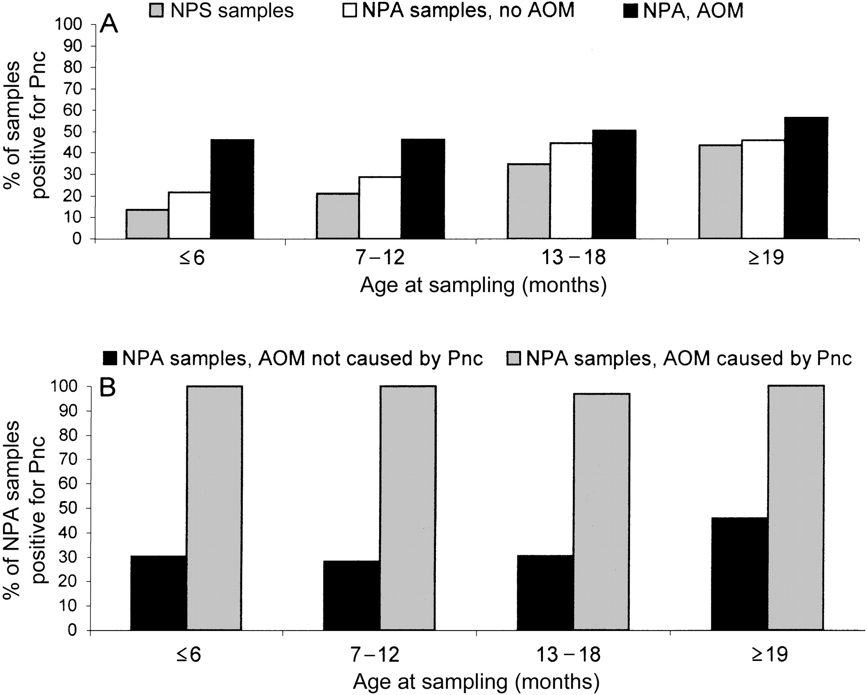
Figure 2 Proportions of 5031 nasopharyngeal (NP) cultures positive for Streptococcus pneumoniae (Pnc) during health or ...
Notes:
Figure 2 Proportions of 5031 nasopharyngeal (NP) cultures positive for Streptococcus pneumoniae (Pnc) during health or respiratory infection with or without acute otitis media (AOM). Samples were obtained during 4 age intervals from children followed from ages 2 to 24 months. A NP swab (NPS) samples obtained during scheduled healthy visits (n=3024, gray bars) and NP aspirates (NPA) obtained during respiratory infections without (n=1158, white bars) or with (n=849, black bars) concurrent AOM. B NPA samples obtained during concurrent AOM without (n=562, black bars) or with (n=199, gray bars) pneumococcal etiology
Unless provided in the caption above, the following copyright applies to the content of this slide: © 2001 by the Infectious Diseases Society of America

Slide 4
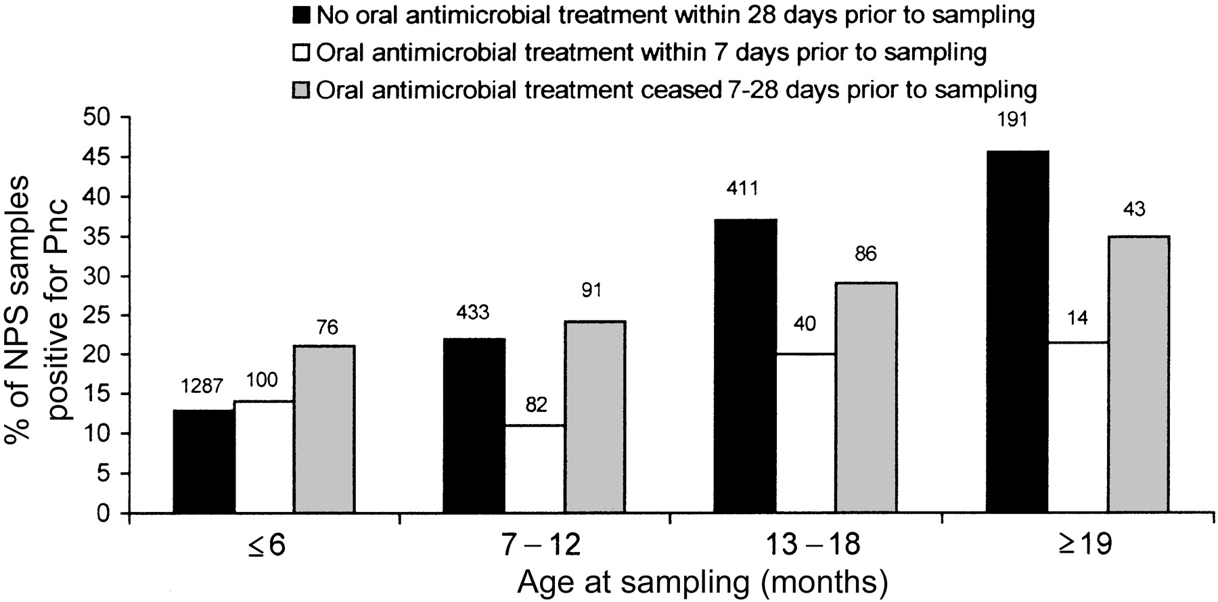
Figure 3 Nasopharyngeal (NP) carriage of Streptococcus pneumoniae (Pnc) in relation to oral antimicrobial medication ...
Notes:
Figure 3 Nasopharyngeal (NP) carriage of Streptococcus pneumoniae (Pnc) in relation to oral antimicrobial medication within 28 days before sampling. NP swab (NPS) samples obtained at 2854 scheduled healthy visits during 4 age intervals: ⩽6 months; 7–12 months; 13–18 months; and ⩾19 months (±4 weeks). Results are shown by antibiotic usage before sampling. Total nos. of samples are shown above the bars
Unless provided in the caption above, the following copyright applies to the content of this slide: © 2001 by the Infectious Diseases Society of America

Slide 5
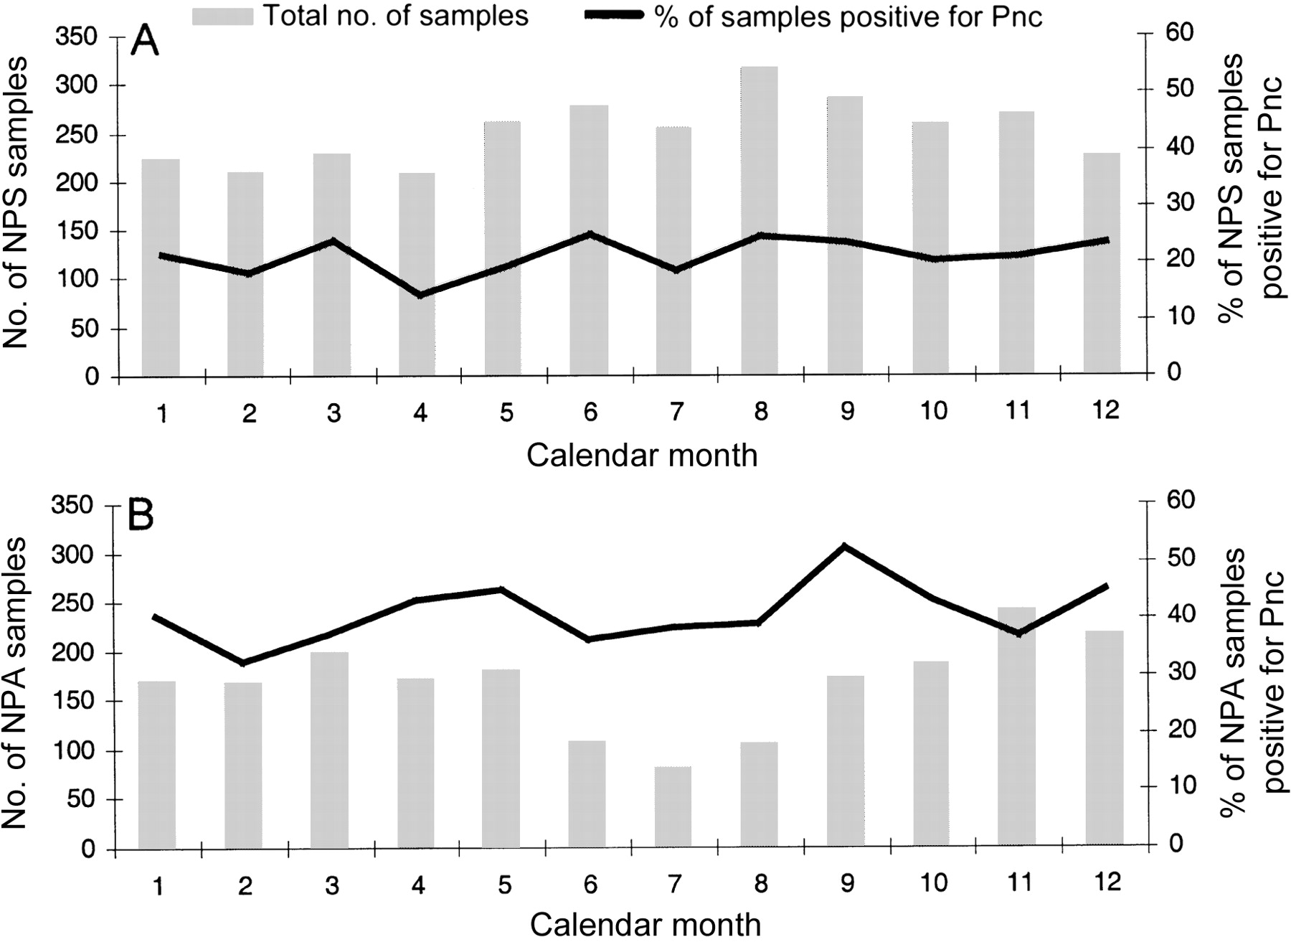
Figure 4 Proportion of nasopharyngeal (NP) samples positive for Streptococcus pneumoniae (Pnc) by calendar month, ...
Notes:
Figure 4 Proportion of nasopharyngeal (NP) samples positive for Streptococcus pneumoniae (Pnc) by calendar month, January–December (1–12, respectively). A NP swab (NPS) samples obtained during health. B NP aspirate (NPA) samples obtained during respiratory infection. Bars Total samples; lines percentage of samples positive for S. pneumoniae
Unless provided in the caption above, the following copyright applies to the content of this slide: © 2001 by the Infectious Diseases Society of America

Slide 6
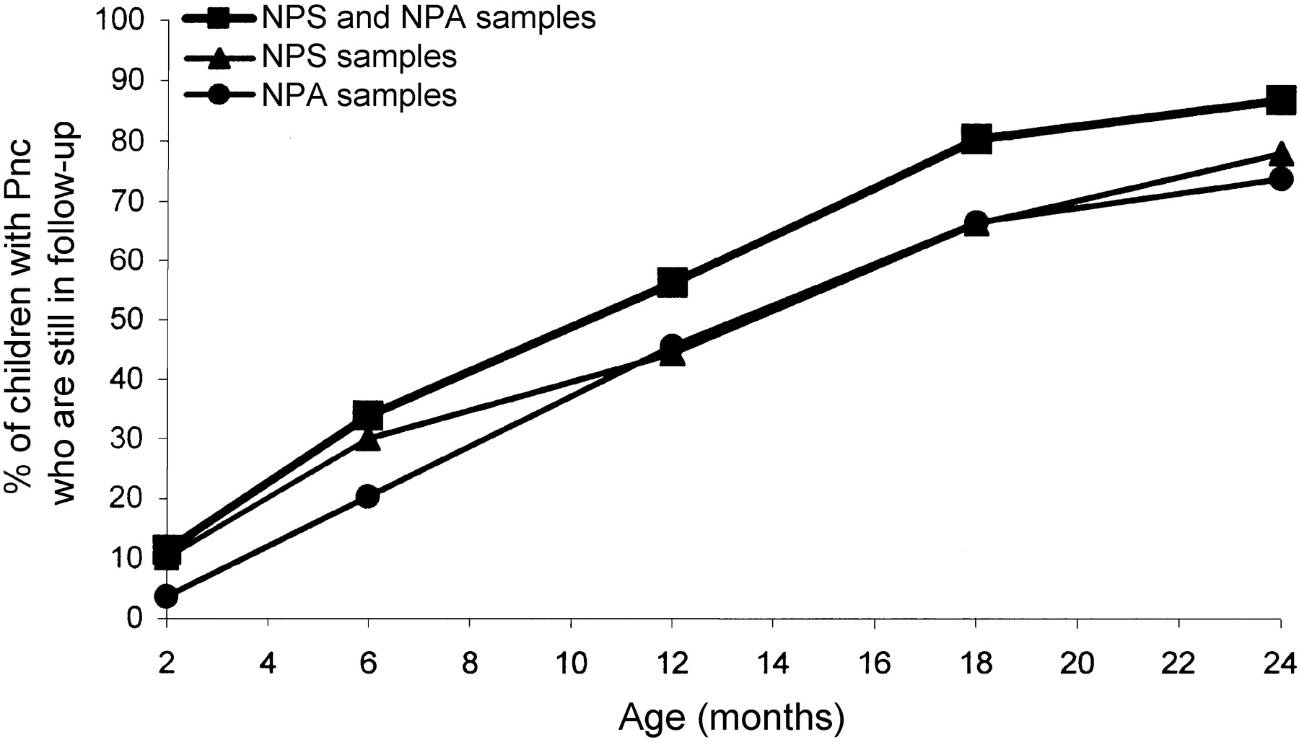
Figure 5 Cumulative rates of first acquisition of Streptococcus pneumoniae (Pnc) of children still in follow-up by ...
Notes:
Figure 5 Cumulative rates of first acquisition of Streptococcus pneumoniae (Pnc) of children still in follow-up by age. Nasopharyngeal (NP) swab (NPS) samples were obtained at scheduled healthy visits at 2–6, 9, 12, and 15 months (±2 weeks) and at 18 and 24 months (±4 weeks); second NP aspirate (NPA) samples were obtained at sick visits during respiratory infections with or without acute otitis media
Unless provided in the caption above, the following copyright applies to the content of this slide: © 2001 by the Infectious Diseases Society of America

Slide 7
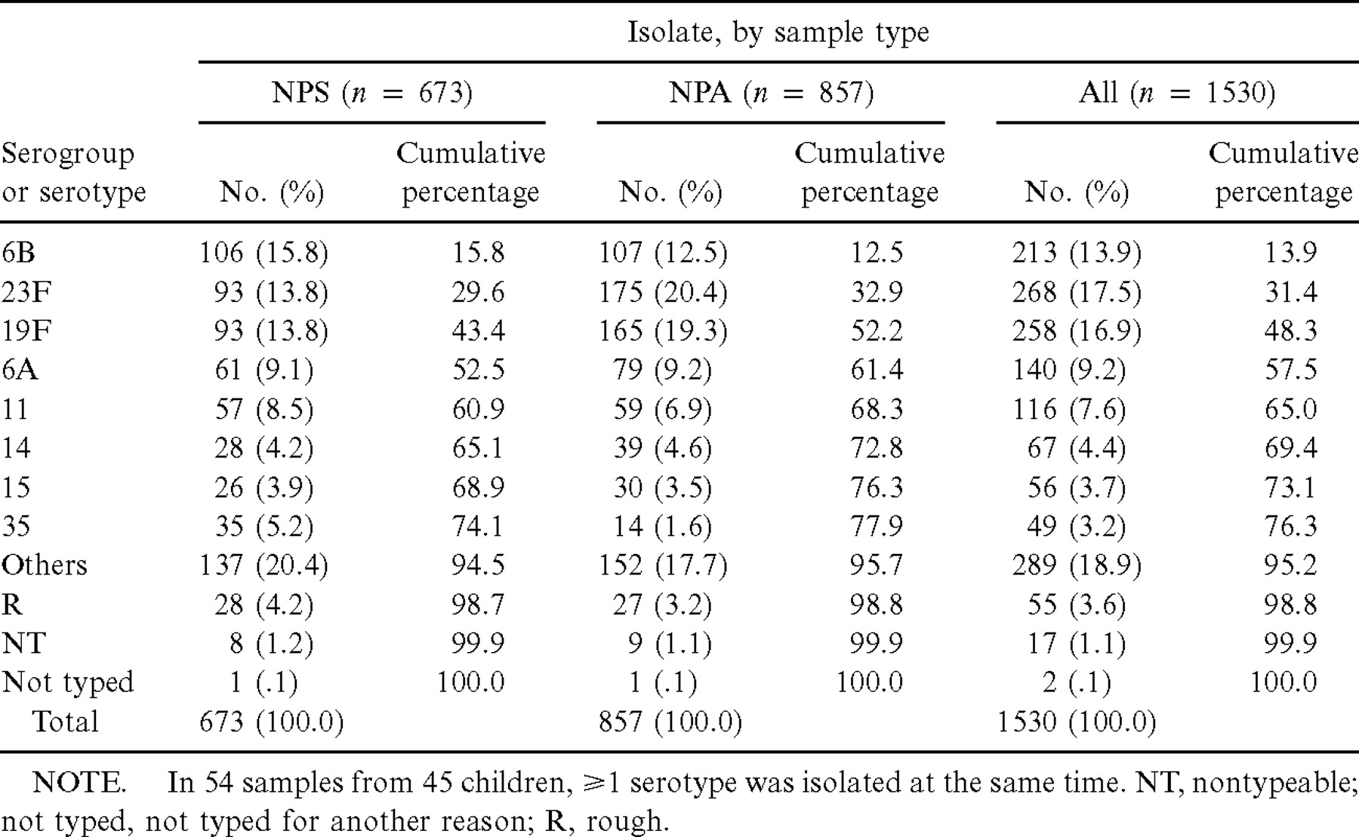
Table 2 Distribution of Streptococcus pneumoniae serogroups or serotypes in 1475 nasopharyngeal (NP) samples obtained ...
Notes:
Table 2 Distribution of Streptococcus pneumoniae serogroups or serotypes in 1475 nasopharyngeal (NP) samples obtained from 267 children during health (NP swab [NPS]) and during respiratory infection (NP aspirate [NPA]) with or without acute otitis media
Unless provided in the caption above, the following copyright applies to the content of this slide: © 2001 by the Infectious Diseases Society of America

