Slide 1
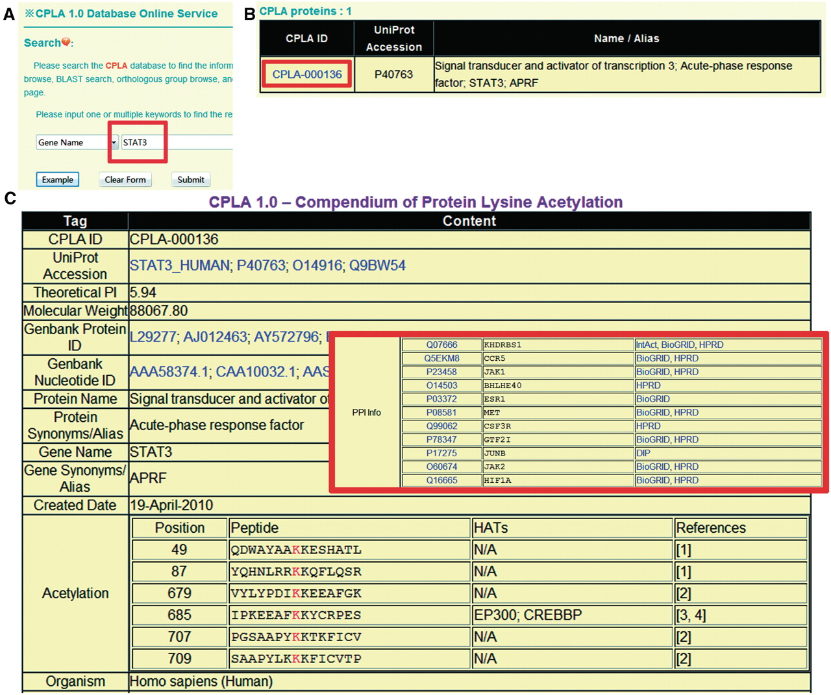
Figure 1. The search option of CPLA 1.0 database. ( A ) Users could simply input ‘STAT3’ for querying. ( B ) The ...
Notes:
Figure 1. The search option of CPLA 1.0 database. ( A ) Users could simply input ‘STAT3’ for querying. ( B ) The results will be shown in a tabular format. Users could click on the CPLA ID (CPLA-000025) to visualize the detailed information. ( C ) The detailed information of human STAT3. The PPI information was also presented.
Unless provided in the caption above, the following copyright applies to the content of this slide: © The Author(s) 2010. Published by Oxford University Press.This is an Open Access article distributed under the terms of the Creative Commons Attribution Non-Commercial License (http://creativecommons.org/licenses/by-nc/2.5), which permits unrestricted non-commercial use, distribution, and reproduction in any medium, provided the original work is properly cited.

Slide 2
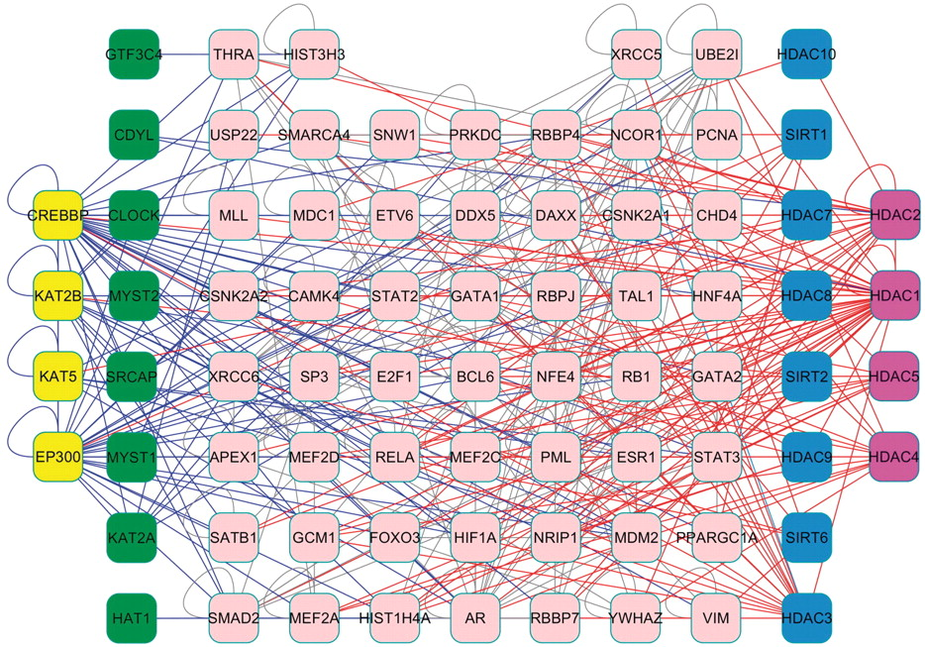
Figure 2. A core HLAN identified from experimentally identified PPI data. The HATs, substrates, and HDACs form a dense ...
Notes:
Figure 2. A core HLAN identified from experimentally identified PPI data. The HATs, substrates, and HDACs form a dense network. Green node: HAT; Blue node: HDAC; yellow node: HAT that is acetylated; purple node: HDAC that is acetylated; pink node: substrate.
Unless provided in the caption above, the following copyright applies to the content of this slide: © The Author(s) 2010. Published by Oxford University Press.This is an Open Access article distributed under the terms of the Creative Commons Attribution Non-Commercial License (http://creativecommons.org/licenses/by-nc/2.5), which permits unrestricted non-commercial use, distribution, and reproduction in any medium, provided the original work is properly cited.

