Slide 1
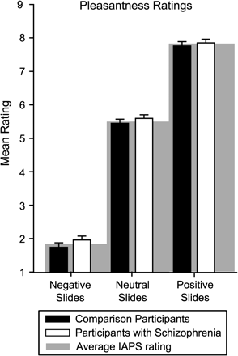
Fig. 1. Average Pleasantness Ratings of Affectively Valenced International Affective Picture System (IAPS) Stimuli. ...
Notes:
Fig. 1. Average Pleasantness Ratings of Affectively Valenced International Affective Picture System (IAPS) Stimuli. There were no group differences for any slide valence category (P = .14). Participants’ ratings did not differ from the average IAPS rating (gray-shaded regions; P‘s > .26).
Unless provided in the caption above, the following copyright applies to the content of this slide: © The Author 2008. Published by Oxford University Press on behalf of the Maryland Psychiatric Research Center. All rights reserved. For permissions, please email: journals.permissions@oxfordjournals.org.

Slide 2
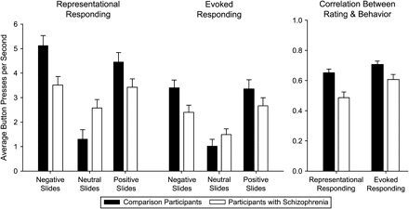
Fig. 2. Speeded Button Pressing for Negative, Neutral, and Positive IAPS Stimuli. In the representational responding ...
Notes:
Fig. 2. Speeded Button Pressing for Negative, Neutral, and Positive IAPS Stimuli. In the representational responding condition, participants pressed to indicate whether they did or did not wish to see each slide again later. In this condition, stimuli were not visible during responding. In the evoked responding condition, participants pressed to increase or decrease viewing time while slides were on the screen. We also show the average correlation between each participant's rating and button-pressing behavior across conditions. Participants with schizophrenia had more difficulty calibrating their responses to stimulus valence than did healthy participants (P = .001), particularly in the representational responding condition (P = .02).
Unless provided in the caption above, the following copyright applies to the content of this slide: © The Author 2008. Published by Oxford University Press on behalf of the Maryland Psychiatric Research Center. All rights reserved. For permissions, please email: journals.permissions@oxfordjournals.org.

Slide 3
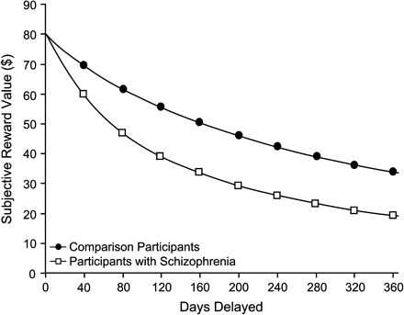
Fig. 3. Decreases in Subjective Reward Value Over Time in Healthy Participants and Participants With Schizophrenia. ...
Notes:
Fig. 3. Decreases in Subjective Reward Value Over Time in Healthy Participants and Participants With Schizophrenia. Participants with schizophrenia showed greater discounting of future rewards than did healthy participants (P = .03).
Unless provided in the caption above, the following copyright applies to the content of this slide: © The Author 2008. Published by Oxford University Press on behalf of the Maryland Psychiatric Research Center. All rights reserved. For permissions, please email: journals.permissions@oxfordjournals.org.

Slide 4
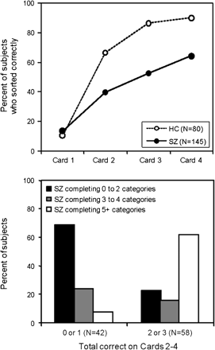
Fig. 4. (a) (Top panel) Accuracy on Cards 1–4 by Subject Group.(b) (Bottom panel) Early accuracy predicts overall ...
Notes:
Fig. 4. (a) (Top panel) Accuracy on Cards 1–4 by Subject Group.(b) (Bottom panel) Early accuracy predicts overall task success. Of the patients with the poorest accuracy on Cards 2–4, 69% were unable to complete more than 2 categories. Of the patients with good accuracy on Cards 2–4, 62% completed 5 or more categories.
Unless provided in the caption above, the following copyright applies to the content of this slide: © The Author 2008. Published by Oxford University Press on behalf of the Maryland Psychiatric Research Center. All rights reserved. For permissions, please email: journals.permissions@oxfordjournals.org.

Slide 5
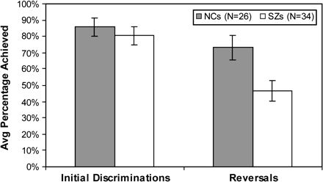
Fig. 5. Performance of schizophrenia (SZ) Patients and Controls on 2 Measures from the Reversal Learning Paradigm ...
Notes:
Fig. 5. Performance of schizophrenia (SZ) Patients and Controls on 2 Measures from the Reversal Learning Paradigm Used by Waltz and Gold.45 Although patients and controls achieved similar numbers of initial discriminations (t(58) = 0.69), patients achieved far fewer reversal than controls on the task (t(58) = 2.70; P = .01).
Unless provided in the caption above, the following copyright applies to the content of this slide: © The Author 2008. Published by Oxford University Press on behalf of the Maryland Psychiatric Research Center. All rights reserved. For permissions, please email: journals.permissions@oxfordjournals.org.

Slide 6
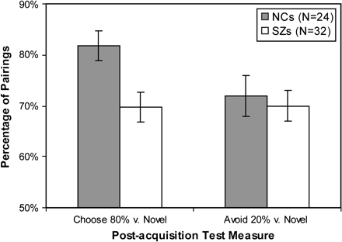
Fig. 6. Performance of schizophrenia (SZ) Patients and Controls on Transfer Measures from the Frank Probabilistic ...
Notes:
Fig. 6. Performance of schizophrenia (SZ) Patients and Controls on Transfer Measures from the Frank Probabilistic Selection Paradigm (Waltz et al61). Patients showed significant impairment, relative to controls, on the measure of procedural Go learning (choosing the best stimulus at test, in all pairings; t(54) = 2.85; P = .01). By contrast, patients and controls performed similarly on the measure of procedural NoGo learning (avoiding the worst stimulus at test, in all pairings; t(54) = 0.40).
Unless provided in the caption above, the following copyright applies to the content of this slide: © The Author 2008. Published by Oxford University Press on behalf of the Maryland Psychiatric Research Center. All rights reserved. For permissions, please email: journals.permissions@oxfordjournals.org.

