Slide 1
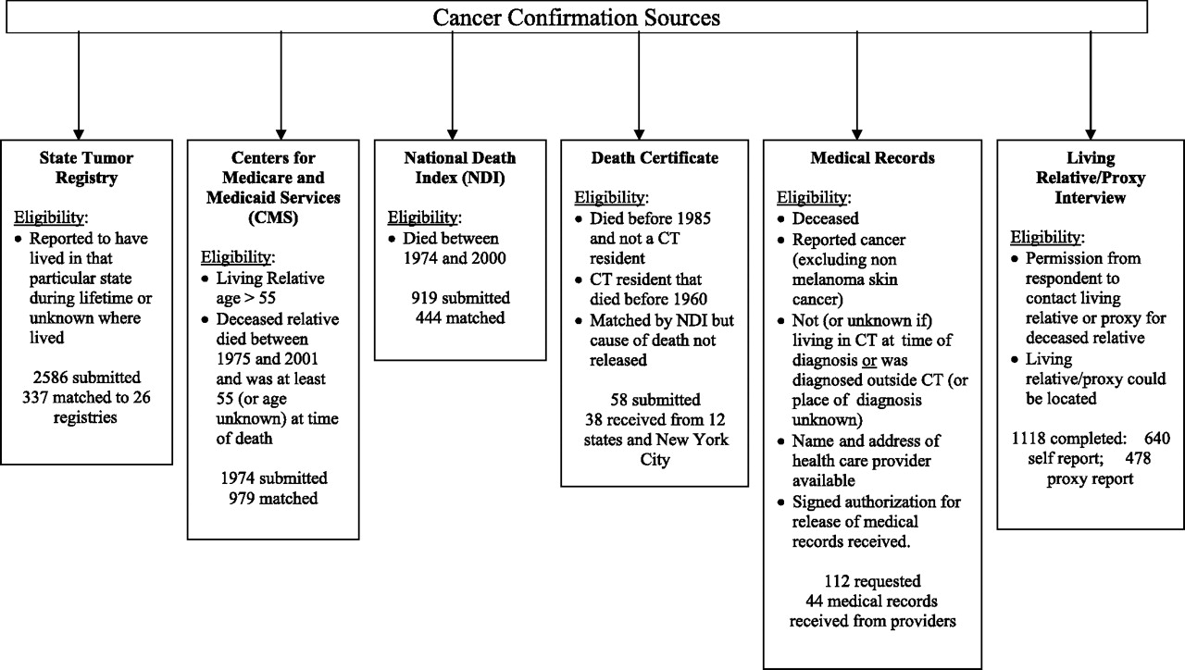
Figure 1 Data sources, with inclusion criteria, used to confirm relatives’ cancer diagnoses as reported by ...
Notes:
Figure 1 Data sources, with inclusion criteria, used to confirm relatives’ cancer diagnoses as reported by respondents. The numbers of records submitted and matched are shown for each source. CT = Connecticut.
Unless provided in the caption above, the following copyright applies to the content of this slide: Published by Oxford University Press 2011.

