Slide 1
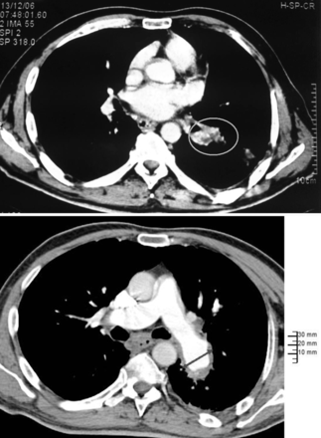
Figure 1: (a) A margined defect (8 mm) in the left lower pulmonary artery on a transversed-enhanced computed tomography ...
Notes:
Figure 1: (a) A margined defect (8 mm) in the left lower pulmonary artery on a transversed-enhanced computed tomography image (initial CT scan). (b) Pseudoaneurysmal dilation of the left pulmonary artery (24 mm) with a circumferential parietal thrombosis on a transverse contrast-enhanced computed tomography image (preoperative CT scan).
Unless provided in the caption above, the following copyright applies to the content of this slide: © The Author 2012. Published by Oxford University Press on behalf of the European Association for Cardio-Thoracic Surgery. All rights reserved.

Slide 2
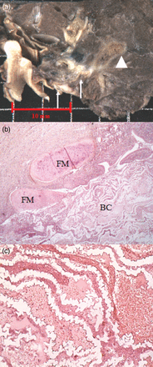
Figure 2: (a) Gross appearance: dilated ruptured left pulmonary artery containing an extensive adherent thrombus (thin ...
Notes:
Figure 2: (a) Gross appearance: dilated ruptured left pulmonary artery containing an extensive adherent thrombus (thin arrow) filling the lower intrapulmonary artery branches. Distal emboli of foreign material (large arrow). (b) Microscopic examination (hemateine eosine safran (HES), ×20): erosion of the bronchial cartilage (BC) by foreign material (FM). Marked inflammatory reaction with peribronchial fibrosis. (c) Microscopic examination (HES, ×40): ribbon-like appearance with a faintly visible meshwork of foreign material (probably dissolved during specimen preparation).
Unless provided in the caption above, the following copyright applies to the content of this slide: © The Author 2012. Published by Oxford University Press on behalf of the European Association for Cardio-Thoracic Surgery. All rights reserved.

