Slide 1
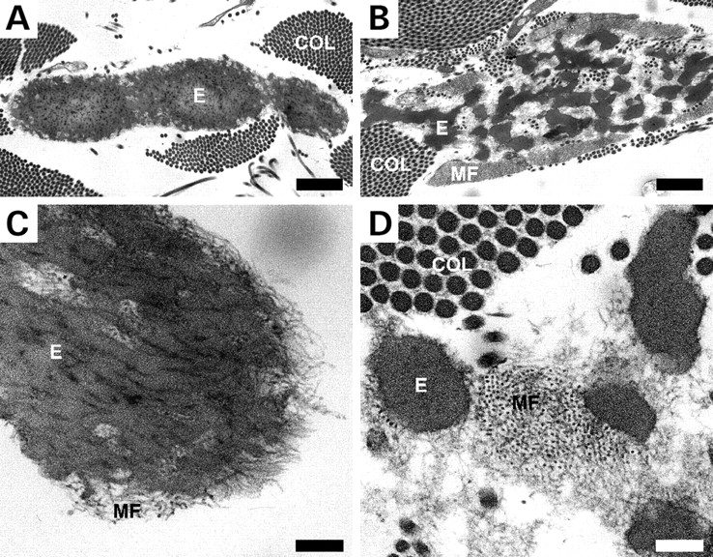
Figure 8. Ultrastructure of dermal elastic fibers. Electron microscopic analysis of the skin from an unaffected ...
Notes:
Figure 8. Ultrastructure of dermal elastic fibers. Electron microscopic analysis of the skin from an unaffected 7-month-old child (A and C) and a cutis laxa patient with the S227P fibulin-5 mutation at the same age (B and D). In normal skin, elastin forms a continuous, solid core of the elastic fiber (A). In contrast, elastic fibers in the dermis of the cutis laxa patient consist of globules of elastin (E) with adjacent bundles of microfibrils (MF) (B). At higher magnification, the integration of elastin (E) and MF in normal elastic fibers can be seen (C), whereas the two components are distinct in the patient (D). Magnification bars: (A and B), 1.0 µm; (C and D), 0.2 µm. COL, collagen.
Unless provided in the caption above, the following copyright applies to the content of this slide: © The Author 2006. Published by Oxford University Press. All rights reserved. For Permissions, please email: journals.permissions@oxfordjournals.org

Slide 2
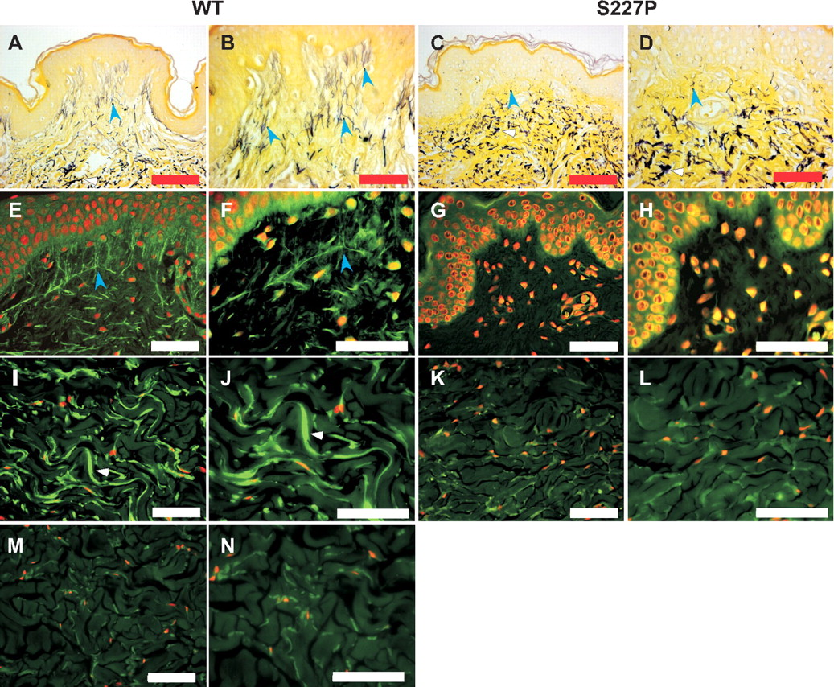
Figure 7. The impact of fibulin-5 mutation S227P on elastic fiber formation in vivo. (A and B) Hart's elastin stain of ...
Notes:
Figure 7. The impact of fibulin-5 mutation S227P on elastic fiber formation in vivo. (A and B) Hart's elastin stain of skin from a healthy donor (WT, 9-month-old) showed robust horizontal elastic fibers (white arrowhead) in the deep dermis and abundant fine vertical tree-like structures in the papillary dermis (blue arrowheads). (C and D) In contrast, skin from a cutis laxa patient (S227P, 6-month-old) had abnormally clumped elastin deposits in the deep dermis (white arrowhead) and greatly diminished elastic fibers in the papillary dermis (blue arrowheads). (E and F) Both papillary and (I and J) deep dermal elastic fibers were positive for fibulin-5 immunostaining (green). Negative control WT skin sections stained with pre-immune serum showed low background in the deep dermis (M and N). Cutis laxa skin showed complete lack of staining in the papillary dermis (G and H) and only background staining in the deep dermis (K and L). Nuclei in images (E–L) were counterstained with propidium iodide (red). Magnification bars: (A and C), 20 µm; (B, D, E, G, I and K), 50 µm; (F, H, J and L), 100 µm.
Unless provided in the caption above, the following copyright applies to the content of this slide: © The Author 2006. Published by Oxford University Press. All rights reserved. For Permissions, please email: journals.permissions@oxfordjournals.org

Slide 3
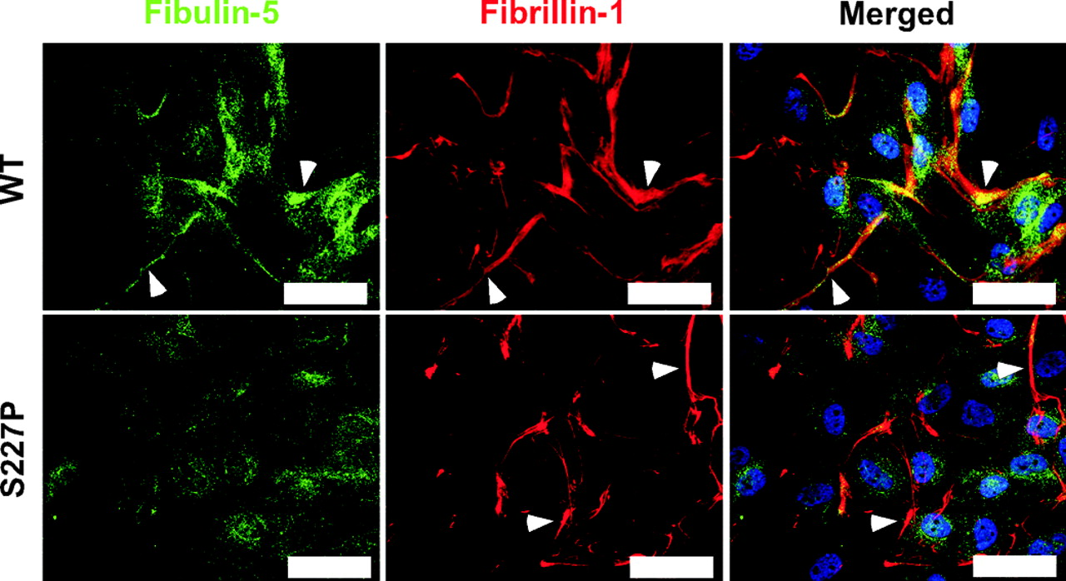
Figure 4. Mutant fibulin-5 fails to interact with fibrillin-1 microfibrils. Fibulin-5 (green) and fibrillin-1 (red) ...
Notes:
Figure 4. Mutant fibulin-5 fails to interact with fibrillin-1 microfibrils. Fibulin-5 (green) and fibrillin-1 (red) showed overlapping distribution in ECM fibrils produced by wild-type cells (WT, arrowheads). In contrast, fibrillin-1 microfibrils made by S227P mutant fibroblasts showed diminished fibulin-5 staining (S227P, arrowheads). Magnification bars: 50 µm.
Unless provided in the caption above, the following copyright applies to the content of this slide: © The Author 2006. Published by Oxford University Press. All rights reserved. For Permissions, please email: journals.permissions@oxfordjournals.org

Slide 4
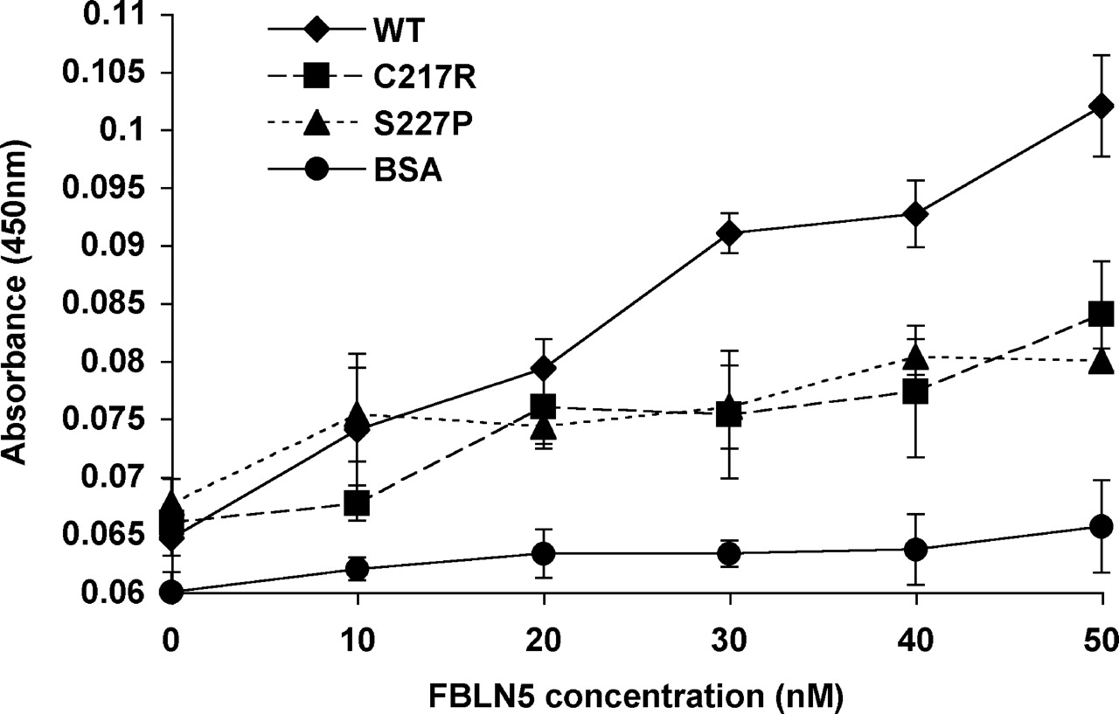
Figure 3. Reduced binding of mutant fibulin-5 to tropoelastin. Solid-phase binding assay using immobilized tropoelastin ...
Notes:
Figure 3. Reduced binding of mutant fibulin-5 to tropoelastin. Solid-phase binding assay using immobilized tropoelastin and purified recombinant wild-type (WT) or mutant (C217R, S227P) fibulin-5 in the solution phase. Wells coated with BSA only were used as negative controls. Significantly reduced binding of tropoelastin by mutant fibulin-5 compared with wild-type was observed at concentrations of 30–50 nm (t-test, P<0.01).
Unless provided in the caption above, the following copyright applies to the content of this slide: © The Author 2006. Published by Oxford University Press. All rights reserved. For Permissions, please email: journals.permissions@oxfordjournals.org

Slide 5
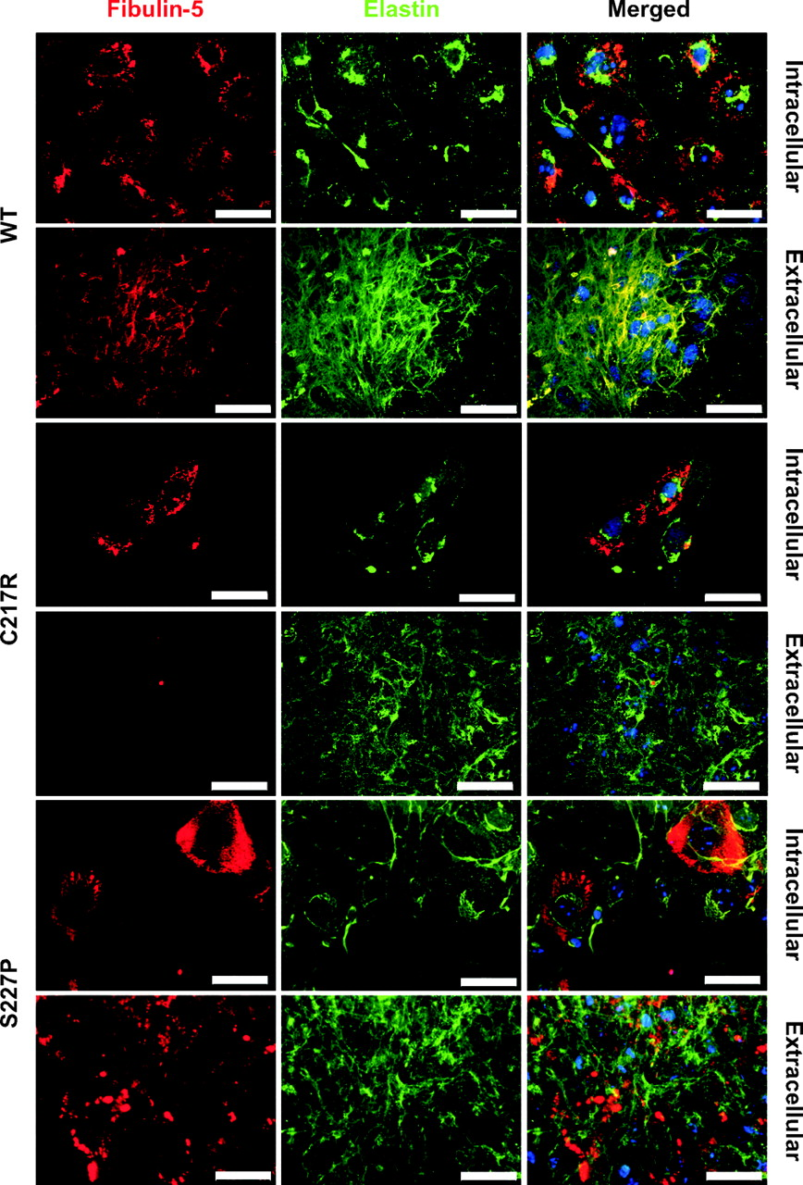
Figure 2. Defective association of mutant fibulin-5 with elastic fibers. RFL-6 cells were transfected to express ...
Notes:
Figure 2. Defective association of mutant fibulin-5 with elastic fibers. RFL-6 cells were transfected to express wild-type (WT) or mutant (C217R, S227P) fibulin-5 with a C-terminal Myc-tag. Anti-Myc mouse monoclonal and anti-elastin rabbit polyclonal primary antibodies were used to investigate co-localization of the fibulin-5 (red) and (tropo)elastin (green) in permeabilized (intracellular) and non-permeabilized (extracellular) cultures. Both wild-type and mutant fibulin-5 were localized to a different subcellular compartment from tropoelastin. Wild-type fibulin-5 showed strong co-localization with elastin in fibrillar structures of the ECM. In contrast, mutant fibulin-5 showed a complete lack of deposition into the ECM (C217R) or formed globular extracellular deposits separate from elastic fibers (S227P). Magnification bars: 50 µm.
Unless provided in the caption above, the following copyright applies to the content of this slide: © The Author 2006. Published by Oxford University Press. All rights reserved. For Permissions, please email: journals.permissions@oxfordjournals.org

Slide 6
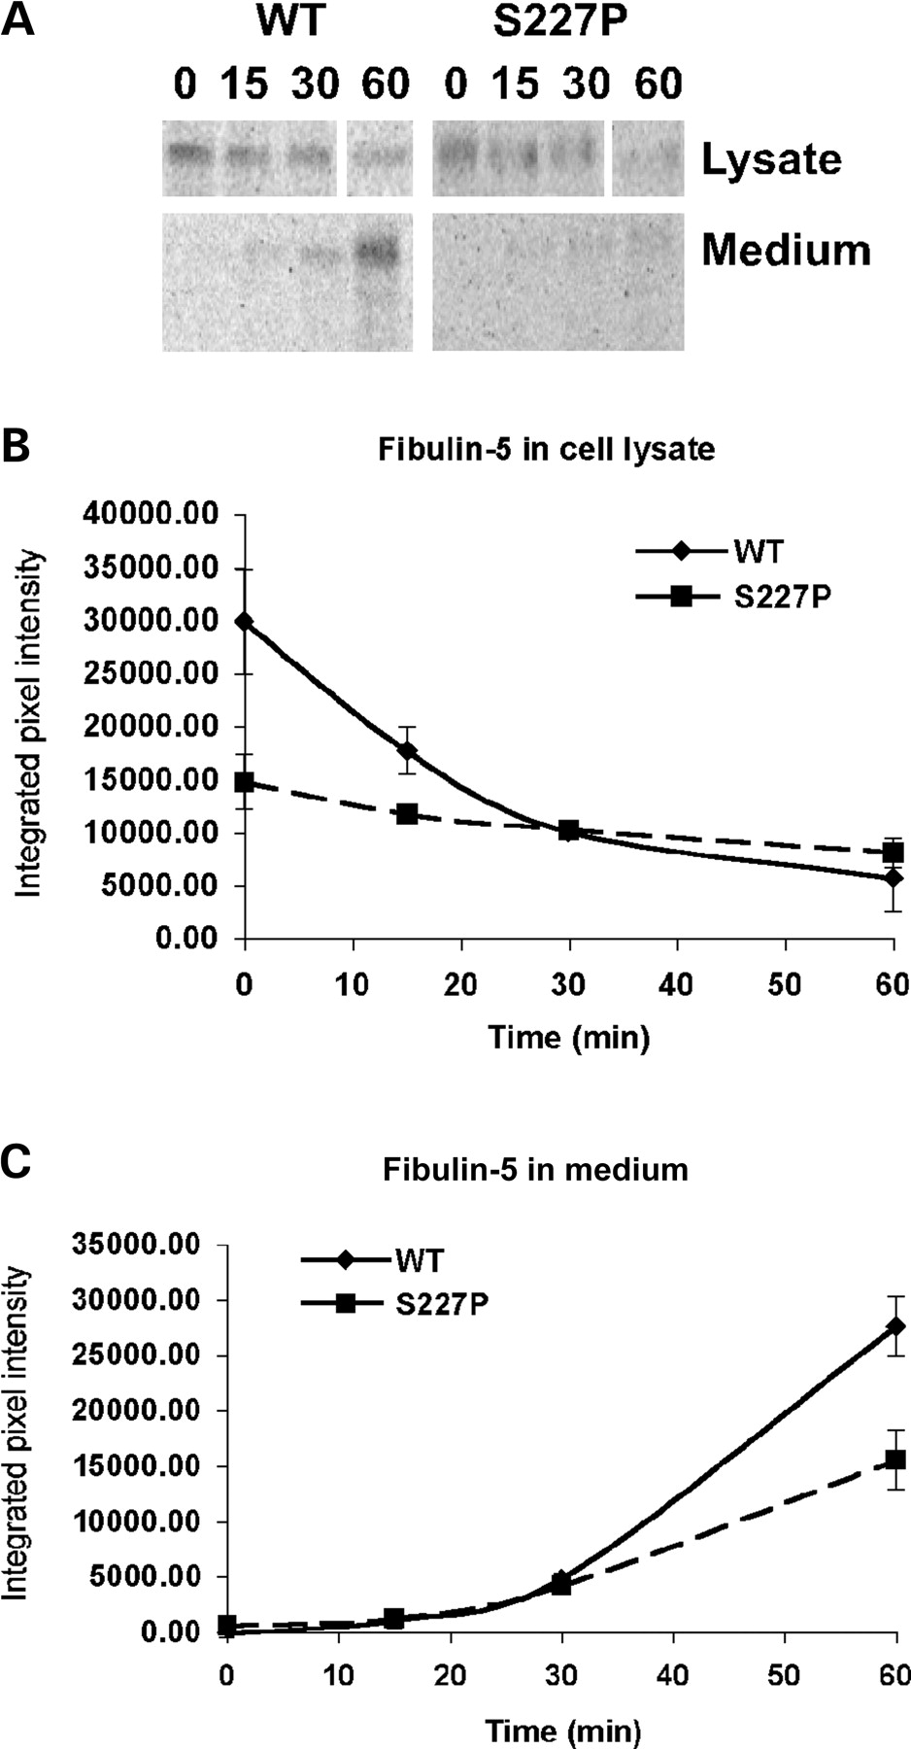
Figure 1. Impaired synthesis and secretion of fibulin-5 in cutis laxa. Skin fibroblasts from a patient with a ...
Notes:
Figure 1. Impaired synthesis and secretion of fibulin-5 in cutis laxa. Skin fibroblasts from a patient with a homozygous mutation in fibulin-5 (S227P) and from a wild-type control (WT) were pulse-labeled for 15 min using 35S-cysteine and then incubated for 0, 15, 30 and 60 min in unlabeled media before immunoprecipitating fibulin-5 from cell lysates and conditioned media. (A) Phosphorimaging of immunoprecipitated fibulin-5 following SDS–PAGE. (B) Quantitative analysis of fibulin-5 in triplicate lysate samples. Mutant samples contained significantly less fibulin-5 than wild-type at 0 min (P<0.01, t-test) and at 15 min (P<0.05). (C) Quantitative analysis of fibulin-5 in triplicate medium samples showed a significantly reduced amount of fibulin-5 in mutant cultures at 60 min (P<0.01, t-test).
Unless provided in the caption above, the following copyright applies to the content of this slide: © The Author 2006. Published by Oxford University Press. All rights reserved. For Permissions, please email: journals.permissions@oxfordjournals.org

Slide 7
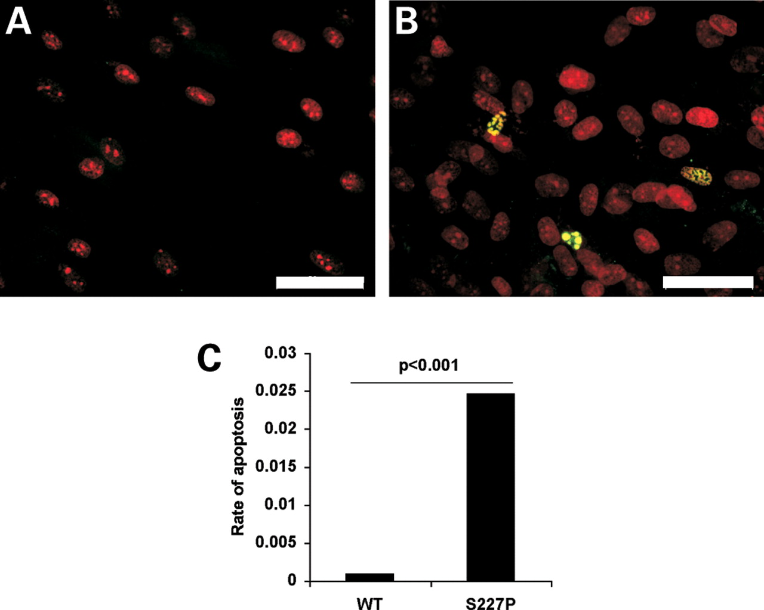
Figure 6. Increased apoptosis in S227P fibroblasts. TUNEL staining (green) was used to detect apoptotic cells. Nuclei ...
Notes:
Figure 6. Increased apoptosis in S227P fibroblasts. TUNEL staining (green) was used to detect apoptotic cells. Nuclei were counterstained with propidium iodide (red). Wild-type cells showed a very low level of apoptosis with most microscopic fields lacking TUNEL-positive nuclei (A). Cutis laxa fibroblasts with the S227P mutation often showed apoptotic cells (B). The rate of apoptosis (C), based on counting of positive and negative nuclei, was significantly increased in cutis laxa fibroblasts (S227P) compared with wild-type (WT). Fisher's exact test was used for statistical analysis. Magnification bars: 50 µm.
Unless provided in the caption above, the following copyright applies to the content of this slide: © The Author 2006. Published by Oxford University Press. All rights reserved. For Permissions, please email: journals.permissions@oxfordjournals.org

Slide 8
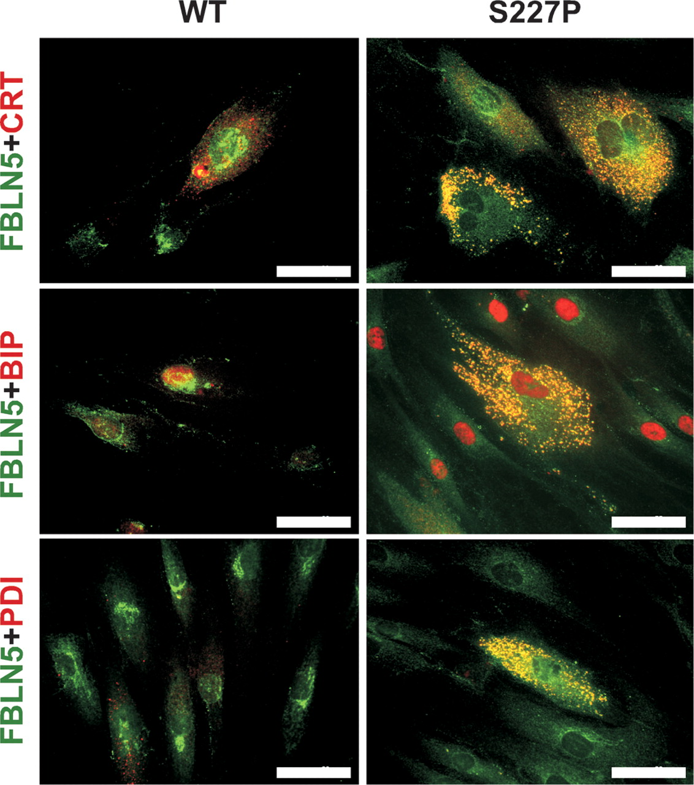
Figure 5. ER stress response to mutant fibulin-5 in fibroblasts. Dermal fibroblasts from a cutis laxa patient with ...
Notes:
Figure 5. ER stress response to mutant fibulin-5 in fibroblasts. Dermal fibroblasts from a cutis laxa patient with homozygous mutation S227P in fibulin-5 (S227P) and a normal control (WT) were stained for fibulin-5 (FBLN5, green) and for the chaperones (red), CRT, BiP and PDI. Mutant fibulin-5 showed strong co-localization with all three chaperones. In contrast, no significant co-localization of fibulin-5 with any of the chaperones was found in wild-type cells. Magnification bars: 50 µm.
Unless provided in the caption above, the following copyright applies to the content of this slide: © The Author 2006. Published by Oxford University Press. All rights reserved. For Permissions, please email: journals.permissions@oxfordjournals.org

