Slide 1
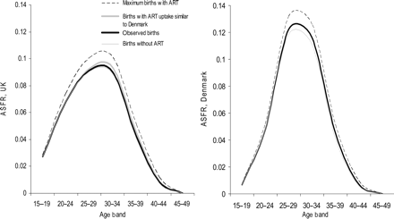
Figure 1: The empirical and potential impact of ART on ASFR
Notes:
Figure 1: The empirical and potential impact of ART on ASFR
Unless provided in the caption above, the following copyright applies to the content of this slide: © The Author 2007. Published by Oxford University Press on behalf of the European Society of Human Reproduction and Embryology. All rights reserved. For Permissions, please email: journals.permissions@oxfordjournals.org

Slide 2
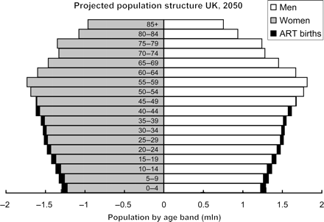
Figure 2: The projected impact of ART on age-structure in the UK, 2050
Notes:
Figure 2: The projected impact of ART on age-structure in the UK, 2050
Unless provided in the caption above, the following copyright applies to the content of this slide: © The Author 2007. Published by Oxford University Press on behalf of the European Society of Human Reproduction and Embryology. All rights reserved. For Permissions, please email: journals.permissions@oxfordjournals.org

Slide 3
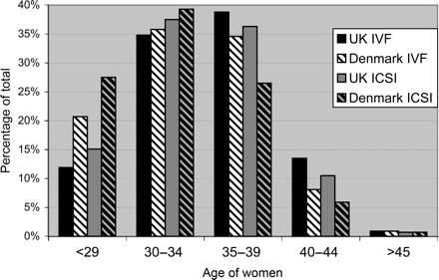
Figure 3: Percentage of women treated with IVF by age band, 2002 (Nyboe Andersen et al., 2006)
Notes:
Figure 3: Percentage of women treated with IVF by age band, 2002 (Nyboe Andersen et al., 2006)
Unless provided in the caption above, the following copyright applies to the content of this slide: © The Author 2007. Published by Oxford University Press on behalf of the European Society of Human Reproduction and Embryology. All rights reserved. For Permissions, please email: journals.permissions@oxfordjournals.org

