Slide 1
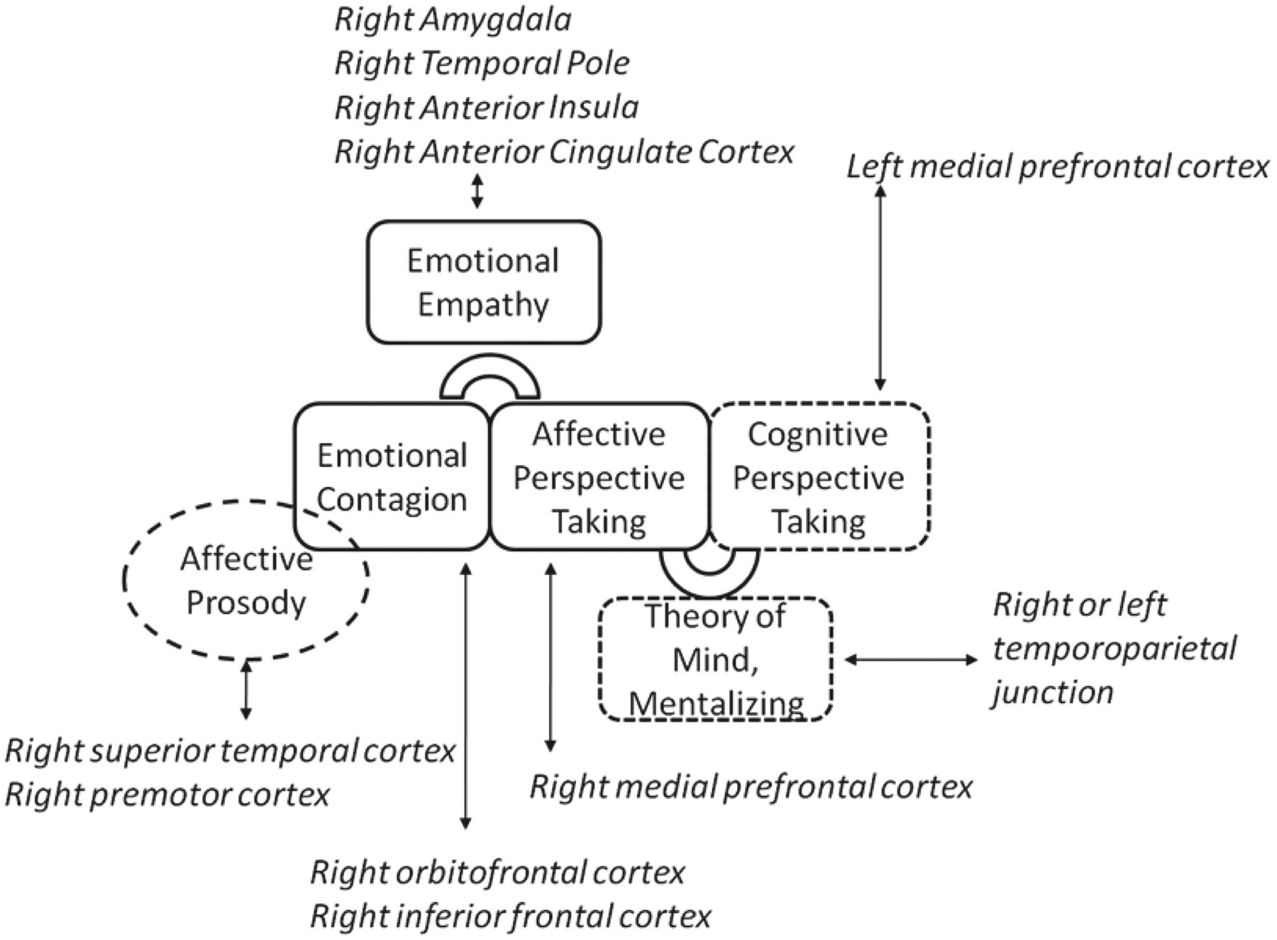
Figure 1 A schematic of some of the proposed cognitive and neural mechanisms underlying emotional empathy (in solid ...
Notes:
Figure 1 A schematic of some of the proposed cognitive and neural mechanisms underlying emotional empathy (in solid borders) and associated cognitive processes (in dashed borders). Right amygdala, temporal pole, anterior insula, and anterior cingulate cortex are hypothesized to be critical for both emotional contagion and affective perspective-taking. In contrast, right orbitofrontal cortex and inferior frontal cortex are hypothesized to be selectively important for emotional contagion, and right medial prefrontal cortex is hypothesized to be selectively critical for affective perspective-taking.
Unless provided in the caption above, the following copyright applies to the content of this slide: © The Author (2013). Published by Oxford University Press on behalf of the Guarantors of Brain. All rights reserved. For Permissions, please email: journals.permissions@oup.com

