Slide 1
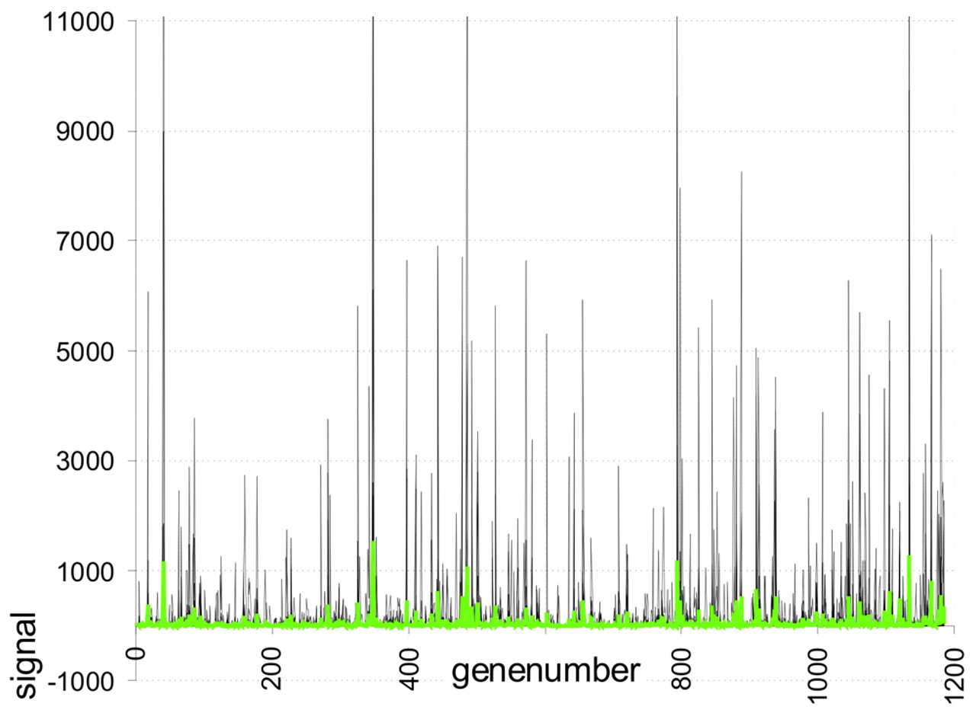
Figure 1. Display of not-normalised expression signals from different experiments arranged according to their ...
Notes:
Figure 1. Display of not-normalised expression signals from different experiments arranged according to their arbitrary gene number (human atlas array 1.2). The left axis shows the signal of expression after background correction in arbitrary units. Each grey curve represents one experiment. The green curve is the mean value of the not normalised intensity of each curve.
Unless provided in the caption above, the following copyright applies to the content of this slide:

Slide 2
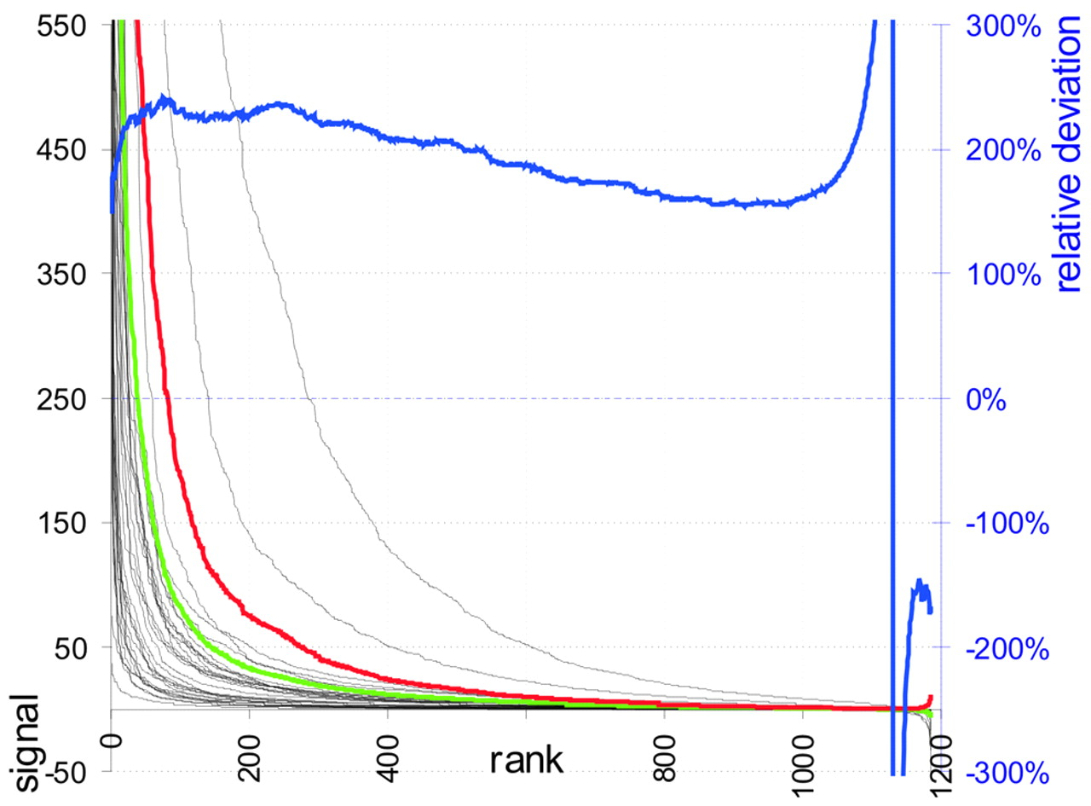
Figure 2. RIP of not-normalised expression signals from different experiments arranged according to their ...
Notes:
Figure 2. RIP of not-normalised expression signals from different experiments arranged according to their intensity rank (black). The left axis shows the signal of expression after background correction in arbitrary units. Additionally displayed are the mean of signals of a rank (RMC, green) and the absolute standard deviation between ranked intensities (ARD, red). The right axis scales the percentage of the RRD, blue.
Unless provided in the caption above, the following copyright applies to the content of this slide:

Slide 3
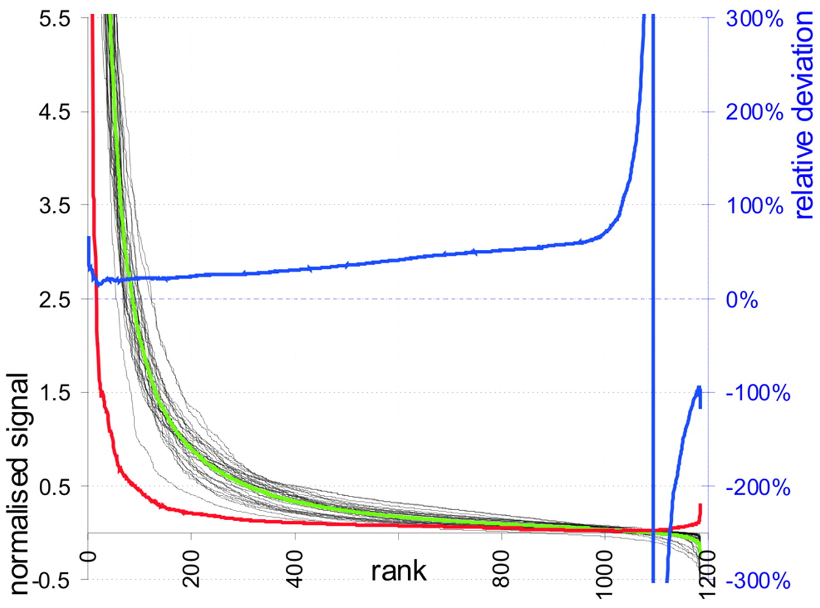
Figure 3. RIP of mean normalised expression signals from different experiments arranged according to their ...
Notes:
Figure 3. RIP of mean normalised expression signals from different experiments arranged according to their intensity rank. Experiments, black; RMC, green; ARD, red; RRD, blue.
Unless provided in the caption above, the following copyright applies to the content of this slide:

Slide 4
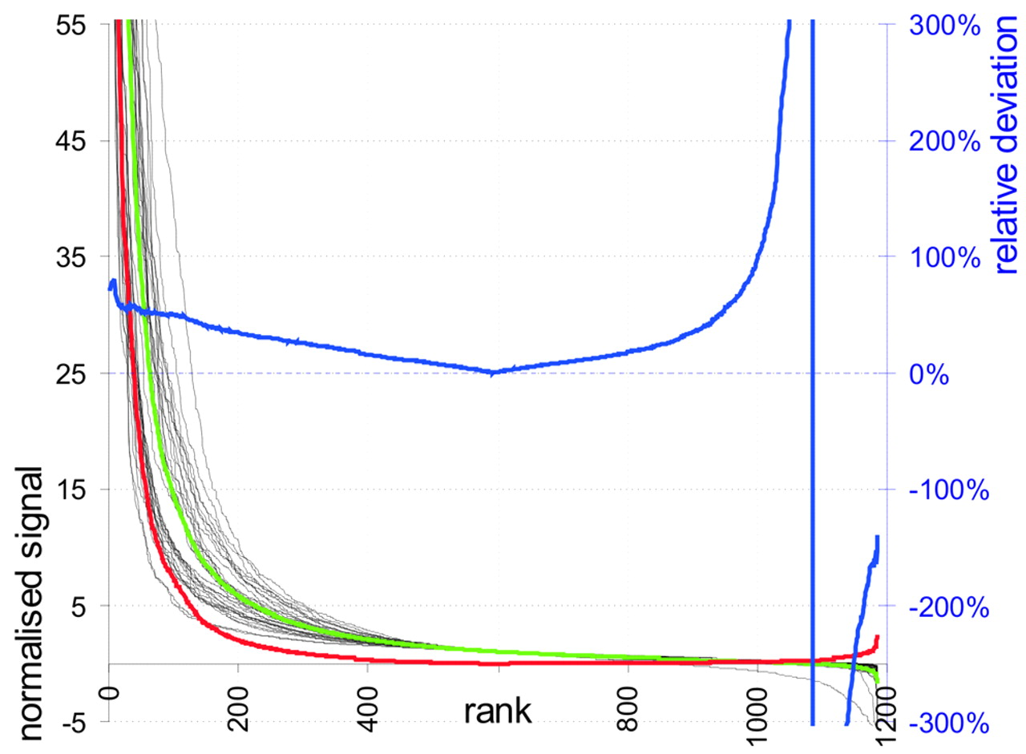
Figure 4. RIP of median normalised expression signals from different experiments arranged according to their ...
Notes:
Figure 4. RIP of median normalised expression signals from different experiments arranged according to their intensity rank. Experiments, black; RMC, green; ARD, red; RRD, blue.
Unless provided in the caption above, the following copyright applies to the content of this slide:

Slide 5
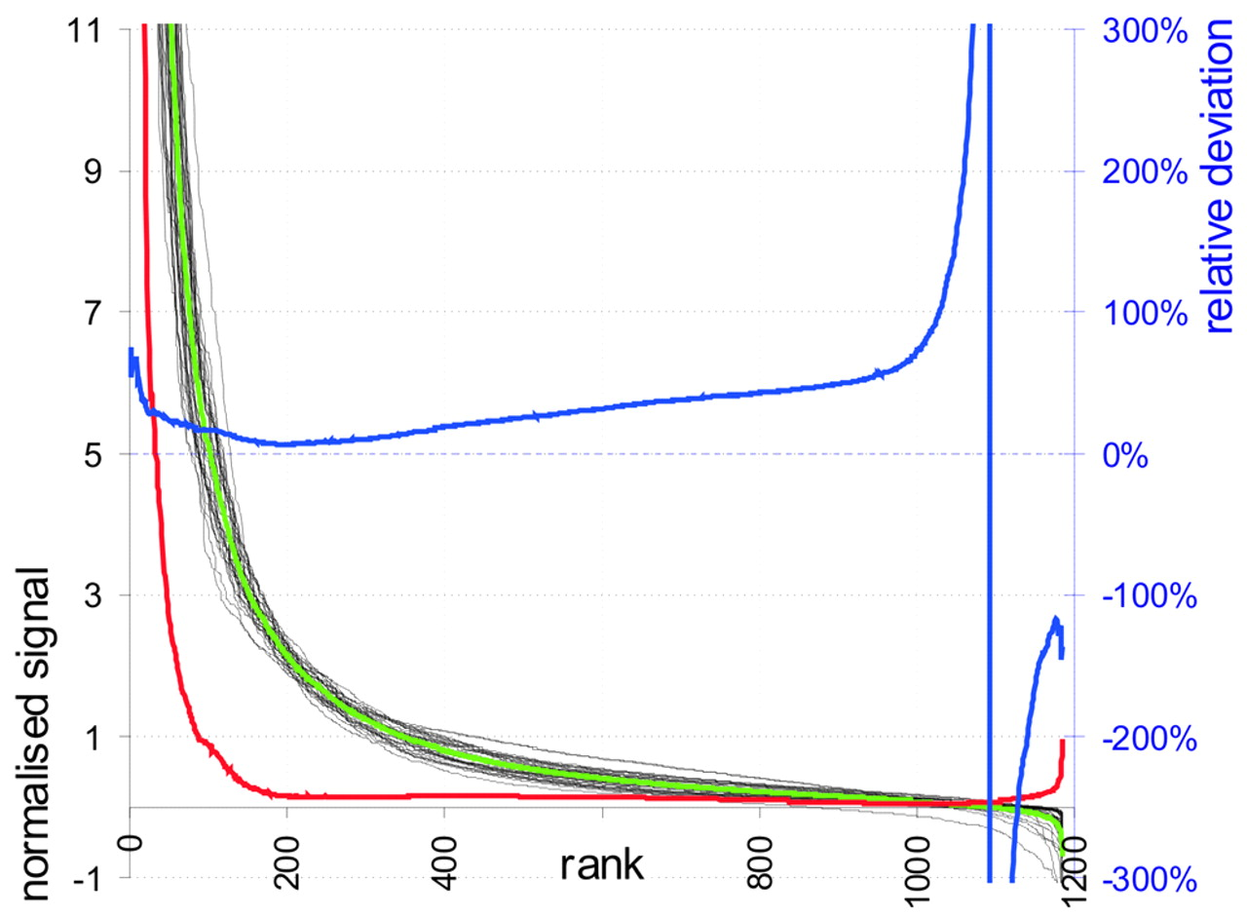
Figure 5. RIP of signals normalised with the 10% trimmed mean arranged according to their intensity rank. ...
Notes:
Figure 5. RIP of signals normalised with the 10% trimmed mean arranged according to their intensity rank. Experiments, grey; RMC, black; ARD, red; RRD, blue.
Unless provided in the caption above, the following copyright applies to the content of this slide:

Slide 6
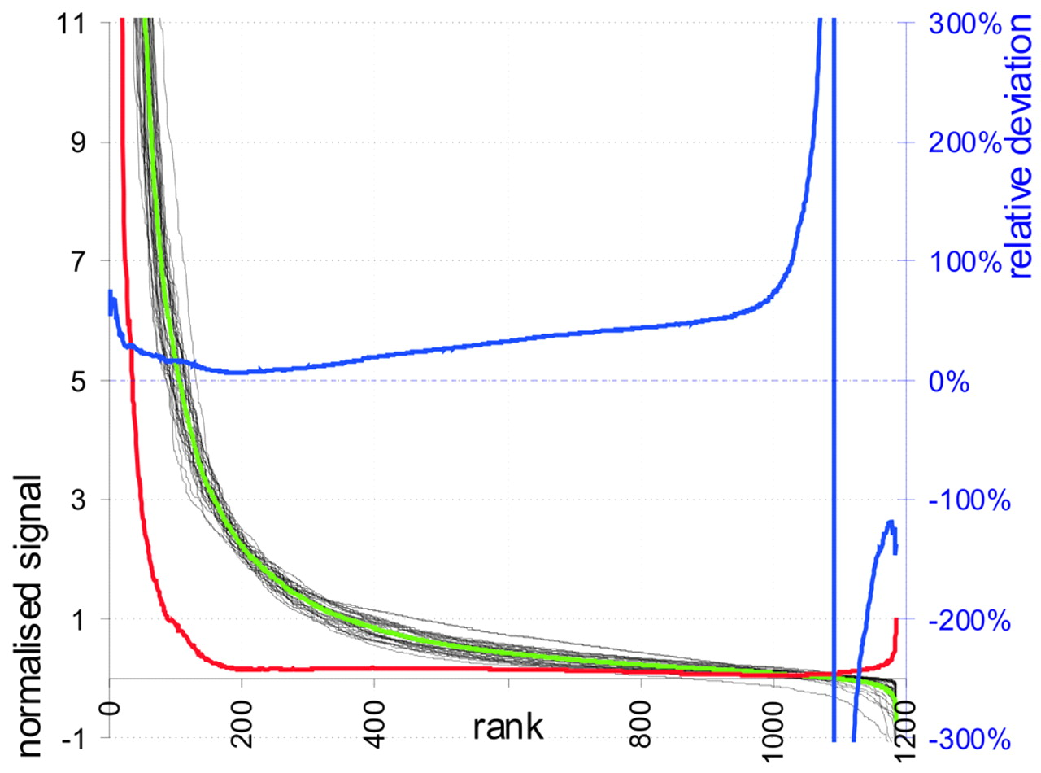
Figure 6. RIP of signals normalised with the 5% upper trimmed mean arranged according to their intensity ...
Notes:
Figure 6. RIP of signals normalised with the 5% upper trimmed mean arranged according to their intensity rank. Experiments, black; RMC, green; ARD, red; RRD, blue.
Unless provided in the caption above, the following copyright applies to the content of this slide:

