Slide 1
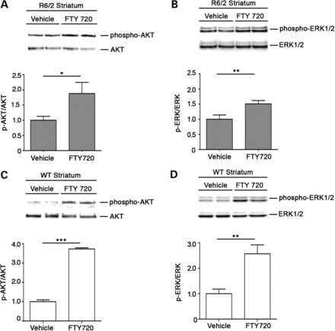
Figure 5. FTY720 induces AKT and ERK phosphorylation in vivo. Representative western blottings and densitometric ...
Notes:
Figure 5. FTY720 induces AKT and ERK phosphorylation in vivo. Representative western blottings and densitometric analysis of AKT and ERK phosphorylation in striatal tissues from R6/2 (A and B) and WT mice (C and D) after acute infusion of FTY720 (0.1 mg/kg). Data are represented as mean ± SD, n = 5 for each group of mice. *P < 0.05; **P < 0.001; ***P < 0.0001 (non-parametric Mann–Whitney U-test).
Unless provided in the caption above, the following copyright applies to the content of this slide: © The Author 2013. Published by Oxford University Press. All rights reserved. For Permissions, please email: journals.permissions@oup.com

Slide 2
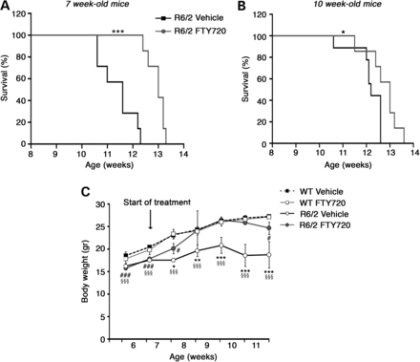
Figure 4. FTY720 prolongs lifespan and stabilize body weight in R6/2 mice. (A) Kaplan–Meier probability of survival ...
Notes:
Figure 4. FTY720 prolongs lifespan and stabilize body weight in R6/2 mice. (A) Kaplan–Meier probability of survival analysis in FTY720- and vehicle-treated R6/2 mice at 7 weeks of age, n = 7–8 for each group of mice. ***P < 0.001 (log-rank test), median survival ratio (untreated versus treated): 0.8923; hazard ratio (untreated versus treated): 4.620. (B) Kaplan–Meier probability of survival analysis in FTY720- and vehicle-treated R6/2 mice at 10 weeks of age of age, n = 7–8 for each group of mice. *P < 0.05 (Log-rank Test); median survival ratio (untreated versus treated): 0.9385; hazard ratio (untreated versus treated): 2.248. (C) Analysis of mouse body weight in all groups of animal. Each data point represents the average of body weight ± SD of 10 mice. *P < 0.05; ***P < 0.0001 (FTY720-treated R6/2 versus vehicle-treated R6/2); #P < 0.05, #P < 0.0001 (vehicle- and FTY720-treated WT versus FTY720-treated R6/2); §§§P < 0.0001 (vehicle- and FTY720-treated WT versus vehicle-treated R6/2; two-way ANOVA with Bonferroni post-test).
Unless provided in the caption above, the following copyright applies to the content of this slide: © The Author 2013. Published by Oxford University Press. All rights reserved. For Permissions, please email: journals.permissions@oup.com

Slide 3
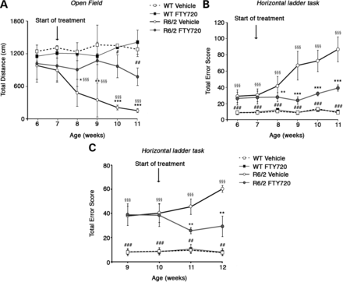
Figure 3. Chronic administration of FTY720 (0.1 mg/kg) improves motor function in R6/2 mice. (A) General locomotor ...
Notes:
Figure 3. Chronic administration of FTY720 (0.1 mg/kg) improves motor function in R6/2 mice. (A) General locomotor activity in the open field in 7-week-old R6/2 mice and control littermates, before and after treatment. (B) Analysis of motor coordination on horizontal ladder task before and after the treatment in 7-week-old or (C) 10-week-old mice. Each data point represents the average performance ± SD of 8–10 mice for each group of mice. *P < 0.05; **P < 0.001; ***P < 0.0001 (FTY720-treated R6/2 versus vehicle-treated R6/2); #P < 0.05; ##P < 0.001; ###P < 0.0001 (vehicle- and FTY720-treated WT versus FTY720-treated R6/2); §§§P < 0.0001 (vehicle- and FTY720-treated WT versus vehicle-treated R6/2; two-way ANOVA with Bonferroni post-test).
Unless provided in the caption above, the following copyright applies to the content of this slide: © The Author 2013. Published by Oxford University Press. All rights reserved. For Permissions, please email: journals.permissions@oup.com

Slide 4
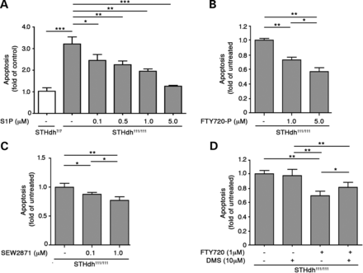
Figure 2. The neuroprotective effect of FTY720 is mimicked by different S1P receptor agonists and is partially ...
Notes:
Figure 2. The neuroprotective effect of FTY720 is mimicked by different S1P receptor agonists and is partially dependent on its phosphorylated form. Apoptosis in striatal-derived cell lines cultured for 6 h in serum-free medium in presence or absence of different concentrations of S1PRs agonists: S1P (A), FTY720-P (B) and SEW2871 (C). (D) Apoptosis in STHdh111/111 cell lines cultured for 6 h in serum-free medium in presence or absence of 1 μm FTY720 and/or 10 μm sphingosine kinases inhibitor, DMS. Data are represented as the mean ± SD of three experiments, each performed in triplicate. *P < 0.05; **P < 0.001; ***P < 0.0001 (non-parametric Mann–Whitney U-test).
Unless provided in the caption above, the following copyright applies to the content of this slide: © The Author 2013. Published by Oxford University Press. All rights reserved. For Permissions, please email: journals.permissions@oup.com

Slide 5
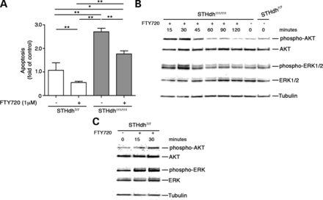
Figure 1. Administration of FTY720 protects WT and HD striatal-derived cell lines from apoptosis and results in AKT and ...
Notes:
Figure 1. Administration of FTY720 protects WT and HD striatal-derived cell lines from apoptosis and results in AKT and ERK activation. (A) Apoptosis in striatal-derived cell lines cultured for 6 h in serum-free medium in presence or absence of 1 μm FTY720. Data are represented as mean ± SD of three experiments, each performed in triplicate. *P<0.05; **P < 0.001 (non-parametric Mann–Whitey U-test). (B and C) AKT and ERK phosphorylation in cellular protein extracts in HD (B) and WT (C) striatal-derived cell lines measured at different time points after FTY720 treatment.
Unless provided in the caption above, the following copyright applies to the content of this slide: © The Author 2013. Published by Oxford University Press. All rights reserved. For Permissions, please email: journals.permissions@oup.com

Slide 6
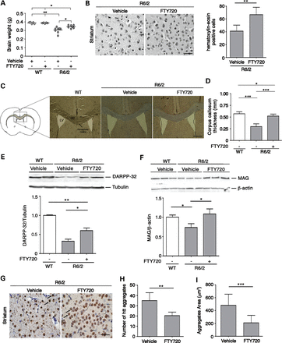
Figure 6. FTY720 ameliorates R6/2 neuropathology. (A) Average brain weight of 11-week-old vehicle- and FY720-treated WT ...
Notes:
Figure 6. FTY720 ameliorates R6/2 neuropathology. (A) Average brain weight of 11-week-old vehicle- and FY720-treated WT and R6/2 mice, vehicle- and FTY-treated WT mice, n = 5 for each group; vehicle-treated R6/2 mice, n = 8; FTY720-treated mice, n = 7, *P < 0.05; **P < 0.001 (non-parametric Mann–Whitey U-test). (B) Representative hematoxylin/eosin staining in striatal tissues from vehicle- and FTY720-treated R6/2 mice at 11 weeks of age (scale bar: 25 μm). Graph represents the quantitation of hematoxylin/eosin-positive cells, n = 5 for each group of mice. (C) Representative micrograph of CC thickness and ventricle enlargement in WT (left), vehicle- (center) and FTY720-treated R6/2 (right) mice (scale bar: 200 μm). LV: lateral ventricle. (D) CC thickness (mm) in correspondence of the middle line of the brain as indicated in (C). (E) Representative western blotting and densitometric analysis of DARPP-32 protein levels in the striatum of vehicle- and FTY720-treated mice at 11 weeks of age. Data are represented as mean ± SD, n = 5 for each group of mice. *P < 0.05; **P < 0.001 (non-parametric Mann–Whitey U-test). (F) Representative western blotting and densitometric analysis of MAG in WM in the same group of animals. Data are represented as mean ± SD, n = 5 for each group of mice. *P < 0.05 (non-parametric Mann–Whitey U-test). (G) Representative micrograph of EM48-positive striatal mHtt aggregates from vehicle- and FTY720-treated R6/2 mice at 11 weeks of age. Arrows indicate mHtt aggregates (scale bar: 25 μm). (H and I) Semi-quantitative analysis of both number and area of mHtt aggregates. Data are represented as mean ± SD, n = 5 for each group of mice. **P < 0.001; ***P < 0.0001 (two-tailed t-test).
Unless provided in the caption above, the following copyright applies to the content of this slide: © The Author 2013. Published by Oxford University Press. All rights reserved. For Permissions, please email: journals.permissions@oup.com

Slide 7
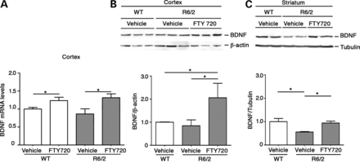
Figure 7. FTY720 increases BDNF levels in cortex and striatum. (A) BDNF mRNA levels in cortical tissues from ...
Notes:
Figure 7. FTY720 increases BDNF levels in cortex and striatum. (A) BDNF mRNA levels in cortical tissues from 11-week-old vehicle- and FTY720-treated mice. Data are represented as mean ± SD, n = 5 for each group of mice. *P < 0.05 (non-parametric Mann–Whitney U-test). (B) Representative western blotting and densitometric analysis of BDNF protein in cortical tissues from vehicle- and FTY720-treated mice at 11 weeks of age. (C) Representative western blotting and densitometric analysis of BDNF protein expression in the striatum of the same group of mice. Data are represented as mean ± SD, n = 5 for each group of mice. *P < 0.05 (non-parametric Mann–Whitney U-test).
Unless provided in the caption above, the following copyright applies to the content of this slide: © The Author 2013. Published by Oxford University Press. All rights reserved. For Permissions, please email: journals.permissions@oup.com

Slide 8
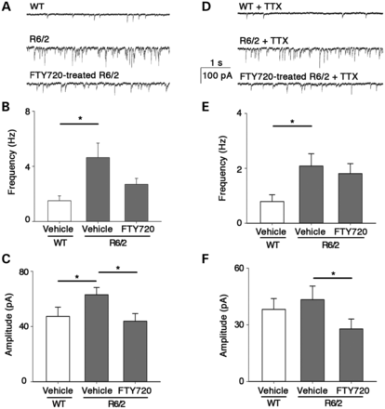
Figure 8. FTY720 restores GABAergic synaptic transmission in 8-week-old R6/2 mice to physiological levels. (A) Typical ...
Notes:
Figure 8. FTY720 restores GABAergic synaptic transmission in 8-week-old R6/2 mice to physiological levels. (A) Typical whole-cell recording from layer IV–V pyramidal neurons in slices from WT (top), R6/2 (middle) and FTY720-tretaed (bottom) mice. (B) Histogram of sIPSCs mean frequency, same conditions as (A), n = 10 for each bar. (C) Histogram of sIPSCs mean amplitude, same cells as (B). (D) Typical whole-cell recording from neurons in slices from WT (top), R6/2 (middle) and FTY720-treated (bottom) mice in the presence of TTX 1 μm; other conditions as in (A). (E) Histogram of mIPSCs mean frequency, same conditions as (D), n = 10 for each bar. (F) Histogram of mIPSCs mean amplitude, same cells as (E). Data are expressed as mean ± SEM; *P < 0.05 (non-parametric Mann–Whitney U-test). Holding potential −70 mV; CNQX 10 μm, AP-5 50 μm.
Unless provided in the caption above, the following copyright applies to the content of this slide: © The Author 2013. Published by Oxford University Press. All rights reserved. For Permissions, please email: journals.permissions@oup.com

Slide 9
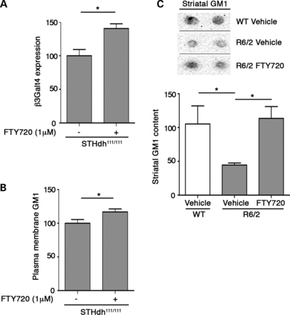
Figure 9. FTY720 increases levels of ganglioside GM1. (A) GM1 synthase (β3galt4) mRNA levels in STHdh^{111/111} ...
Notes:
Figure 9. FTY720 increases levels of ganglioside GM1. (A) GM1 synthase (β3galt4) mRNA levels in STHdh111/111 cultured for 6 h in regular medium supplemented with 1 μm FTY720. (B) Plasma membrane GM1 levels in STHdh111/111 cultured for 6 days in regular medium supplemented with 1 μm FTY720. Data are represented as the mean ± SD of two experiments, each performed in quadruplicate. *P < 0.05 (two-tailed test). (C) Representative dot-blotting and densitometric analysis of GM1 content, in striatal tissues from vehicle- and FTY720-treated mice at 11 weeks of age. Data are represented as the mean ± SD, n = 5 for each group of mice. *P < 0.05 (non-parametric Mann–Whitney U-test).
Unless provided in the caption above, the following copyright applies to the content of this slide: © The Author 2013. Published by Oxford University Press. All rights reserved. For Permissions, please email: journals.permissions@oup.com

Slide 10
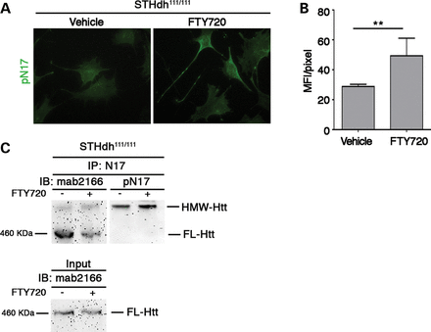
Figure 10. FTY720 induces phosphorylation of Htt at serine13/16 residues. (A) Representative epifluorescence microscope ...
Notes:
Figure 10. FTY720 induces phosphorylation of Htt at serine13/16 residues. (A) Representative epifluorescence microscope images. Striatal knock-in cells were incubated with either vehicle or 1 μm FTY720 for 30 min. (B) Graph shows pN17 immunostaining MFI per pixel ± SD, calculated over a minimum of 30 cells per experimental group. Each experiment was performed in quadruplicate. *P < 0.05 (non-parametric Mann–Whitney U-test). (C) Analysis of mutant huntingtin phosphorylation state by immunoprecipitation and immunoblotting. Striatal knock-in cells (STHdh111/111) were incubated with either vehicle or 1 μm FTY720 for 30 min. Mutant huntingtin was immunoprecipitated by using a rabbit polyclonal anti-huntingtin antibody (N17). Immunoprecipitated material (IP) was immunoblotted with the indicated phospho-Ser 13/16-Htt-specific antibody (pN17) and anti-huntingtin antibody (mab2166). Same amount of protein extracts were immunoprecipitated as indicated by the input lanes. HMW-Htt, high-molecular-weight huntingtin; FL-Htt, full-length huntingtin.
Unless provided in the caption above, the following copyright applies to the content of this slide: © The Author 2013. Published by Oxford University Press. All rights reserved. For Permissions, please email: journals.permissions@oup.com

