Slide 1
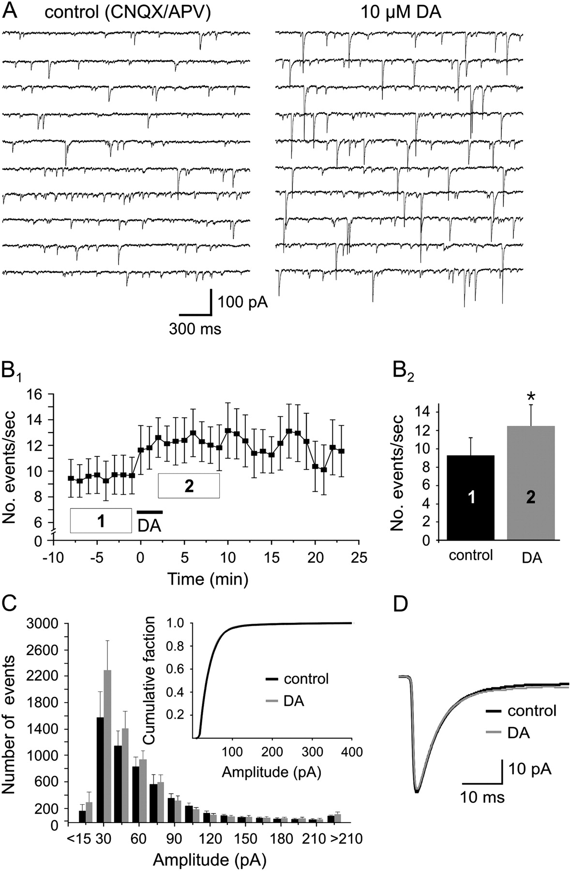
Figure 1. DA increases the frequency of sIPSCs in DLPFC pyramidal neurons. (A) Voltage-clamp recordings of ...
Notes:
Figure 1. DA increases the frequency of sIPSCs in DLPFC pyramidal neurons. (A) Voltage-clamp recordings of pharmacologically isolated sIPSCs from prefrontal layer 2/3 PCs under baseline conditions (left column) and after application of 10 μM DA. (B) In 8 out of 9 neurons, DA application resulted in a robust and long-lasting increase in the frequency of sIPSCs (B1). (B2) Comparison of the average frequency of events from all cells during 8 min of continuous recording before (period “1” in Fig. B1) and after DA application (period “2” in Fig. B1). (C) Histogram of the amplitude distribution of the events before (black bars) and after (gray bars) DA application, respectively. Inset: Same data replotted as cumulative frequency distribution to show that DA (gray line) did not significantly change the relative number of events of a given amplitude. (D) DA (gray line) also did not affect kinetics or amplitude of the average sIPSC (averaged from all events as shown in B).
Unless provided in the caption above, the following copyright applies to the content of this slide: © The Author 2006. Published by Oxford University Press. All rights reserved. For permissions, please e-mail: journals.permissions@oxfordjournals.org

Slide 2
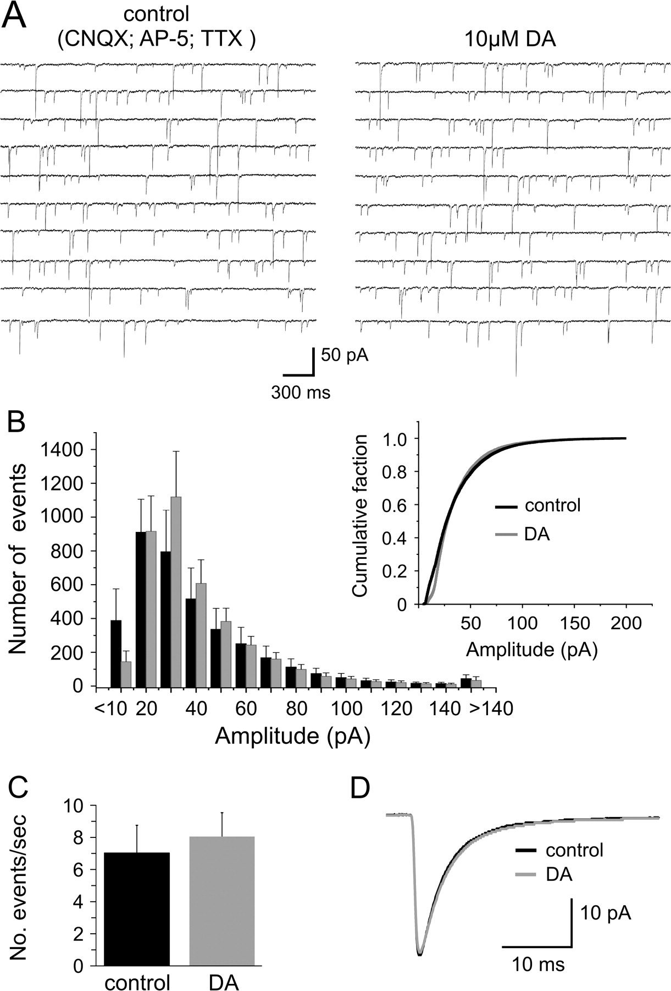
Figure 2. DA does not affect the frequency of mIPSCs in DLPFC pyramidal neurons. (A) Action potential–independent ...
Notes:
Figure 2. DA does not affect the frequency of mIPSCs in DLPFC pyramidal neurons. (A) Action potential–independent mIPSCs were recorded in the presence of 20 μM CNQX, 100 μM APV, and 1 μM TTX in voltage clamp from PCs. Representative traces showing that bath application of DA did not change frequency or amplitude of mIPSCs. (B) Histogram of the amplitude distribution of mIPSCs recorded from 7 neurons before (black bars) and after (gray bars) DA application during 8 min of continuous recording for each condition. Inset: Same data replotted as cumulative frequency distribution to show that DA (gray line) did not change the relative number of events of a given amplitude. (C) Comparison of the average frequency of events from all cells during 8 min of continuous recording under control conditions and after DA application. (D) As was the case with action potential–dependent sIPSCs, DA (gray line) did not affect the kinetics or averaged amplitude of mIPSCs.
Unless provided in the caption above, the following copyright applies to the content of this slide: © The Author 2006. Published by Oxford University Press. All rights reserved. For permissions, please e-mail: journals.permissions@oxfordjournals.org

Slide 3
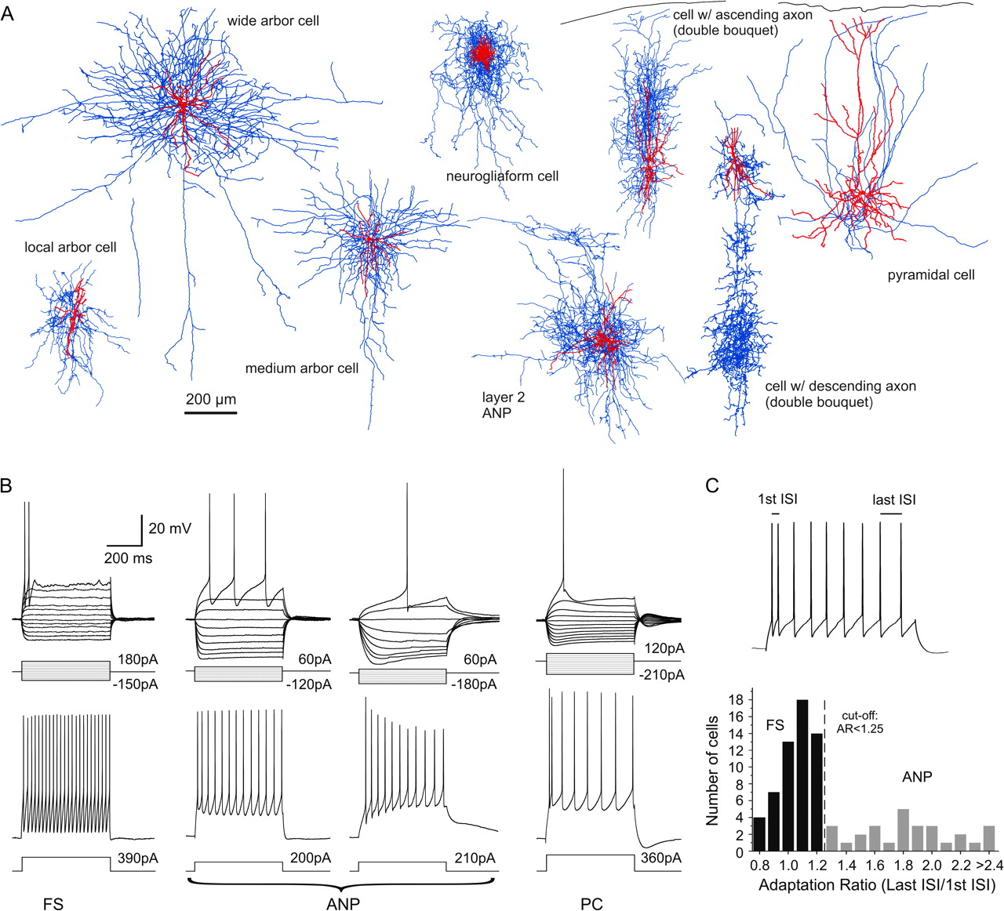
Figure 3. Electrophysiological and morphological characteristics of primate DLPFC neurons. (A) Computer reconstructions ...
Notes:
Figure 3. Electrophysiological and morphological characteristics of primate DLPFC neurons. (A) Computer reconstructions of biocytin-filled neurons that displayed morphological features of aspiny non-PCs and a pyramidal neuron (far right). Examples of cells with FS firing characteristics included arbor (or basket) cells, which could be further distinguished by the lateral extent of their axonal arbors into local, medium, or wide arbor cells (3 cells on the right) and 2 chandelier cells (not shown). Examples of cells with adapting firing patterns included neurogliaform cells (top center) or types of cells with predominantly vertically oriented axonal arbors, including double bouquet cells. In the reconstructed neurons, the somata and dendrites are drawn in red and the axonal arborizations in blue. The example of a wide arbor cell is taken from Krimer and others (2005), used with permission. (B) Examples of membrane responses and firing patterns for the 2 main classes of interneurons in response to somatic current injections (see Results and Table 1 for details). FS and ANP showed different degrees of frequency adaptation during repetitive firing. (C) For the analysis of DA effects, cells were divided into 2 groups based on their adaptation rate in spike firing (calculated as the ratio between the last ISI divided by the first ISI). The histogram shows the distribution of adaptation ratios in our sample of 85 non-PCs used in this study. We designated all cells with ratios smaller than 1.25 as FS cells and cells with larger ratios as adapting interneurons, respectively.
Unless provided in the caption above, the following copyright applies to the content of this slide: © The Author 2006. Published by Oxford University Press. All rights reserved. For permissions, please e-mail: journals.permissions@oxfordjournals.org

Slide 4
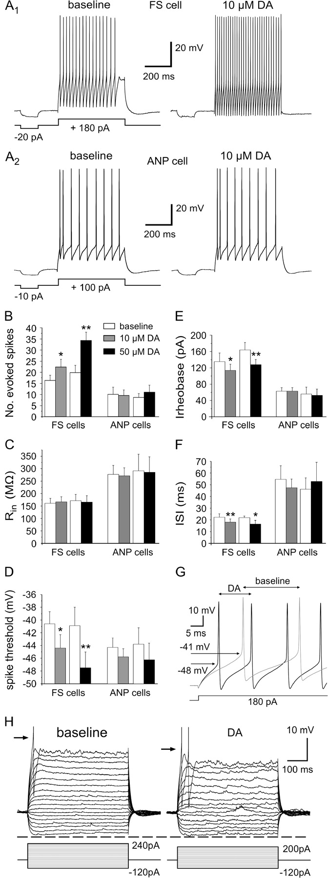
Figure 4. DA increases the membrane excitability of DLPFC interneurons in a cell type–specific fashion. (A) Bath ...
Notes:
Figure 4. DA increases the membrane excitability of DLPFC interneurons in a cell type–specific fashion. (A) Bath application of DA leads to a large increase of action potentials evoked by a 500-ms depolarizing current step in FS cells (A1) but not in adapting interneurons (A2). (B–F) Measures of intrinsic excitability in FS and ANP cells for 2 different concentrations of DA. In FS cells (10 μM DA, n = 11; 50 μM DA, n = 10), but not in adapting cells (10 μM DA, n = 12; 50 μM DA, n = 8), DA resulted in a significant increase of action potentials (B). In FS cells, the increase in spike firing was accompanied by a hyperpolarizing shift in the voltage threshold of the first action potential (D), a reduction in the rheobase current required to initiate spike firing (E), and a shortening of the first ISI (F). Measurements for baseline and drug condition were averaged across the time periods indicated in Figure 5 and compared using paired t-tests. Significant differences compared with baseline condition are indicated as * for P < 0.05 and ** for P < 0.01. (G) Sample traces from a FS neuron for control (gray) and DA conditions illustrating the reduction in spike threshold and latency of the first spike, as well as the shortening of the ISIs. (H) DA modulation of subthreshold electrotonic potentials. An effect of DA on Rin only becomes apparent at potentials close to spike threshold. The increased membrane response at depolarized potentials is reflected in the reduction of the rheobase current and the reduction in the action potential threshold (arrows).
Unless provided in the caption above, the following copyright applies to the content of this slide: © The Author 2006. Published by Oxford University Press. All rights reserved. For permissions, please e-mail: journals.permissions@oxfordjournals.org

Slide 5
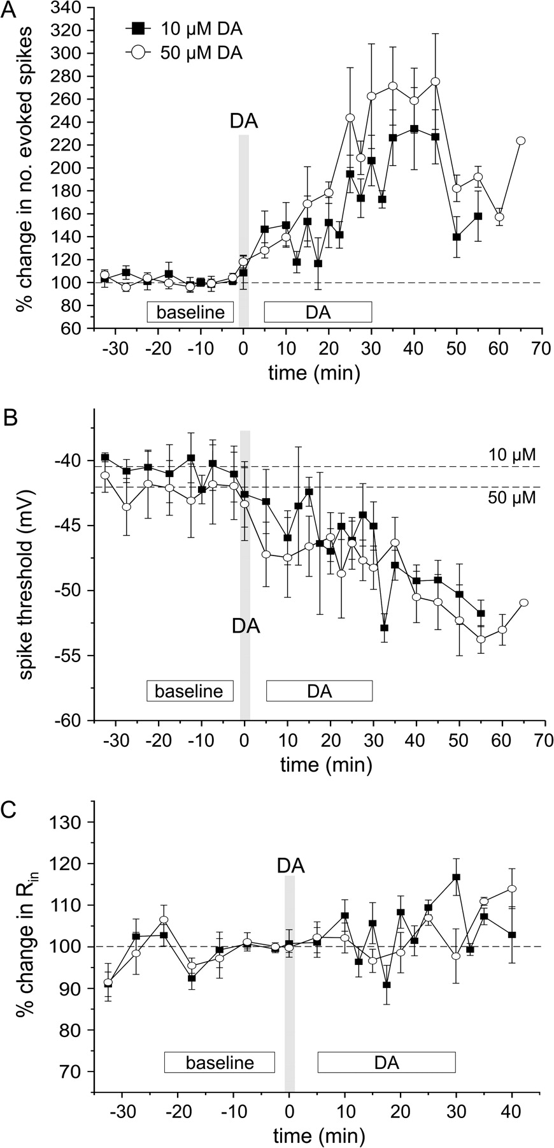
Figure 5. The increase in membrane excitability in FS cells is long lasting. (A–C) The same data as shown in Figure 4 ...
Notes:
Figure 5. The increase in membrane excitability in FS cells is long lasting. (A–C) The same data as shown in Figure 4 for the 10 and 50 μM DA conditions in FS cells shown as a function of time (N = 11 and 10 for 10 and 50 μM DA, respectively, but the number of cells at individual time points varies). Both the increase in evoked spike firing (A) and the shift in action potential threshold (B) developed rapidly within minutes of the drug reaching the chamber. However, the maximal effect of DA on these measures was often only seen after 20–30 min and almost never washed out. In contrast, measures of input resistance (C) showed comparatively little change over time.
Unless provided in the caption above, the following copyright applies to the content of this slide: © The Author 2006. Published by Oxford University Press. All rights reserved. For permissions, please e-mail: journals.permissions@oxfordjournals.org

Slide 6
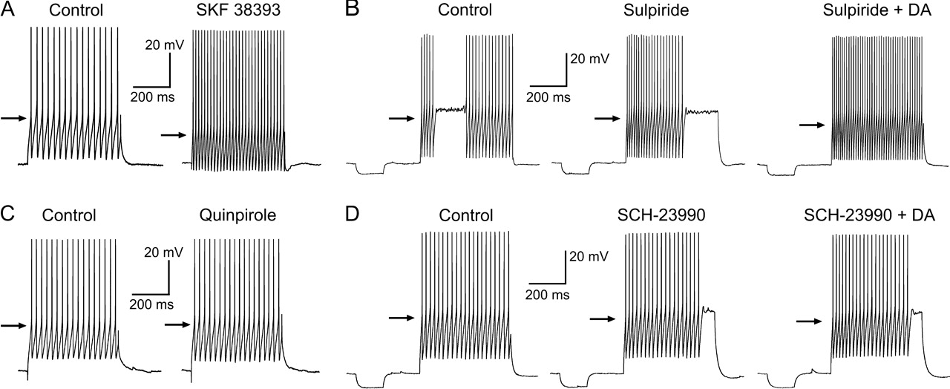
Figure 6. The increase in membrane excitability in FS is mediated by D1 but not D2 receptors. (A) Application of a D1 ...
Notes:
Figure 6. The increase in membrane excitability in FS is mediated by D1 but not D2 receptors. (A) Application of a D1 receptor agonist (SKF 38393 or SKF 81297 at 10 μM) mimicks the effects of DA on evoked firing. (B) Similarly, when D2-like receptors were blocked by the antagonist sulpiride (5 μM; bath applied for at least 10 min before DA application), thus leaving only D1-type receptors available, subsequent DA application (10 μM) lead to large increases in spike firing. On the other hand, activation of D2-type receptors by specific agonists or DA itself had little effect on intrinsic excitability. (C) Application of the D2 receptor agonist quinpirole has no significant effect on spike firing. (D) Blockade of D1-like receptors by the antagonist SCH23990 (5 μM; bath applied for at least 10 min before DA application) prevents the increase in intrinsic excitability normally seen with bath application of DA (50 μM). The arrows indicate the measured action potential threshold in control or drug conditions. See Results and Table 2 for details.
Unless provided in the caption above, the following copyright applies to the content of this slide: © The Author 2006. Published by Oxford University Press. All rights reserved. For permissions, please e-mail: journals.permissions@oxfordjournals.org

