Slide 1
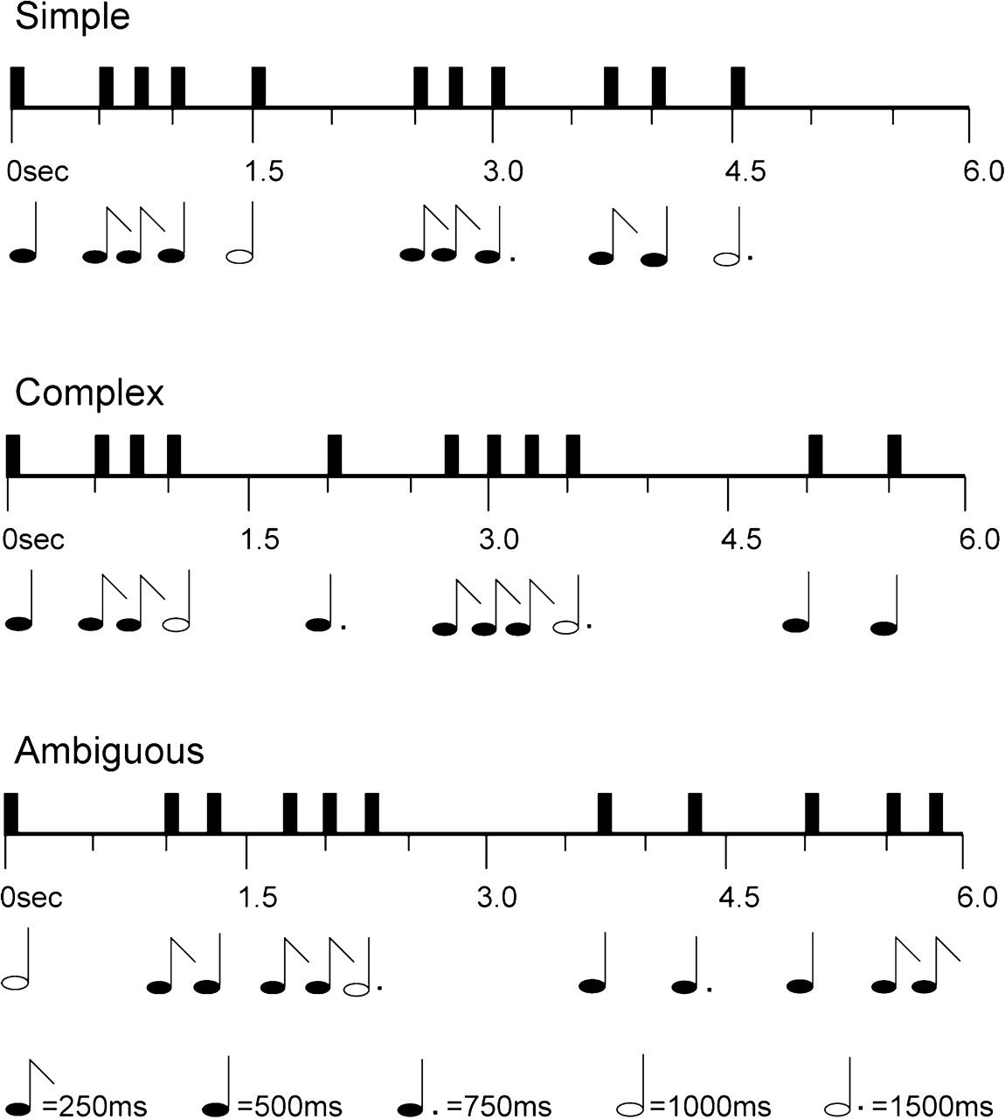
Figure 1. Schematic depiction of stimuli. Top row in each case shows the temporal sequence of events; bottom row shows ...
Notes:
Figure 1. Schematic depiction of stimuli. Top row in each case shows the temporal sequence of events; bottom row shows the equivalent musical notation. All rhythms contained the same number and type of musical note durations, but arranged to create 3 levels of increasing metrical complexity: simple, complex, ambiguous.
Unless provided in the caption above, the following copyright applies to the content of this slide: © The Author 2008. Published by Oxford University Press. All rights reserved. For permissions, please e-mail: journals.permissions@oxfordjournals.org

Slide 2
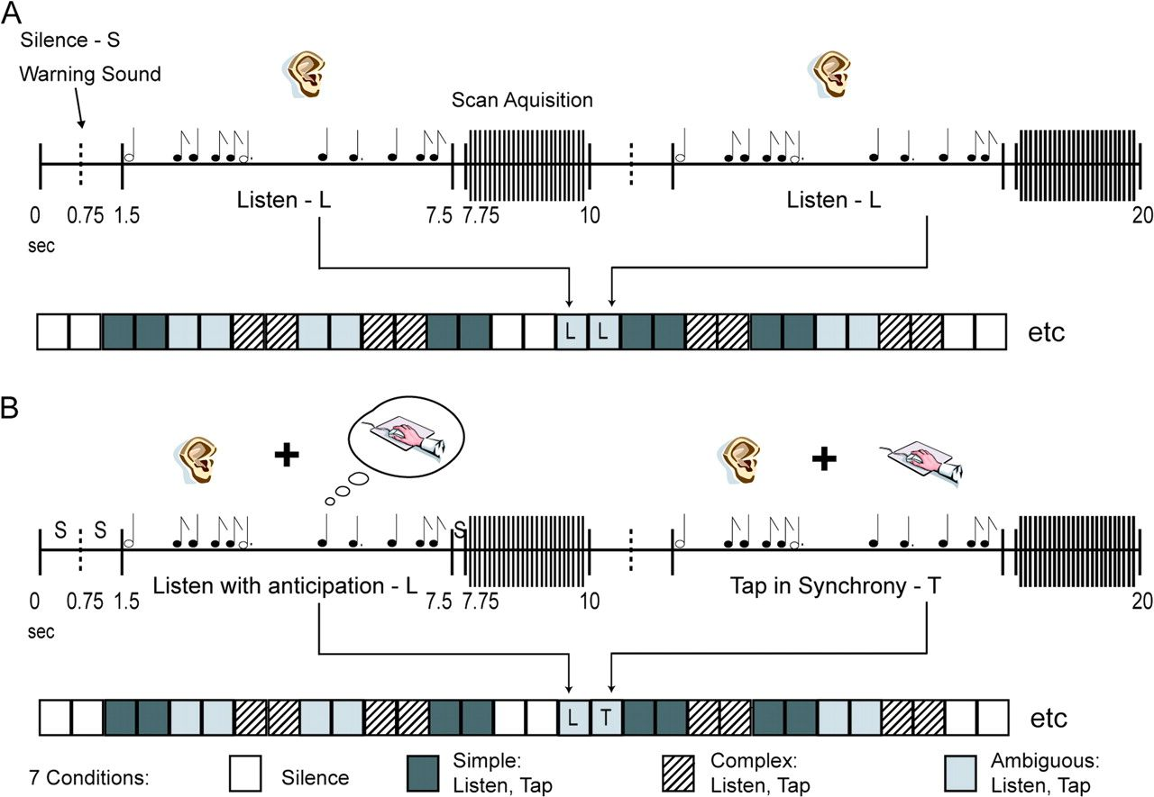
Figure 2. Representation of the fMRI sparse-sampling protocol. In experiment 1, subjects performed the protocol for (B) ...
Notes:
Figure 2. Representation of the fMRI sparse-sampling protocol. In experiment 1, subjects performed the protocol for (B) twice (2 runs). Each rhythm type was presented in a pair and subjects 1st listened attentively and then tapped along with the same rhythm in the following trial. The 3 rhythm types were presented in a pseudorandom order, along with silence. In experiment 2, subjects performed the protocol for (A) (run 1) where they passively listened to the rhythms without being told that they would tap to them later on, and then the protocol for (B) (run 2) as described above.
Unless provided in the caption above, the following copyright applies to the content of this slide: © The Author 2008. Published by Oxford University Press. All rights reserved. For permissions, please e-mail: journals.permissions@oxfordjournals.org

Slide 3
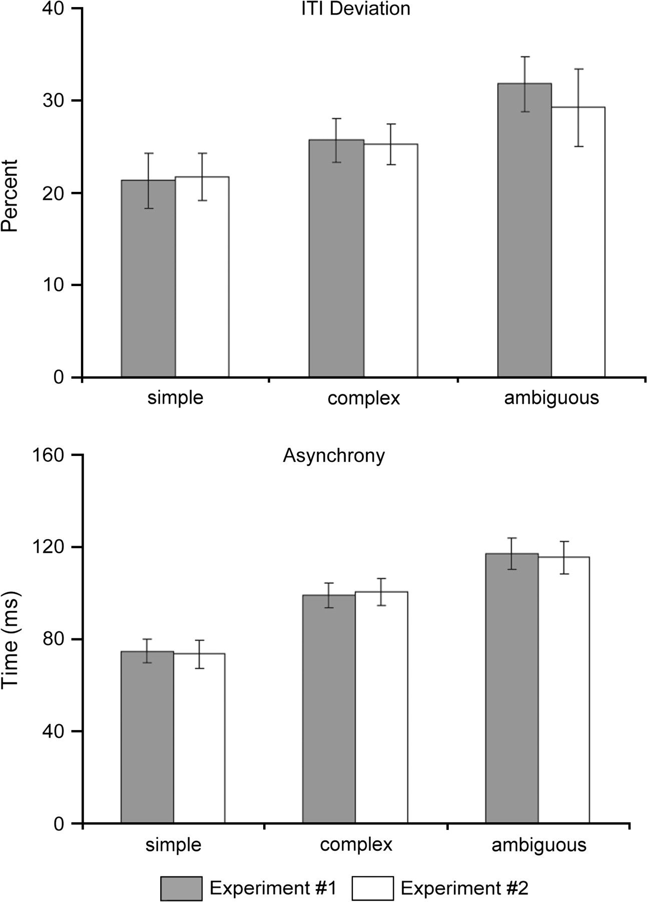
Figure 3. Performance decreases as rhythm complexity increases. Percent ITI deviation and asynchrony measures plotted ...
Notes:
Figure 3. Performance decreases as rhythm complexity increases. Percent ITI deviation and asynchrony measures plotted across rhythm type for the tapping trials performed in experiments 1 and 2. Data are reported as means ± SE.
Unless provided in the caption above, the following copyright applies to the content of this slide: © The Author 2008. Published by Oxford University Press. All rights reserved. For permissions, please e-mail: journals.permissions@oxfordjournals.org

Slide 4
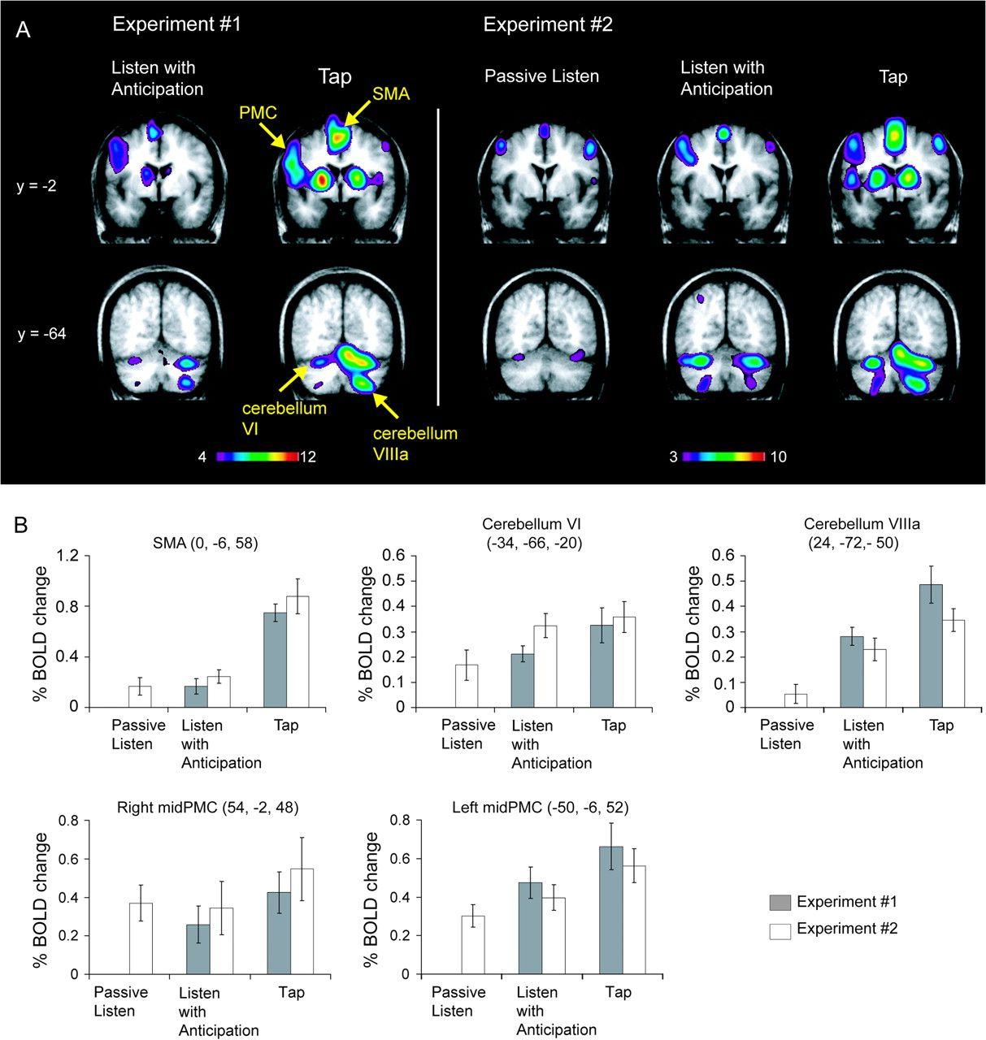
Figure 4. Brain regions involved in action–perception coupling and decoupling. All brain images are all taken in the ...
Notes:
Figure 4. Brain regions involved in action–perception coupling and decoupling. All brain images are all taken in the same Talairach coronal plane. Color bar represents t-values. (A) Left panel shows subtraction results for experiment 1: brain regions engaged while subjects listen with anticipation and tap along with rhythms relative to silence. Right panel shows subtraction results for experiment 2: brain regions engaged while subjects passively listen, listen with anticipation, and tap along with rhythms, relative to silence. (B) % BOLD signal change is plotted for VOIs in each condition (passive listen, listen with anticipation, tap), averaged across rhythm type, for experiments 1 and 2. Data are reported as means ± SE.
Unless provided in the caption above, the following copyright applies to the content of this slide: © The Author 2008. Published by Oxford University Press. All rights reserved. For permissions, please e-mail: journals.permissions@oxfordjournals.org

Slide 5
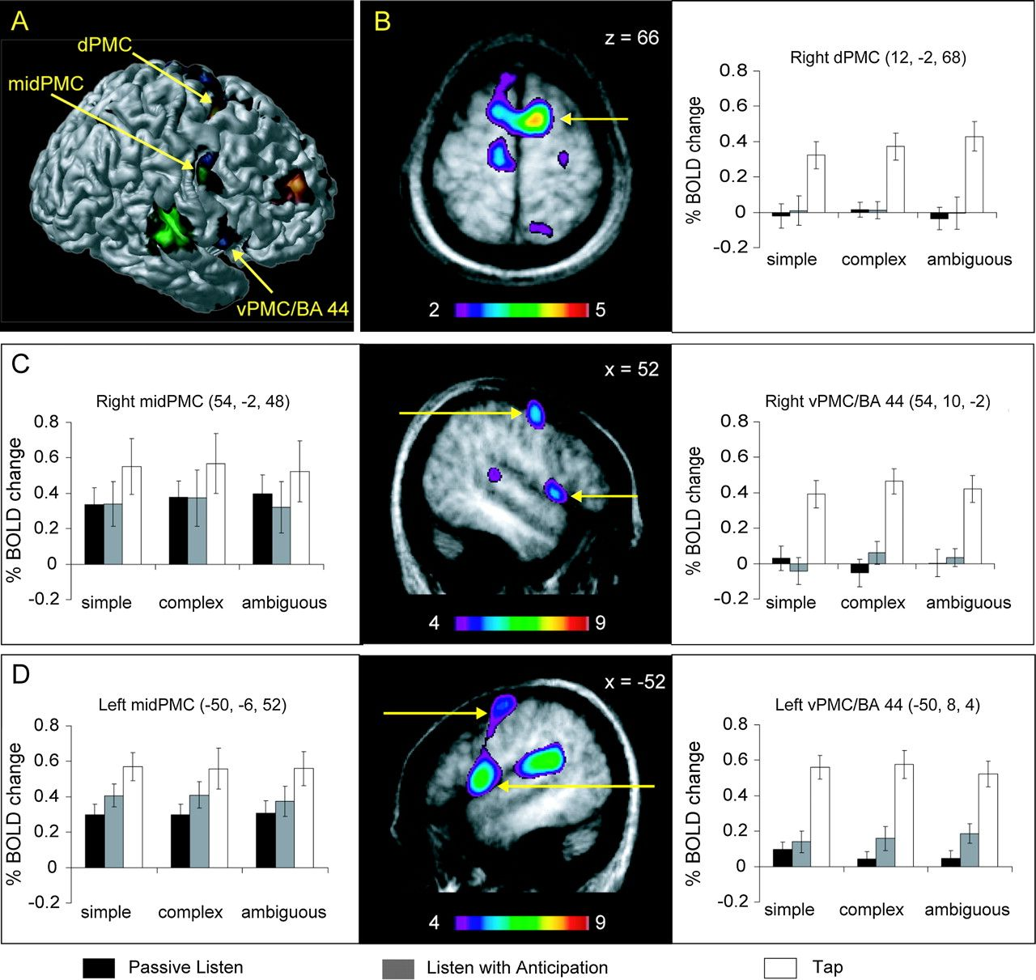
Figure 5. Neural activity in 3 distinct premotor regions: dPMC, mid-PMC, and vPMC, and pars opercularis (vPMC/BA 44). ...
Notes:
Figure 5. Neural activity in 3 distinct premotor regions: dPMC, mid-PMC, and vPMC, and pars opercularis (vPMC/BA 44). (A) Illustration of the premotor functional dissociation with data from experiment 2 projected onto a 3-dimensional anatomical rendering from 1 subject. Brain regions that increase in neural activity as rhythm complexity increases are shown in hot metal (dPMC); brain regions engaged during passive listening are shown in green (mid-PMC); brain regions engaged during tapping are shown in blue (vPMC/BA 44). The mid-PMC is engaged during both passive listening and tapping (and listen with anticipation not depicted in this image); this region is color coded with a mix of blue and green. (B) Illustration of dPMC sensitivity to metric organization; brain image taken in the Talairach horizontal plane of the covariation contrast from experiment 2 with graph showing corresponding % BOLD signal change plotted across rhythm type for each condition (passive listen, listen with anticipation, tap). (C and D) Illustration of mid-PMC sensitivity across all conditions and vPMC/BA 44 sensitivity during action and action-related sounds; brain images taken in the Talairach sagittal plane of the conjunction contrast “tap minus silence” from experiment 2 (graphs in same format as in A). Color bar represents t-values. Data are reported as means ± SE.
Unless provided in the caption above, the following copyright applies to the content of this slide: © The Author 2008. Published by Oxford University Press. All rights reserved. For permissions, please e-mail: journals.permissions@oxfordjournals.org

