Slide 1
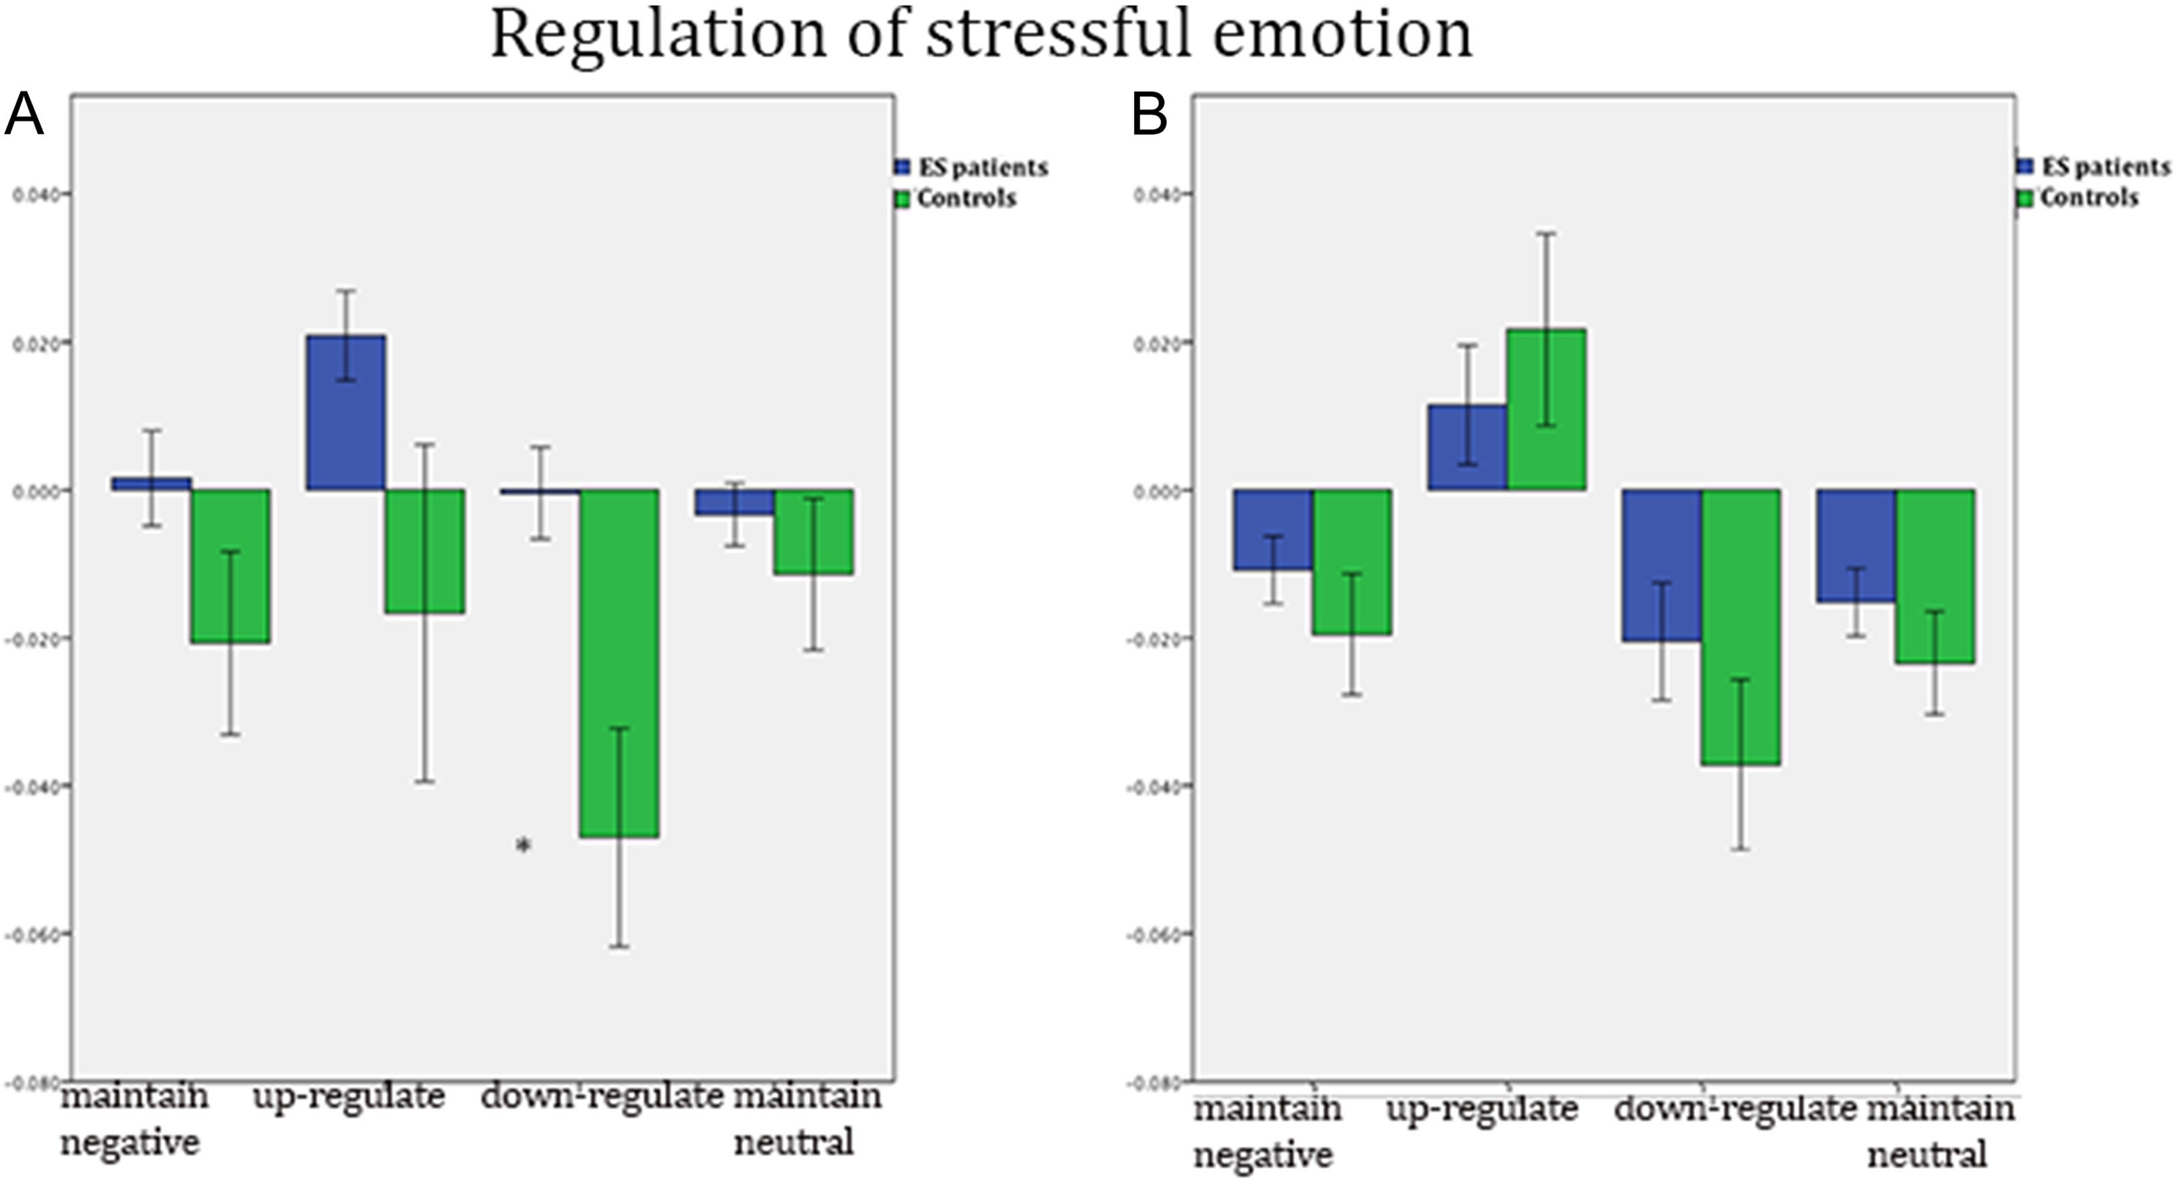
Figure 1. Comparison between ES patients and controls (longitudinal groups only) regarding startle reactions across ...
Notes:
Figure 1. Comparison between ES patients and controls (longitudinal groups only) regarding startle reactions across task instructions. (A) Startle modulation among ES patients and controls at visit 1. (B) Corresponding startle modulations at visit 2. For detailed information on the experimental design, please see Golkar et al. (2014) and Supplementary material. The acoustic startle reflex was measured while participants were viewing emotionally charged images and asked to suppress (down-regulate), enhance (up-regulate), or maintain their emotional response (negative emotion). As a comparison, participants were also presented with pairs of neutral images and instructed to maintain the emotion. Note that the y-axis shows the means for all of the startle responses (startle 2 response—startle 1 response) according to each instruction. At visit 1, the ES patient group displayed overall larger startle responses when viewing pictures evoking negative emotions, a pattern that was significantly pronounced during down-regulation. This difference between ES patients and controls was not found at visit 2 (after treatment); * P < 0.05. Error bars indicate ± 1SE.
Unless provided in the caption above, the following copyright applies to the content of this slide: © The Author 2017. Published by Oxford University Press. All rights reserved. For Permissions, please e-mail: journals.permissions@oup.com

Slide 2
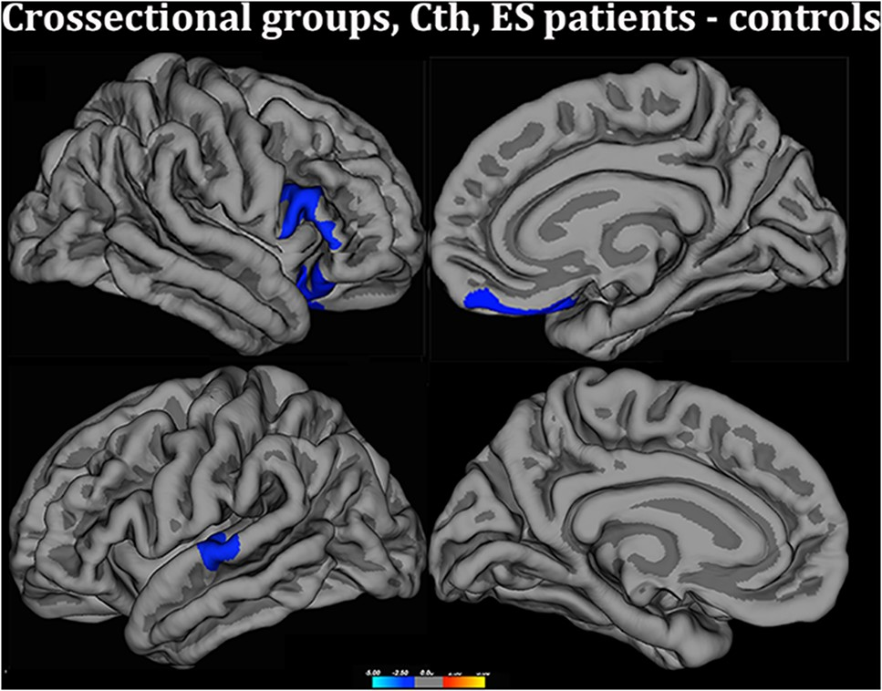
Figure 2. Group comparisons of Cth, cross-sectional groups (48 ES patients and 80 controls), visit 1. The contrasts ...
Notes:
Figure 2. Group comparisons of Cth, cross-sectional groups (48 ES patients and 80 controls), visit 1. The contrasts were calculated at P < 0.05 corrected for multiple comparisons (Monte Carlo permutation), using age as the covariate of no interest. The projection of cerebral hemispheres (MR images of the FreeSurfer atlas) is standardized. Scale is logarithmic and shows −log 10(P), with cool colors indicating negative contrast (lower values in ES patients), warm colors positive contrast (there were no regions with thicker cortex in the ES group).
Unless provided in the caption above, the following copyright applies to the content of this slide: © The Author 2017. Published by Oxford University Press. All rights reserved. For Permissions, please e-mail: journals.permissions@oup.com

Slide 3
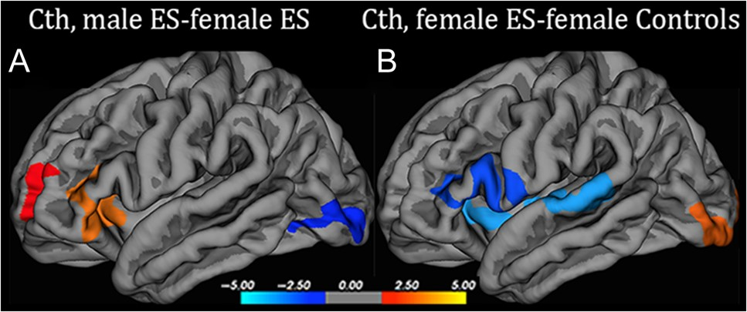
Figure 3. Group comparisons of Cth at visit 1, accounting for gender differences. (A) Difference in Cth between male ...
Notes:
Figure 3. Group comparisons of Cth at visit 1, accounting for gender differences. (A) Difference in Cth between male and female ES patients. The image shows thicker temporal and frontal cortex among male ES patients, although Cth is normally greater in women. (B) Difference in Cth between female ES patients and female controls. Illustrates cortical thinning (blue clusters) among female ES patients. Only left hemisphere is shown, but there were subsignificant clusters with cortical thinning in female ES patients also in the right PFC (before Monte Carlo correction). Notably, no significant clusters were detected when running the corresponding comparisons between male ES patients and male controls. Scale is logarithmic and shows −log 10(P), warm colors indicating positive contrast, and cool colors indicating negative contrast. Clusters calculated at P < 0.05 corrected for multiple comparisons (Monte Carlo permutation).
Unless provided in the caption above, the following copyright applies to the content of this slide: © The Author 2017. Published by Oxford University Press. All rights reserved. For Permissions, please e-mail: journals.permissions@oup.com

Slide 4
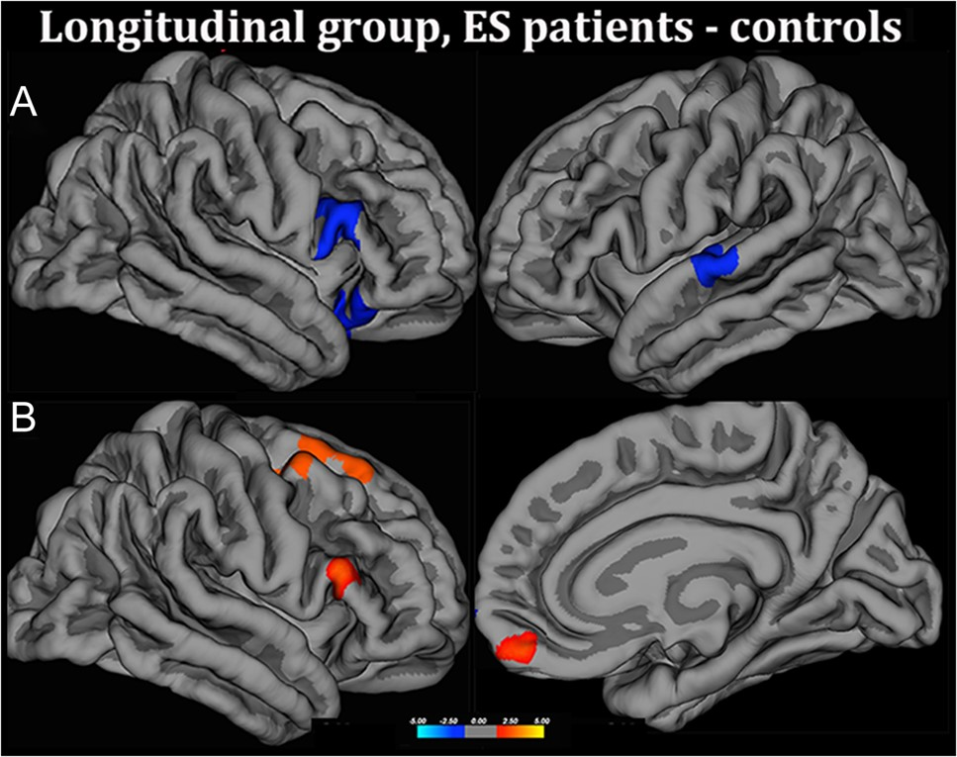
Figure 4. Group comparisons of Cth, only for longitudinal groups (25 ES patients and 19 controls). (A) Group comparison ...
Notes:
Figure 4. Group comparisons of Cth, only for longitudinal groups (25 ES patients and 19 controls). (A) Group comparison of Cth at visit 1. The ACC cluster observed when the entire group was taken into account (Fig. 1) was only subsignificant in the longitudinal group at visit 1. (B) Comparison between the same groups with respect to Pc1 (percent change of Cth between visit 1 and visit 2, corrected for time between the 2 scans). Scale is logarithmic and shows −log 10(P), warm colors indicating positive contrast (significant increase in Cth in ES patients compared with controls), with cool colors indicating negative contrast. Increase in Cth was detected in patients in prefrontal regions showing cortical thinning in the initial scan (visit 1). The cluster indicating increased Cth in the superior frontal cortex was only subsignificantly thinner at visit 1. Significance level was P < 0.05 corrected with Monte Carlo permutations.
Unless provided in the caption above, the following copyright applies to the content of this slide: © The Author 2017. Published by Oxford University Press. All rights reserved. For Permissions, please e-mail: journals.permissions@oup.com

