Slide 1
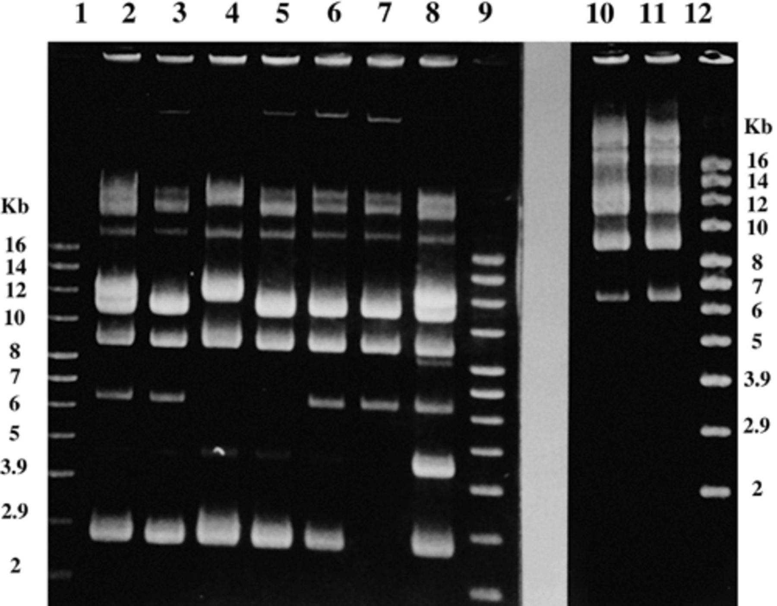
1 Plasmid profiles of closely related Enterococcus isolates. Lanes 1, 9, 12, supercoiled DNA molecular weight ...
Notes:
1 Plasmid profiles of closely related Enterococcus isolates. Lanes 1, 9, 12, supercoiled DNA molecular weight marker (Gibco-BRL); lanes 2–8, PSS 52, PSS 53, PSS 34, PSS 28, PSS 47, PSS 118, PSS 119 isolates; lanes 10 and 11, PSS 133, PSS 135. Electrophoresis was performed on a 0.8% agarose gel in TAE buffer at a constant voltage of 80 V.
Unless provided in the caption above, the following copyright applies to the content of this slide: © 1999 Federation of European Microbiological Societies. Published by Elsevier Science B.V. All rights reserved.

Slide 2
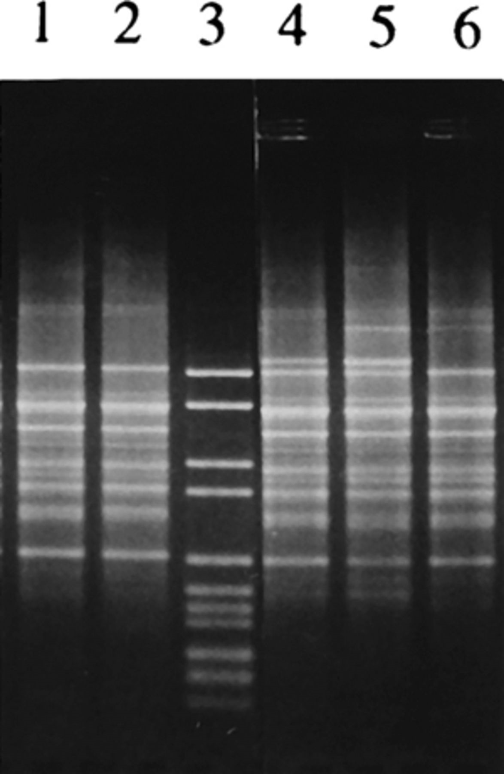
2 RAPD patterns obtained with primer M13 of closely related Enterococcus isolates. Lane 3, DNA molecular weight ...
Notes:
2 RAPD patterns obtained with primer M13 of closely related Enterococcus isolates. Lane 3, DNA molecular weight marker VI (Boehringer); lanes 1 and 2, PSS 28, PSS 34; lanes 4–6, PSS 38, PSS 47, PSS 53. PCR products were resolved on 1.5% agarose gel in TAE buffer at a constant voltage of 85 V.
Unless provided in the caption above, the following copyright applies to the content of this slide: © 1999 Federation of European Microbiological Societies. Published by Elsevier Science B.V. All rights reserved.

Slide 3
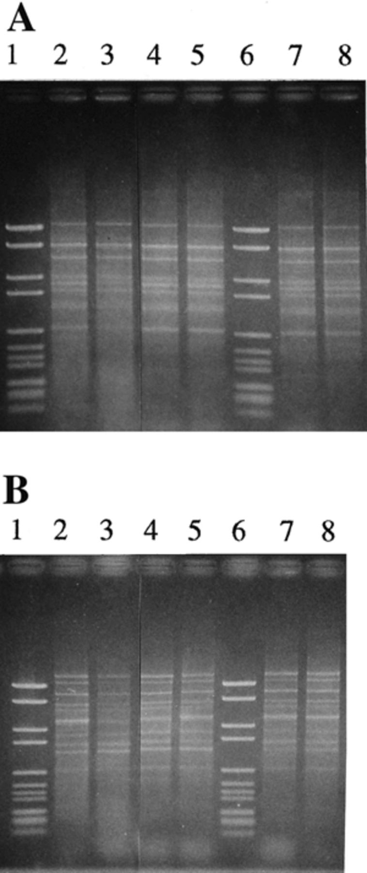
3 RAPD patterns of closely related Enterococcus isolates. (A) Pattern obtained with M13 primer. (B) Pattern ...
Notes:
3 RAPD patterns of closely related Enterococcus isolates. (A) Pattern obtained with M13 primer. (B) Pattern obtained with OPB7 primer. Lanes 1 and 6, DNA molecular weight marker VI (Boehringer); lanes 2–5, PSS 119, PSS 52, PSS 118, PSS 133; lanes 7 and 8, PSS 135, PSS 34. Electrophoresis was performed on a 1.5% agarose gel in TAE buffer at a constant voltage of 85 V.
Unless provided in the caption above, the following copyright applies to the content of this slide: © 1999 Federation of European Microbiological Societies. Published by Elsevier Science B.V. All rights reserved.

Slide 4
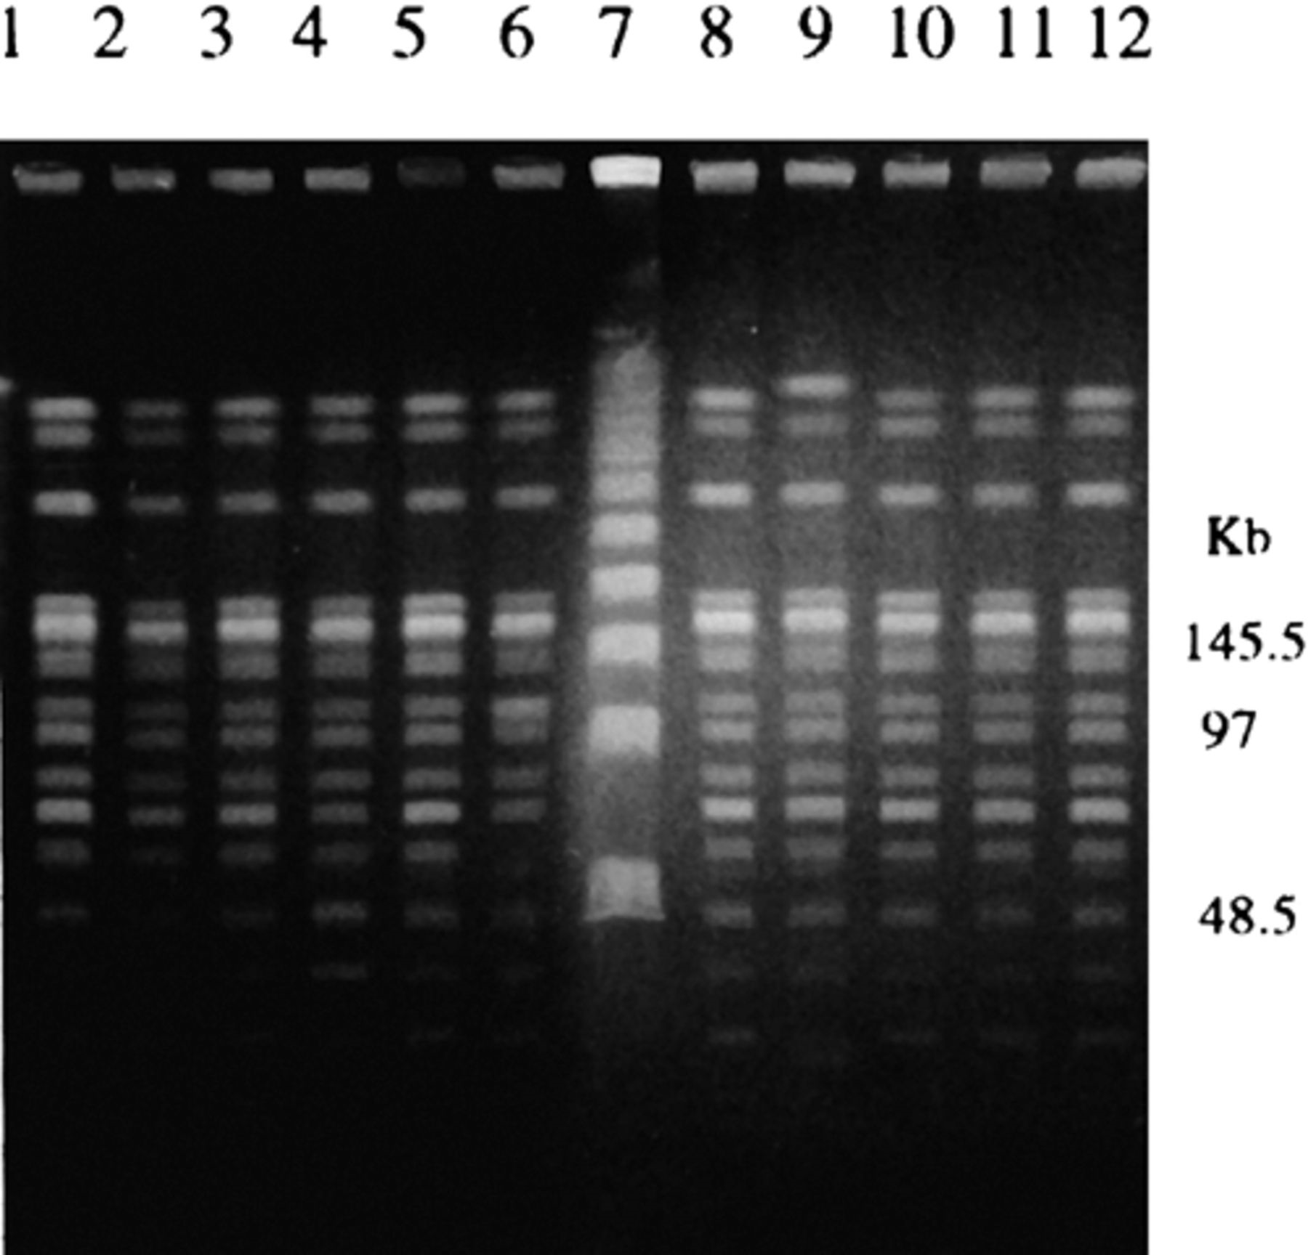
4 PFGE patterns of SmaI digested genomic DNA from a representative isolate of each clonal lineage. Lanes 1–6, ...
Notes:
4 PFGE patterns of SmaI digested genomic DNA from a representative isolate of each clonal lineage. Lanes 1–6, PSS 119, PSS 52, PSS 47, PSS 34, PSS 28, PSS 118; lanes 8–12, PSS 31, PSS 133, PSS 138, PSS 126, PSS 136; lane 7, PFGE molecular weight marker I (Boehringer). Electrophoresis was performed on a 0.8% agarose gel in TBE buffer at a constant voltage of 6 V cm−1.
Unless provided in the caption above, the following copyright applies to the content of this slide: © 1999 Federation of European Microbiological Societies. Published by Elsevier Science B.V. All rights reserved.

