Slide 1
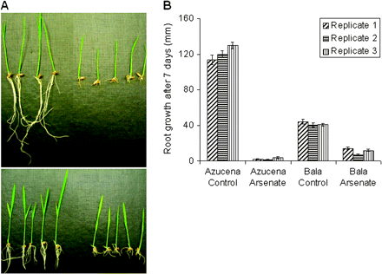
Fig. 1. (A) Azucena control conditions (top left), Azucena grown in 13.3 μM sodium arsenate (top right), Bala control ...
Notes:
Fig. 1. (A) Azucena control conditions (top left), Azucena grown in 13.3 μM sodium arsenate (top right), Bala control conditions (bottom left), and Bala grown in 13.3 μM sodium arsenate (bottom right) for 1 week showing marked inhibition of root growth. (B) Length of the roots for the three replicates used in the gene expression experiment. Bar = SE.
Unless provided in the caption above, the following copyright applies to the content of this slide: © 2008 The Author(s).This is an Open Access article distributed under the terms of the Creative Commons Attribution Non-Commercial License (http://creativecommons.org/licenses/by-nc/2.0/uk/) which permits unrestricted non-commercial use, distribution, and reproduction in any medium, provided the original work is properly cited.This paper is available online free of all access charges (see http://jxb.oxfordjournals.org/open_access.html for further details)

Slide 2
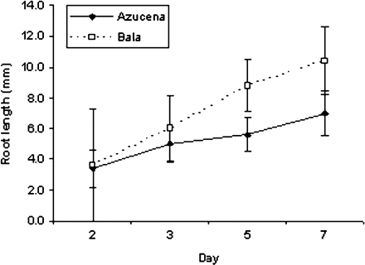
Fig. 2. Root lengths of plants grown in 13.3 μM sodium arsenate. Maximum root length was measured on days 2, 3, 5, ...
Notes:
Fig. 2. Root lengths of plants grown in 13.3 μM sodium arsenate. Maximum root length was measured on days 2, 3, 5, and 7. Bar = SE.
Unless provided in the caption above, the following copyright applies to the content of this slide: © 2008 The Author(s).This is an Open Access article distributed under the terms of the Creative Commons Attribution Non-Commercial License (http://creativecommons.org/licenses/by-nc/2.0/uk/) which permits unrestricted non-commercial use, distribution, and reproduction in any medium, provided the original work is properly cited.This paper is available online free of all access charges (see http://jxb.oxfordjournals.org/open_access.html for further details)

Slide 3
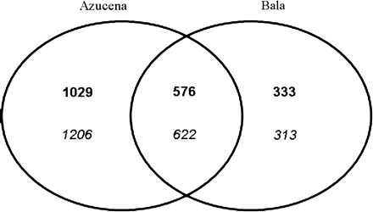
Fig. 3. Venn diagram of the number of probe sets up- and down-regulated in response to arsenate in Azucena and Bala. ...
Notes:
Fig. 3. Venn diagram of the number of probe sets up- and down-regulated in response to arsenate in Azucena and Bala. The number of probe sets which were up-regulated (bold) and the number of probe sets which were down-regulated (italic) with an adjusted P-value of ≤0.05 and a ≥2-fold change in gene expression.
Unless provided in the caption above, the following copyright applies to the content of this slide: © 2008 The Author(s).This is an Open Access article distributed under the terms of the Creative Commons Attribution Non-Commercial License (http://creativecommons.org/licenses/by-nc/2.0/uk/) which permits unrestricted non-commercial use, distribution, and reproduction in any medium, provided the original work is properly cited.This paper is available online free of all access charges (see http://jxb.oxfordjournals.org/open_access.html for further details)

Slide 4
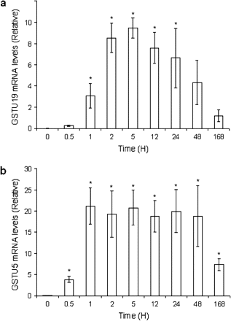
Fig. 4. Gene expression of GSTU5 (A) and GSTU19 (B) in response to 13.3 μM sodium arsenate over time as detected by ...
Notes:
Fig. 4. Gene expression of GSTU5 (A) and GSTU19 (B) in response to 13.3 μM sodium arsenate over time as detected by quantitative real-time PCR (relative to actin expression). Bar = SE.
Unless provided in the caption above, the following copyright applies to the content of this slide: © 2008 The Author(s).This is an Open Access article distributed under the terms of the Creative Commons Attribution Non-Commercial License (http://creativecommons.org/licenses/by-nc/2.0/uk/) which permits unrestricted non-commercial use, distribution, and reproduction in any medium, provided the original work is properly cited.This paper is available online free of all access charges (see http://jxb.oxfordjournals.org/open_access.html for further details)

