Slide 1
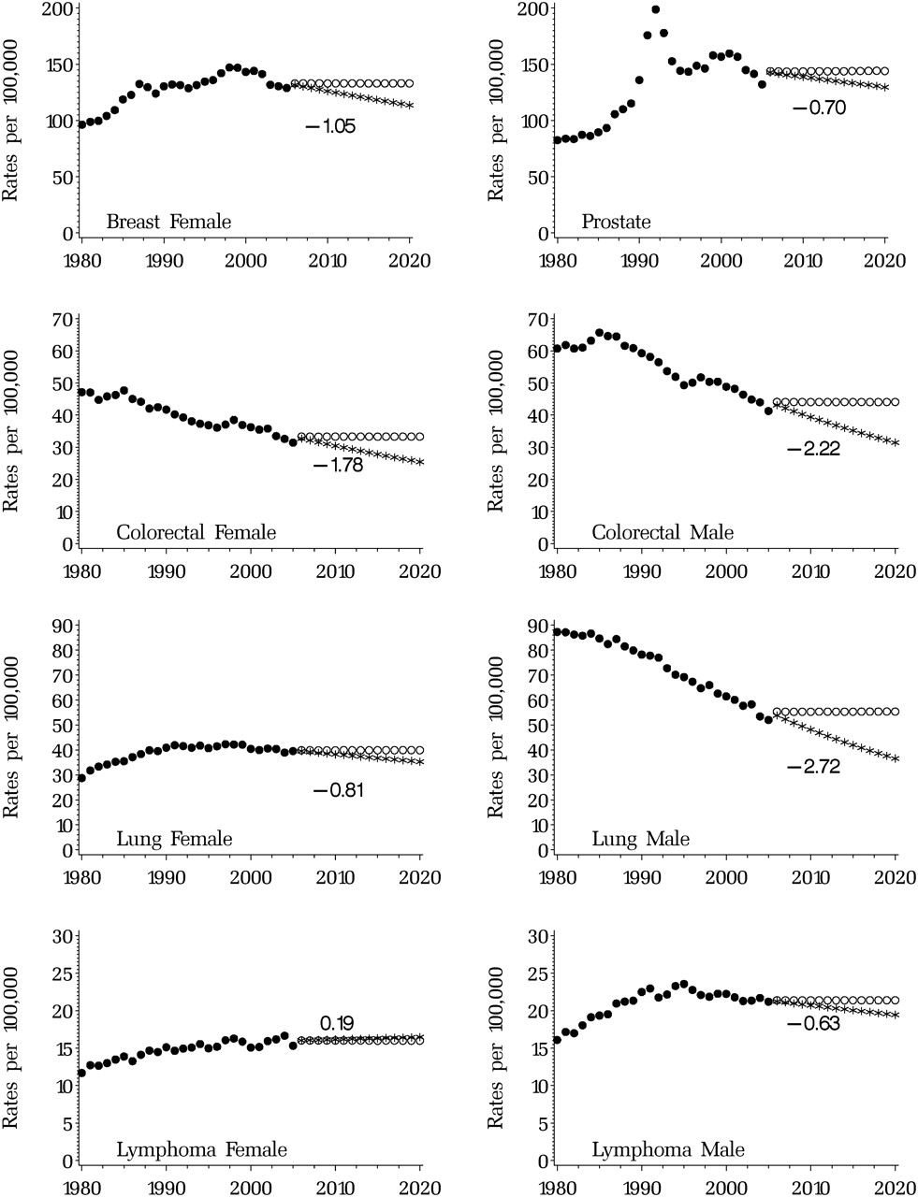
Figure 1 Observed age-adjusted incidence ( solid circles ) and projected age-adjusted incidence under the assumption ...
Notes:
Figure 1 Observed age-adjusted incidence ( solid circles ) and projected age-adjusted incidence under the assumption of future constant incidence ( open circles ) and continuing incidence trend ( asterisks ). The number represents the estimated annual percent change from 1996 through 2005.
Unless provided in the caption above, the following copyright applies to the content of this slide: Published by Oxford University Press 2011.

Slide 2
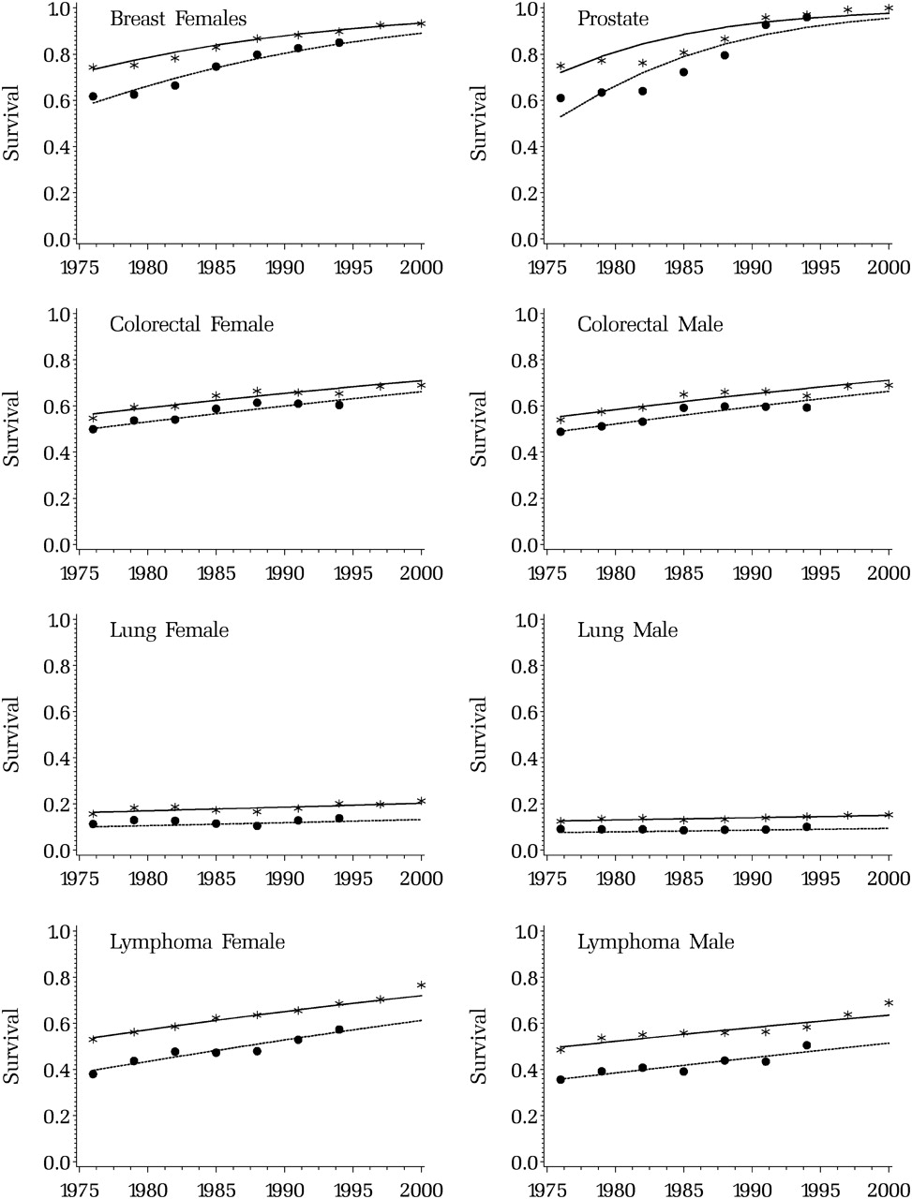
Figure 2 Fit of the survival model to observed data. Observed ( solid circles [10-year] and asterisks [5-year]) and ...
Notes:
Figure 2 Fit of the survival model to observed data. Observed ( solid circles [10-year] and asterisks [5-year]) and modeled ( solid line [5-year] and dashed line [10-year]) relative survival trends for the major cancer sites for people diagnosed between the ages of 65 and 74 years.
Unless provided in the caption above, the following copyright applies to the content of this slide: Published by Oxford University Press 2011.

Slide 3
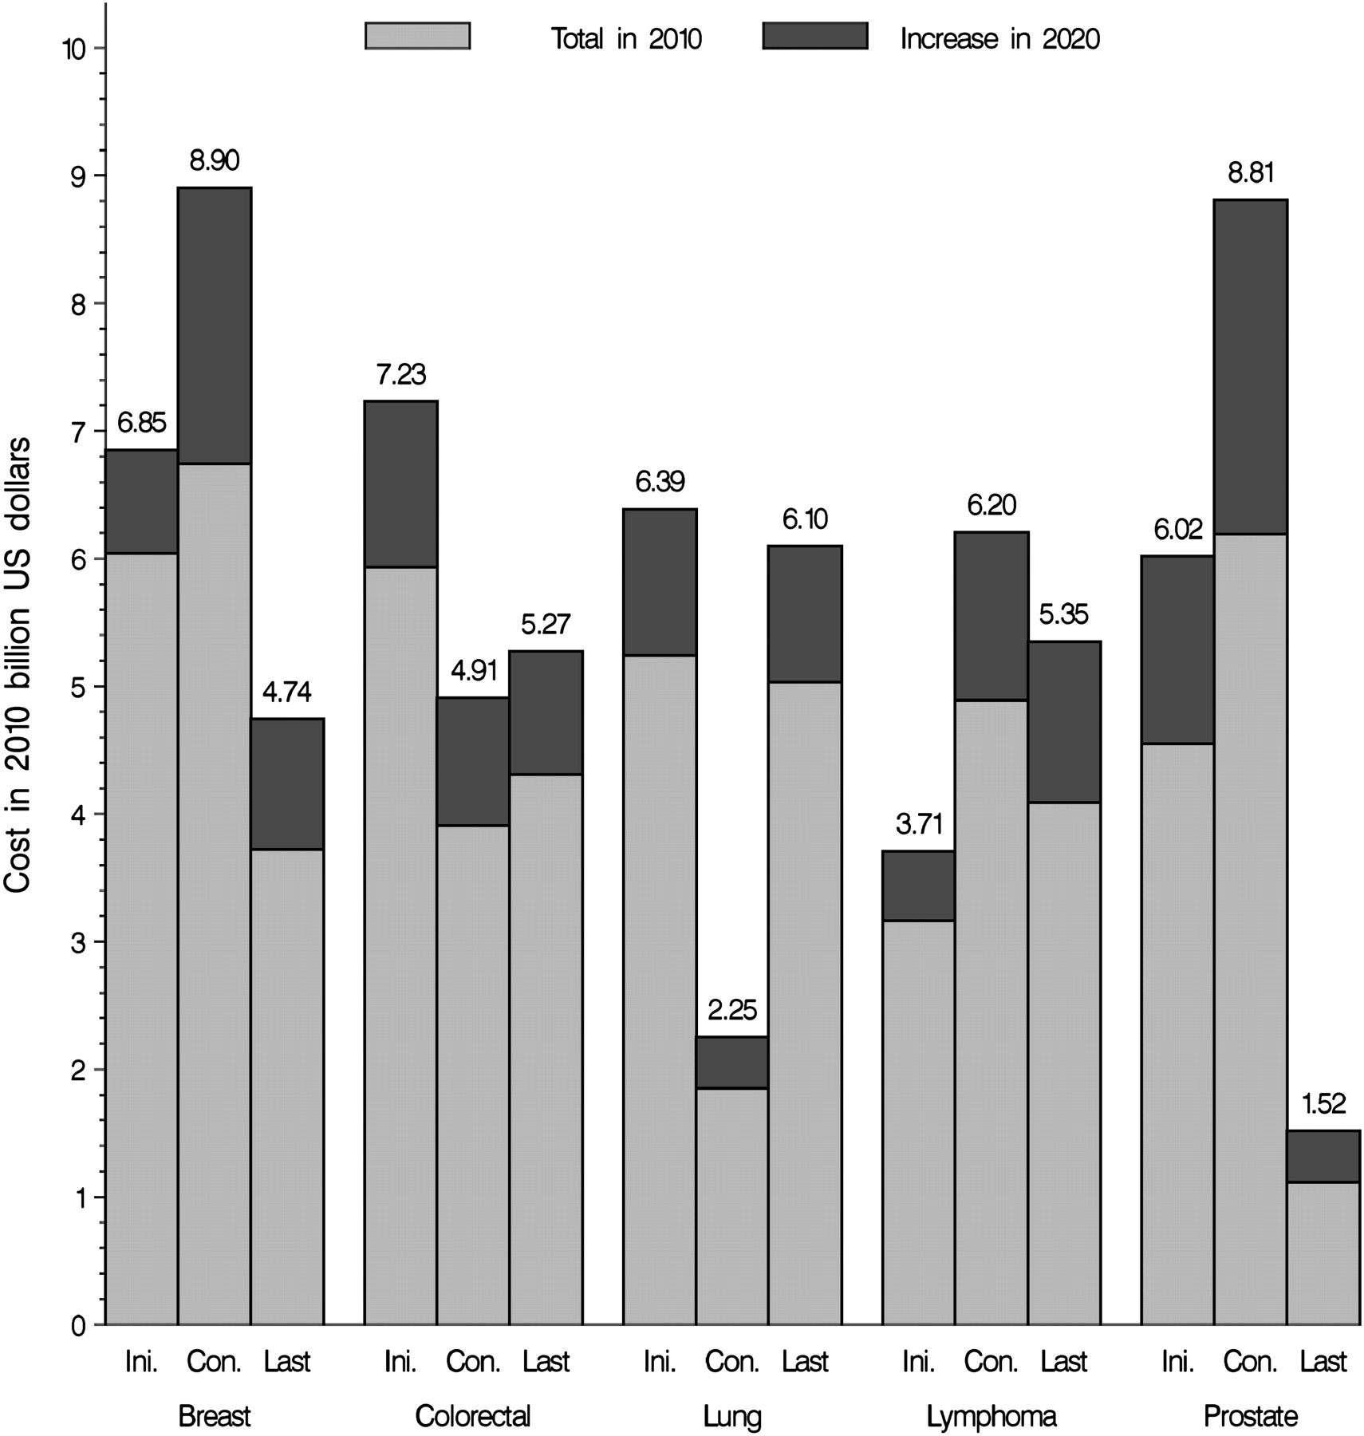
Figure 3 Estimates of the national expenditures for cancer care in 2010 ( light gray areas ) and the estimated ...
Notes:
Figure 3 Estimates of the national expenditures for cancer care in 2010 ( light gray areas ) and the estimated increase in cost in 2020 ( dark gray areas ) because of the aging and growth of the US population under assumptions of constant incidence survival and cost for the major cancer sites. Costs in 2010 billion US dollars by phase of care: initial year after diagnosis (Ini.) continuing care (Con.) and last year of life (Last).
Unless provided in the caption above, the following copyright applies to the content of this slide: Published by Oxford University Press 2011.

