Slide 1
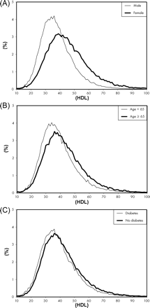
Figure 1 Comparison of the continuous distribution of high-density lipoprotein (HDL) (mg/dL) levels among selected ...
Notes:
Figure 1 Comparison of the continuous distribution of high-density lipoprotein (HDL) (mg/dL) levels among selected categories of patients: (A) men vs. women; (B) age <65 years vs. age ≥65 years; (C) diabetes mellitus vs. no diabetes mellitus.
Unless provided in the caption above, the following copyright applies to the content of this slide: Published on behalf of the European Society of Cardiology. All rights reserved. © The Author 2008. For permissions please email: journals.permissions@oxfordjournals.org

Slide 2
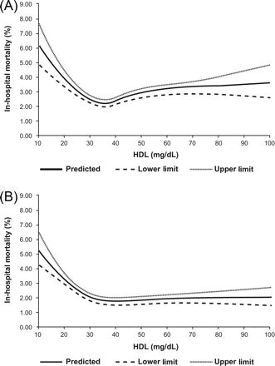
Figure 2 Continuous relationship between in-hospital mortality rates and high-density lipoprotein (HDL) (mg/dL) ...
Notes:
Figure 2 Continuous relationship between in-hospital mortality rates and high-density lipoprotein (HDL) (mg/dL) values. Broken lines indicate 95% confidence intervals: (A) overall population unadjusted mortality rates; (B) overall population mortality rates adjusted for age and sex.
Unless provided in the caption above, the following copyright applies to the content of this slide: Published on behalf of the European Society of Cardiology. All rights reserved. © The Author 2008. For permissions please email: journals.permissions@oxfordjournals.org

