Slide 1
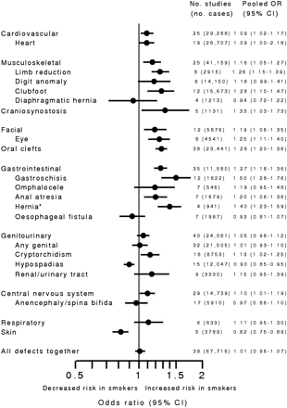
Figure 1 Summary of the meta-analyses for maternal smoking in pregnancy and birth defects. The pooled ORs are shown ...
Notes:
Figure 1 Summary of the meta-analyses for maternal smoking in pregnancy and birth defects. The pooled ORs are shown for each body system and specific defects (total number of malformed cases in brackets). CI: confidence interval *Umbilical, inguinal or ventral hernia. ‘Oesophageal fistula’ is ‘oesophageal atresia/tracheoesophageal fistula’.
Unless provided in the caption above, the following copyright applies to the content of this slide: © The Author 2011. Published by Oxford University Press on behalf of the European Society of Human Reproduction and Embryology. For Permissions, please email: journals.permissions@oup.comThis is an Open Access article distributed under the terms of the Creative Commons Attribution Non-Commercial License (http://creativecommons.org/licenses/by-nc/2.5) which permits unrestricted non-commercial use, distribution, and reproduction in any medium, provided the original work is properly cited

Slide 2
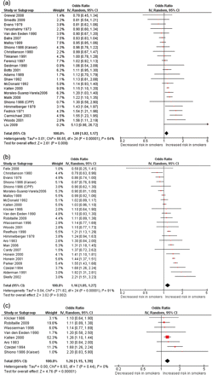
Figure 2 Forest plots for (a) cardiovascular/heart defects (Kelsey 1978 had no standard error, OR = 1.08), (b) all ...
Notes:
Figure 2 Forest plots for (a) cardiovascular/heart defects (Kelsey 1978 had no standard error, OR = 1.08), (b) all musculoskeletal defects (two studies had no standard error: Kelsey 1978 OR = 0.93, and Hemminki 1981 OR = 1.35), (c) limb reduction defects, (d) digit anomaly (ie polydactyly, syndactyly and adactyly), (e) clubfoot (Kelsey 1978 had no standard error, OR = 1.22; and the pooled OR excluding Shiono 1986 Kaiser is 1.35, 95% CI 1.17–1.54), and (f) craniosynostosis. Studies are ranked according to size of the odds ratio.
Unless provided in the caption above, the following copyright applies to the content of this slide: © The Author 2011. Published by Oxford University Press on behalf of the European Society of Human Reproduction and Embryology. For Permissions, please email: journals.permissions@oup.comThis is an Open Access article distributed under the terms of the Creative Commons Attribution Non-Commercial License (http://creativecommons.org/licenses/by-nc/2.5) which permits unrestricted non-commercial use, distribution, and reproduction in any medium, provided the original work is properly cited

Slide 3
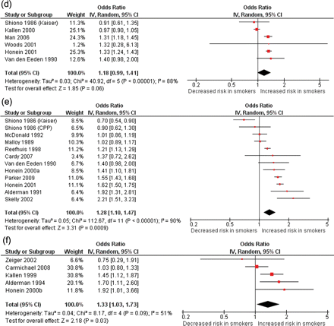
Figure 2 Forest plots for (a) cardiovascular/heart defects (Kelsey 1978 had no standard error, OR = 1.08), (b) all ...
Notes:
Figure 2 Forest plots for (a) cardiovascular/heart defects (Kelsey 1978 had no standard error, OR = 1.08), (b) all musculoskeletal defects (two studies had no standard error: Kelsey 1978 OR = 0.93, and Hemminki 1981 OR = 1.35), (c) limb reduction defects, (d) digit anomaly (ie polydactyly, syndactyly and adactyly), (e) clubfoot (Kelsey 1978 had no standard error, OR = 1.22; and the pooled OR excluding Shiono 1986 Kaiser is 1.35, 95% CI 1.17–1.54), and (f) craniosynostosis. Studies are ranked according to size of the odds ratio.
Unless provided in the caption above, the following copyright applies to the content of this slide: © The Author 2011. Published by Oxford University Press on behalf of the European Society of Human Reproduction and Embryology. For Permissions, please email: journals.permissions@oup.comThis is an Open Access article distributed under the terms of the Creative Commons Attribution Non-Commercial License (http://creativecommons.org/licenses/by-nc/2.5) which permits unrestricted non-commercial use, distribution, and reproduction in any medium, provided the original work is properly cited

Slide 4
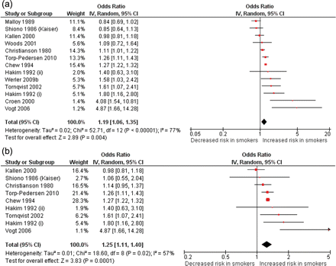
Figure 3 Forest plots for (a) facial defects, (b) eye defects only, and (c) cleft lip or palate. Studies are ranked ...
Notes:
Figure 3 Forest plots for (a) facial defects, (b) eye defects only, and (c) cleft lip or palate. Studies are ranked according to size of the odds ratio.
Unless provided in the caption above, the following copyright applies to the content of this slide: © The Author 2011. Published by Oxford University Press on behalf of the European Society of Human Reproduction and Embryology. For Permissions, please email: journals.permissions@oup.comThis is an Open Access article distributed under the terms of the Creative Commons Attribution Non-Commercial License (http://creativecommons.org/licenses/by-nc/2.5) which permits unrestricted non-commercial use, distribution, and reproduction in any medium, provided the original work is properly cited

Slide 5
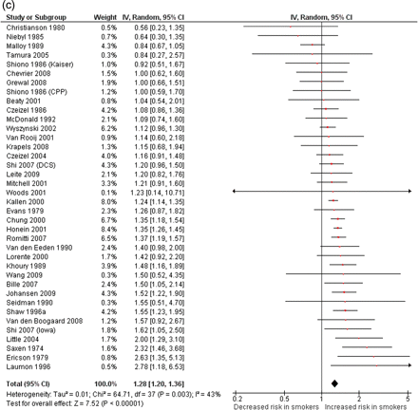
Figure 3 Forest plots for (a) facial defects, (b) eye defects only, and (c) cleft lip or palate. Studies are ranked ...
Notes:
Figure 3 Forest plots for (a) facial defects, (b) eye defects only, and (c) cleft lip or palate. Studies are ranked according to size of the odds ratio.
Unless provided in the caption above, the following copyright applies to the content of this slide: © The Author 2011. Published by Oxford University Press on behalf of the European Society of Human Reproduction and Embryology. For Permissions, please email: journals.permissions@oup.comThis is an Open Access article distributed under the terms of the Creative Commons Attribution Non-Commercial License (http://creativecommons.org/licenses/by-nc/2.5) which permits unrestricted non-commercial use, distribution, and reproduction in any medium, provided the original work is properly cited

Slide 6
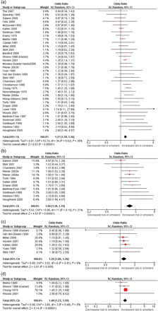
Figure 4 Forest plots for (a) all gastrointestinal defects (Kelsey 1978 had no standard error, OR = 1.55), (b) ...
Notes:
Figure 4 Forest plots for (a) all gastrointestinal defects (Kelsey 1978 had no standard error, OR = 1.55), (b) gastroschisis, (c) anal atresia, (d) umbilical/ventral/inguinal hernias, (e) all genitourinary defects, and (f) cryptorchidism. Studies are ranked according to size of the odds ratio.
Unless provided in the caption above, the following copyright applies to the content of this slide: © The Author 2011. Published by Oxford University Press on behalf of the European Society of Human Reproduction and Embryology. For Permissions, please email: journals.permissions@oup.comThis is an Open Access article distributed under the terms of the Creative Commons Attribution Non-Commercial License (http://creativecommons.org/licenses/by-nc/2.5) which permits unrestricted non-commercial use, distribution, and reproduction in any medium, provided the original work is properly cited

Slide 7
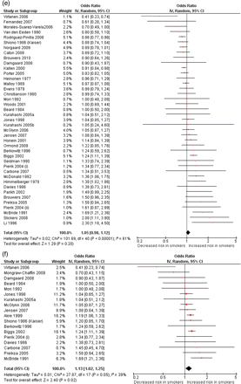
Figure 4 Forest plots for (a) all gastrointestinal defects (Kelsey 1978 had no standard error, OR = 1.55), (b) ...
Notes:
Figure 4 Forest plots for (a) all gastrointestinal defects (Kelsey 1978 had no standard error, OR = 1.55), (b) gastroschisis, (c) anal atresia, (d) umbilical/ventral/inguinal hernias, (e) all genitourinary defects, and (f) cryptorchidism. Studies are ranked according to size of the odds ratio.
Unless provided in the caption above, the following copyright applies to the content of this slide: © The Author 2011. Published by Oxford University Press on behalf of the European Society of Human Reproduction and Embryology. For Permissions, please email: journals.permissions@oup.comThis is an Open Access article distributed under the terms of the Creative Commons Attribution Non-Commercial License (http://creativecommons.org/licenses/by-nc/2.5) which permits unrestricted non-commercial use, distribution, and reproduction in any medium, provided the original work is properly cited

