Slide 1
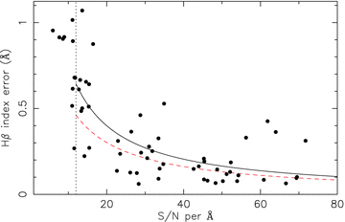
Figure 1 Hβ index error versus S/N for galaxies in our spectroscopic sample. The solid line shows the best fit to our ...
Notes:
Figure 1 Hβ index error versus S/N for galaxies in our spectroscopic sample. The solid line shows the best fit to our measured index errors as a function of S/N (see Section 3.3), while the dashed line shows a similar fit for 6dFGS DR1 data derived by P+08. The dotted, vertical line shows our adopted S/N cut of 12.
Unless provided in the caption above, the following copyright applies to the content of this slide: © 2009 The Authors. Journal compilation © 2009 RAS

Slide 2
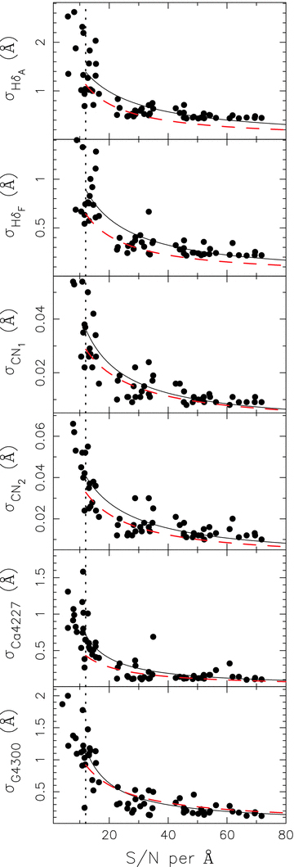
Figure A1 Index error as a function of S/N. Solid (black) and dashed (red) lines represent the best-fitting hyperbolic ...
Notes:
Figure A1 Index error as a function of S/N. Solid (black) and dashed (red) lines represent the best-fitting hyperbolic functions for these data and the 6dFGS DR1 data of P+08, respectively. The vertical dotted line represents our adopted S/N cut of 12.
Unless provided in the caption above, the following copyright applies to the content of this slide: © 2009 The Authors. Journal compilation © 2009 RAS

Slide 3
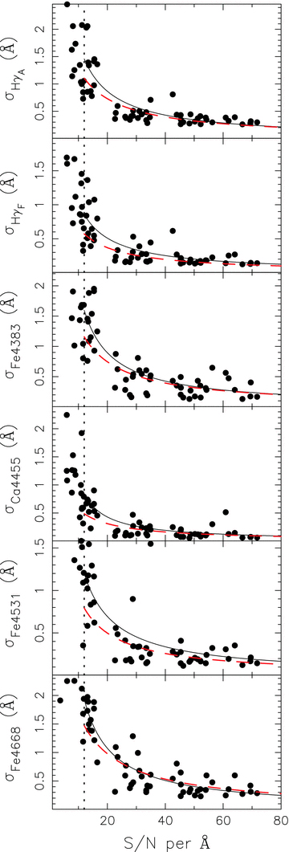
Figure A2 Same as Fig. A1.
Notes:
Figure A2 Same as Fig. A1.
Unless provided in the caption above, the following copyright applies to the content of this slide: © 2009 The Authors. Journal compilation © 2009 RAS

Slide 4
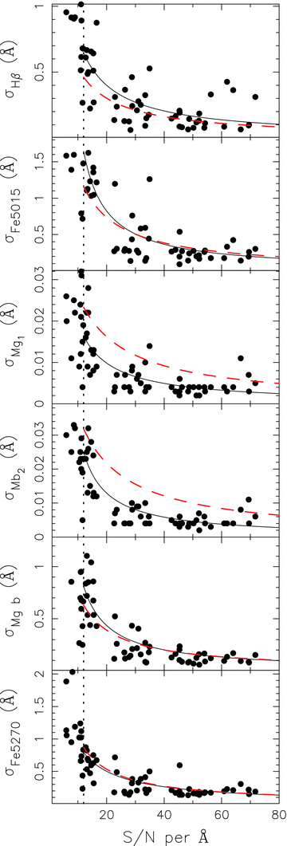
Figure A3 Same as Fig. A1.
Notes:
Figure A3 Same as Fig. A1.
Unless provided in the caption above, the following copyright applies to the content of this slide: © 2009 The Authors. Journal compilation © 2009 RAS

Slide 5
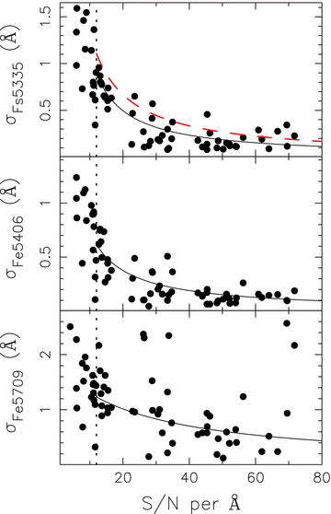
Figure A4 Same as Fig. A1. Fe5406 and Fe5709 indices were not measured in the 6dFGS DR1, so their error curves are ...
Notes:
Figure A4 Same as Fig. A1. Fe5406 and Fe5709 indices were not measured in the 6dFGS DR1, so their error curves are omitted.
Unless provided in the caption above, the following copyright applies to the content of this slide: © 2009 The Authors. Journal compilation © 2009 RAS

Slide 6
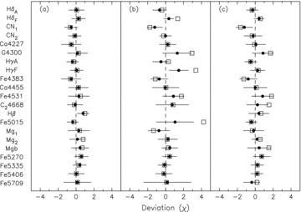
Figure 2 Mean deviation of indices from the best-fitting TMB03 SSP model. Open squares show the mean deviation for all ...
Notes:
Figure 2 Mean deviation of indices from the best-fitting TMB03 SSP model. Open squares show the mean deviation for all indices in each galaxy, while filled circles show the mean deviation only for indices included in the fits. (a) Galaxies with no detectable emission, (b) galaxies with visible emission in their spectra and (c) emission galaxies with spectra cleaned using the gandalf routine (see Section 2.4).
Unless provided in the caption above, the following copyright applies to the content of this slide: © 2009 The Authors. Journal compilation © 2009 RAS

Slide 7
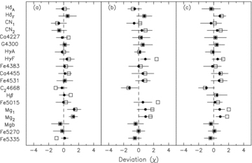
Figure 3 Same as Fig. 2, but for 6dFGS data. Data shown are without correction to the Lick/IDS system (see Section ...
Notes:
Figure 3 Same as Fig. 2, but for 6dFGS data. Data shown are without correction to the Lick/IDS system (see Section 4.1).
Unless provided in the caption above, the following copyright applies to the content of this slide: © 2009 The Authors. Journal compilation © 2009 RAS

Slide 8
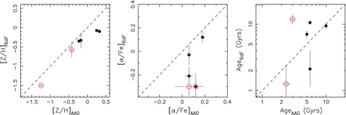
Figure 4 Comparison of metallicity ([Z/H]), α-element abundance and age for the six overlapping 6dFGS and AAOmega ...
Notes:
Figure 4 Comparison of metallicity ([Z/H]), α-element abundance and age for the six overlapping 6dFGS and AAOmega galaxies with S/N > 12. Open (red) and filled (black) circles represent galaxies with and without emission lines. Dashed lines in each panel represent equality. Parameters for 6dFGS data are shown with no applied correction to the Lick/IDS system (see Section 3.2).
Unless provided in the caption above, the following copyright applies to the content of this slide: © 2009 The Authors. Journal compilation © 2009 RAS

Slide 9
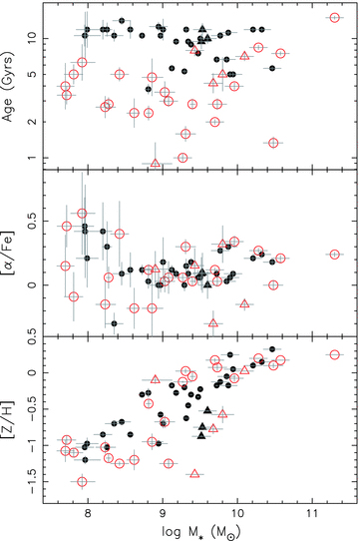
Figure 5 Relationship between stellar population properties and stellar mass (see Section 5.1). Filled (black) and ...
Notes:
Figure 5 Relationship between stellar population properties and stellar mass (see Section 5.1). Filled (black) and open (red) symbols represent passive and emission-line galaxies (see Section 2.4), with circles and triangles delineating galaxies measured using AAOmega and 6dFGS spectra, respectively. Error bars represent 1σ deviations estimated using the Monte Carlo technique described in Section 4.
Unless provided in the caption above, the following copyright applies to the content of this slide: © 2009 The Authors. Journal compilation © 2009 RAS

Slide 10
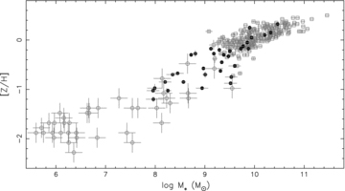
Figure 6 Mass–metallicity relation for galaxies spanning a broad range of environments. Filled circles, open circles ...
Notes:
Figure 6 Mass–metallicity relation for galaxies spanning a broad range of environments. Filled circles, open circles and open squares represent data from the NGC 5044 group, Local Group and Shapley supercluster, respectively. Errors for the Local Group data are taken as the average error quoted in Woo et al. (2008) of 0.17 and 0.2 dex for stellar mass and metallicity. Errors on NGC 5044 group and Shapley supercluster metallicities have been estimated using the Monte Carlo technique described in Section 4.
Unless provided in the caption above, the following copyright applies to the content of this slide: © 2009 The Authors. Journal compilation © 2009 RAS

Slide 11
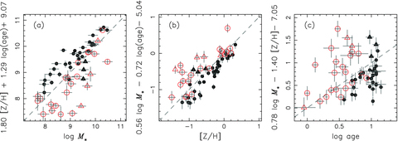
Figure 7 Projections of the fitted plane to age, mass and metallicity. Symbols are the same as Fig. 5. Dashed lines ...
Notes:
Figure 7 Projections of the fitted plane to age, mass and metallicity. Symbols are the same as Fig. 5. Dashed lines represent equality and are shown for reference.
Unless provided in the caption above, the following copyright applies to the content of this slide: © 2009 The Authors. Journal compilation © 2009 RAS

Slide 12
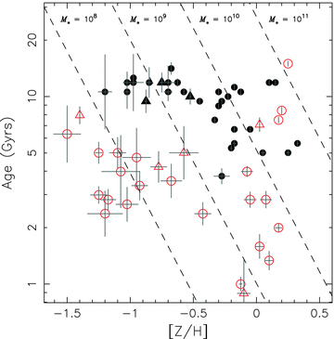
Figure 8 Age–metallicity relation for NGC 5044 group galaxies. Symbols are the same as in Fig. 5. Lines of constant ...
Notes:
Figure 8 Age–metallicity relation for NGC 5044 group galaxies. Symbols are the same as in Fig. 5. Lines of constant stellar mass are shown for log M*= 8, 9, 10, 11 M⊙. Error bars are the 1σ errors determined from Monte Carlo simulations (see Section 4).
Unless provided in the caption above, the following copyright applies to the content of this slide: © 2009 The Authors. Journal compilation © 2009 RAS

Slide 13
Figure 9 BC03 predicted colours versus observed global B−K, B−V and g−i. Filled and open symbols represent passive and ...
Notes:
Figure 9 BC03 predicted colours versus observed global B−K, B−V and g−i. Filled and open symbols represent passive and emission-line galaxies, respectively. Errors on predicted colours are calculated using the errors estimates on our central ages and metallicities. Dashed lines represent equality between the predicted and observed colours.
Unless provided in the caption above, the following copyright applies to the content of this slide: © 2009 The Authors. Journal compilation © 2009 RAS

Slide 14
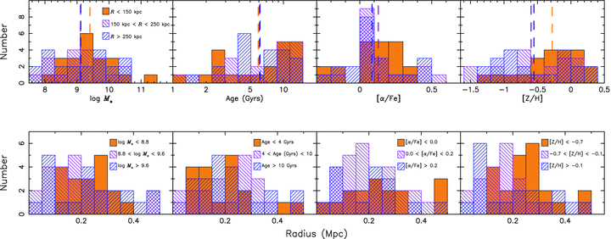
Figure 10 The radial dependence of various properties of galaxies in the NGC 5044 group. Top panels show the ...
Notes:
Figure 10 The radial dependence of various properties of galaxies in the NGC 5044 group. Top panels show the distribution of stellar mass, age, α-element abundance and metallicity in three different radial bins of R 250 kpc (solid orange, green and blue hatched regions, respectively). Vertical dashed lines show the mean of each bin. Lower panels show the radial distribution of galaxy properties in three separate bins of stellar mass, age, α-element abundance and metallicity, where bins have been selected to contain roughly equal numbers of galaxies.
Unless provided in the caption above, the following copyright applies to the content of this slide: © 2009 The Authors. Journal compilation © 2009 RAS

Slide 15
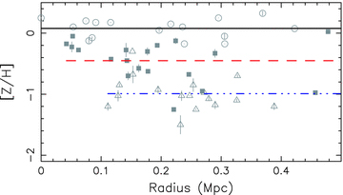
Figure 11 Galaxy metallicity against projected group-centric radius. Galaxies are divided into three mass bins with ...
Notes:
Figure 11 Galaxy metallicity against projected group-centric radius. Galaxies are divided into three mass bins with approximately equal numbers such that circles, squares and triangles represent galaxies with log M* > 9.6, 8.8 ≤ log M* < 9.6 and log M*≤ 8.8. Solid, dashed and dot–dashed lines represent the mean metallicity for each mass bin.
Unless provided in the caption above, the following copyright applies to the content of this slide: © 2009 The Authors. Journal compilation © 2009 RAS

Slide 16
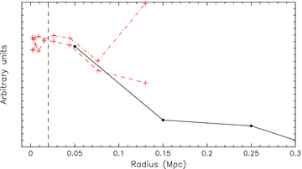
Figure 12 Comparison of stellar mass density (solid black line) and X-ray derived iron and silicon abundances (red ...
Notes:
Figure 12 Comparison of stellar mass density (solid black line) and X-ray derived iron and silicon abundances (red dashed and dot–dashed lines, respectively) as a function of radius. Data have had a fixed offset applied to be shown on the same figure. X-ray data have been binned for clarity. The vertical dashed line represents the radial extent of NGC 5044's light profile of ∼20 kpc.
Unless provided in the caption above, the following copyright applies to the content of this slide: © 2009 The Authors. Journal compilation © 2009 RAS

Slide 17
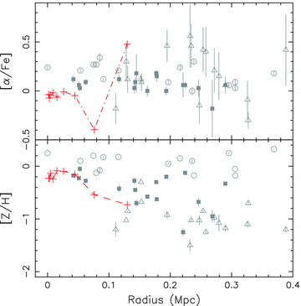
Figure 13 Comparison of X-ray derived silicon and iron abundance profiles (dashed lines in each panel) with the ...
Notes:
Figure 13 Comparison of X-ray derived silicon and iron abundance profiles (dashed lines in each panel) with the distribution of galaxy α-element abundances and metallicities. Galaxy symbols are the same as in Fig. 11. X-ray data have been binned for clarity.
Unless provided in the caption above, the following copyright applies to the content of this slide: © 2009 The Authors. Journal compilation © 2009 RAS

Slide 18
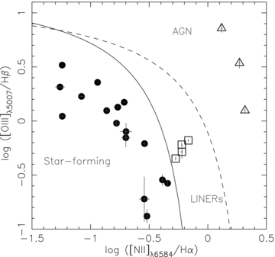
Figure 14 Line diagnostic for emission galaxies in our NGC 5044 group sample. The solid and dashed lines represent the ...
Notes:
Figure 14 Line diagnostic for emission galaxies in our NGC 5044 group sample. The solid and dashed lines represent the semi-empirical pure star formation line from Kauffmann et al. (2003) and the theoretical maximum starburst line from Kewley et al. (2001), respectively. Symbols represent galaxies which are likely purely star-forming, AGN or composite AGN and star-forming (circles, open triangles and open squares, respectively).
Unless provided in the caption above, the following copyright applies to the content of this slide: © 2009 The Authors. Journal compilation © 2009 RAS

Slide 19
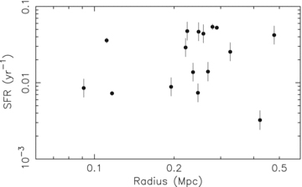
Figure 15 Specific SFR as it varies with projected distance from the group centre. Errors are indicative of the ...
Notes:
Figure 15 Specific SFR as it varies with projected distance from the group centre. Errors are indicative of the uncertainty in our EW[O II] and B-band luminosity measurements, but do not include the systematic contribution from using [O ii] over Hα and equivalent widths as opposed to line fluxes (see Section 7.1).
Unless provided in the caption above, the following copyright applies to the content of this slide: © 2009 The Authors. Journal compilation © 2009 RAS

Slide 20
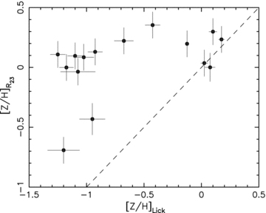
Figure 16 Comparison of metallicity derived from the nebular oxygen abundance, [Z/H]R₂₃ and stellar ...
Notes:
Figure 16 Comparison of metallicity derived from the nebular oxygen abundance, [Z/H]R23 and stellar metallicity, [Z/H]Lick, derived using Lick indices. The dashed line represents equality between the nebular and stellar metallicities.
Unless provided in the caption above, the following copyright applies to the content of this slide: © 2009 The Authors. Journal compilation © 2009 RAS

Slide 21
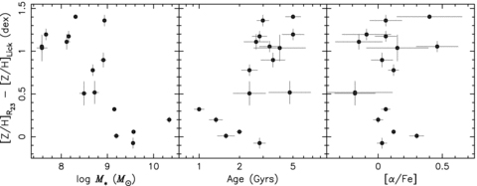
Figure 17 Offset between nebular and stellar metallicity plotted against stellar mass, age and α-element abundance.
Notes:
Figure 17 Offset between nebular and stellar metallicity plotted against stellar mass, age and α-element abundance.
Unless provided in the caption above, the following copyright applies to the content of this slide: © 2009 The Authors. Journal compilation © 2009 RAS

