Slide 1
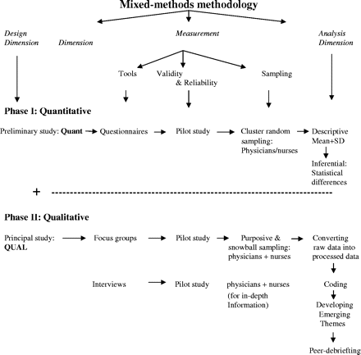
Figure 1 Flowchart of the research design
Notes:
Figure 1 Flowchart of the research design
Unless provided in the caption above, the following copyright applies to the content of this slide: © The Author 2005. Published by Oxford University Press on behalf of the European Public Health Association. All rights reserved.

