Slide 1
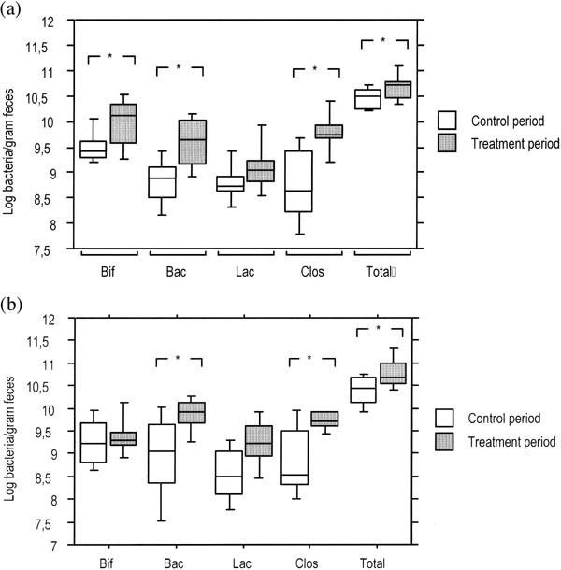
Figure 1 Bacterial composition of fecal samples prior and post supplementation with Lactobacillus GG from (a) control, ...
Notes:
Figure 1 Bacterial composition of fecal samples prior and post supplementation with Lactobacillus GG from (a) control, and (b) milk-hypersensitive individuals. Bif, Bifidobacterium sp.; Bac, Bacteroides sp.; Lac, Lactobacillus/Enterococcus sp.; Clos, Clostridium sp. Total bacterial counts were also carried out. The 10th, 25th, 50th, 75th and 90th percentiles and all the observations below the 10th and above the 90th percentile are displayed. * Indicates a significant (P<0.05) difference in the bacterial numbers between the control and treatment period.
Unless provided in the caption above, the following copyright applies to the content of this slide: © 2001 Federation of European Microbiological Societies.

