Slide 1
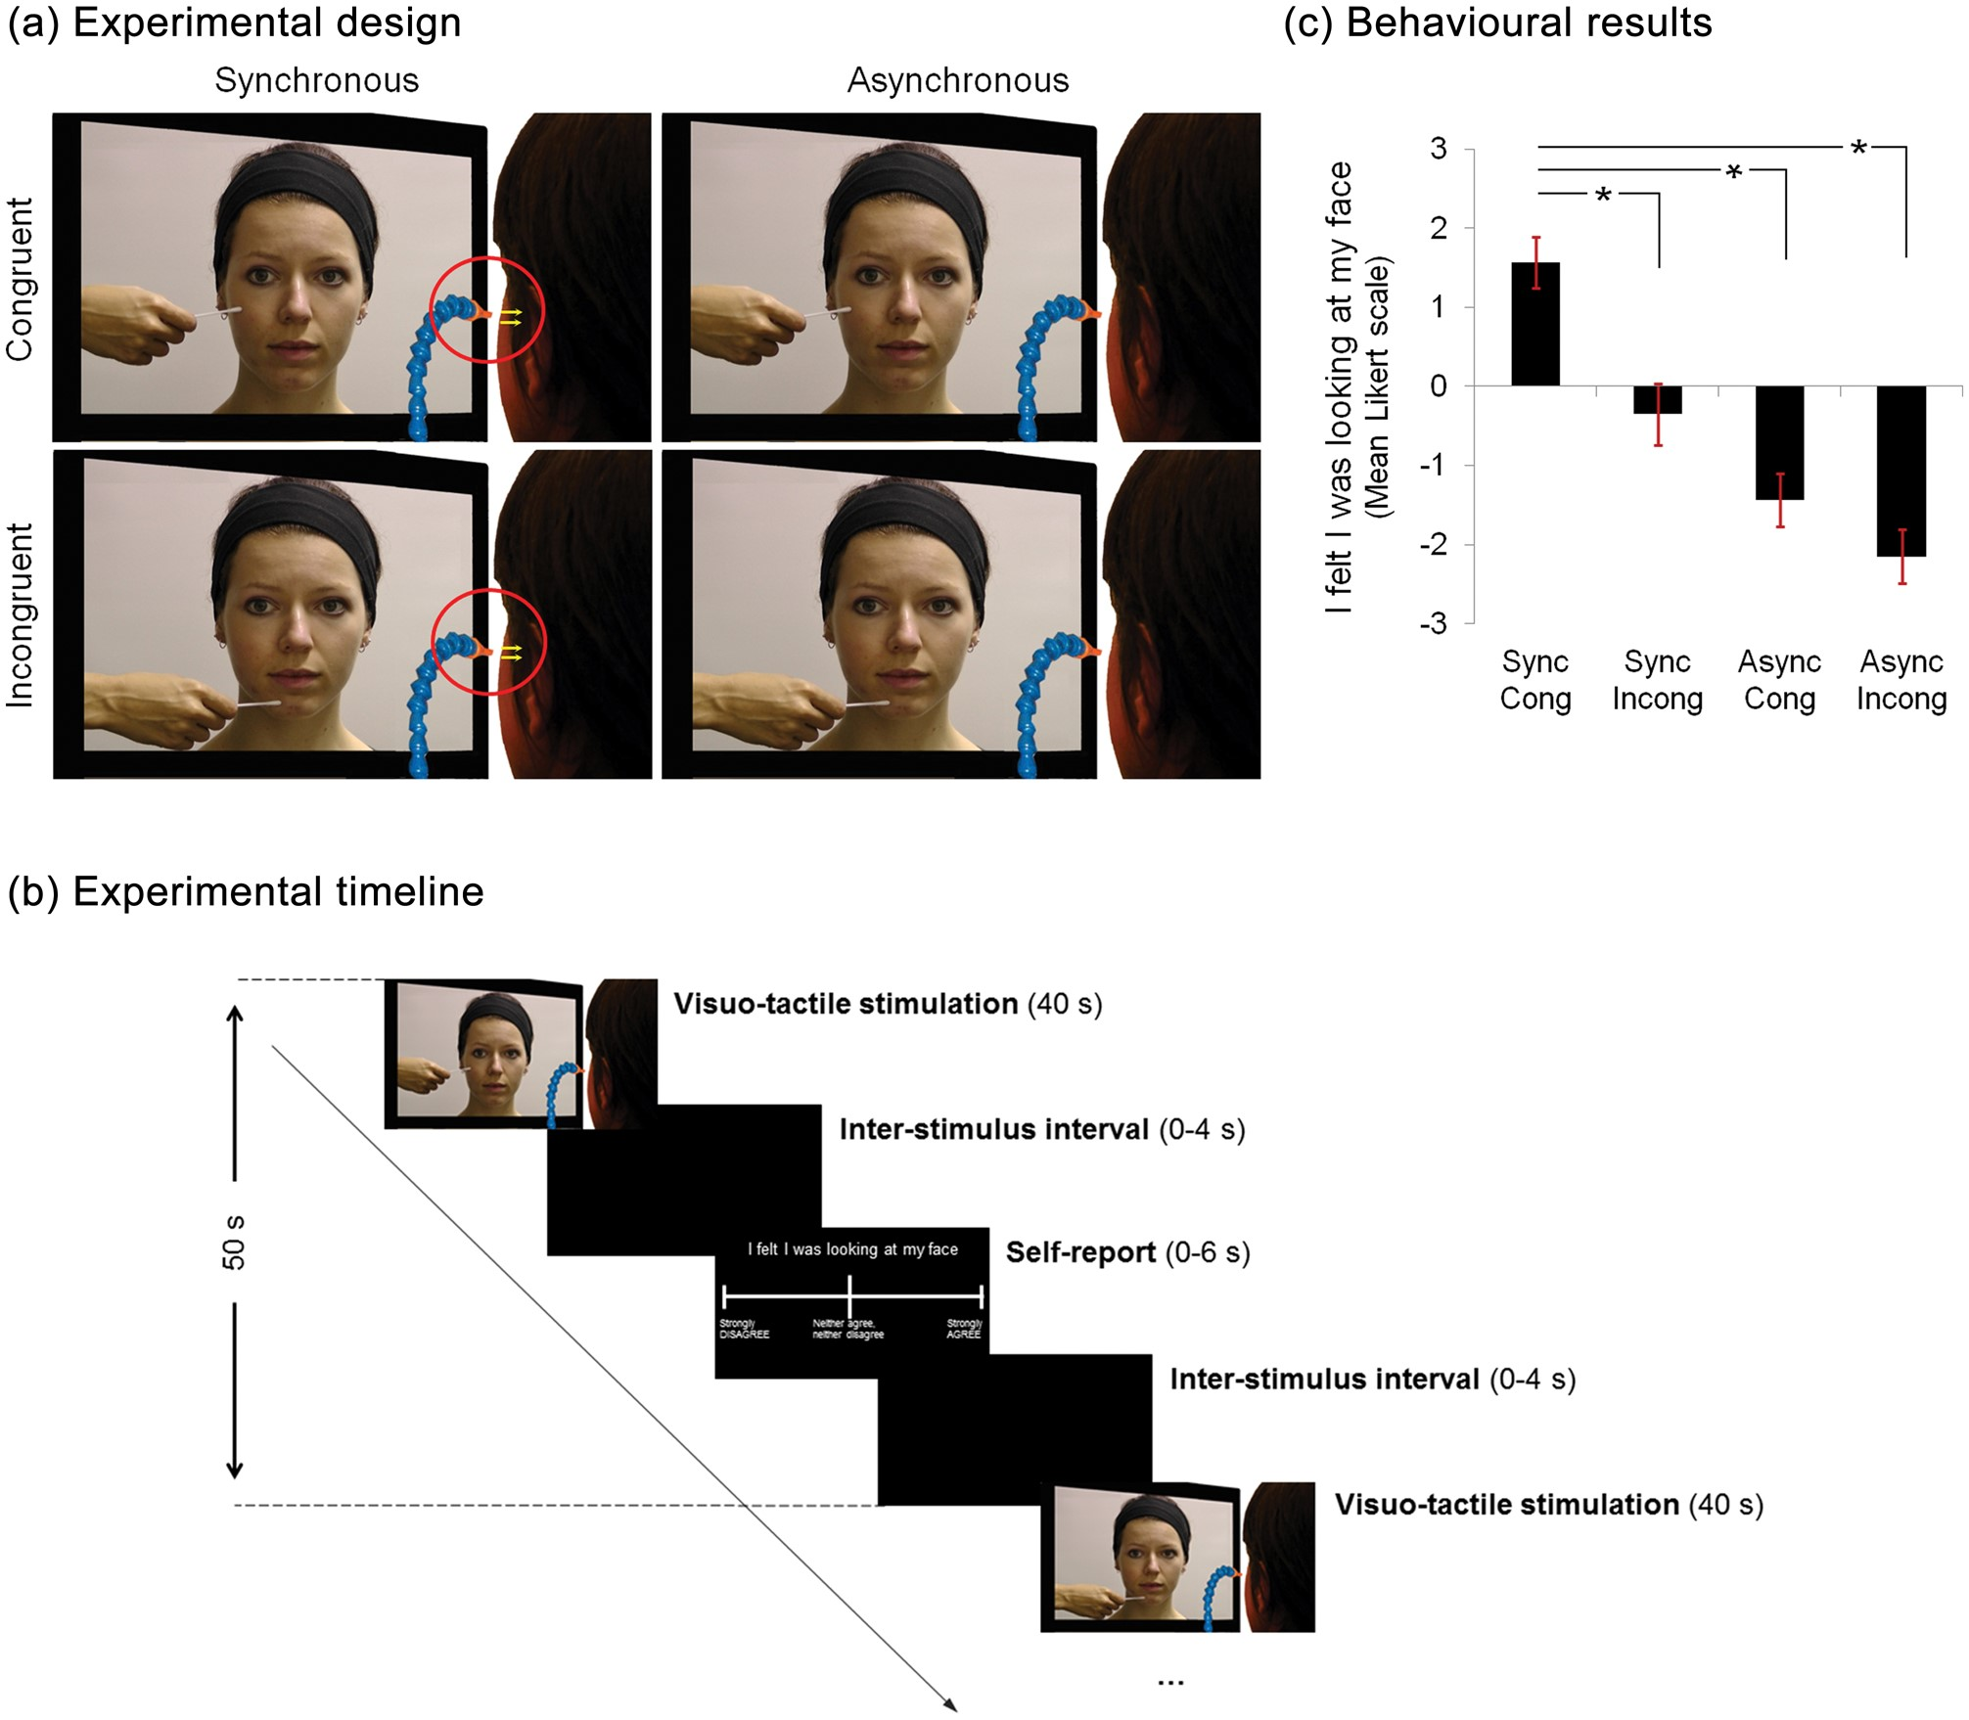
Figure 1. Experimental design, timeline, and behavioral results. (a) While in the scanner and in 40 s blocks, ...
Notes:
Figure 1. Experimental design, timeline, and behavioral results. (a) While in the scanner and in 40 s blocks, participants received tactile stimulation to their left cheek from puffs of air. The stimulation was akin to the cotton bud that was seen touching the face of another unfamiliar person in a movie which was played to the participant at the same time. The tactile stimulation on the 2 faces could be either synchronous or asynchronous and on either specularly congruent or incongruent locations. For the incongruent stimulation, participants observed the other person being touched on the chin. After each block of stimulation, participants rated the strength of the illusory experience on a 7-point Likert scale, ranging from “strongly agree” (+3) to “strongly disagree” (−3). (b) The block interval was 50 s, during which there was, a movie (40 s), followed by a blank screen presented for a variable interstimulus interval (0–4 s), followed by the question and Likert scale (maximum 6 s), followed by a blank screen presented for the remaining time to complete 50 s. (c) The mean Likert scale responses across participants for the 4 conditions are shown. As it can be seen, participants showed a stronger illusory experience in the synchronous, congruent condition, as predicted. Error bars depict standard error of the mean.
Unless provided in the caption above, the following copyright applies to the content of this slide: © The Author 2013. Published by Oxford University Press. All rights reserved. For Permissions, please e-mail: journals.permissions@oup.com

Slide 2
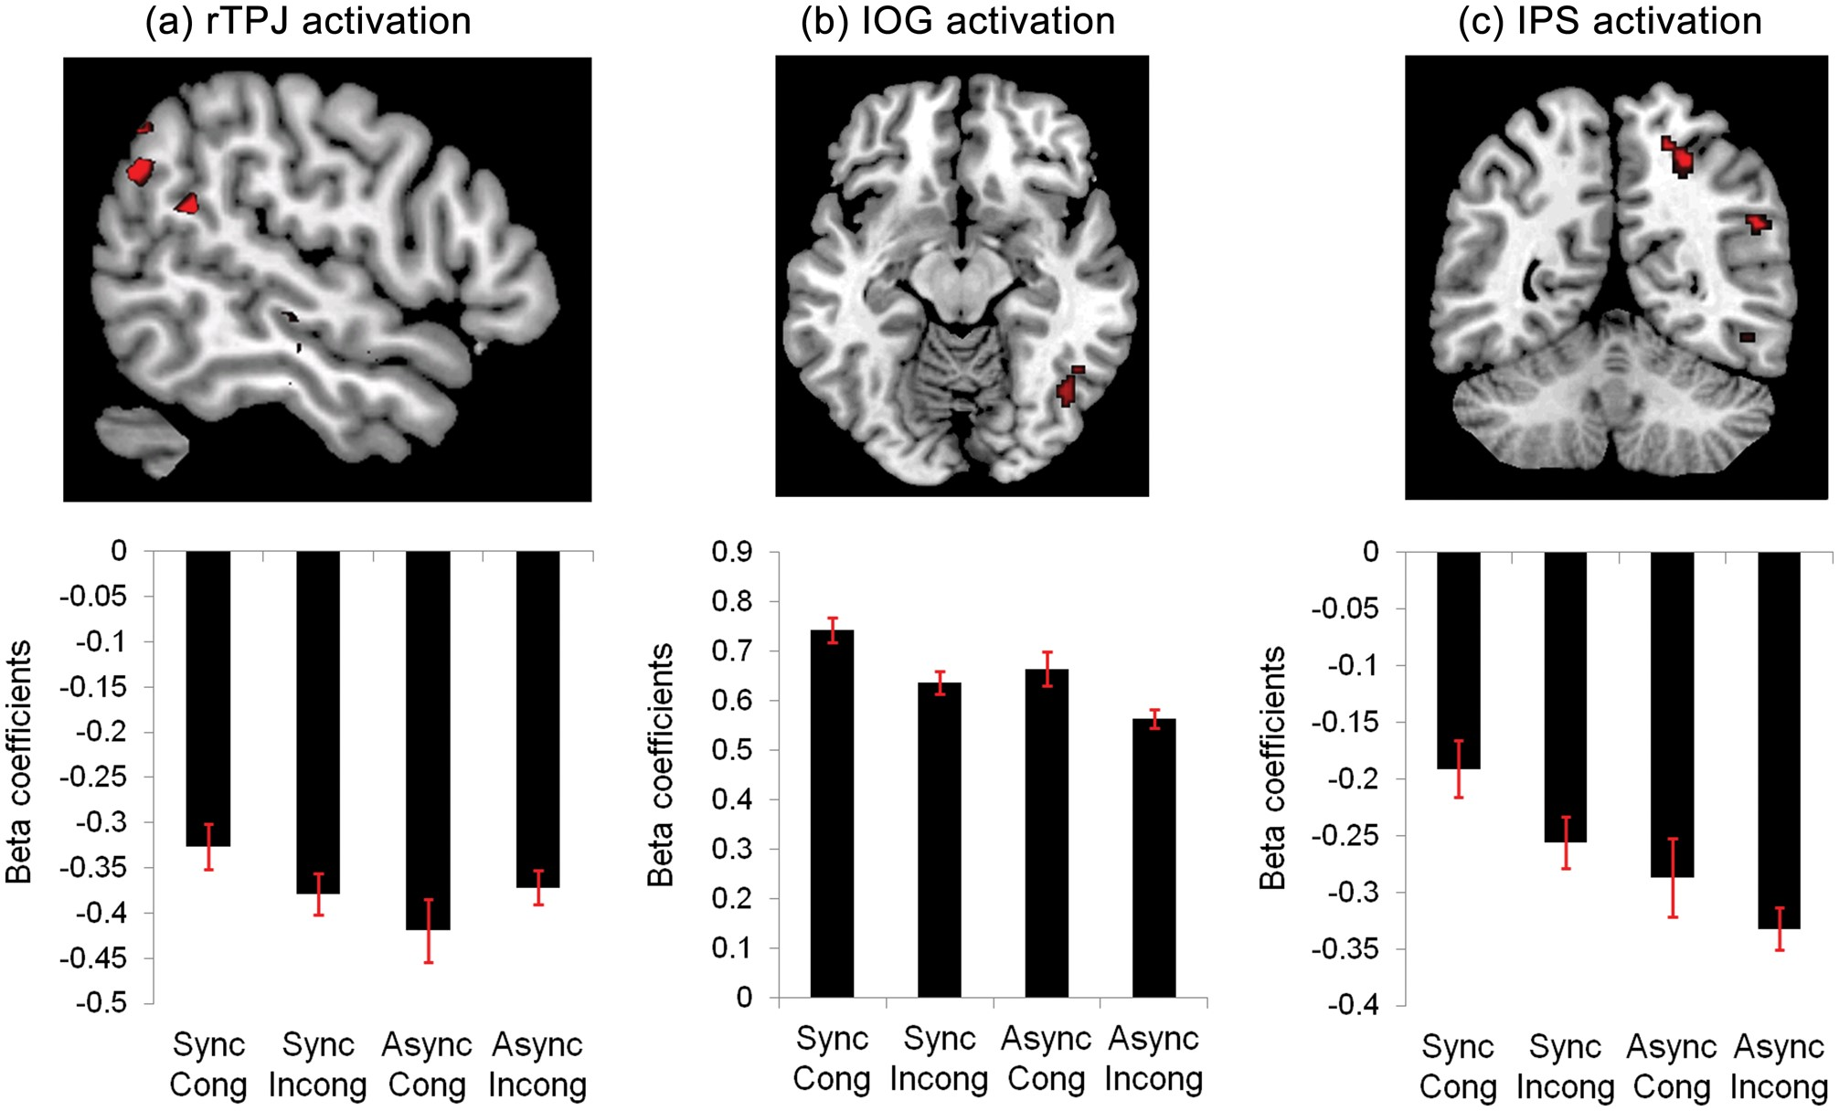
Figure 2. fMRI results. Activity in voxels that showed a significant interaction between Synchronicity and Congruency, ...
Notes:
Figure 2. fMRI results. Activity in voxels that showed a significant interaction between Synchronicity and Congruency, and also in which activity varied parametrically with the illusory experience. Voxels that showed this response were found in the right TPJ (a), the right IOG (b) and the right IPS (c) and are displayed in the upper panels (P < 0.001 uncorrected is used for display purposes). Plots of the beta coefficients from the peak voxels from the factorial analysis are displayed in the lower panels.
Unless provided in the caption above, the following copyright applies to the content of this slide: © The Author 2013. Published by Oxford University Press. All rights reserved. For Permissions, please e-mail: journals.permissions@oup.com

