Slide 1
Figure 1. Behavioral ratings. (a) Given during the scan on the perceived valence of composed (black) and ...
Notes:
Figure 1. Behavioral ratings. (a) Given during the scan on the perceived valence of composed (black) and computer-generated (white) pieces (P = 0.98) and (b) after the scan on the extent to which participants thought an intention was being expressed, which was higher for composed (black) than computer-generated pieces (white; P < 0.05).
Unless provided in the caption above, the following copyright applies to the content of this slide: © The Author 2008. Published by Oxford University Press. All rights reserved. For permissions, please e-mail: journals.permissions@oxfordjournals.org

Slide 2
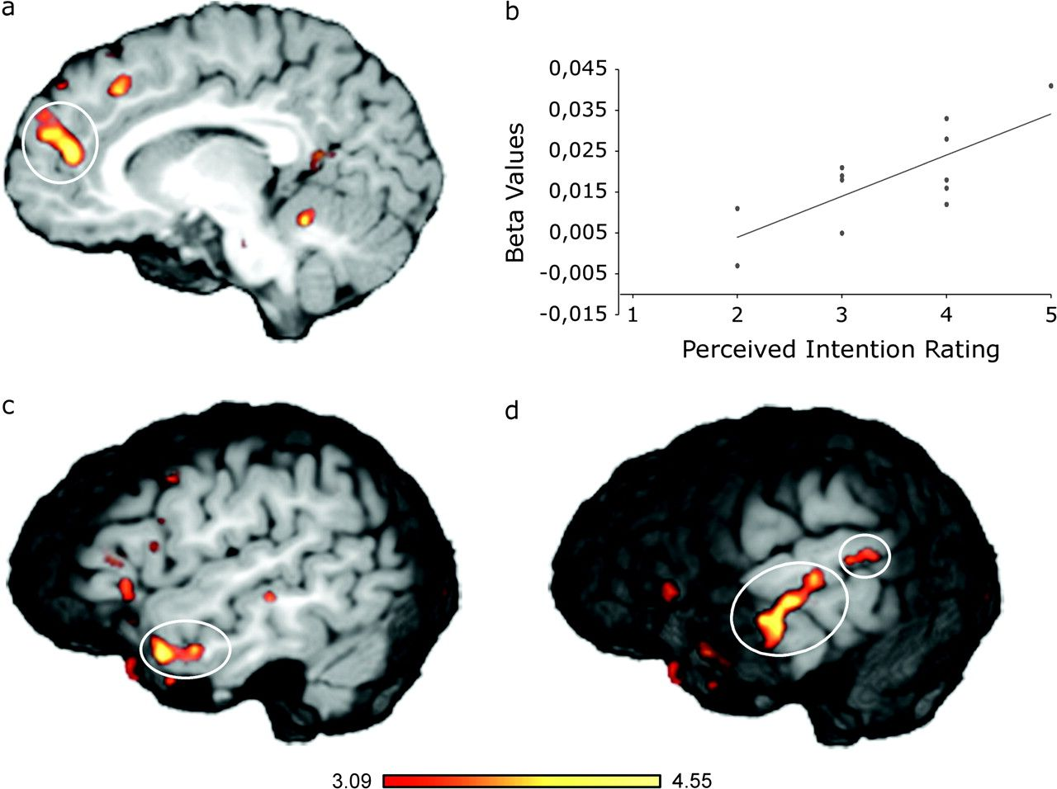
Figure 2. Activations when listening to musical pieces cued as compositions as opposed to computer-generated. (a) ...
Notes:
Figure 2. Activations when listening to musical pieces cued as compositions as opposed to computer-generated. (a) Increased activation in the aMFC [−11, 48, 18], which (b) correlated positively with the extent to which participants thought an intention was being expressed in the compositions (r = 0.76; P < 0.01). (c) Increased activation in the left TP [−50, 7, −21] as well as (d) the left STS [−62, −23, 0].
Unless provided in the caption above, the following copyright applies to the content of this slide: © The Author 2008. Published by Oxford University Press. All rights reserved. For permissions, please e-mail: journals.permissions@oxfordjournals.org

