Slide 1
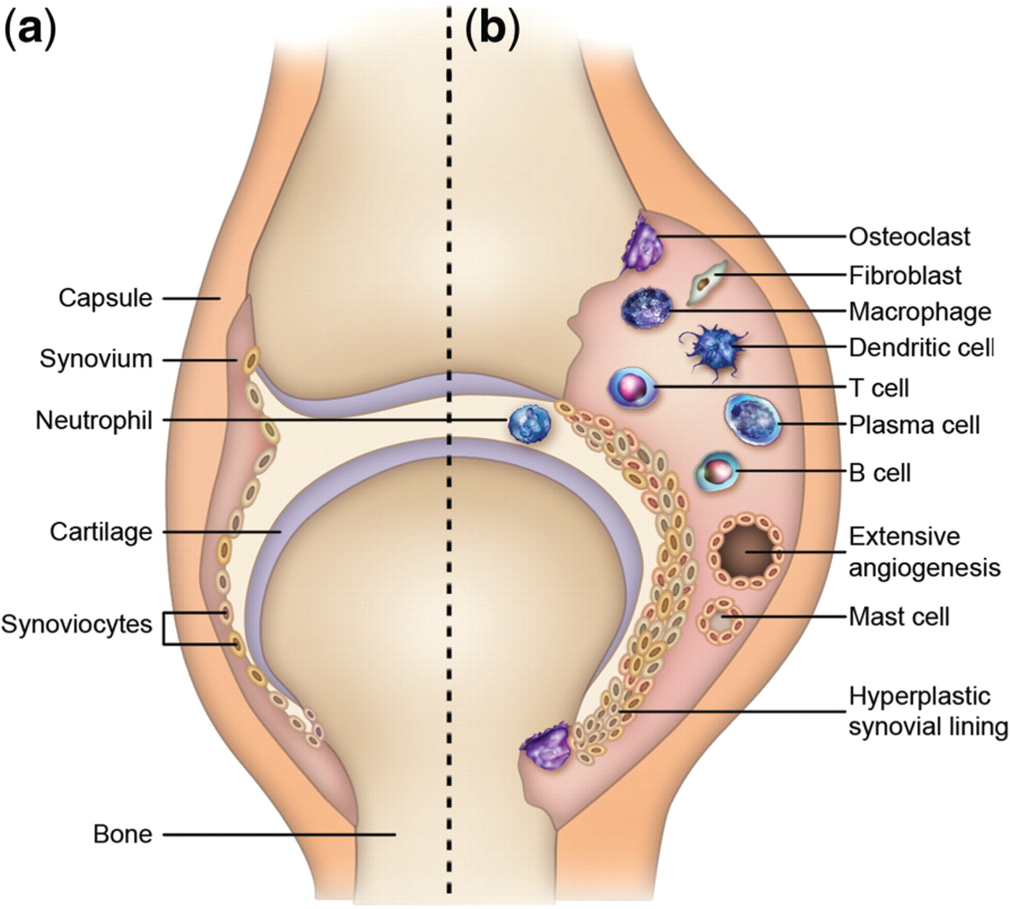
Fig. 1 Schematic view of a normal joint (a) and a joint affected by RA (b) [12]. The joint affected by RA (b) shows ...
Notes:
Fig. 1 Schematic view of a normal joint (a) and a joint affected by RA (b) [12]. The joint affected by RA (b) shows increased inflammation and cellular activity. Reprinted by permission from Macmillan Publishers Ltd (Nature Reviews Drug Discovery) from [12], © 2003.
Unless provided in the caption above, the following copyright applies to the content of this slide: © The Author 2012. Published by Oxford University Press on behalf of the British Society for Rheumatology. All rights reserved. For Permissions, please email: journals.permissions@oup.com

Slide 2
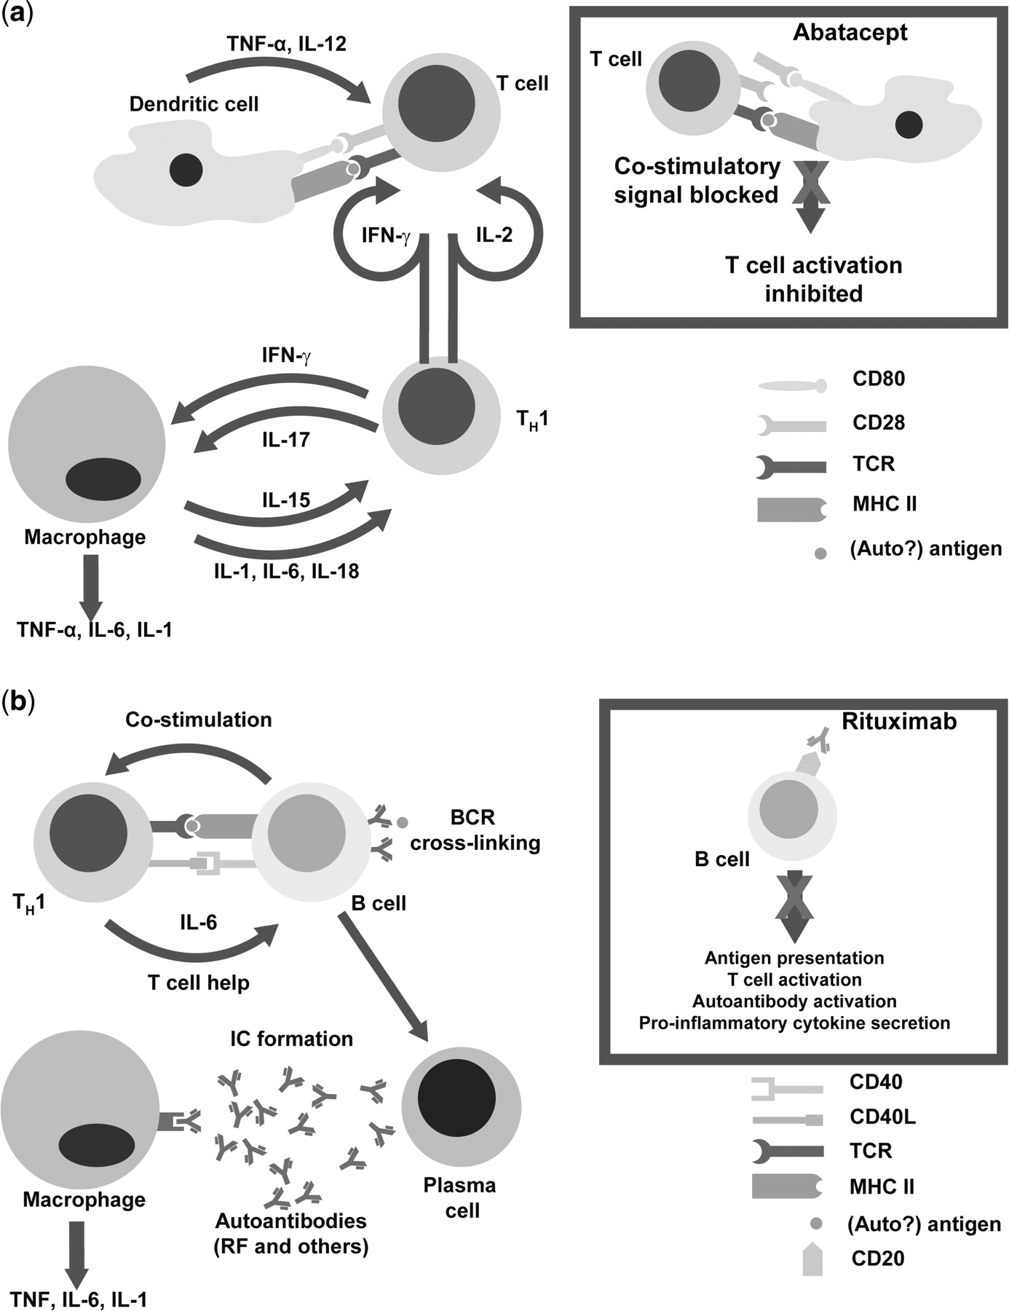
Fig. 2 Consequences of the activation of effector cells by cytokines. (a) Effects on T cells. The inset depicts the ...
Notes:
Fig. 2 Consequences of the activation of effector cells by cytokines. (a) Effects on T cells. The inset depicts the mechanism of action of abatacept, which inhibits T-cell co-stimulation. (b) Effects on B cells. The inset depicts the mechanism of action of rituximab, which selectively depletes CD20+ B cells [12, 13].
Unless provided in the caption above, the following copyright applies to the content of this slide: © The Author 2012. Published by Oxford University Press on behalf of the British Society for Rheumatology. All rights reserved. For Permissions, please email: journals.permissions@oup.com

