Slide 1
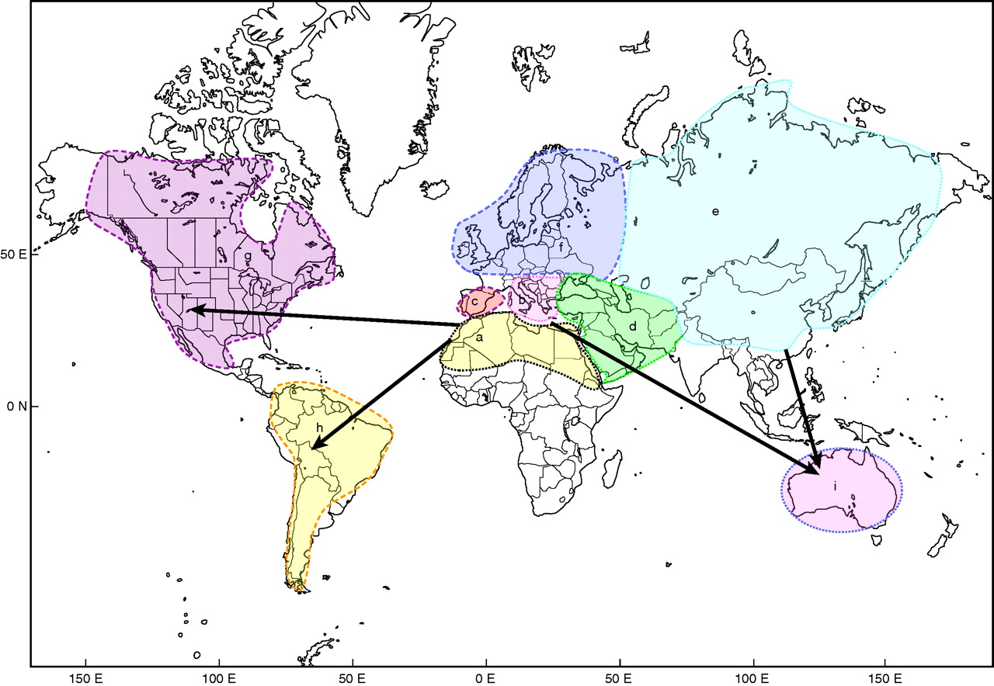
Fig. 1. Map detailing the distribution and areas of endemism for Erodium species (shaded). The arrows represent the ...
Notes:
Fig. 1. Map detailing the distribution and areas of endemism for Erodium species (shaded). The arrows represent the four possible intercontinental dispersals (see main text). a = North Africa, b = Italy and Balkans, c = Iberian Peninsula, d = The Middle East, e = Asia, f = North Europe, g = North America, h = South America, i = Australia.
Unless provided in the caption above, the following copyright applies to the content of this slide: © The Author 2010. Published by Oxford University Press on behalf of the Annals of Botany Company. All rights reserved. For Permissions, please email: journals.permissions@oxfordjournals.org

Slide 2
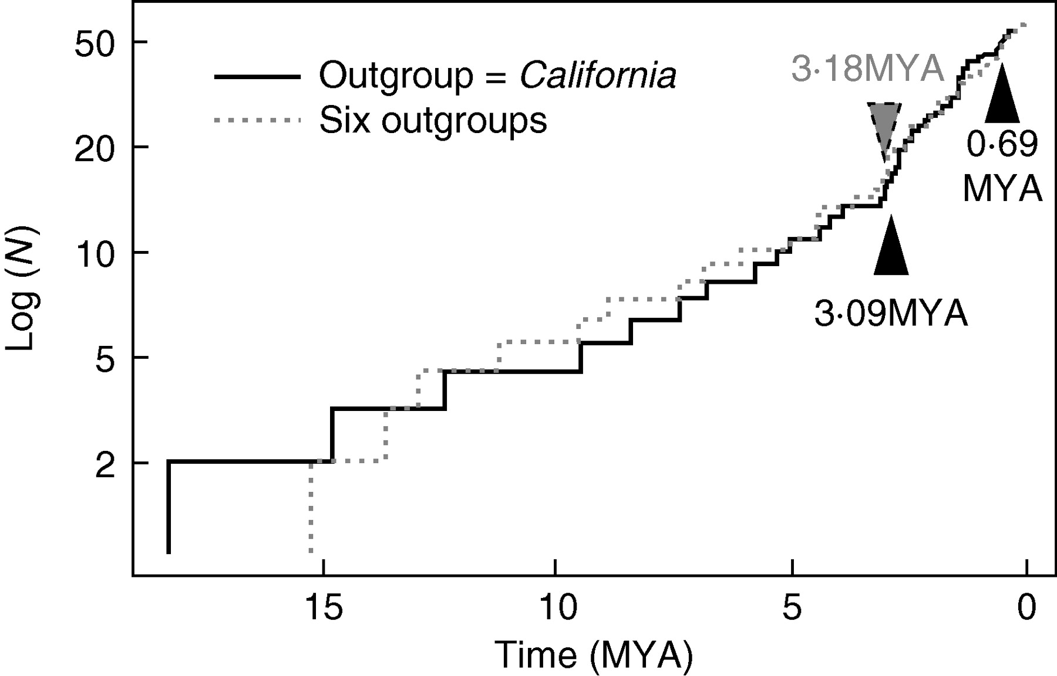
Fig. 4. Lineage-through-time plot for nrITS chronogram using California as the outgroup and using six outgroups, as ...
Notes:
Fig. 4. Lineage-through-time plot for nrITS chronogram using California as the outgroup and using six outgroups, as indicated. The diversification rate shifts located by LASER are indicated as triangles.
Unless provided in the caption above, the following copyright applies to the content of this slide: © The Author 2010. Published by Oxford University Press on behalf of the Annals of Botany Company. All rights reserved. For Permissions, please email: journals.permissions@oxfordjournals.org

Slide 3
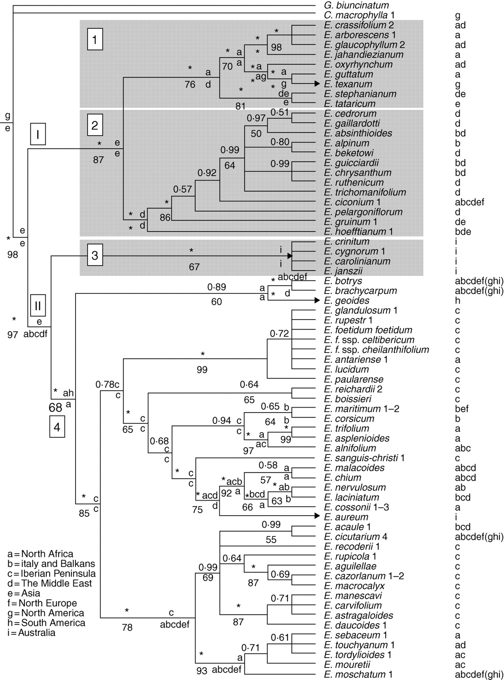
Fig. 3. Combined majority rule consensus tree (nrITS and trnL-trnF sequences) obtained from Bayesian analysis using ...
Notes:
Fig. 3. Combined majority rule consensus tree (nrITS and trnL-trnF sequences) obtained from Bayesian analysis using one sequence per taxa. Values above branches are posterior probabilities (pp) and those below correspond to bootstrap (BS) supports >50 %. An asterisk denotes 1·0 pp or 100 % BS. Ancestral ranges recovered with the highest probability with Lagrange are shown at internal nodes (letters following those in Fig. 1). No letter indicates invariable estimated range for the remaining nodes of that lineage. Arrows highlight cases of intercontinental dispersals (see Fig. 1). Current ranges for each taxon are indicated on the right. For these reconstructions, it was assumed that cosmopolitan taxa have been recently introduced to the New World and Australia. Clade names (squares I and II, and 1–4) are also indicated.
Unless provided in the caption above, the following copyright applies to the content of this slide: © The Author 2010. Published by Oxford University Press on behalf of the Annals of Botany Company. All rights reserved. For Permissions, please email: journals.permissions@oxfordjournals.org

Slide 4
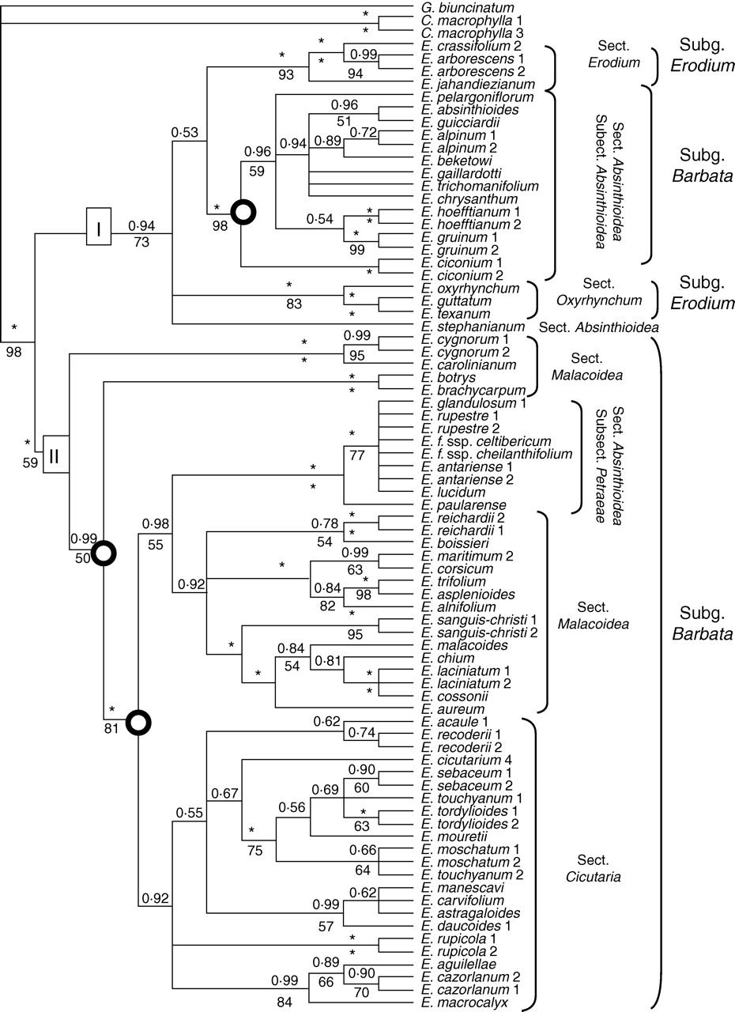
Fig. 2. Majority rule consensus tree obtained using Bayesian analysis of all ITS sequences available in this study. ...
Notes:
Fig. 2. Majority rule consensus tree obtained using Bayesian analysis of all ITS sequences available in this study. Posterior probabilities (pp) are given as values above branches. Bootstrap support (BS) values >50 % are below the branches. An asterisk denotes 1·0 pp or 100 BS. Diversification rate shifts (obtained from SymmeTREE and LASER) are indicated by circles. Clade names (I and II) according to Fiz et al. (2006) are highlighted in squares and taxonomic information according to Guittonneau (1990) is indicated on the right.
Unless provided in the caption above, the following copyright applies to the content of this slide: © The Author 2010. Published by Oxford University Press on behalf of the Annals of Botany Company. All rights reserved. For Permissions, please email: journals.permissions@oxfordjournals.org

