Slide 1
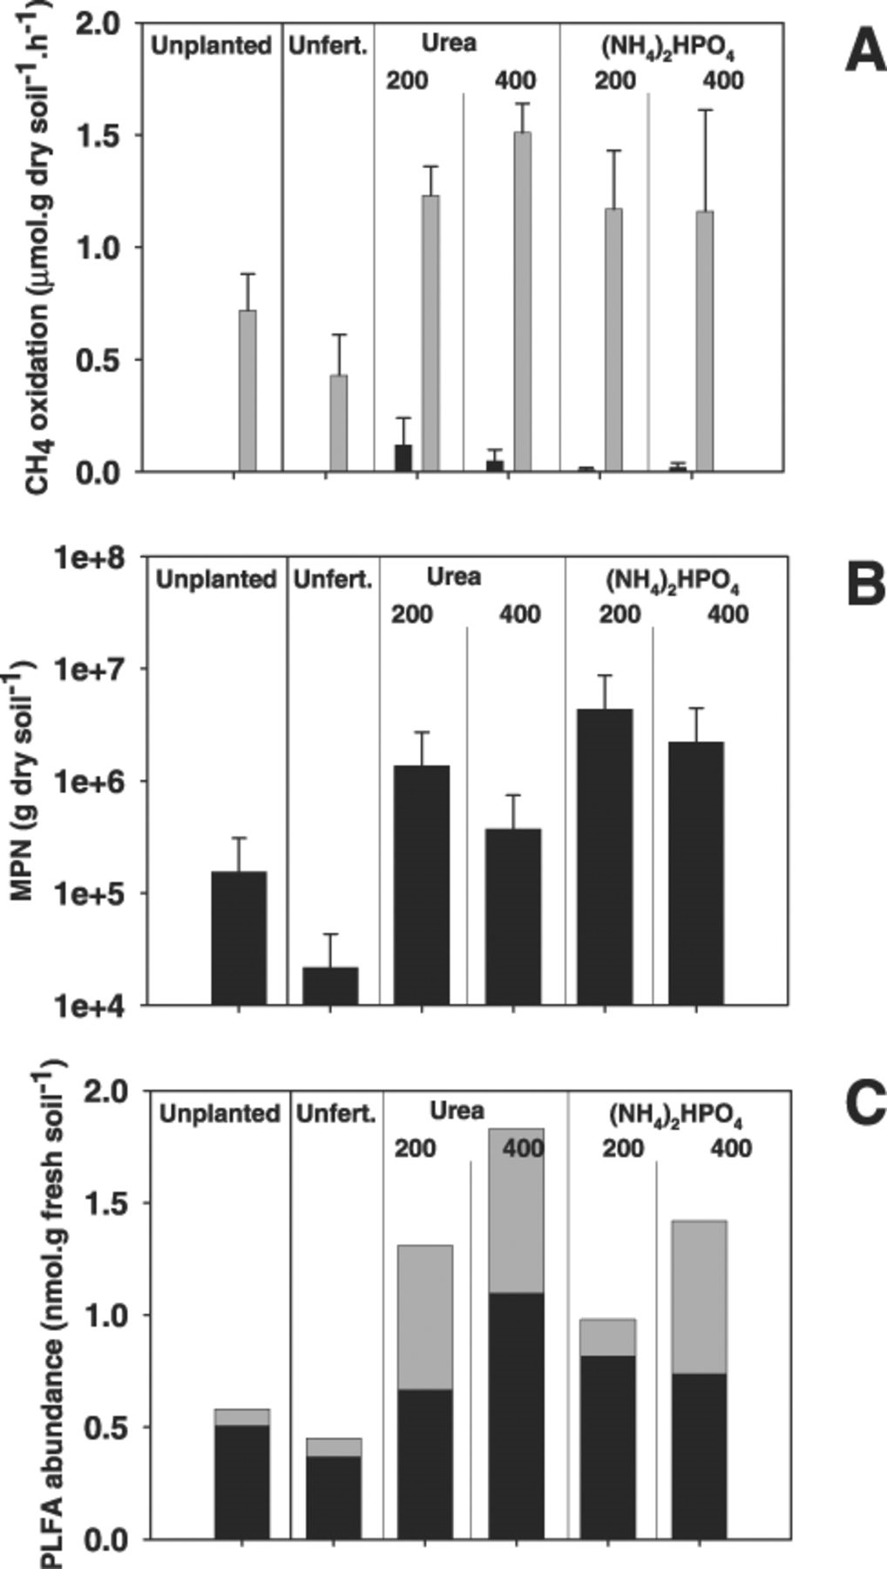
1 Methane-oxidising activities (A), most probable numbers (B) and PLFA (C) abundance in rice soil microcosms as ...
Notes:
1 Methane-oxidising activities (A), most probable numbers (B) and PLFA (C) abundance in rice soil microcosms as determined 68 days after planting. Displayed are the effects of ammonium-based fertilisation and rice plants on the methane-oxidising community in unplanted and in rhizosphere soil from microcosms that were either unfertilised or supplemented with urea (200 or 400 kg ha−1) or (NH4)2PO4 (200 or 400 kg ha−1). The bars in A represent the arithmetic means of initial (black bars) and induced (grey bars) oxidation rates of four replicate microcosms. The bars in C represent the total abundances of type I specific PLFA (C16:1w8c) (grey bar) and type II specific PLFA (C18:1w8c) (black bar). Data displayed in A and B were analysed using the Kruskal–Wallis test. This test revealed significant (P<0.05) effects of the presence of roots and fertiliser application on methane-oxidising activities (A) as well as on numbers (B).
Unless provided in the caption above, the following copyright applies to the content of this slide: © 2004 Federation of European Microbiological Societies. Published by Elsevier Science B.V. All rights reserved.

Slide 2
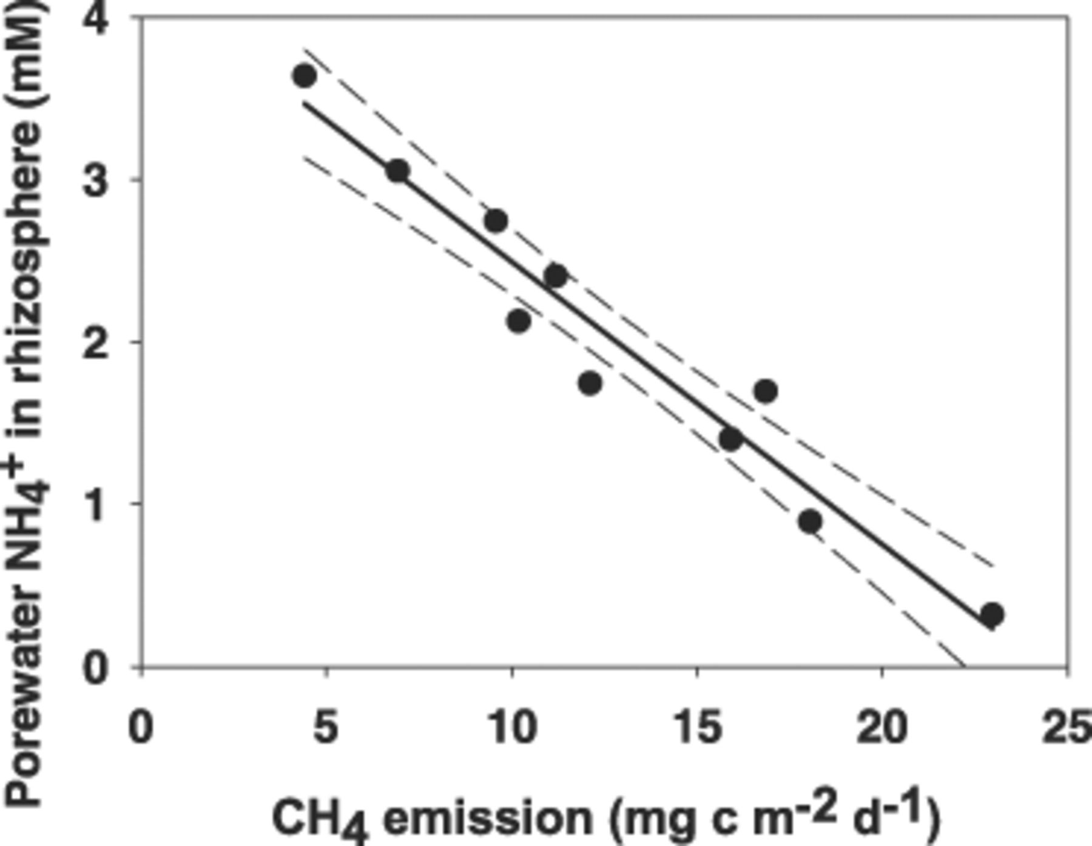
2 Relationship between the pore water ammonium concentration in the rhizosphere soil of rice soil microcosms ...
Notes:
2 Relationship between the pore water ammonium concentration in the rhizosphere soil of rice soil microcosms and methane emission from these systems. These microcosms were supplemented weekly after pore water samples had withdrawn with (NH4)2PO4 to a total amount of 400 kg N ha−1. The emission measurements were analysed weekly for a period of 10 weeks. The dotted line indicates 95% confidence interval of the fitted linear regression.
Unless provided in the caption above, the following copyright applies to the content of this slide: © 2004 Federation of European Microbiological Societies. Published by Elsevier Science B.V. All rights reserved.

Slide 3
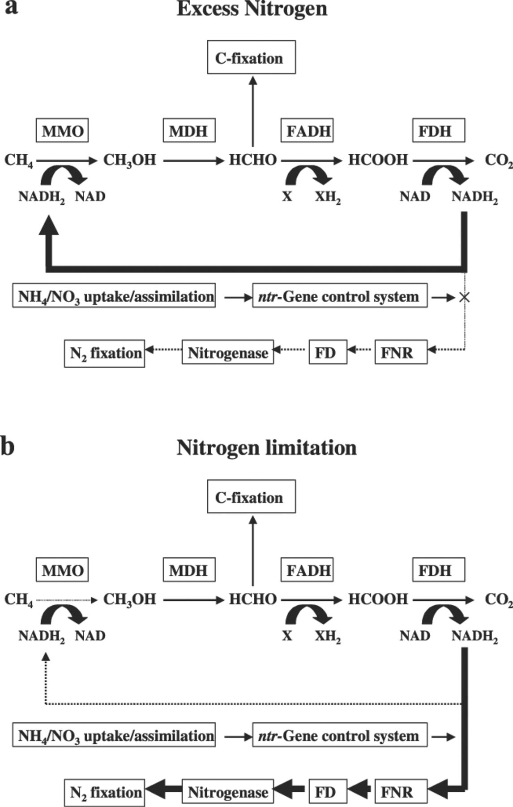
3 Schematic presentation of the hypothetical mechanism explaining the immediate stimulation of methane ...
Notes:
3 Schematic presentation of the hypothetical mechanism explaining the immediate stimulation of methane oxidation by ammonium or nitrate addition to soils or sediments. a: The flow of NADH2 when nitrogen is not limiting. NADH2 is diverted to the MMO reaction. The ntr gene control system prevents the use of NADH2 for the nitrogenase reaction. b: The situation when inorganic nitrogen is available for assimilation. The ntr gene control system diverts NADH2 to enable nitrogen fixation thereby reducing or even diminishing the NADH2 flow to the methane oxidation reaction.
Unless provided in the caption above, the following copyright applies to the content of this slide: © 2004 Federation of European Microbiological Societies. Published by Elsevier Science B.V. All rights reserved.

