Slide 1
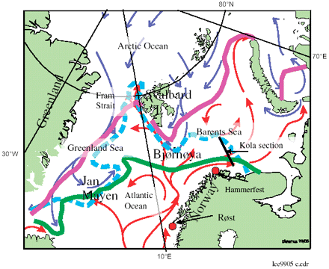
Figure 1 Study area with some ice-edge observations and ocean current patterns (after Vinje, 2001).
Notes:
Figure 1 Study area with some ice-edge observations and ocean current patterns (after Vinje, 2001).
Unless provided in the caption above, the following copyright applies to the content of this slide: © 2005 International Council for the Exploration of the Sea

Slide 2
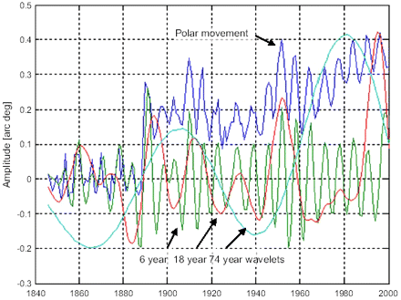
Figure 4 Polar position in the y direction time-series, 1846–2000, and estimated dominant-wavelet cycles of 74, 18, ...
Notes:
Figure 4 Polar position in the y direction time-series, 1846–2000, and estimated dominant-wavelet cycles of 74, 18, and 6 years.
Unless provided in the caption above, the following copyright applies to the content of this slide: © 2005 International Council for the Exploration of the Sea

Slide 3
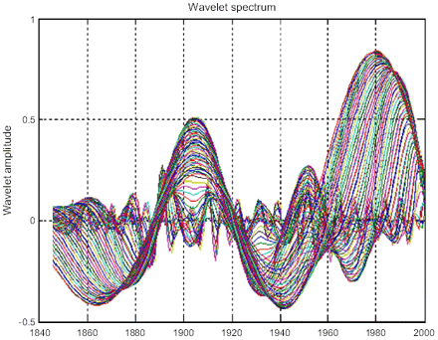
Figure 3 Wavelet spectrum W_{P(1:80)}(t) of the polar position time-series in the y direction.
Notes:
Figure 3 Wavelet spectrum WP(1:80)(t) of the polar position time-series in the y direction.
Unless provided in the caption above, the following copyright applies to the content of this slide: © 2005 International Council for the Exploration of the Sea

Slide 4
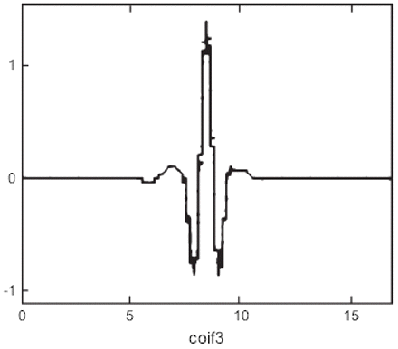
Figure 2 Coiflet 3 wavelet function.
Notes:
Figure 2 Coiflet 3 wavelet function.
Unless provided in the caption above, the following copyright applies to the content of this slide: © 2005 International Council for the Exploration of the Sea

Slide 5
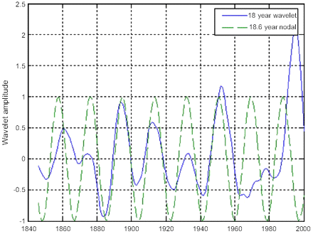
Figure 5 Identified 18-year wavelet cycle and an 18.6-year lunar nodal cycle.
Notes:
Figure 5 Identified 18-year wavelet cycle and an 18.6-year lunar nodal cycle.
Unless provided in the caption above, the following copyright applies to the content of this slide: © 2005 International Council for the Exploration of the Sea

Slide 6
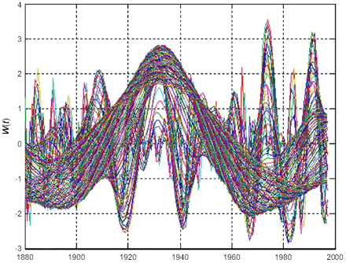
Figure 14 Wavelet spectrum from the Røst air temperature time-series.
Notes:
Figure 14 Wavelet spectrum from the Røst air temperature time-series.
Unless provided in the caption above, the following copyright applies to the content of this slide: © 2005 International Council for the Exploration of the Sea

Slide 7
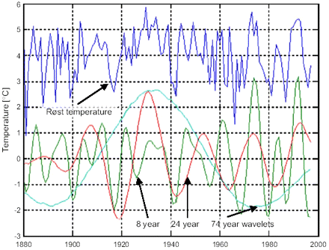
Figure 15 Røst annual mean winter air temperature time-series (+4), and the dominant wavelets of 8, 24, and 74 years.
Notes:
Figure 15 Røst annual mean winter air temperature time-series (+4), and the dominant wavelets of 8, 24, and 74 years.
Unless provided in the caption above, the following copyright applies to the content of this slide: © 2005 International Council for the Exploration of the Sea

Slide 8
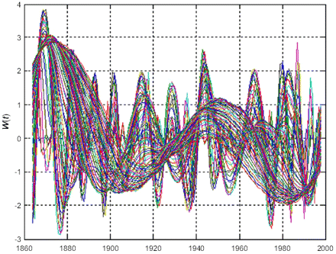
Figure 6 Wavelet spectrum W_{B(1:80)}(t) of the Barents Sea ice-extent time-series.
Notes:
Figure 6 Wavelet spectrum WB(1:80)(t) of the Barents Sea ice-extent time-series.
Unless provided in the caption above, the following copyright applies to the content of this slide: © 2005 International Council for the Exploration of the Sea

Slide 9
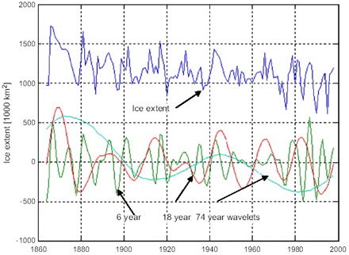
Figure 7 Time-series of Barents Sea ice extent, and dominant wavelets of 6, 18, and 74 years during the period ...
Notes:
Figure 7 Time-series of Barents Sea ice extent, and dominant wavelets of 6, 18, and 74 years during the period 1864–1998.
Unless provided in the caption above, the following copyright applies to the content of this slide: © 2005 International Council for the Exploration of the Sea

Slide 10
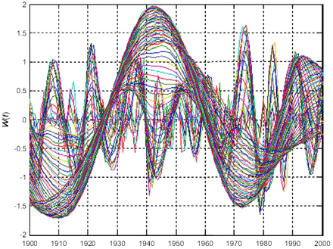
Figure 8 Wavelet spectrum of the Kola section temperature time-series.
Notes:
Figure 8 Wavelet spectrum of the Kola section temperature time-series.
Unless provided in the caption above, the following copyright applies to the content of this slide: © 2005 International Council for the Exploration of the Sea

Slide 11
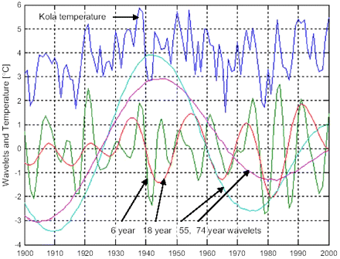
Figure 9 Kola section temperature time-series, and estimated dominant wavelets of about 6, 18, 55, and 74 years.
Notes:
Figure 9 Kola section temperature time-series, and estimated dominant wavelets of about 6, 18, 55, and 74 years.
Unless provided in the caption above, the following copyright applies to the content of this slide: © 2005 International Council for the Exploration of the Sea

Slide 12
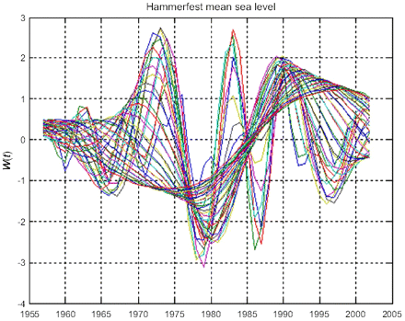
Figure 10 Wavelet spectrum from the Hammerfest annual mean sea-level time-series.
Notes:
Figure 10 Wavelet spectrum from the Hammerfest annual mean sea-level time-series.
Unless provided in the caption above, the following copyright applies to the content of this slide: © 2005 International Council for the Exploration of the Sea

Slide 13
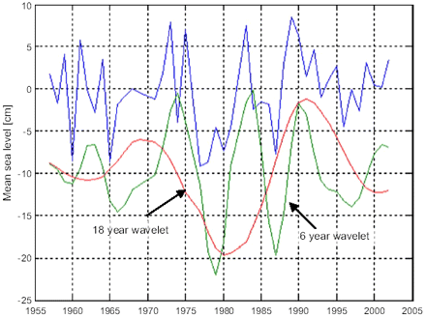
Figure 11 Hammerfest annual mean sea-level time-series, and dominant wavelets of about 6 and 18 years.
Notes:
Figure 11 Hammerfest annual mean sea-level time-series, and dominant wavelets of about 6 and 18 years.
Unless provided in the caption above, the following copyright applies to the content of this slide: © 2005 International Council for the Exploration of the Sea

Slide 14
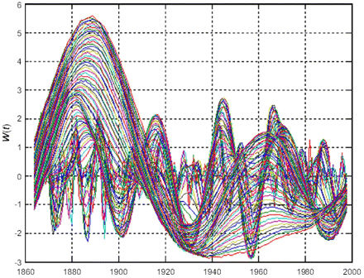
Figure 12 Wavelet spectrum from the Greenland Sea ice-extent time-series.
Notes:
Figure 12 Wavelet spectrum from the Greenland Sea ice-extent time-series.
Unless provided in the caption above, the following copyright applies to the content of this slide: © 2005 International Council for the Exploration of the Sea

Slide 15
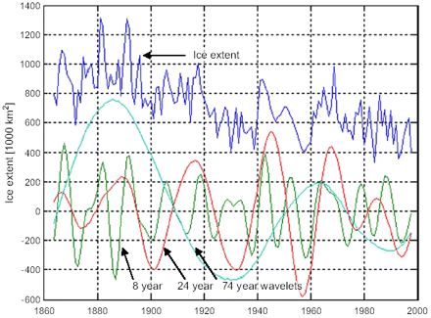
Figure 13 Greenland Sea ice-extent time-series, and identified wavelet cycles of about 6, 24, and 74 years.
Notes:
Figure 13 Greenland Sea ice-extent time-series, and identified wavelet cycles of about 6, 24, and 74 years.
Unless provided in the caption above, the following copyright applies to the content of this slide: © 2005 International Council for the Exploration of the Sea

Slide 16
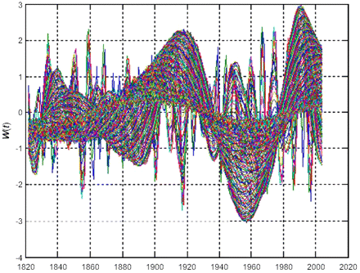
Figure 16 Wavelet spectrum from the NAO winter index time-series.
Notes:
Figure 16 Wavelet spectrum from the NAO winter index time-series.
Unless provided in the caption above, the following copyright applies to the content of this slide: © 2005 International Council for the Exploration of the Sea

Slide 17
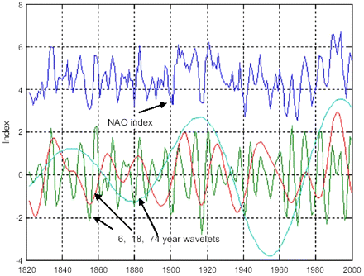
Figure 17 Time-series of the NAO winter index (+4), and the dominant-wavelet cycles of 6, 18, and 74 years.
Notes:
Figure 17 Time-series of the NAO winter index (+4), and the dominant-wavelet cycles of 6, 18, and 74 years.
Unless provided in the caption above, the following copyright applies to the content of this slide: © 2005 International Council for the Exploration of the Sea

